Slide 1





Optimization of the Korea-4GSR Storage Ring
for Increasing the Off-Momentum Dynamic Aperture by Analyzing Resonance Driving Terms
Junha Kim
PAL, UNIST
Jaehyun Kim, Gyeongsu Jang, Jimin Seok, Jaeyu Lee, Moses Chung*
PAL, POSTECH

Slide 2

Outline
Introduction
Optimizing Amplitude dependent tune shifts(ADTS)
Optimizing on-momentum Resonance driving terms (RDTs)
Optimizing off-momentum RDTs
Storage ring optimization
Summary

Slide 3

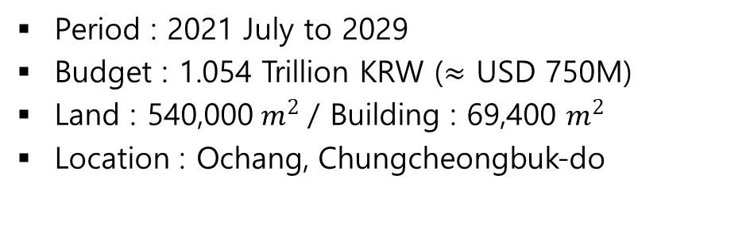
Korea-4GSR
Multipurpose Synchrotron Radiation Construction Project
Period : 2021 July to 2029
Budget : 1.054 Trillion KRW ($≈$ USD 750M)
Land : 540,000$m^{2}$ / Building : 69,400 $m^{2}$
Location : Ochang, Chungcheongbuk-do
Seoul
Korea-4GSR
Specifications
Beam Energy : 4GeV
Natural Emittance : less than 100pm (TDR : 62pm)
Circumference : 800m
Beamlines : more than 40
Accelerator : Gun, Injector LINAC, 4GeV Booster
Lattice : Hybrid 7 Bend Achromat (H7BA)
3/20

Slide 4
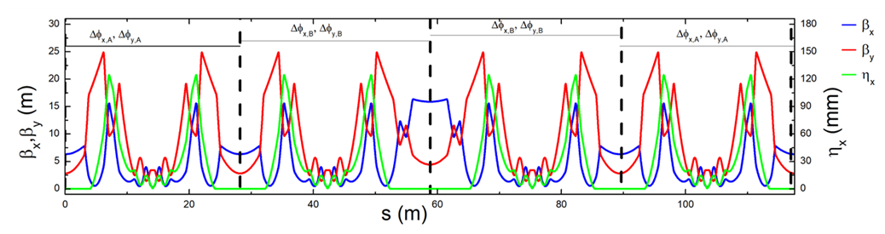
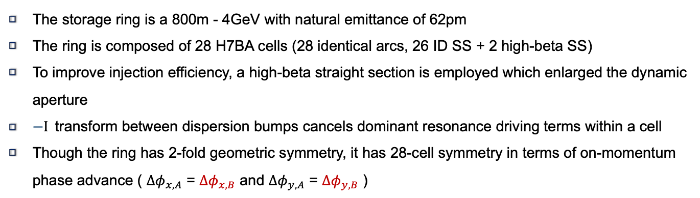

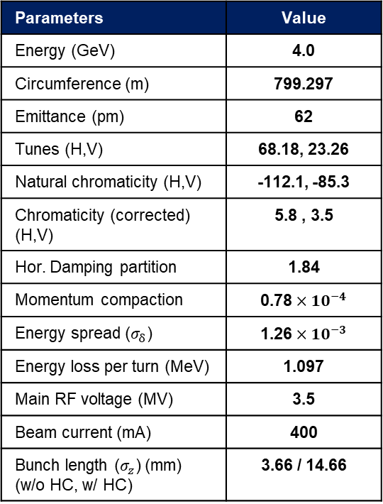
Storage ring lattice design
Parameters | Value
Energy (GeV) | 4.0
Circumference (m) | 799.297
Emittance (pm) | 62
Tunes (H,V) | 68.18, 23.26
Natural chromaticity (H,V) | -112.1, -85.3
Chromaticity (corrected) (H,V) | 5.8 , 3.5
Hor. Damping partition | 1.84
Momentum compaction | 0.78${ ×10}^{−4}$
Energy spread ($σ_{δ}$) | 1.26${ ×10}^{−3}$
Energy loss per turn (MeV) | 1.097
Main RF voltage (MV) | 3.5
Beam current (mA) | 400
Bunch length ($σ_{z}$) (mm) (w/o HC, w/ HC) | 3.66 / 14.66
Beta functions at the center of High-beta SS: ($β_{x}$, $β_{y}$) = (15.90 m, 4.45 m)
The storage ring is a 800m - 4GeV with natural emittance of 62pm
The ring is composed of 28 H7BA cells (28 identical arcs, 26 ID SS + 2 high-beta SS)
To improve injection efficiency, a high-beta straight section is employed which enlarged the dynamic aperture
$−Ι$transform between dispersion bumps cancels dominant resonance driving terms within a cell
Though the ring has 2-fold geometric symmetry, it has 28-cell symmetry in terms of on-momentum phase advance ( $Δφ_{x, A}$ = $Δφ_{x, B}$ and $Δφ_{y, A}$ = $Δφ_{y, B}$ )
4/20

Slide 5
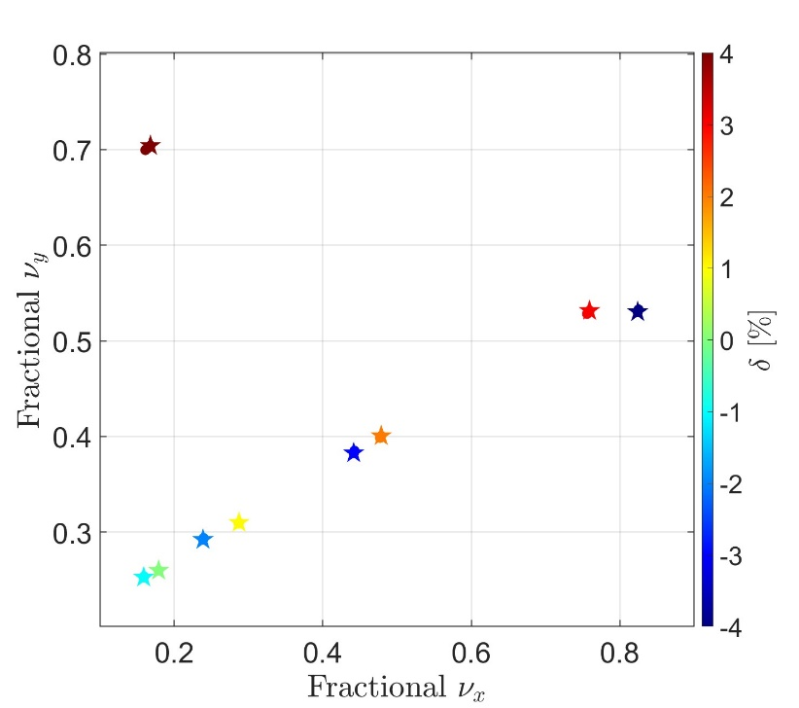
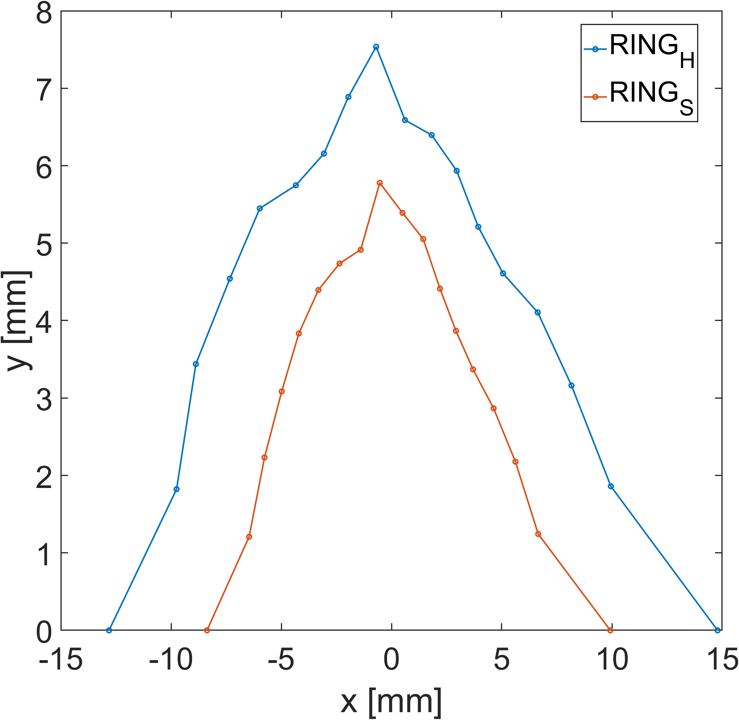
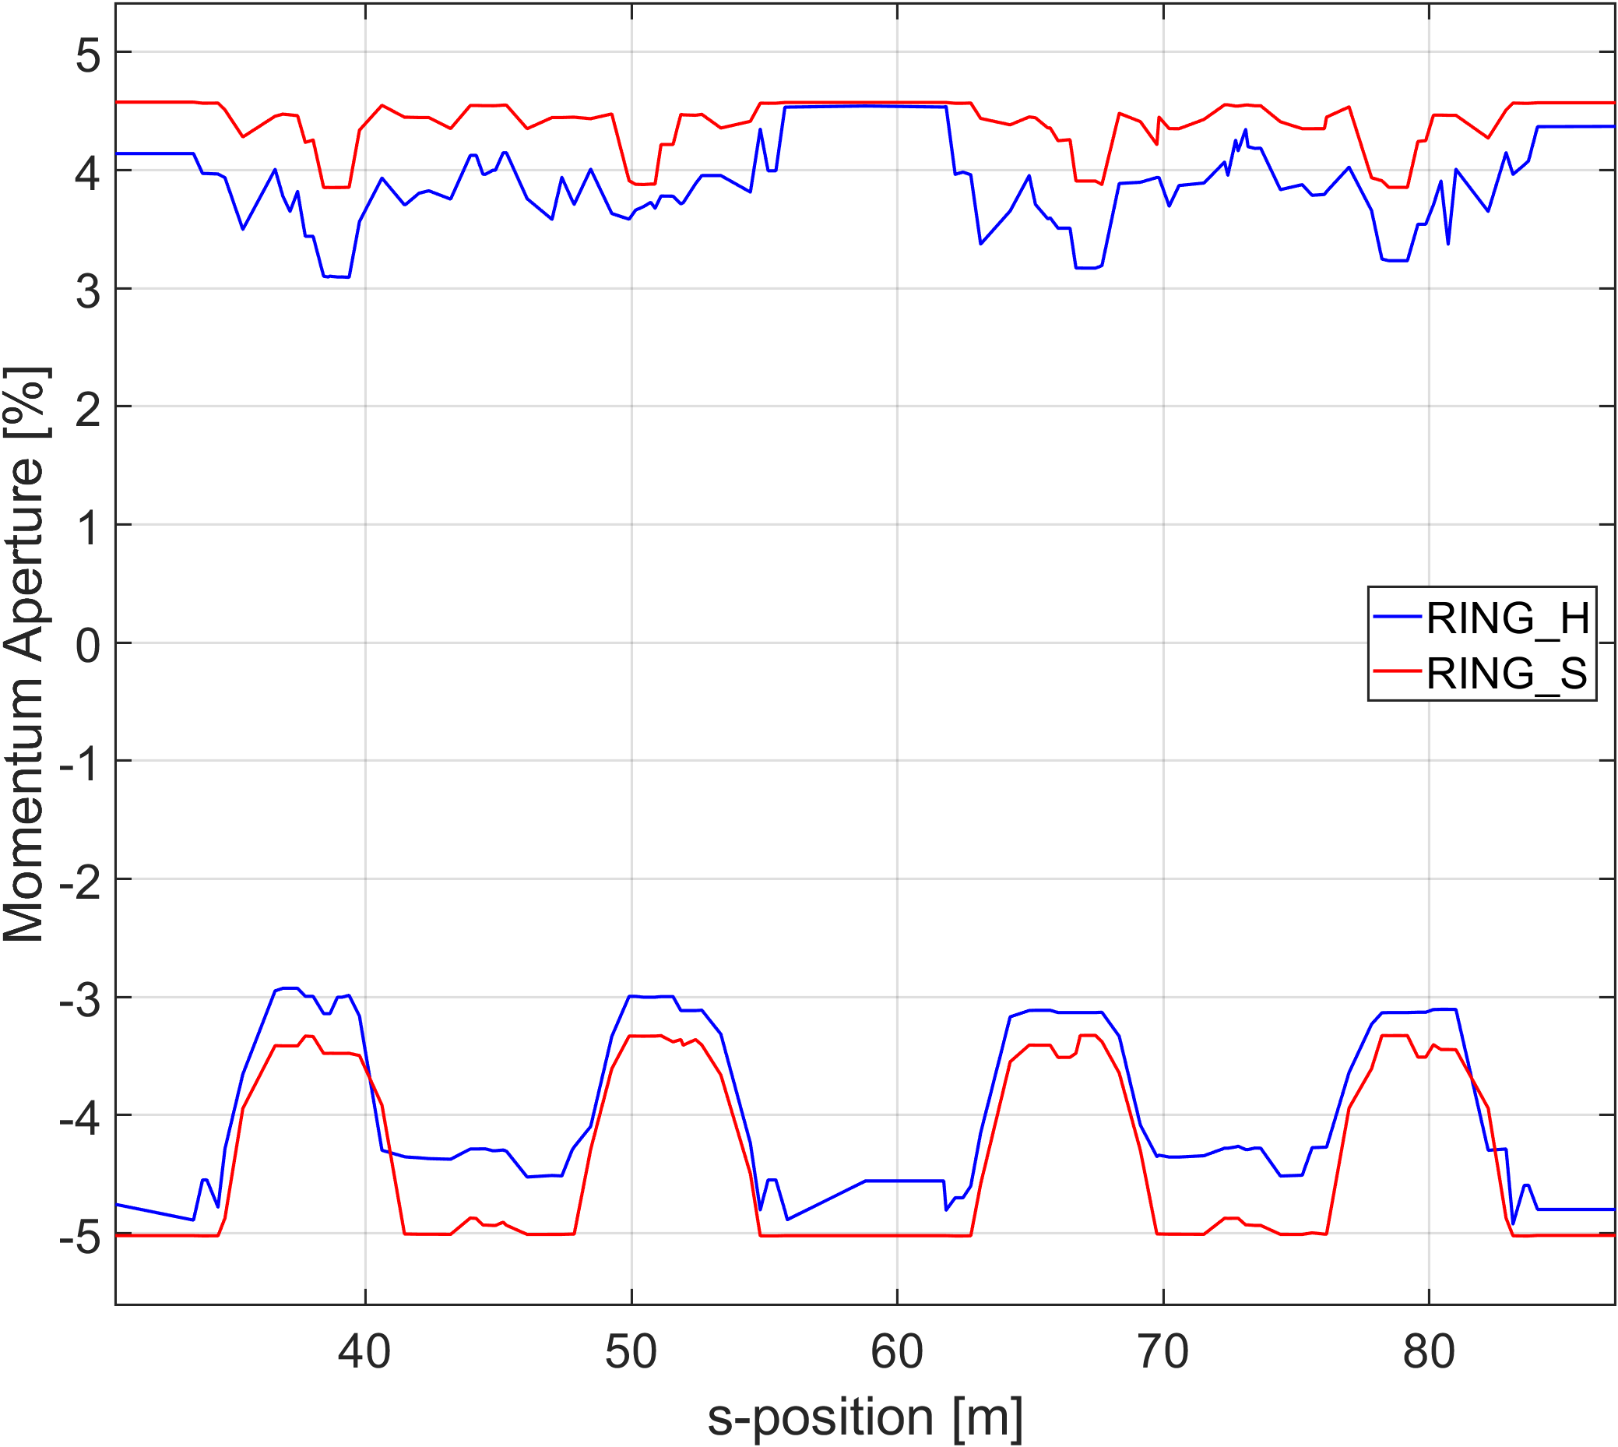
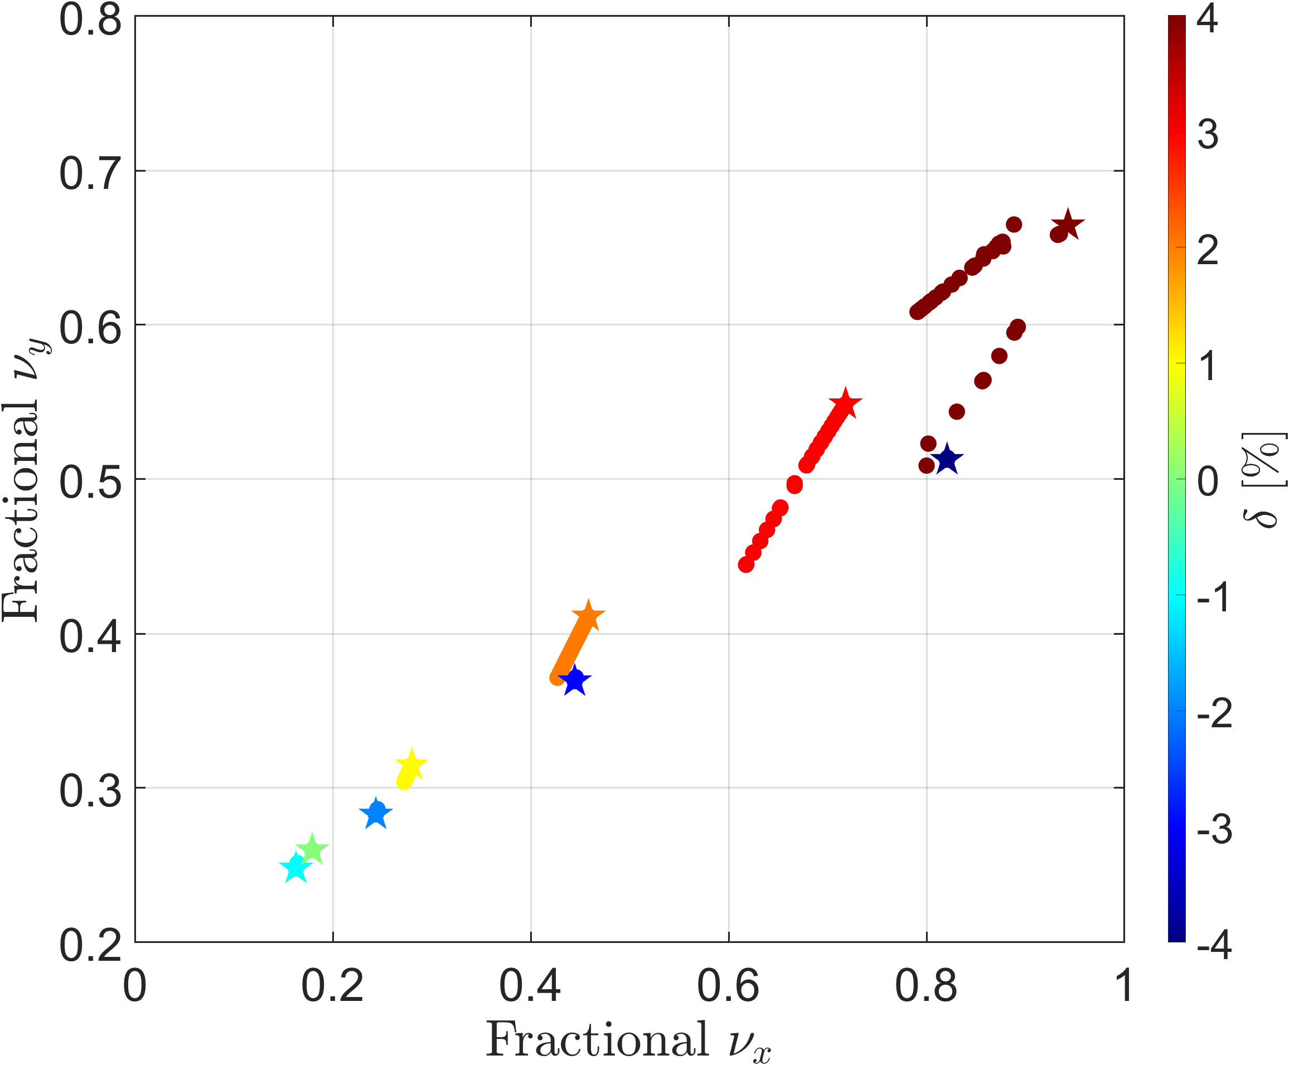
High-beta section of Korea-4GSR
RING_S : Ring with full periodic 28-cell (no high-beta straight)
RING_H : Ring with 26 ID straights + 2 high-beta straights (28 identical arcs)
RING_S
Dynamic aperture
Momentum aperture
RING_H
RING_H has about twice the DA compared to RING_S.
RING_H has smaller MA which result in 41% decrease of Touschek lifetime
RING_H exhibits larger ADTS than RING_S, especially in the off-momentum case at δ = 3%.
5/20

Slide 6
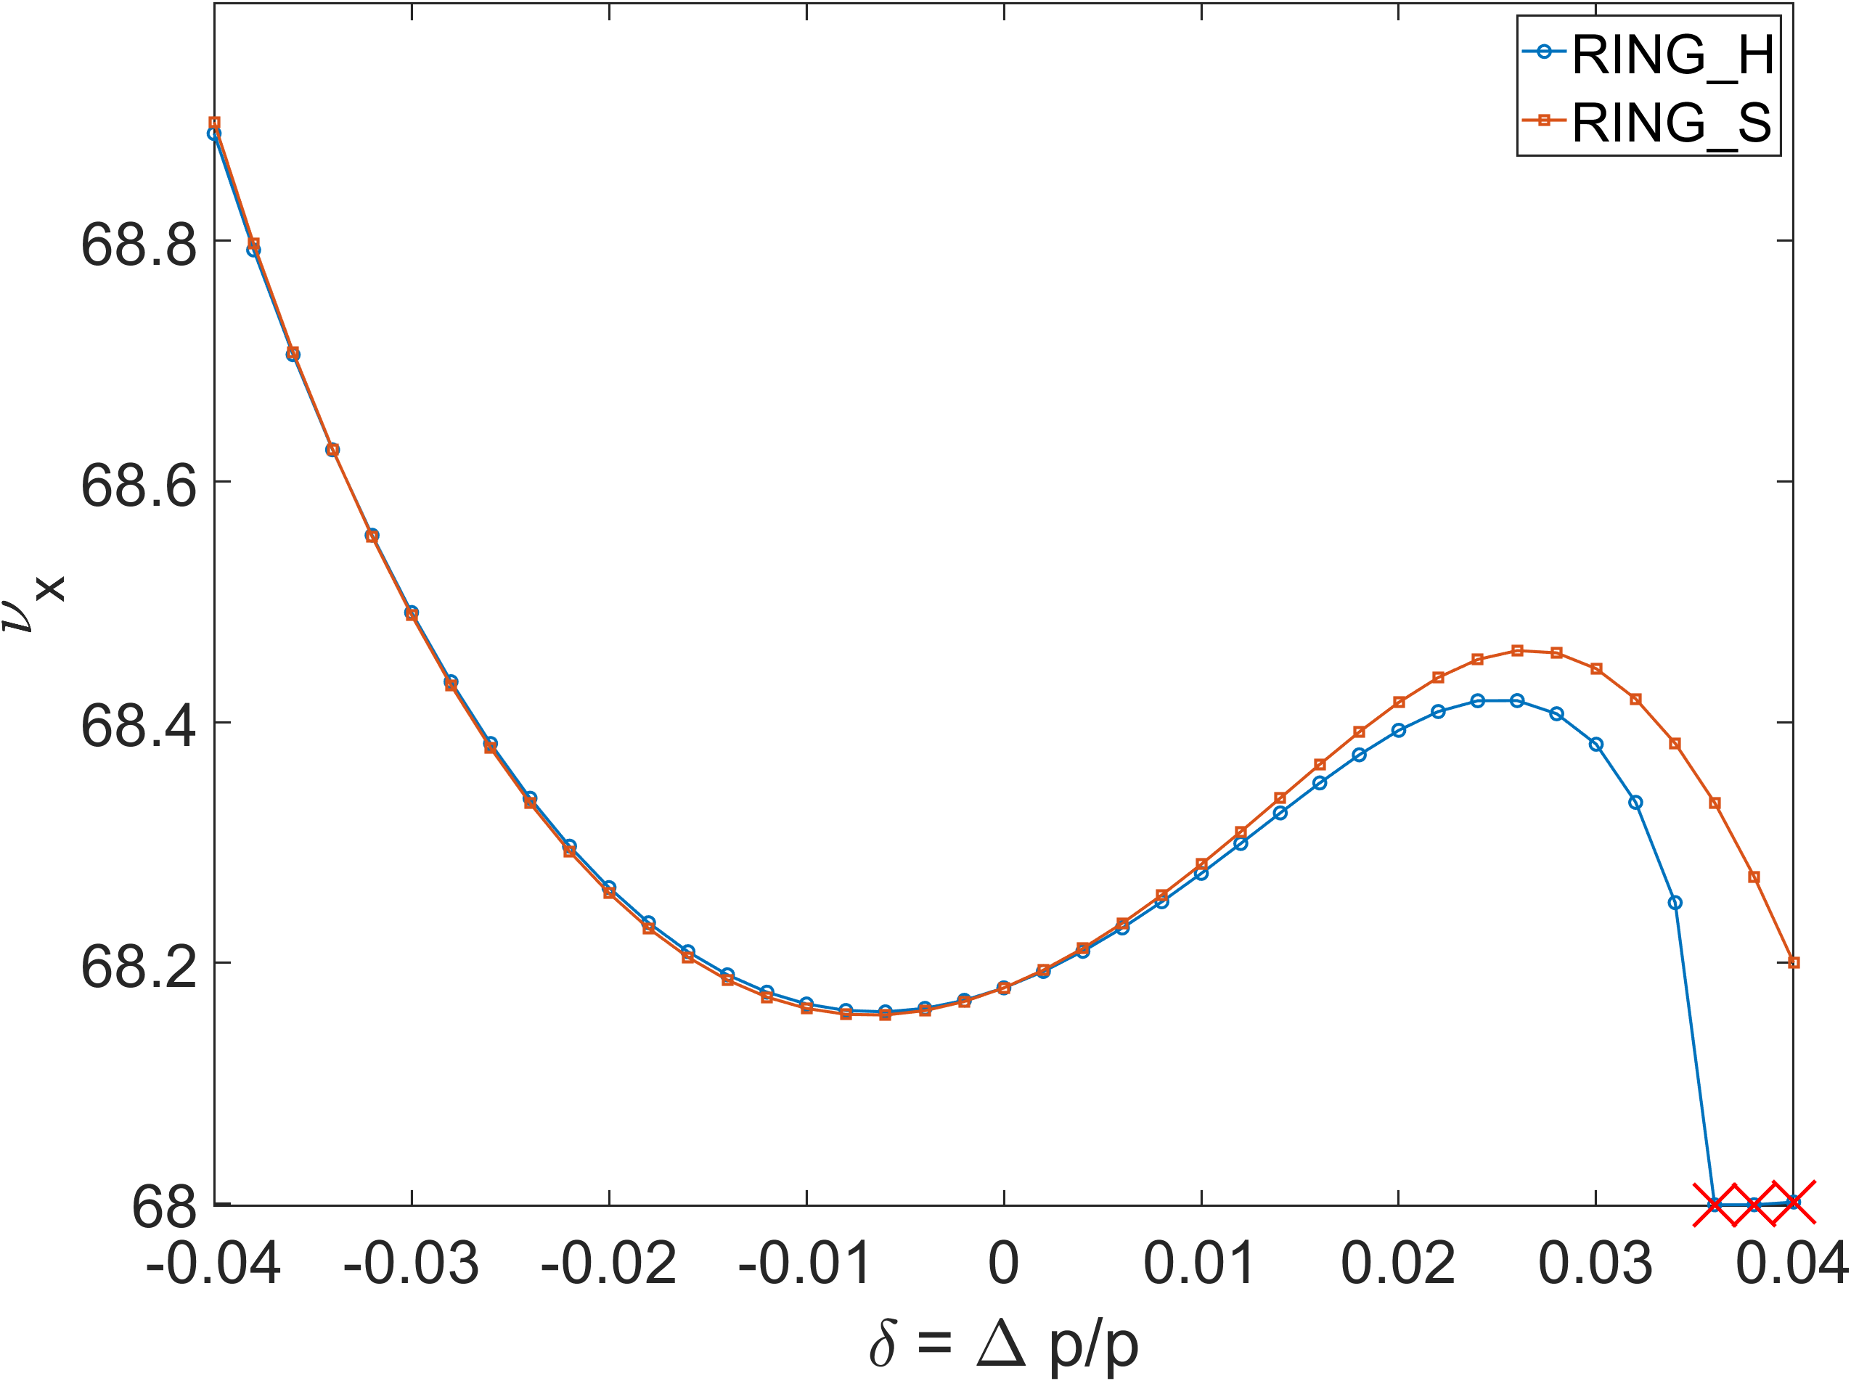
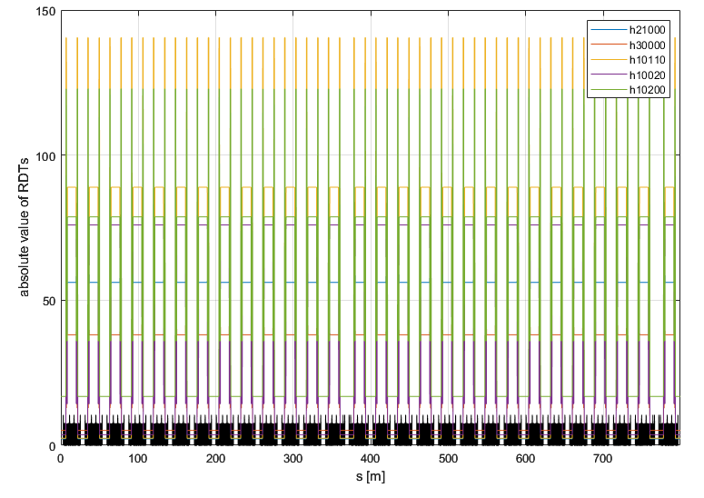
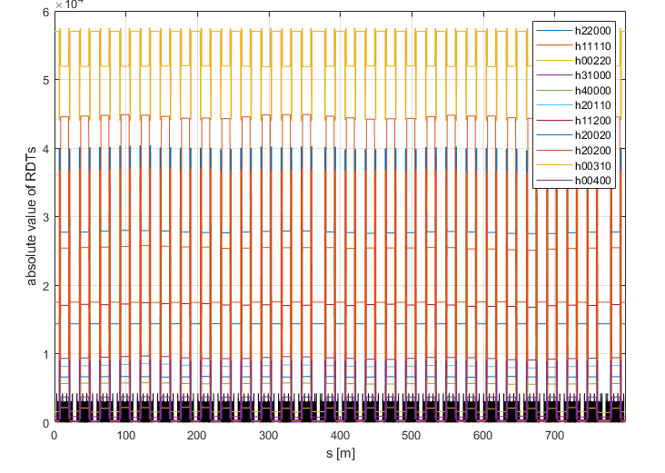
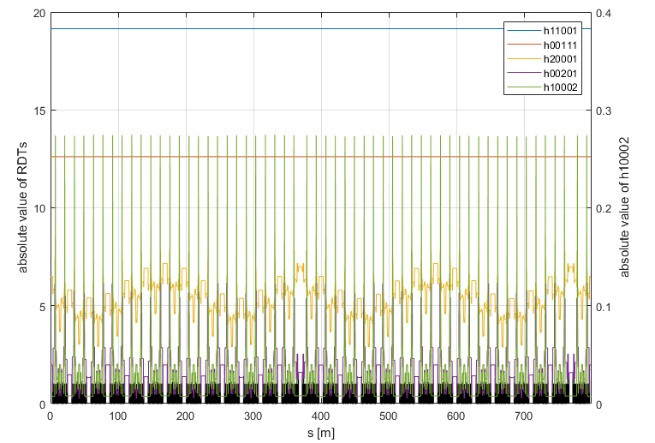
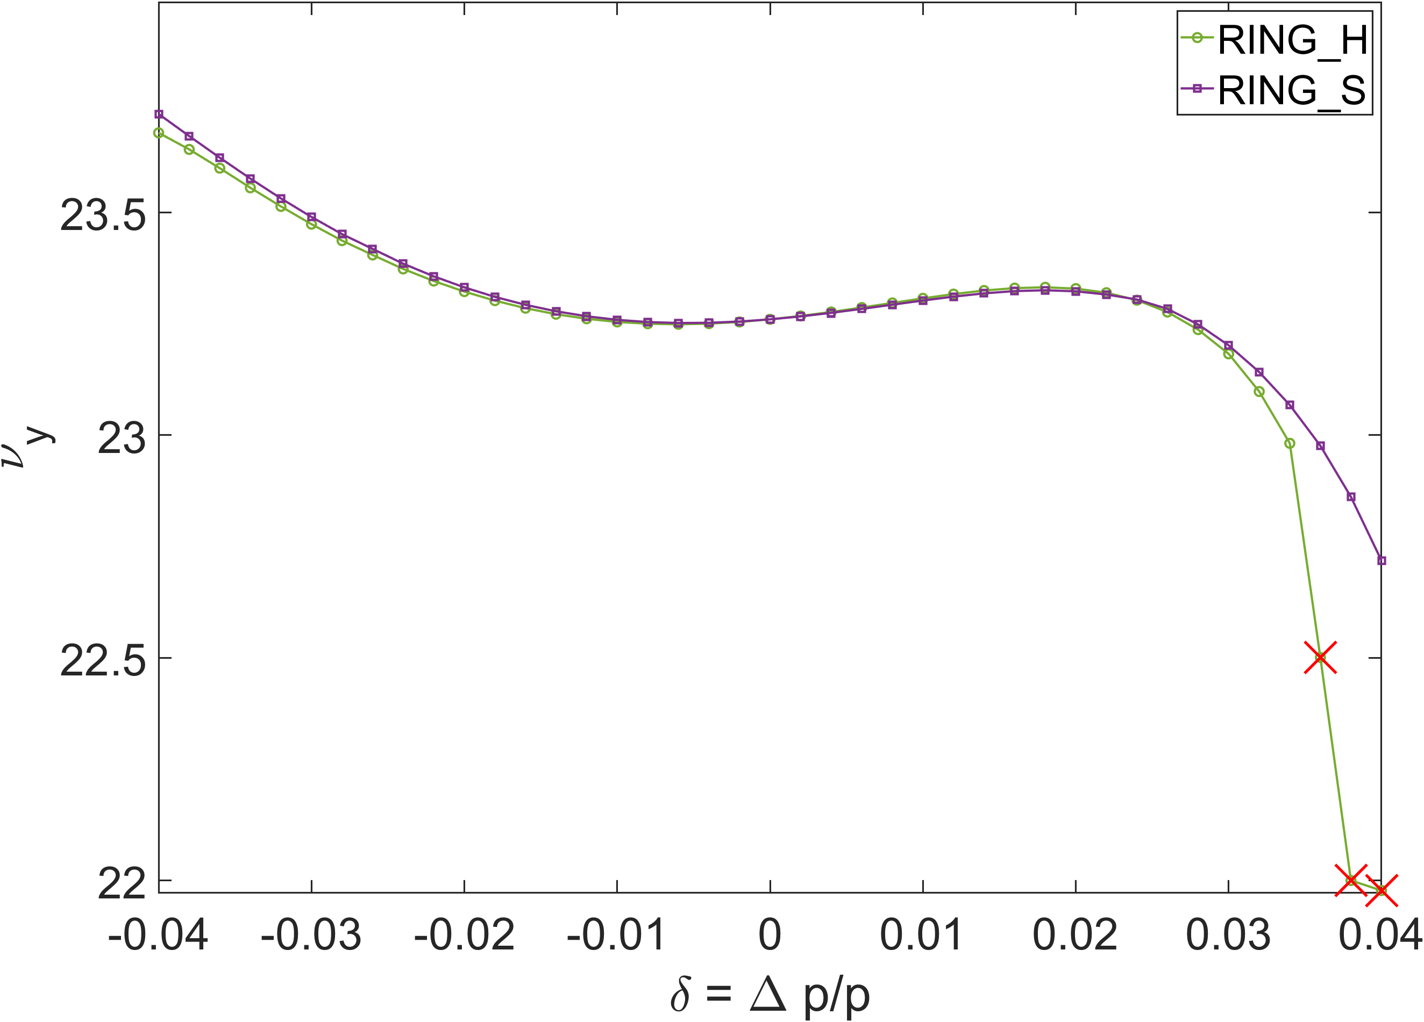
High-beta section of Korea-4GSR
Geometric RDTs up to 3rd order
Geometric RDTs up to 4th order
Hor. MDTS
Chromatic RDT
The geometric RDTs in Korea-4GSR appear symmetric
The chromatic RDTs exhibit asymmetry, originating from the chromaticity difference between the unit cells and the high-beta straight section.
The Momentum dependent tune shift plots compare RING_H and an RING_S. In the RING_H configuration, the beam becomes unstable above δ = +3.6%.
Ver. MDTS
6/20

Slide 7

Optimizing Amplitude dependent tune shifts (ADTS)

Slide 8
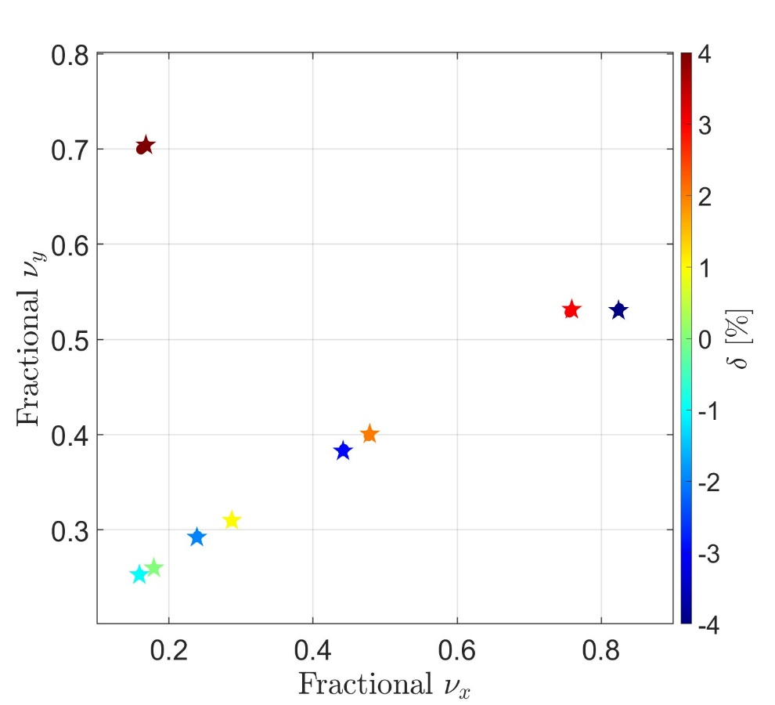
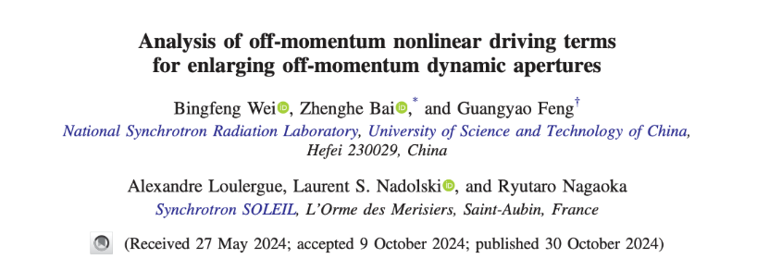
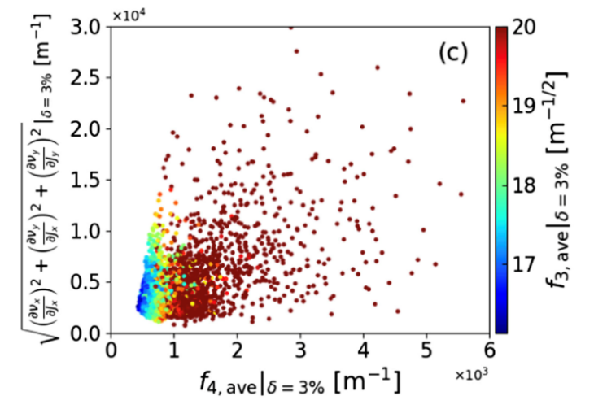
Relation with ADTS and DA
High-beta
Full symmetric
Restore ADTS
Dynamic aperture calculation via particle tracking is computationally expensive. Thus, an indirect method for estimating DA without tracking is desirable.
B. Wei showed that RDT fluctuations correlate with both DA and ADTS, where small fluctuations are linked to lower ADTS and larger DA.
Based on this, we set ADTS as an optimization objective to restore the ADTS of the high-beta ring to that of the fully symmetric ring, aiming to increase DA.
8/20
Minimizing the fluctuation of resonance driving terms in dynamic aperture optimization. B. Wei et al. Phys. Rev. Accel. Beams 26, 084001 (2023)
Analysis of off-momentum nonlinear driving terms for enlarging off-momentum dynamic apertures. B. Wei et al. Phys. Rev. Accel. Beams 27, 104001 (2024)

Slide 9
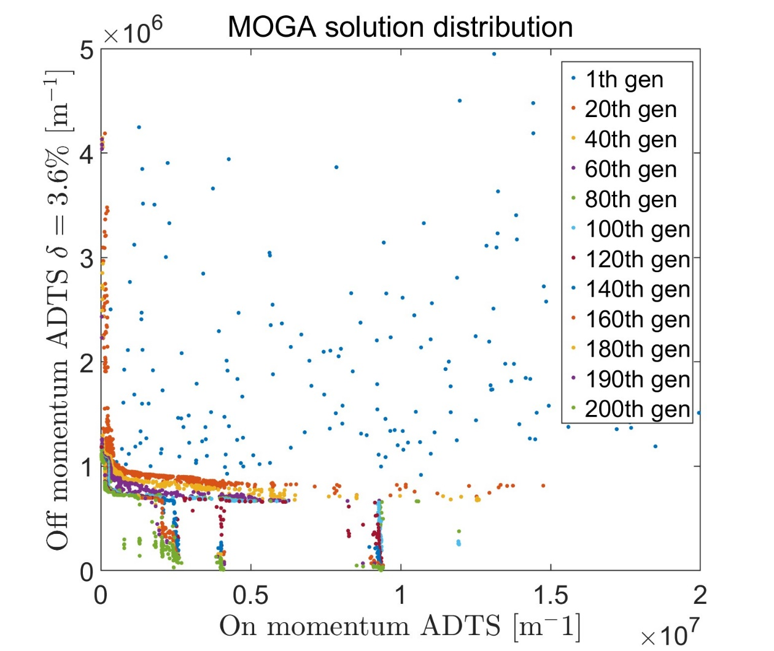
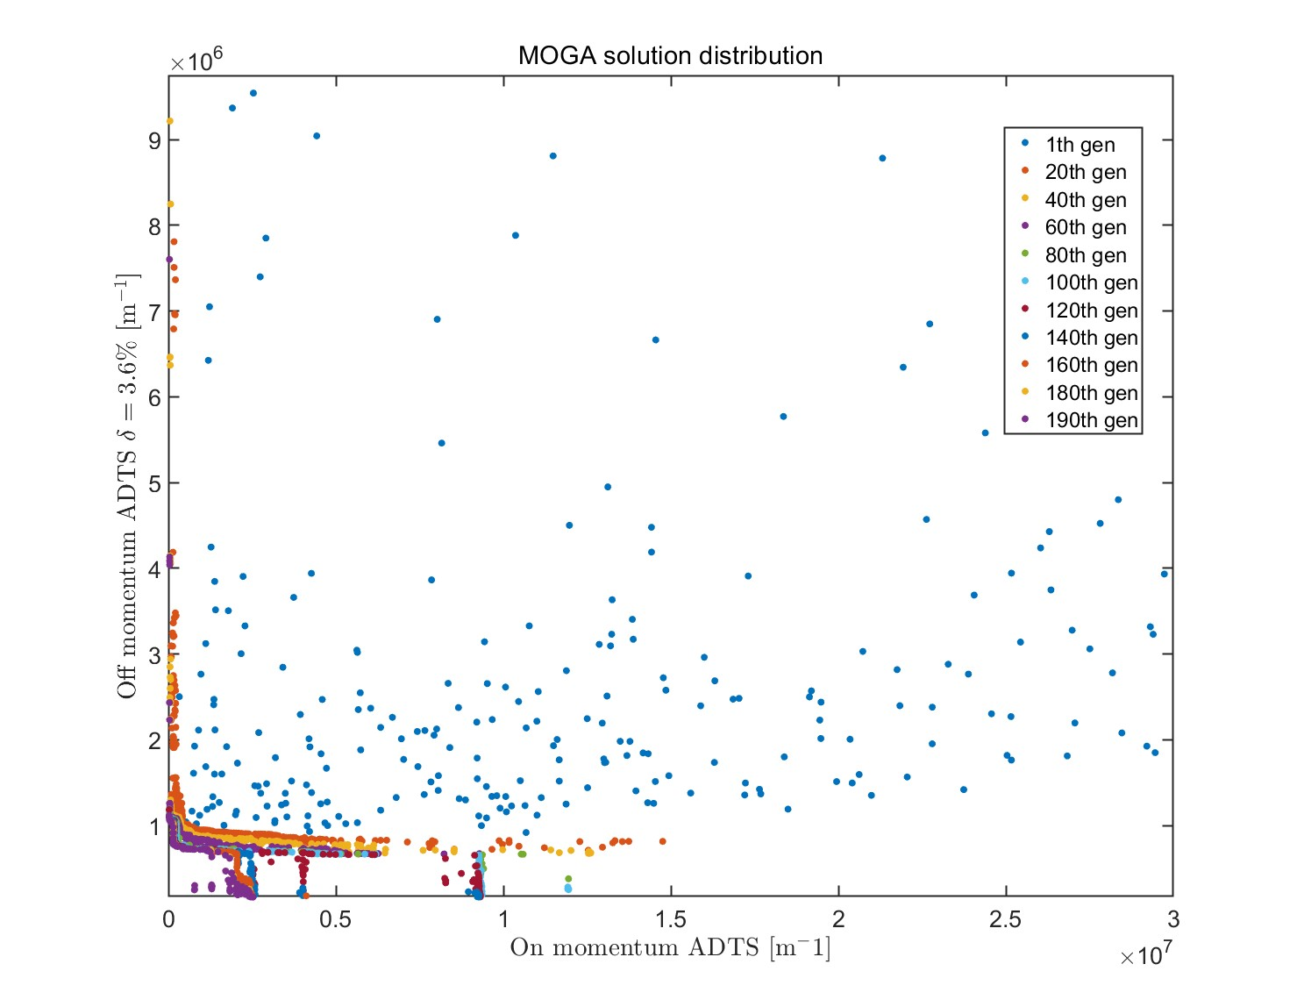
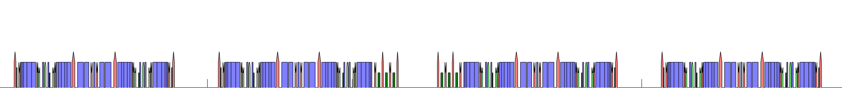

Optimizing ADTS for enlarging DA
Lattice : Korea-4GSR
The population size = 256
Variables :
  S31
  S32
  S33
  OCT31
Objectives :
  ${\sqrt{{\left(\frac{dν_{x}}{dJ_{x}}\right)}^{2}+{\left(\frac{dν_{x}}{dJ_{y}}\right)}^{2}+{\left(\frac{dν_{y}}{dJ_{y}}\right)}^{2}}}_{δ=0\%}$
  ${\sqrt{{\left(\frac{dν_{x}}{dJ_{x}}\right)}^{2}+{\left(\frac{dν_{x}}{dJ_{y}}\right)}^{2}+{\left(\frac{dν_{y}}{dJ_{y}}\right)}^{2}}}_{δ=3.6\%}$
OCT31
OCT31
9/20
S31
S32
S33
S33
S32
S31
Unit cell of Korea-4GSR

Slide 10
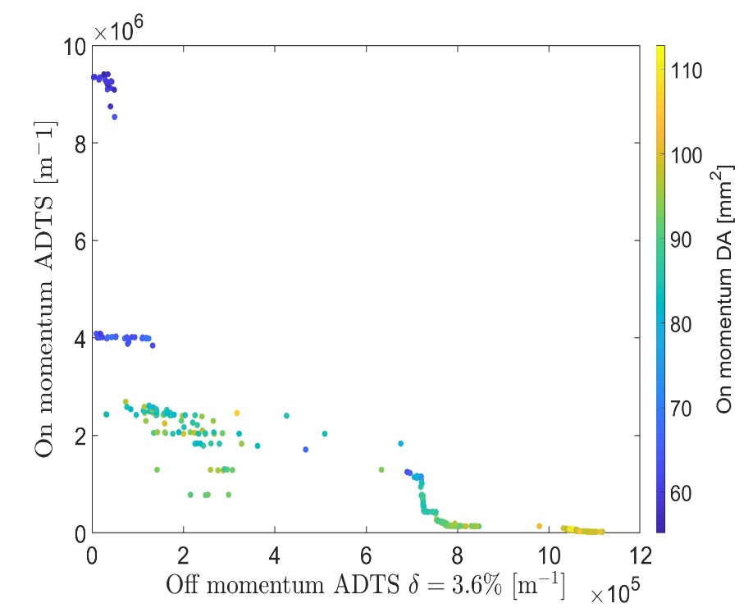
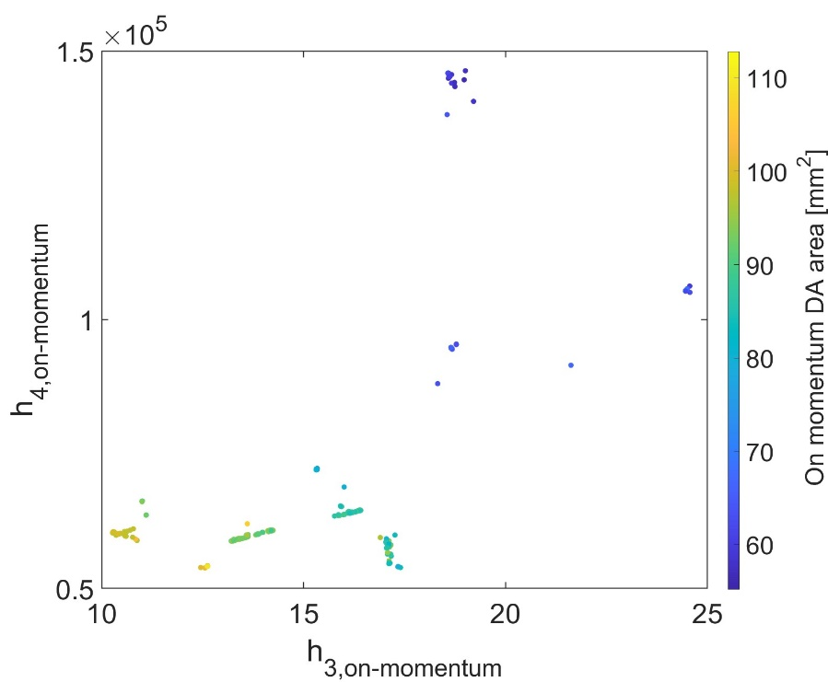
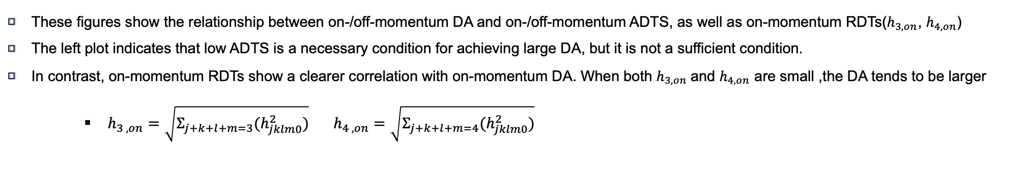
Optimizing ADTS for enlarging DA
These figures show the relationship between on-/off-momentum DA and on-/off-momentum ADTS, as well as on-momentum RDTs($h_{3, on}$, $h_{4,on}$)
The left plot indicates that low ADTS is a necessary condition for achieving large DA, but it is not a sufficient condition.
In contrast, on-momentum RDTs show a clearer correlation with on-momentum DA. When both $h_{3, on}$and $h_{4,on}$ are small ,the DA tends to be larger
    $h_{3 , on}=\sqrt{Σ_{j+k+l+m=3}(h_{jklm0}^{2})} h_{4 , on}=\sqrt{Σ_{j+k+l+m=4}(h_{jklm0}^{2})}$
10/20

Slide 11
Optimizing on-momentum Resonance driving terms (RDTs)

Slide 12
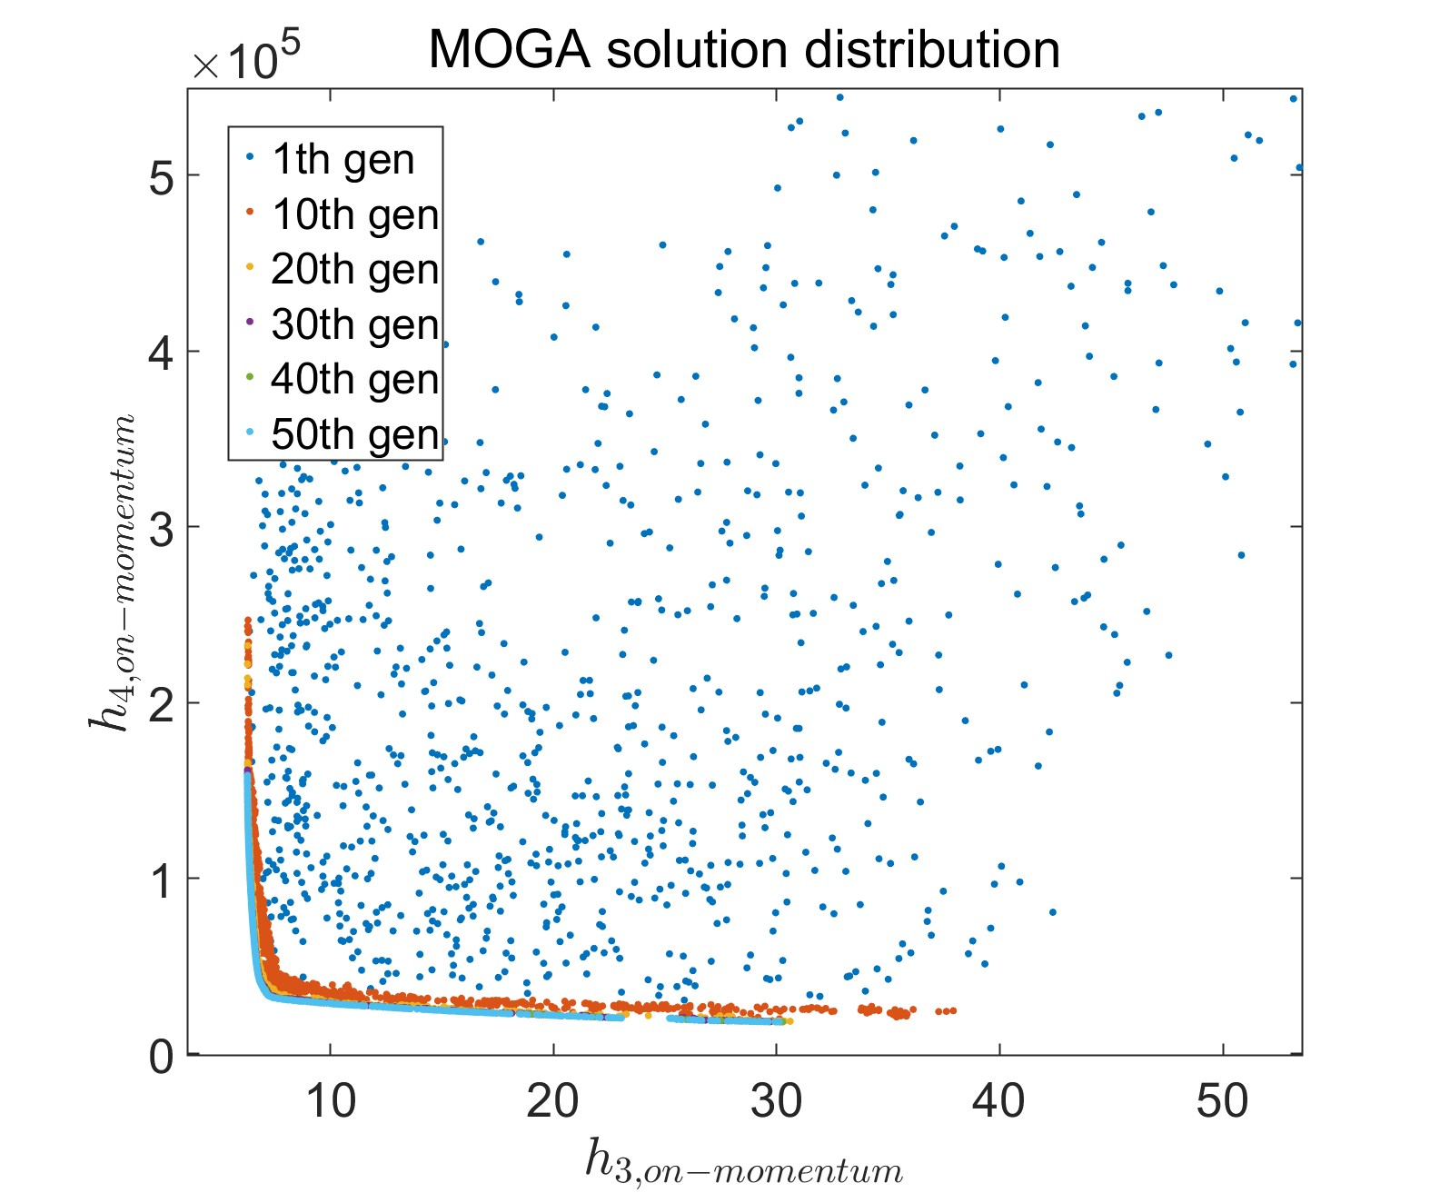
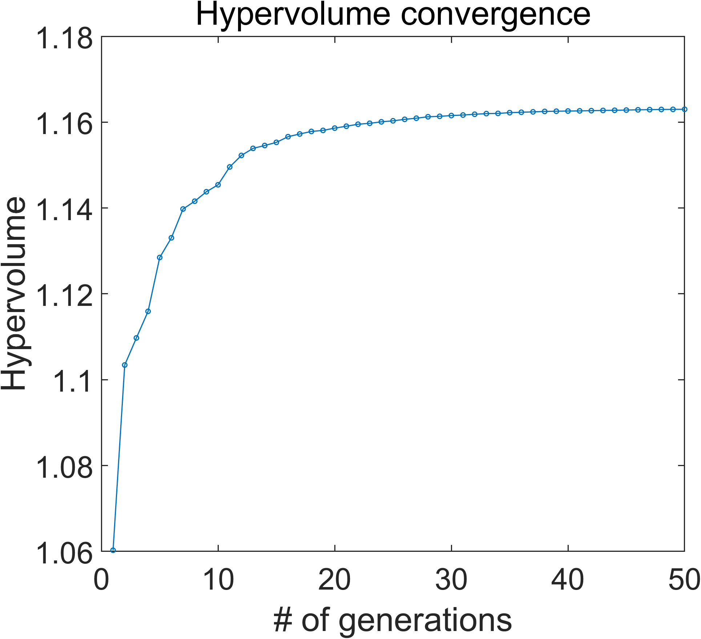
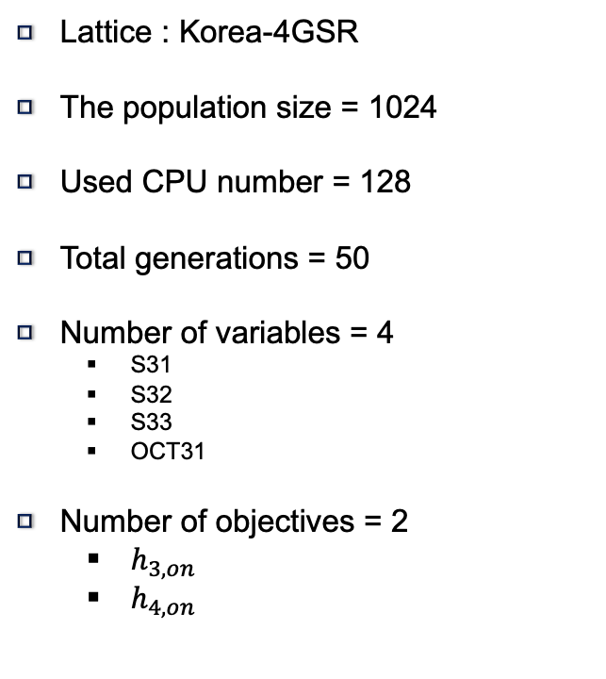
Optimizing on momentum RDT enlarging DA
Lattice : Korea-4GSR
The population size = 1024
Used CPU number = 128
Total generations = 50
Number of variables = 4
  S31
  S32
  S33
  OCT31
Number of objectives = 2
  $h_{3, on}$
  $h_{4, on }$
OCT31
OCT31
12/20
S31
S32
S33
S33
S32
S31
Unit cell of Korea-4GSR

Slide 13
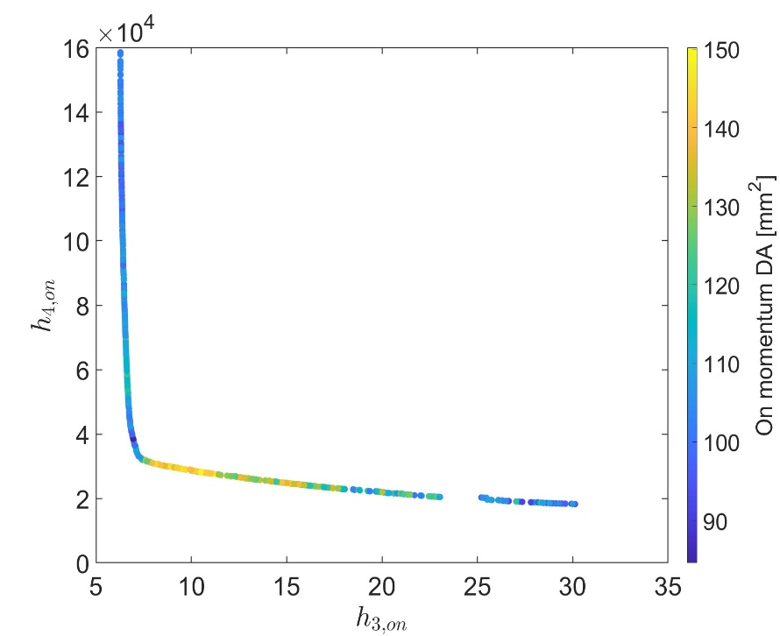
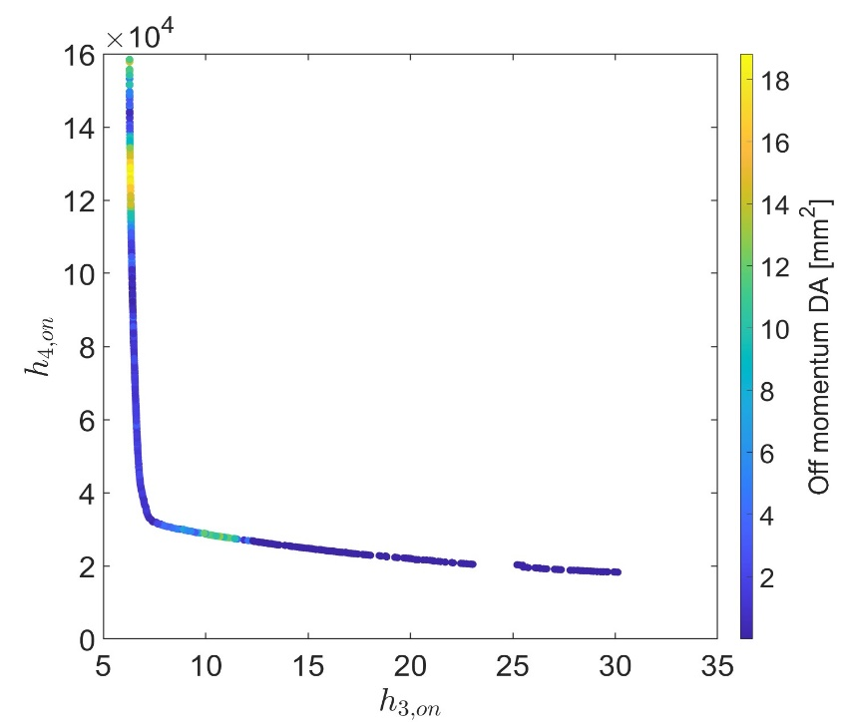
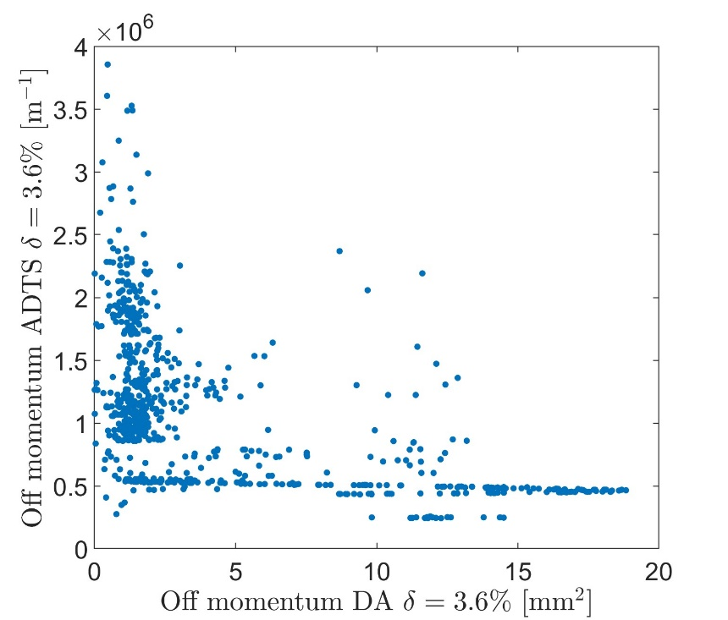
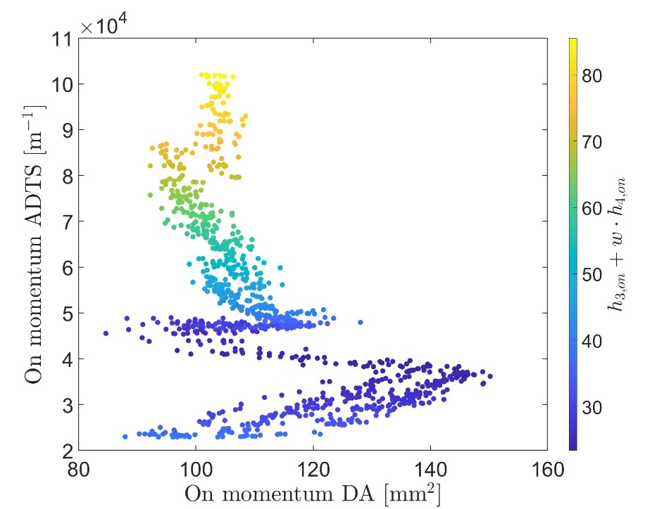
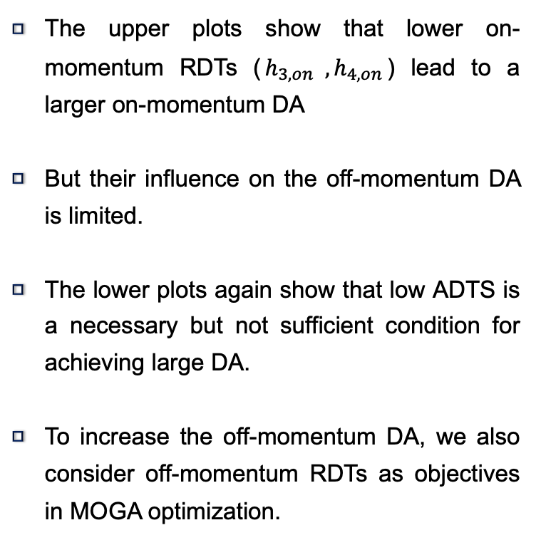
Optimizing on momentum RDT enlarging DA
On RDT vs On DA
On RDT vs Off DA
The upper plots show that lower on-momentum RDTs ($h_{3, on} , h_{4, on}$) lead to a larger on-momentum DA
But their influence on the off-momentum DA is limited.
The lower plots again show that low ADTS is a necessary but not sufficient condition for achieving large DA.
To increase the off-momentum DA, we also consider off-momentum RDTs as objectives in MOGA optimization.
Off DA vs Off ADTS
On DA vs On ADTS
13/20

Slide 14
Optimizing off-momentum RDT

Slide 15
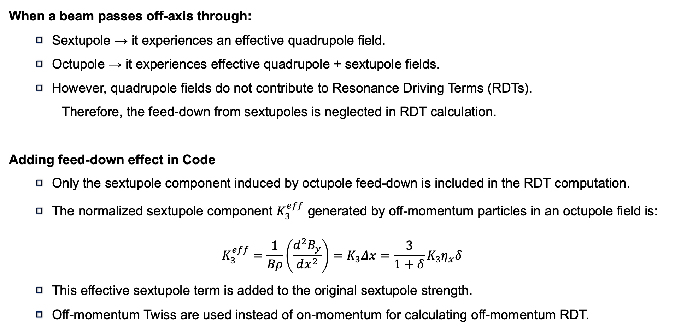
Off-momentum RDT calculation with AT
When a beam passes off-axis through:
  Sextupole → it experiences an effective quadrupole field.
  Octupole → it experiences effective quadrupole + sextupole fields.
  However, quadrupole fields do not contribute to Resonance Driving Terms (RDTs).
    Therefore, the feed-down from sextupoles is neglected in RDT calculation.
Adding feed-down effect in Code
  Only the sextupole component induced by octupole feed-down is included in the RDT computation.
  The normalized sextupole component $K_{3}^{eff}$​ generated by off-momentum particles in an octupole field is:
$$K_{3}^{eff}\text{​}=\frac{1}{Bρ}\left(\frac{d^{2}B_{y}}{dx^{2}}\right)=K_{3}Δx={\frac{3}{1+δ}K}_{3}η_{x}δ$$
  This effective sextupole term is added to the original sextupole strength.
  Off-momentum Twiss are used instead of on-momentum for calculating off-momentum RDT.
15/20

Slide 16
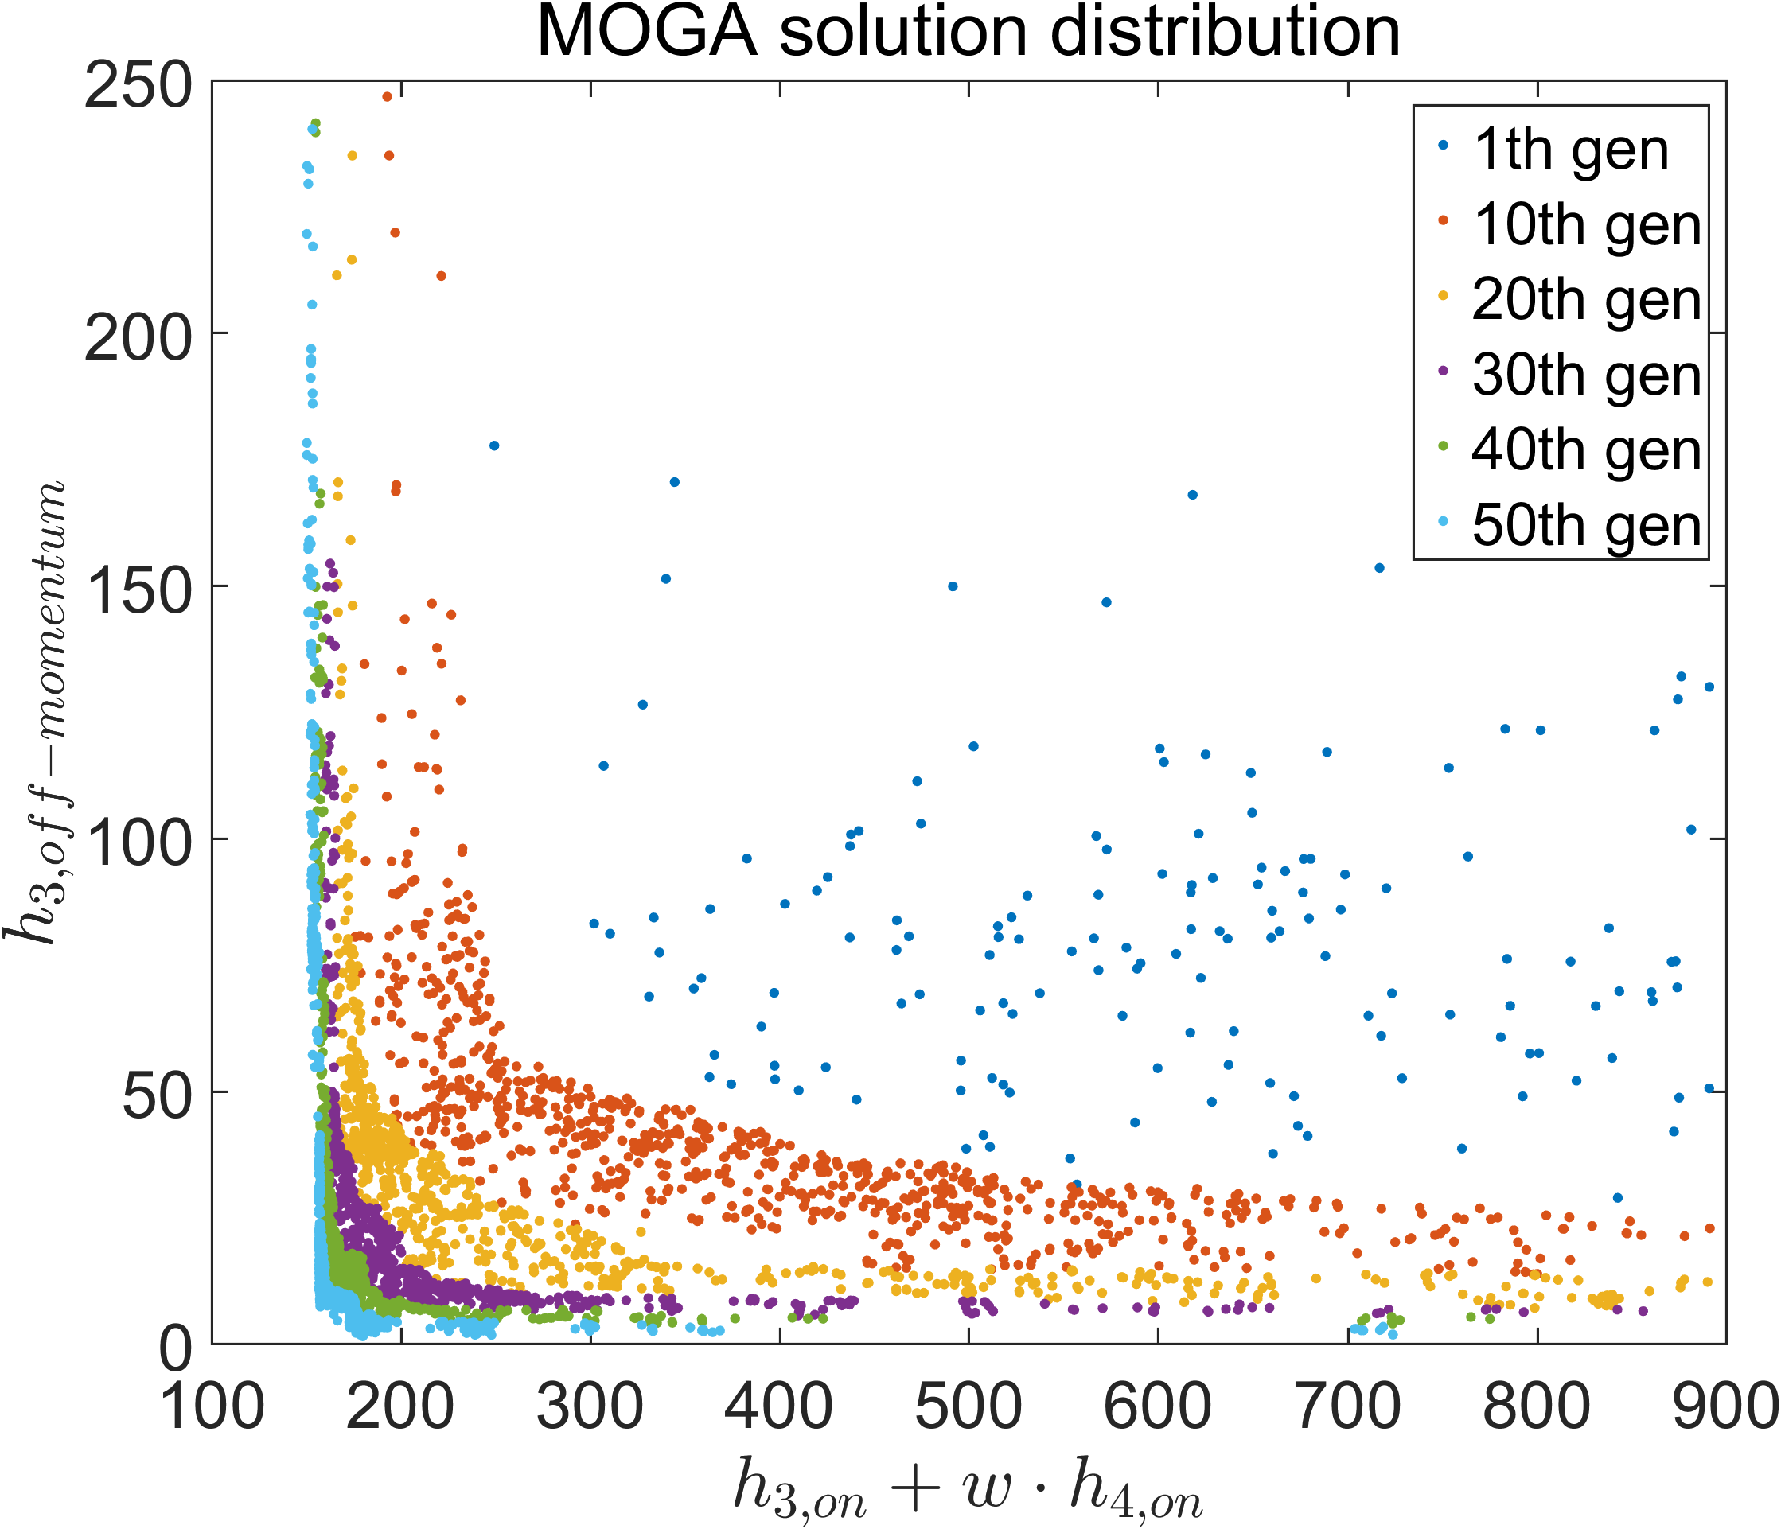
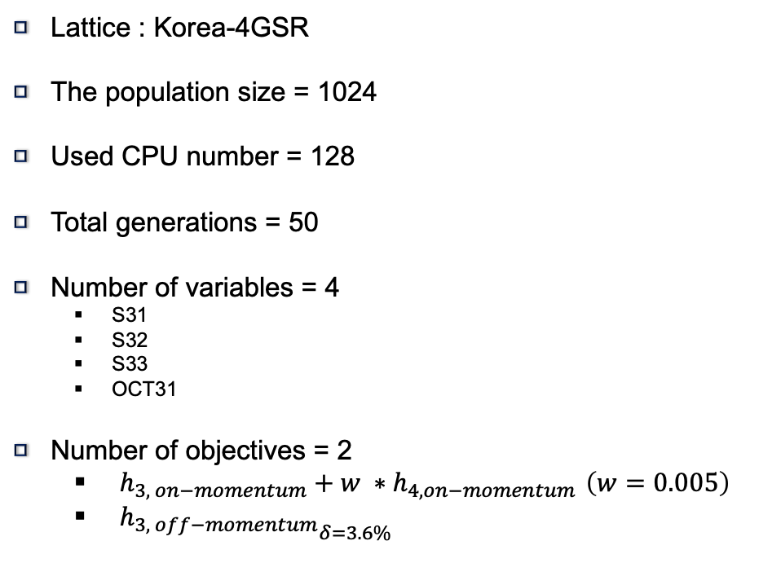
Optimizing on & off RDTs for enlarging DA
Lattice : Korea-4GSR
The population size = 1024
Used CPU number = 128
Total generations = 50
Number of variables = 4
  S31
  S32
  S33
  OCT31
Number of objectives = 2
  $h_{3, on−momentum}+w ∗h_{4, on−momentum }\left(w=0.005\right)$
  ${h_{3, off−momentum}}_{δ=3.6\% }$
OCT31
OCT31
S31
S32
S33
S33
S32
S31
16/20
Unit cell of Korea-4GSR

Slide 17
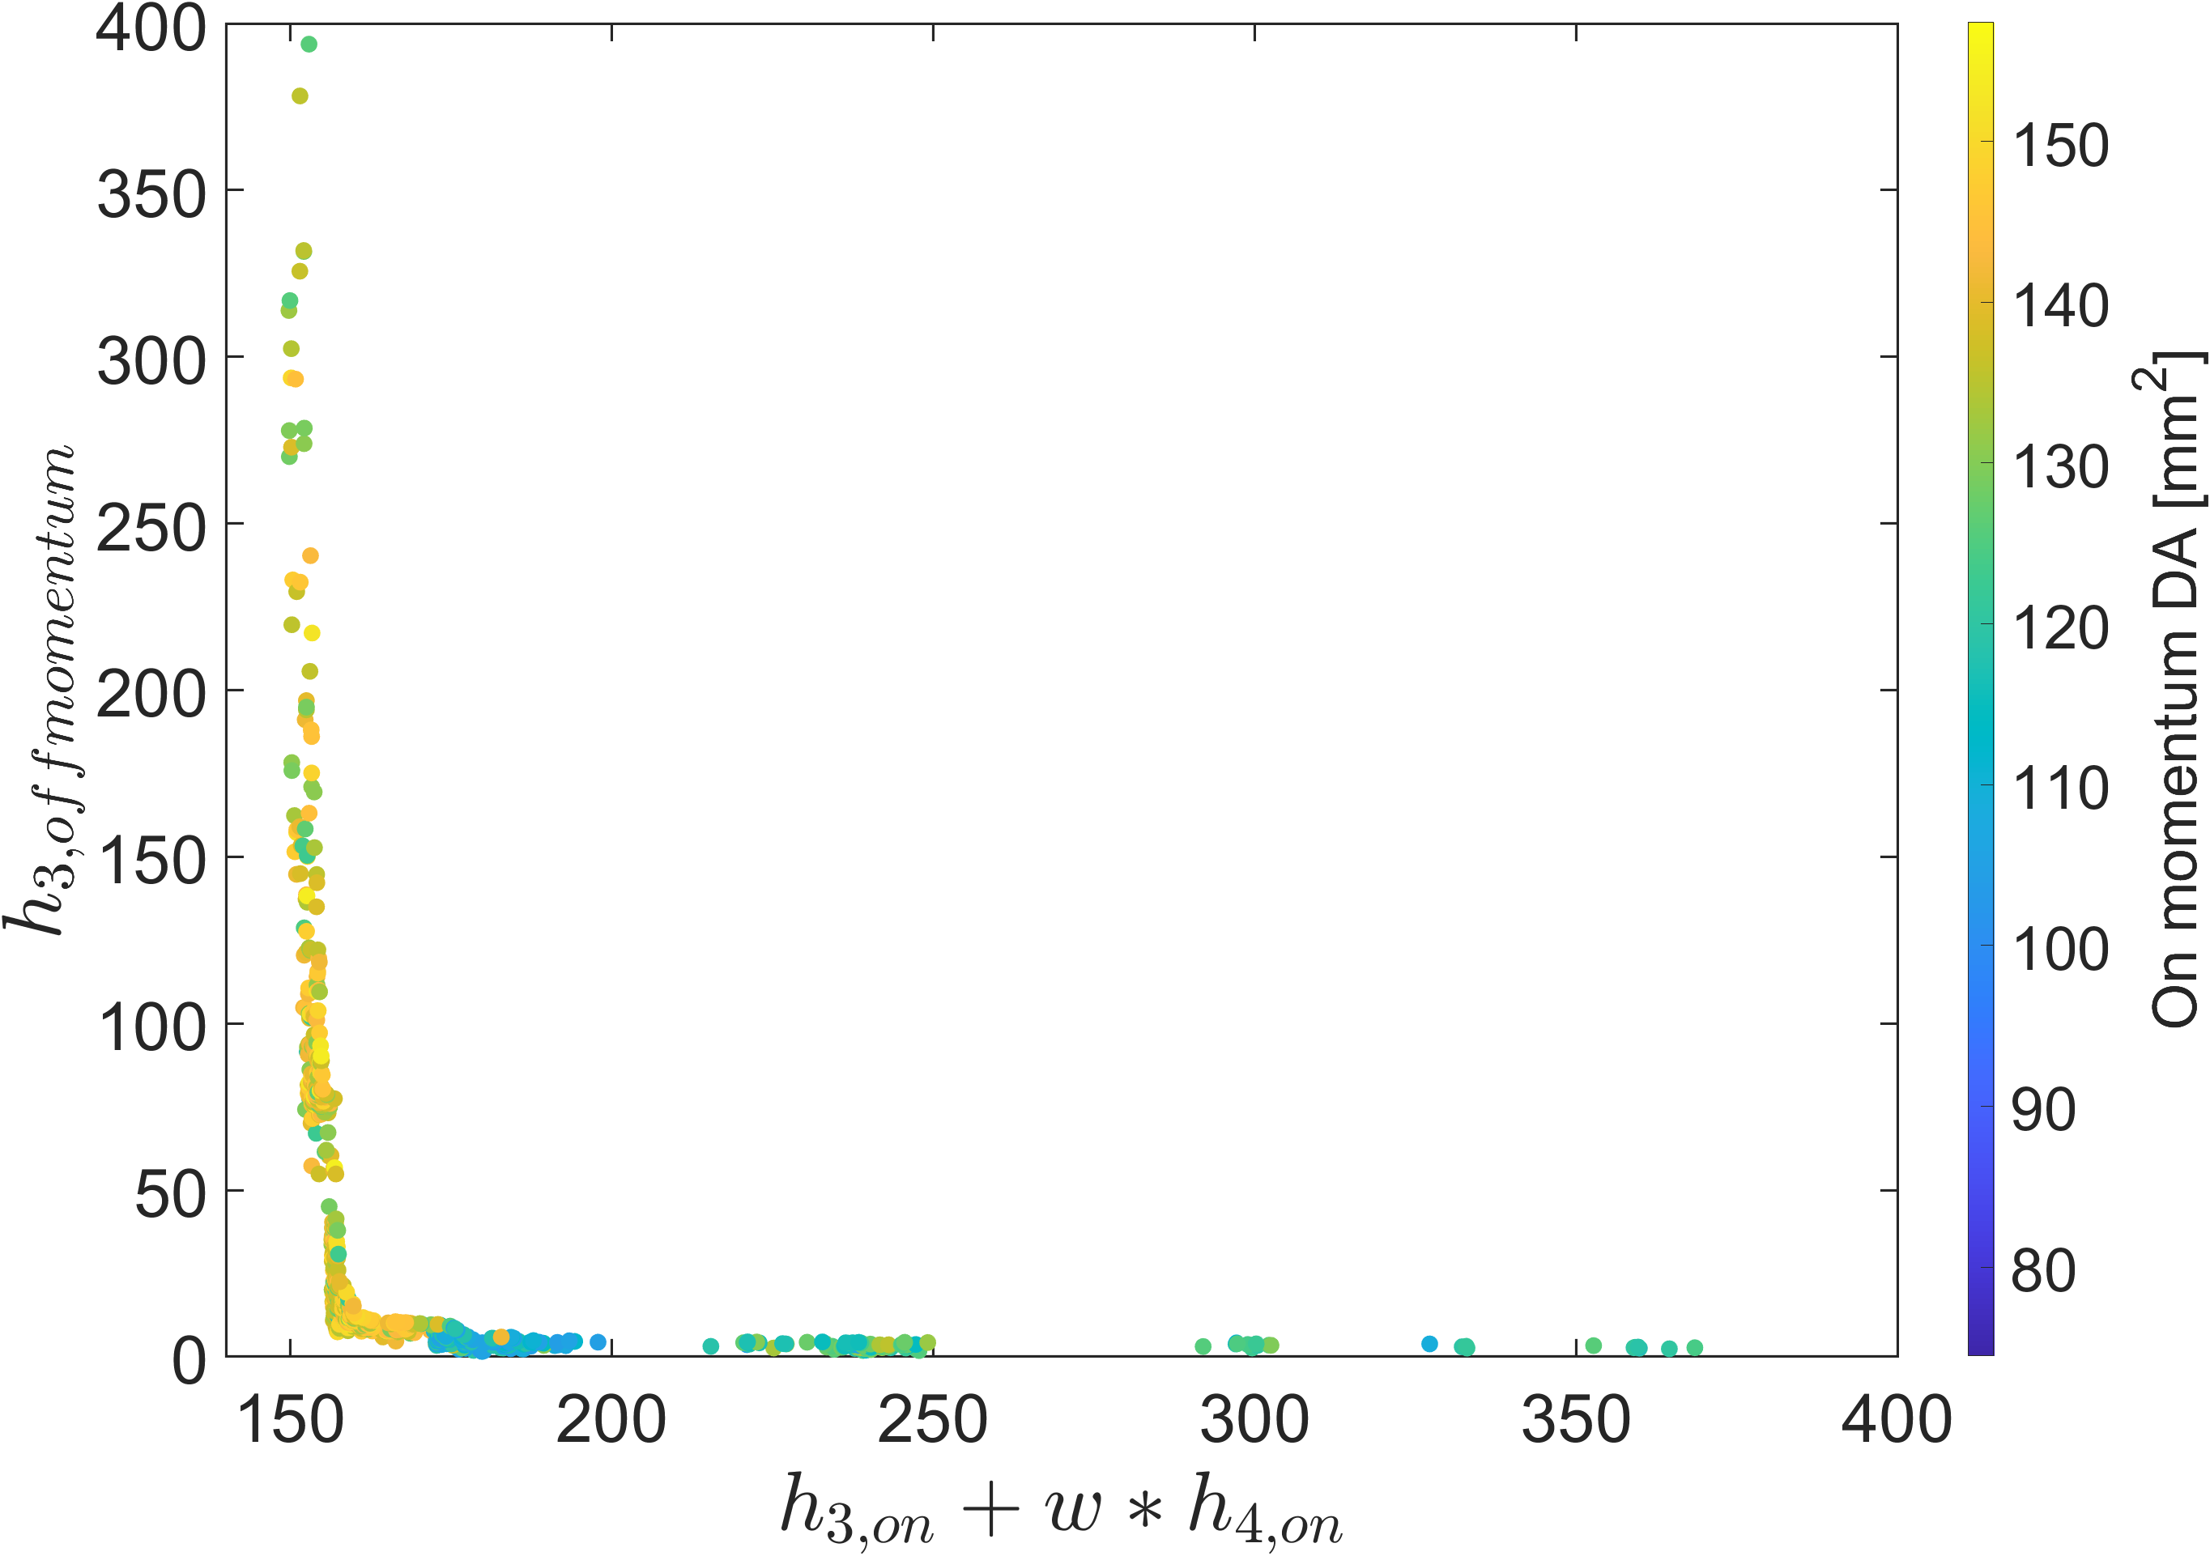
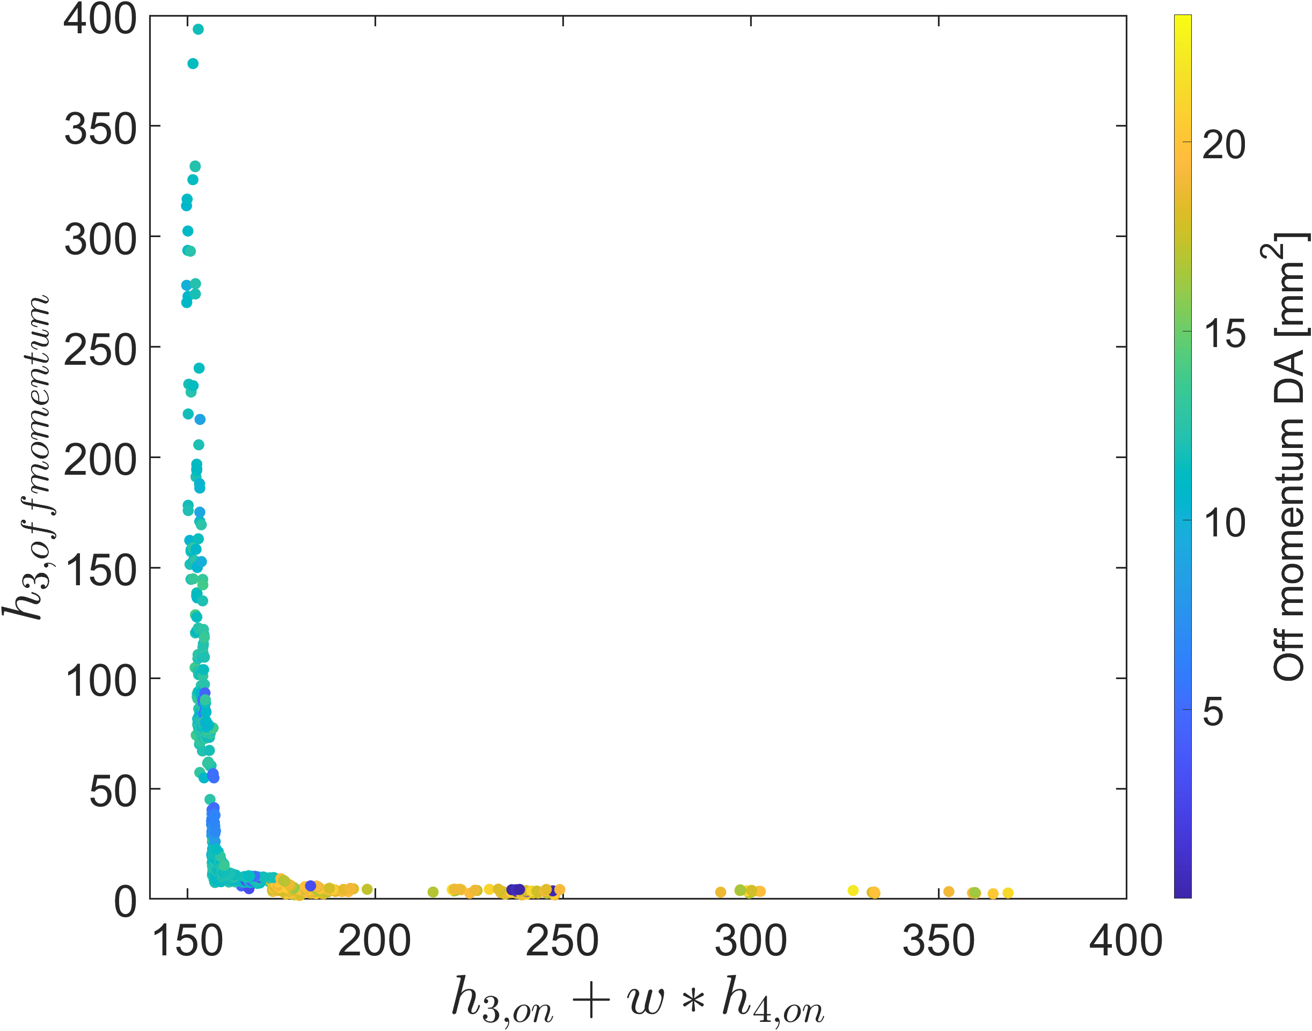
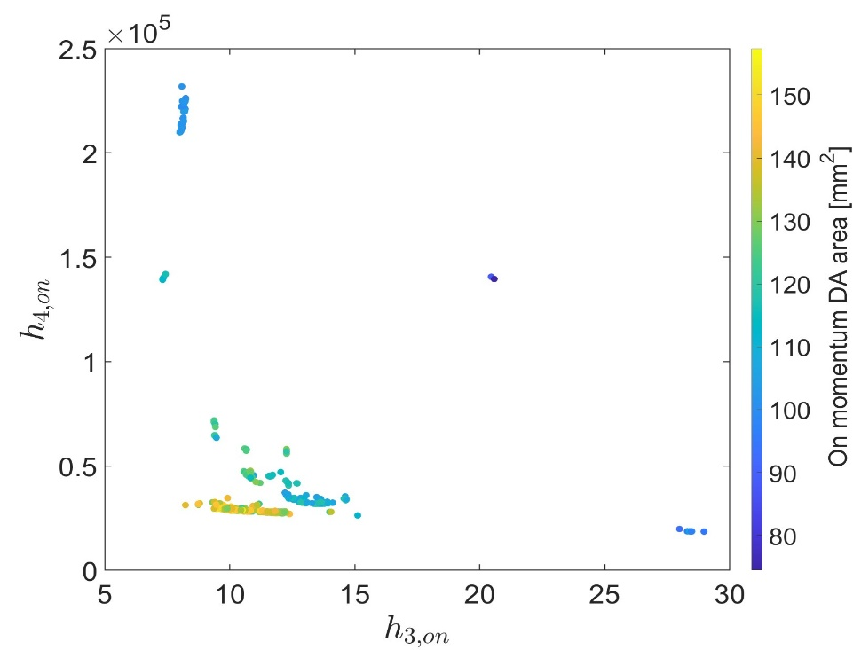
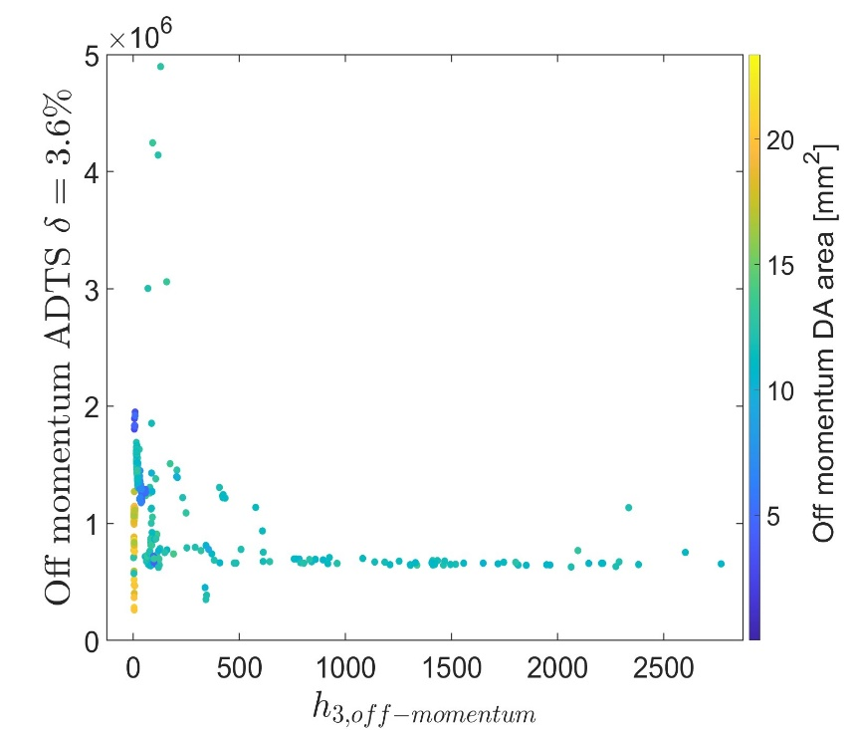
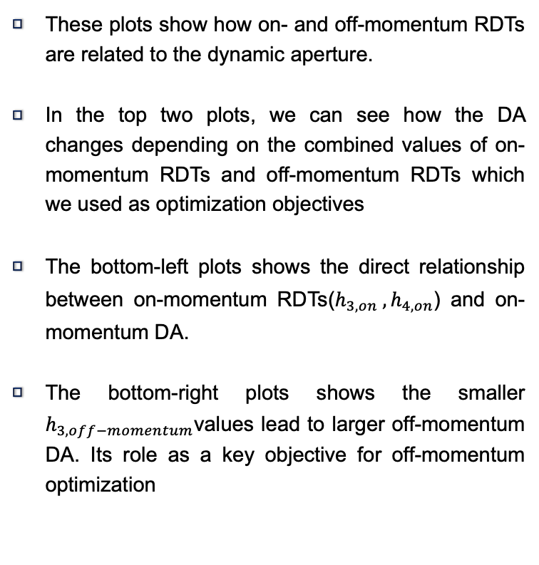
Optimizing on & off RDTs for enlarging DA
On-/Off- RDT vs On DA
On-/Off- RDT vs Off DA
These plots show how on- and off-momentum RDTs are related to the dynamic aperture.
In the top two plots, we can see how the DA changes depending on the combined values of on-momentum RDTs and off-momentum RDTs which we used as optimization objectives
The bottom-left plots shows the direct relationship between on-momentum RDTs($h_{3, on} , h_{4, on}$) and on-momentum DA.
The bottom-right plots shows the smaller $h_{3, off−momentum}$values lead to larger off-momentum DA. Its role as a key objective for off-momentum optimization
On RDT vs On DA
Off RDT /Off ADTS vs Off DA
17/20

Slide 18
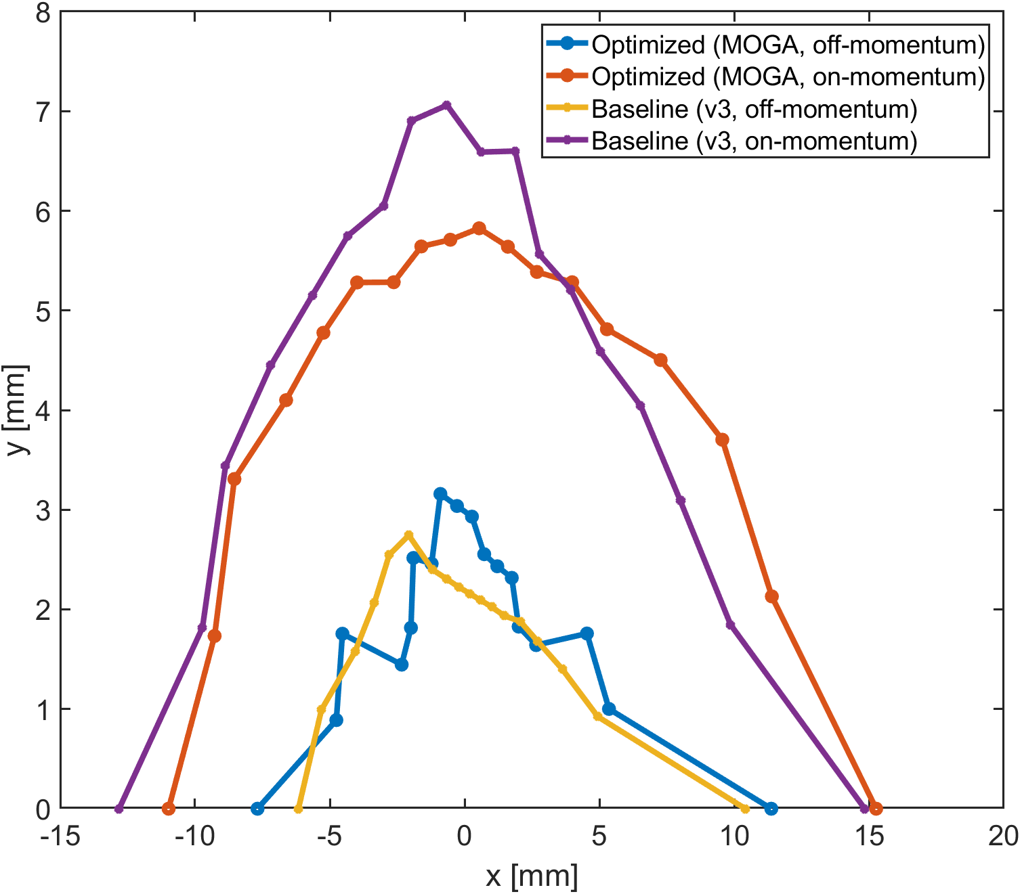
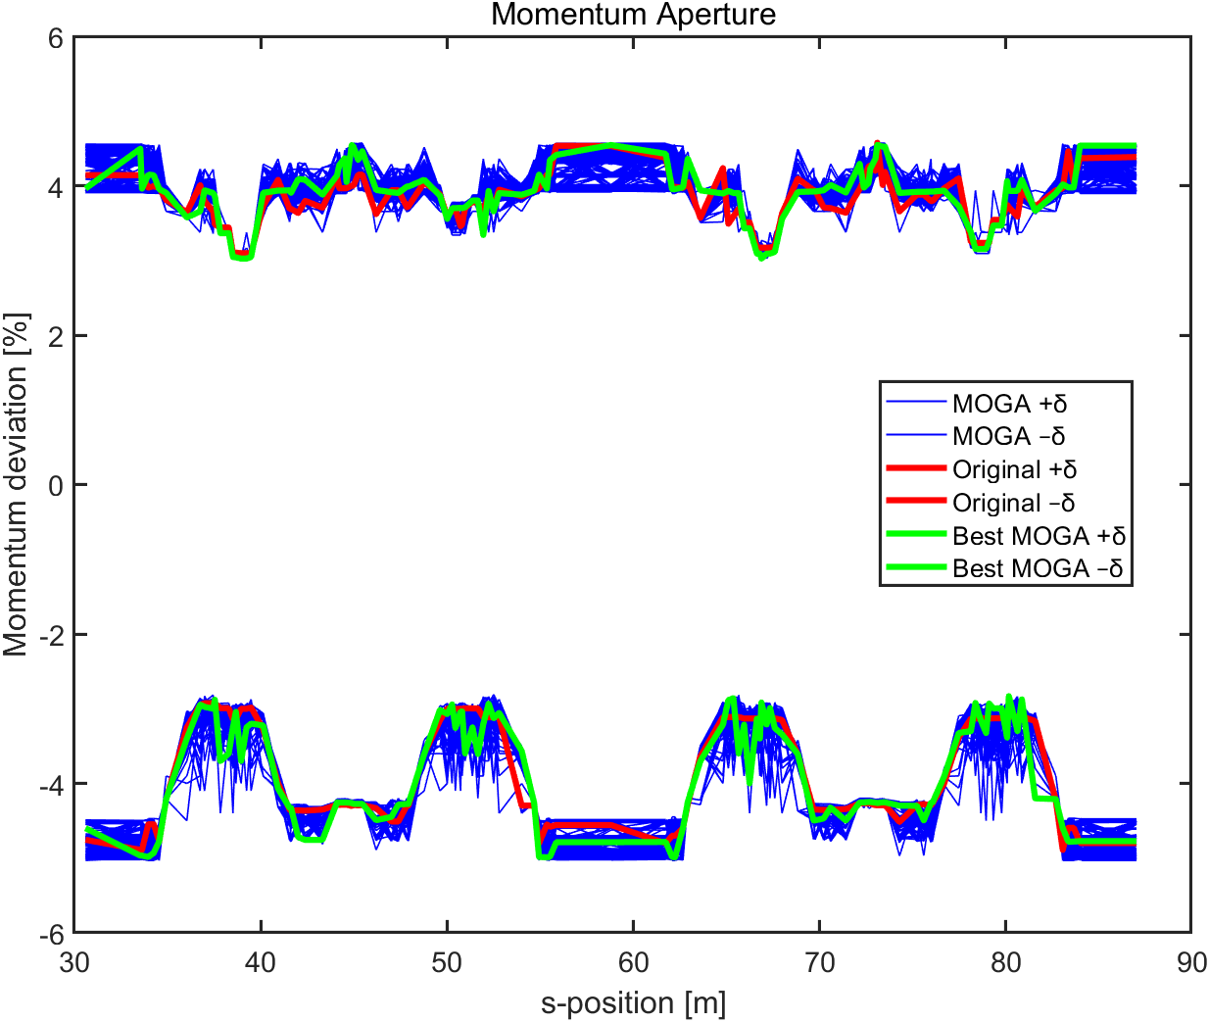
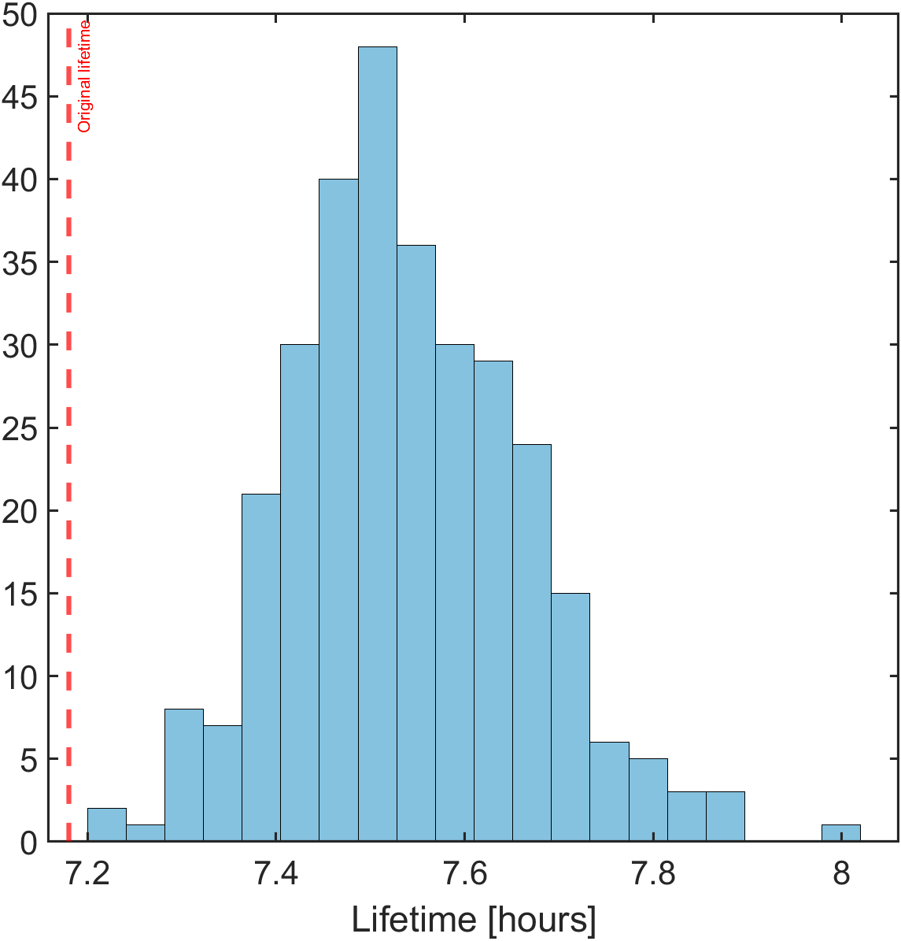
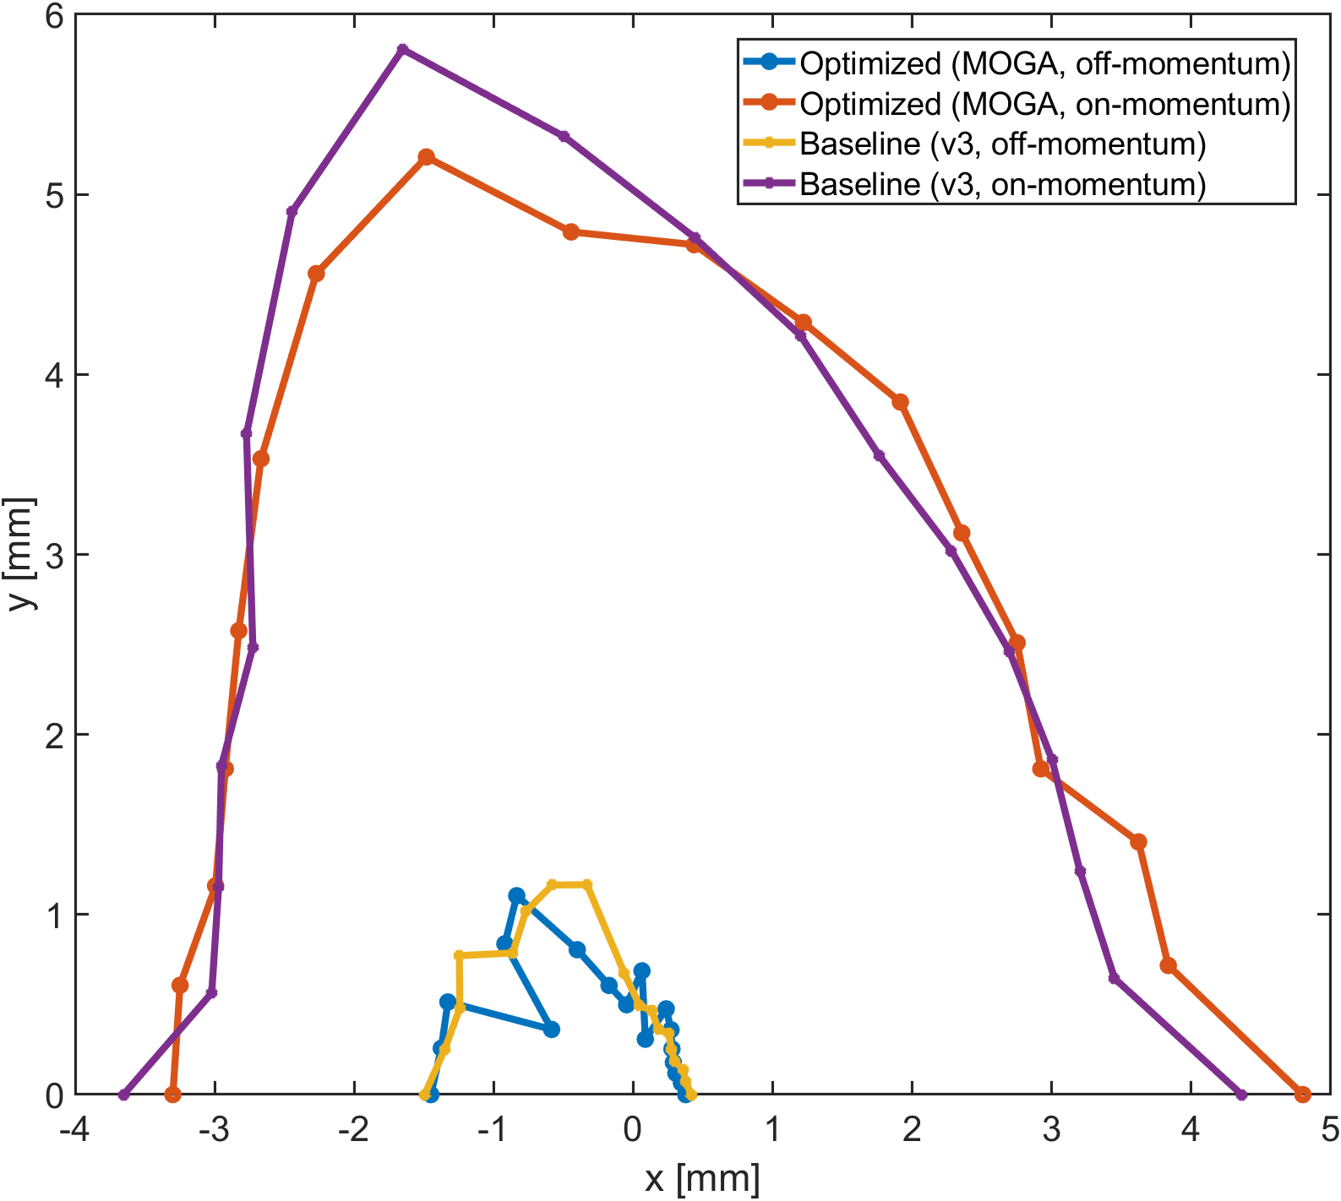
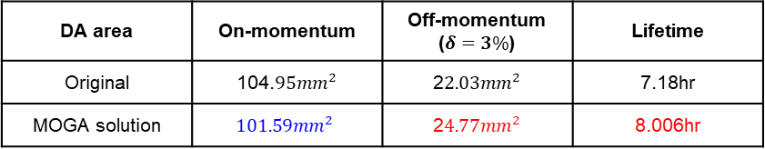
Evaluation result of selected solution
DA evaluation at middle of straight section
DA area | On-momentum | Off-momentum ($δ=3\%$) | Lifetime
Original | 104.$95mm^{2}$ | 2$2.03mm^{2}$ | 7.18hr
MOGA solution | $$101.59mm^{2}$$ | 2$4.77mm^{2}$ | 8.006hr
Lifetime increase 11.50%
Off-momentum DA increase 12.44%
On – momentum DA decrease 3.3%
DA evaluation at dispersion bump
18/20

Slide 19
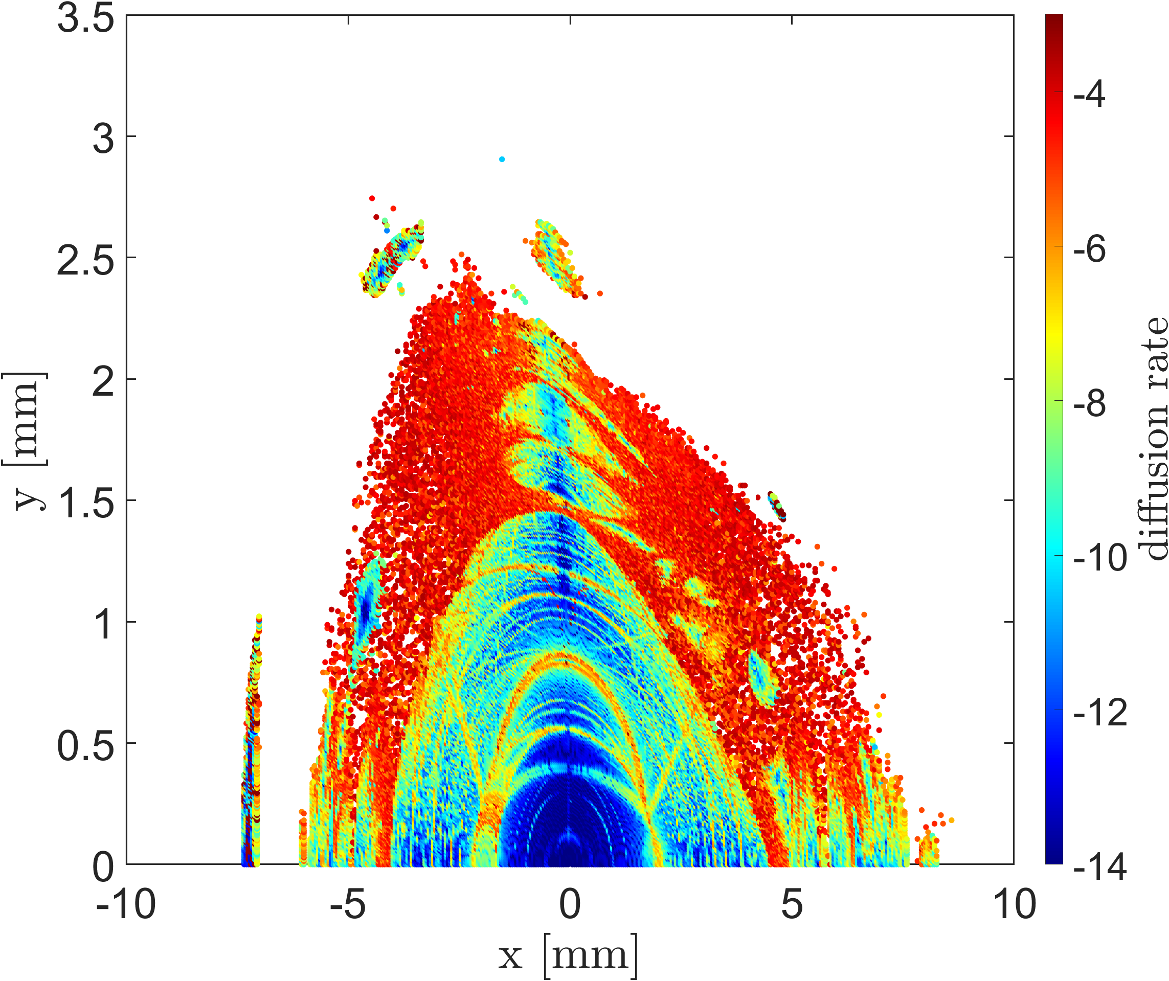
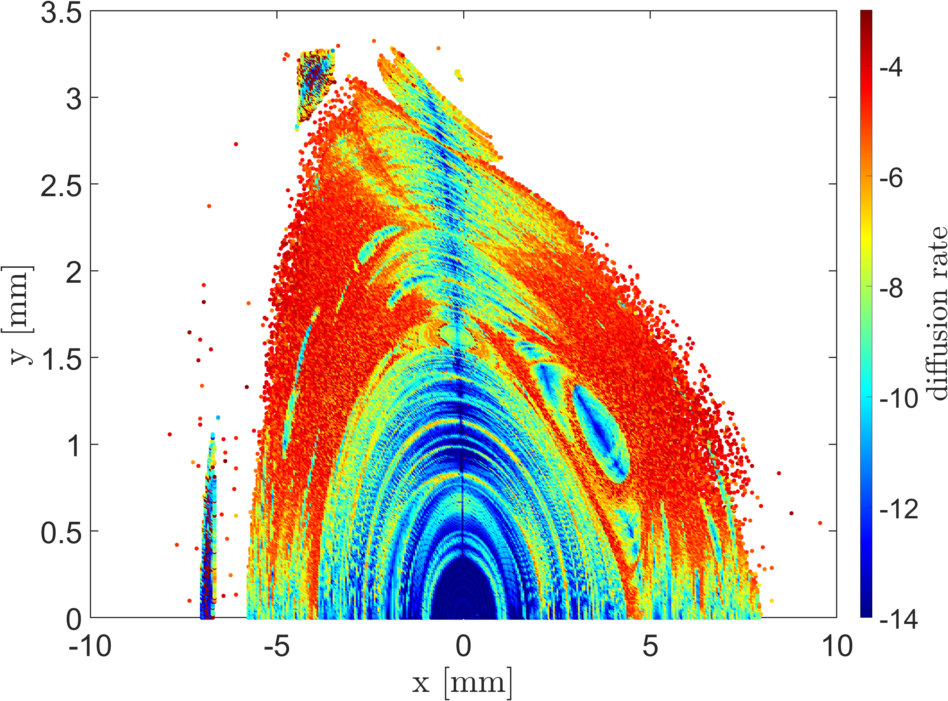
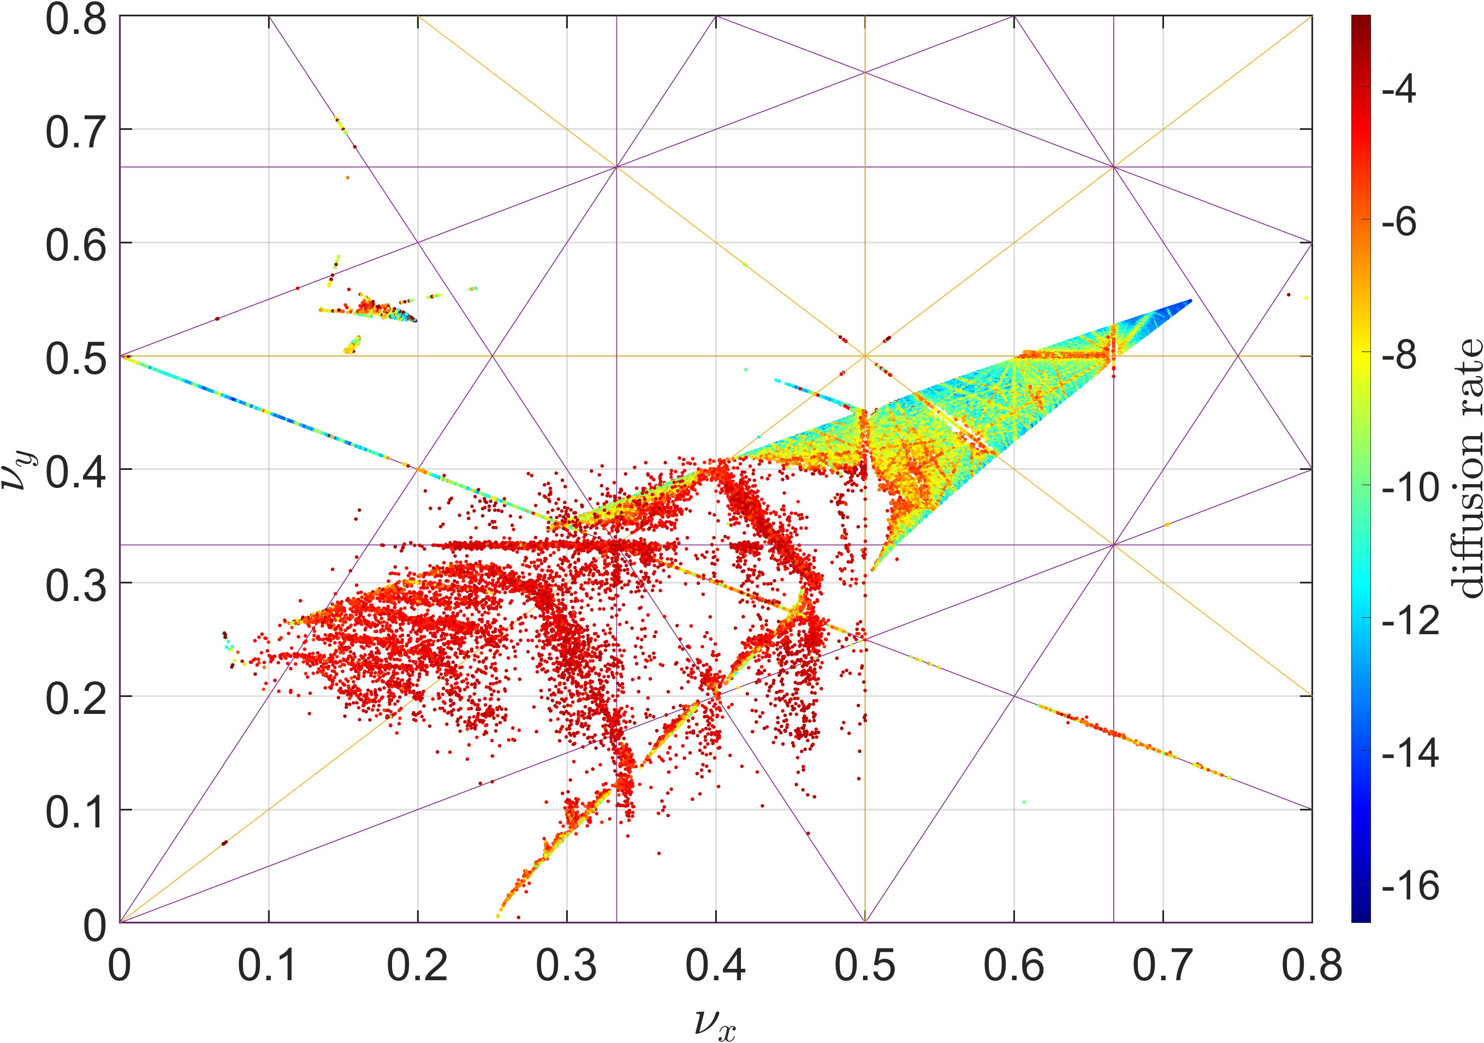
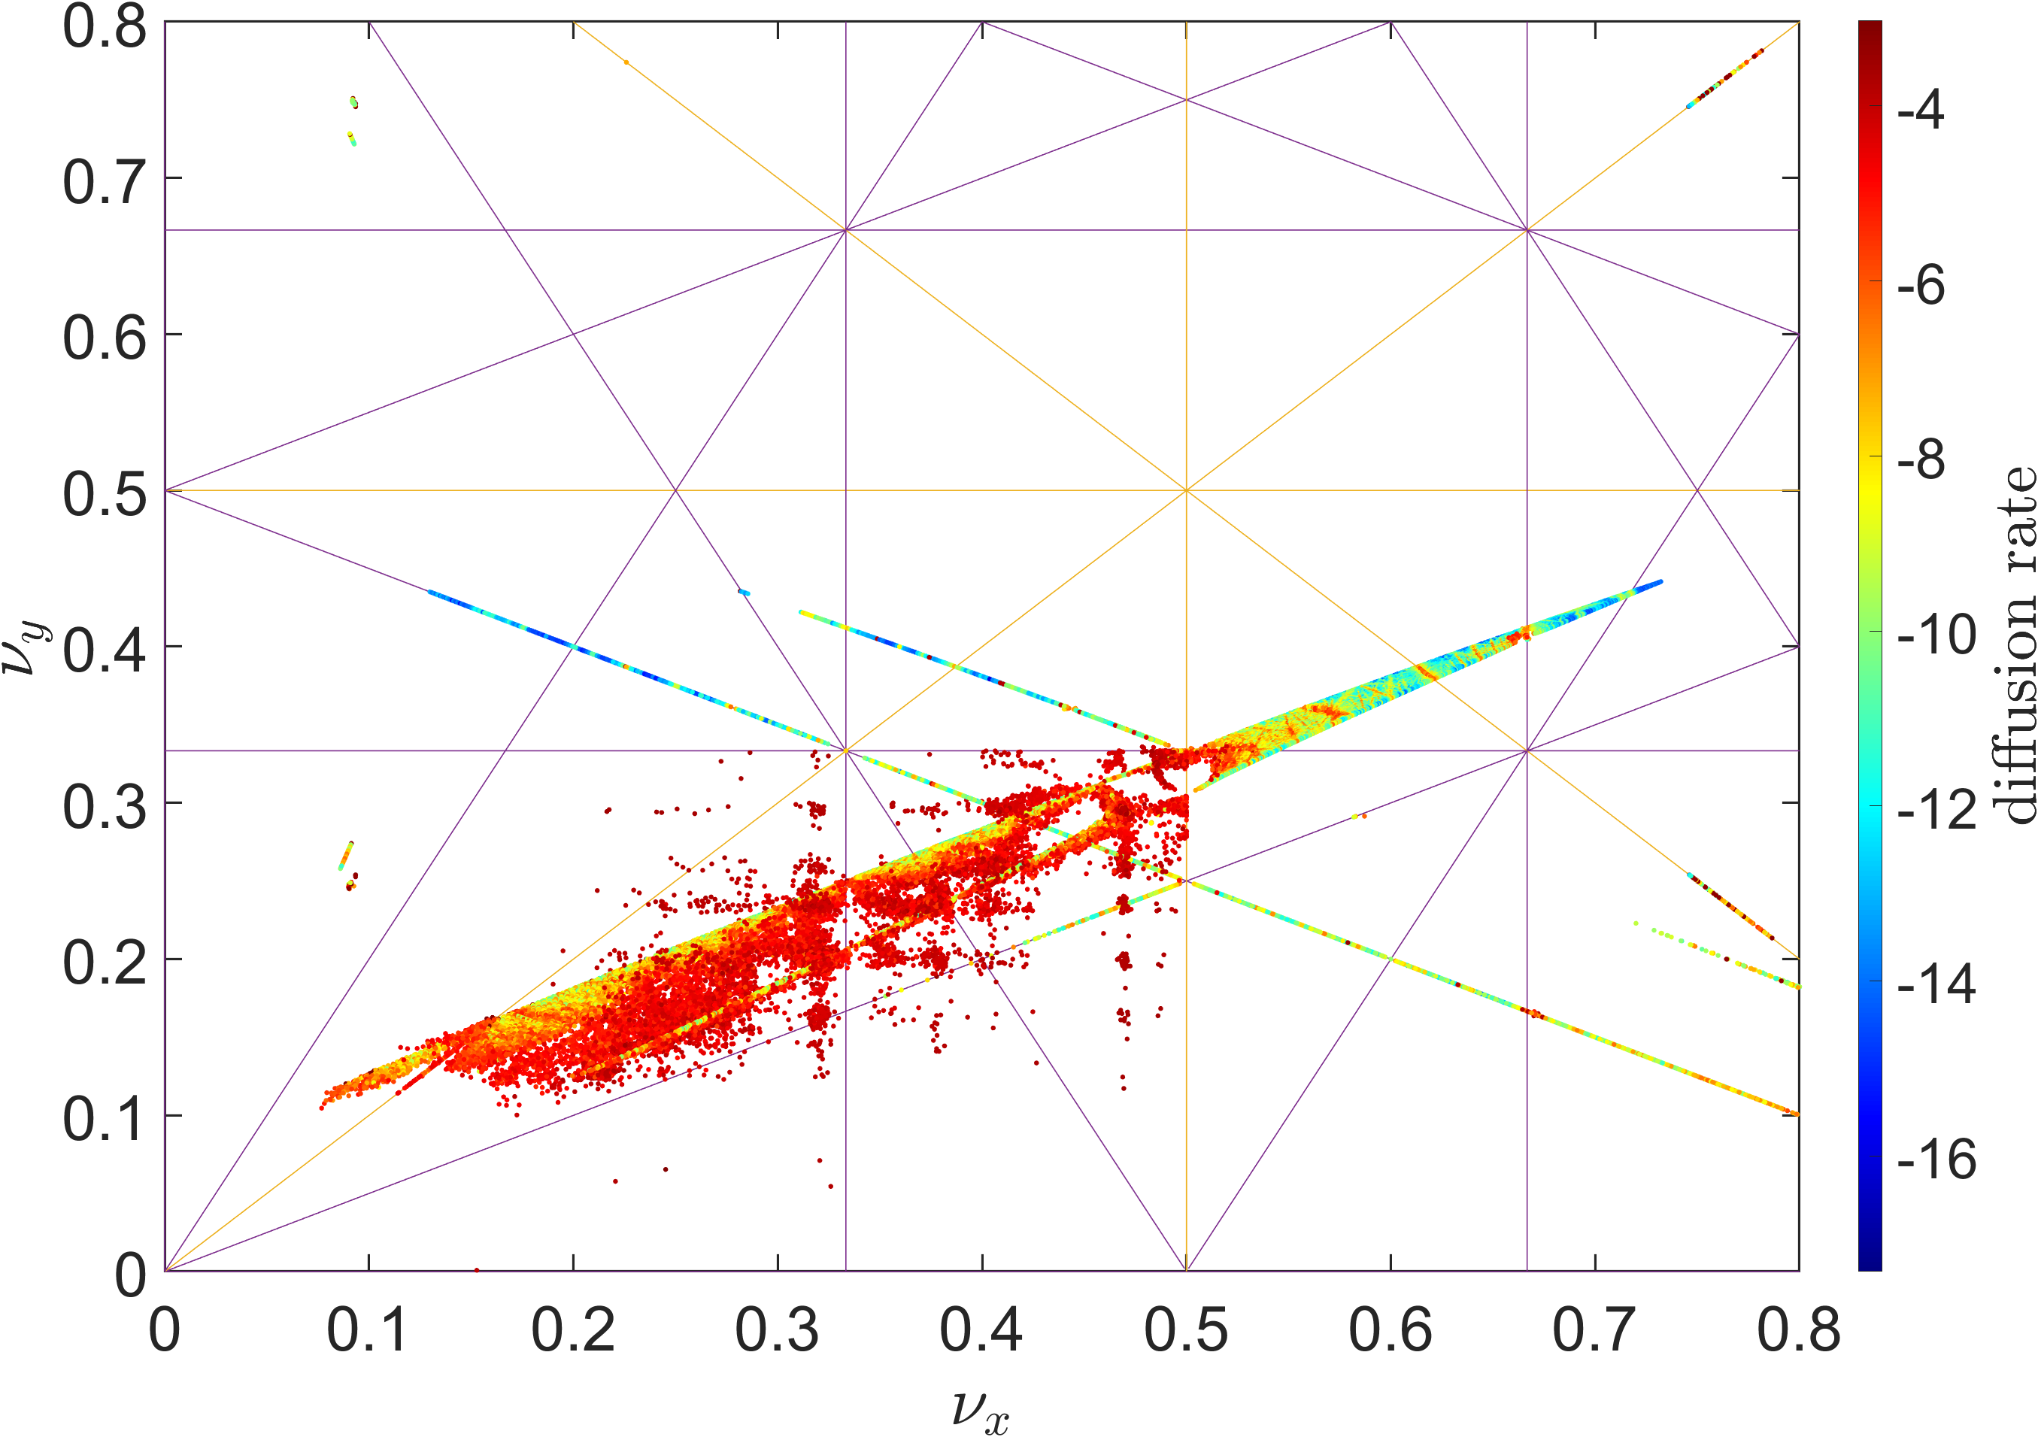
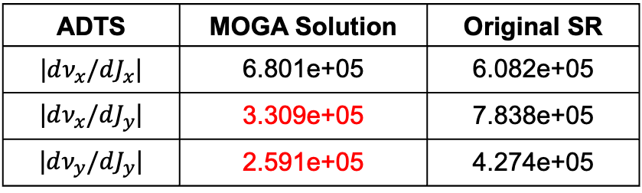
Evaluation result of selected solution
Off-momentum RDT optimization leads to an improved off-momentum dynamic aperture.
The off-momentum dynamic aperture is increased by 12% compared to the original storage ring.
The optimization appears to avoid the half-integer resonance line and reduce the amplitude-dependent tune shifts (ADTS).
ADTS | MOGA Solution | Original SR
|$dν_{x}/dJ_{x}$| | 6.801e+05 | 6.082e+05
|$dν_{x}/dJ_{y}$| | 3.309e+05 | 7.838e+05
|$dν_{y}/dJ_{y}$| | 2.591e+05 | 4.274e+05
19/20
Original SR
MOGA Solution

Slide 20

Summary
The high-beta section in Korea‑4GSR enlarges DA but reduces momentum acceptance, leading to higher ADTS and MDTS.
Low ADTS is necessary but not sufficient for DA enlargement.
On-momentum RDTs help increase DA, but are insufficient for off-momentum DA.
We extended AT to compute off-momentum RDTs, including feed-down and off-momentum optics.
This allowed us to find a solution with ~12% improvement in off-momentum DA and lifetime.
We plan to explore more variables to identify effective magnets for future online optimization.
Thank you for the opportunity to share my work

Slide 21
Thank you

Slide 22
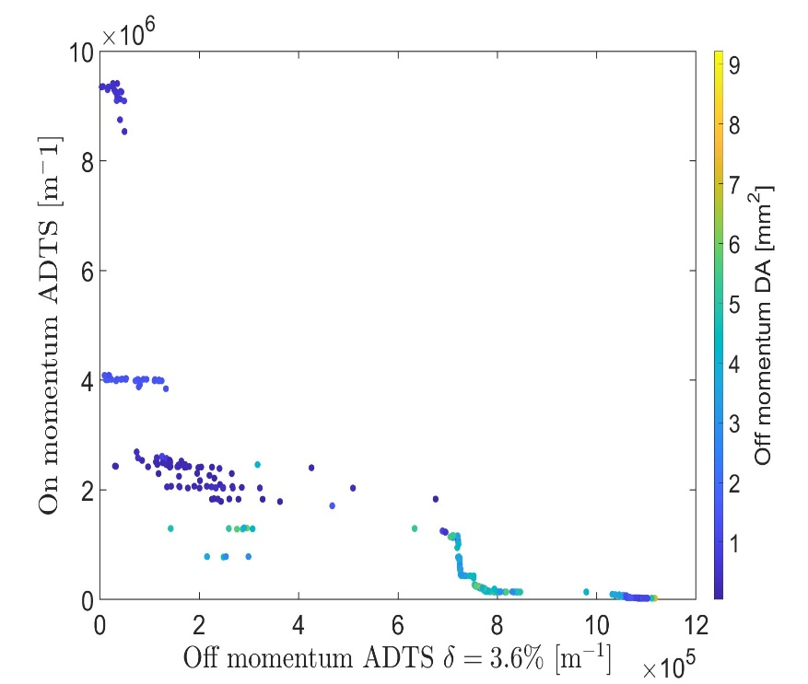


Optimizing ADTS for enlarging DA
These figures show the relationship between on-/off-momentum DA and on-/off-momentum ADTS, as well as on-momentum RDTs($h_{3, on}$, $h_{4,on}$)
The upper plots indicate that low ADTS is a necessary condition for achieving large DA, but it is not a sufficient condition.
In contrast, on-momentum RDTs show a clearer correlation with on-momentum DA. When both $h_{3, on}$and $h_{4,on}$ are small ,the DA tends to be larger
  $h_{3 , on}=\sqrt{Σ_{j+k+l+m=3}(h_{jklm0}^{2})}$
  $h_{4 , on}=\sqrt{Σ_{j+k+l+m=4}(h_{jklm0}^{2})}$
10/20

Slide 23



Slide 24
RING_S : 53.69 mm^2
RING_H : 107.57 mm^2
RING_S : 12.15 hours
RING_H : 7.18 hours

Slide 25





Off-momentum ADTS investigation (High-beta vs Full symmetry)- tracking
W function plot when the ring consists of 28 unit cells
W function plot when the ring consists of 26 unit cells + 2 straight section
$$ξ_{x0}=−3.9789 { ξ}_{y0}=−3.0683$$
$$ξ_{x0}=−3.9789 ,−4.1137{ ξ}_{y0}=−3.0683,−2.9467$$
$(unit cells, straight$)
If the storage ring consists of 28 unit cells, the chromaticity remains the same value across all cells. Therefore, the beta function with momentum deviation does not change along the longitudinal position.
However, our new machine shape resembles a race-track. This means the geometry is not perfectly symmetrical, causing chromaticity differences between the unit cells and the injection straight section. As a result, the W function ($\frac{dβ}{dδ}$ : beta function along with momentum deviation) fluctuates following the longitudinal position. These nonlinear effects occur as a result and affect the beam lifetime.

Slide 26

Off-momentum RDT calculation
Dp 에 따른 Twiss 값 계산 함수
Dp 에 따른 dx 값 계산
Octupole에서 feed down 효과에 의해서 Sextupole field 추가
_get_polynom(e,’’PolynomB”,3) : K3
Dx_i : offset 된 x값

Slide 27



Off-momentum RDT calculation

Slide 28

Variables of MOGA simulations
The total number of variables is 4.
Variables :
S31
S32
S33
OCT31
Objectives :
$h_{3,ring}+w ∗h_{4,ring }\left(w=0.005\right)$
${h_{3,ring_off}}_{δ=3.6\% }$
Variables :
-75 < S31< -45
45 < S32 < 88
-58 < S31< -35
-1800 < OCT31< -1200
OCT31
OCT31
S31
S32
S33
S33
S32
S31

Slide 29


MOGA optimization result
Chromaticity | Horizontal | Vertical | Lifetime
Original | 6.536 | -0.077 | 8.006hr

Slide 30


Off-momentum ADTS investigation (High-beta vs Full symmetry)- tracking
Off-momentum ADTS tracked figure.
Stars are tunes of off-momentum particles with x=0, and dots for |x|<1.5mm

