Slide 1
Free electron laser
25.05.23
Group meeting
Jang Won

Slide 2
Schematic diagram of PAL-XFEL
Reproduced from H.-S. Kang et al., “Hard X-ray free-electron laser with femtosecond-scale timing jitter,” Nature Photonics, vol. 11, pp. 708–713, 2017.

Slide 3
Undulator radiation
Undulator radiation
$$γm\frac{d\vec{v}}{dt}=−e\vec{v}×\vec{B} \text{→}$$
$$x\left(z\right),v_{x}\left(z\right), v_{z}(z)$$
$$\frac{nλ(θ)}{c}=\frac{\tilde{ab}}{v}−\frac{\overline{aa^{′}}}{c}$$
(constructive interference condition)
$$\text{→}λ_{n}=\frac{λ_{u}}{2nγ^{2}}(1+\frac{K^{2}}{2}+γ^{2}θ^{2})$$
Undulator radiation Condition
$$\vec{B}=(0,−B_{o}\sin{\frac{2πz}{λ_{u}},0})$$
$$v_{x}\left(z\right)=\frac{cK}{γ}cosk_{u}z$$
$v_{z}\left(z\right)=1−\frac{1}{2γ^{2} }\left(1+\frac{K^{2}}{2}\right)−\frac{K^{2}}{4γ^{2}}\cos{\frac{4π}{λ_{u}}z}$
$K=\frac{eB_{0}λ_{u}}{2πmc}$ :Undulator parameter

Slide 4
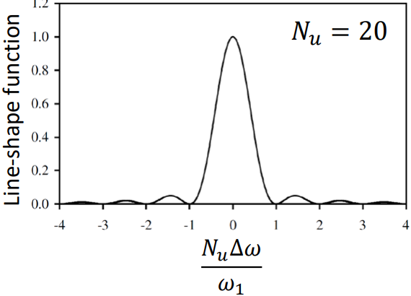
Undulator radiation
Radiation by a moving charge, energy radiated frequency distribution
$$\frac{d^{2}I}{dΩdω}=\frac{1}{4πε_{0}}\frac{q^{2}ω^{2}}{4π^{2}c}{\left|\frac{1}{2π}\int_{−∞}^{∞}{dt^{′}\hat{n}×\left(\hat{n}×\vec{β}\right)e^{iω\left[t^{′}−\frac{\hat{n}⋅\vec{r}\left(t^{′}\right)}{c}\right]}}\right|}^{2}$$
= $\frac{1}{4πε_{0}}\frac{q^{2}N_{u}^{2}ω^{2}}{4π^{2}c}L(\frac{N_{u}Δω}{ω_{1}}){\left|\int_{−\frac{π}{ω_{u}}}^{\frac{π}{ω_{u}}}{dt^{′}\hat{n}×\left(\hat{n}×\vec{β}\right)e^{iω\left[t^{′}−\frac{\hat{n}⋅\vec{r}\left(t^{′}\right)}{c}\right]}}\right|}^{2}$
(by Jackson Ch.11)
Line-shape function
$$L\left(\frac{N_{u}Δω}{ω_{1}}\right)=\frac{\sin^{2}{\frac{N_{u}πΔω}{ω_{1} }}}{N_{u}^{2}\sin^{2}{\frac{πΔω}{ω_{1}}}}$$
$$N_{u}↑ → sharpness↑$$

Slide 5
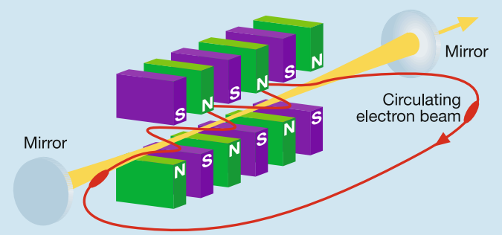
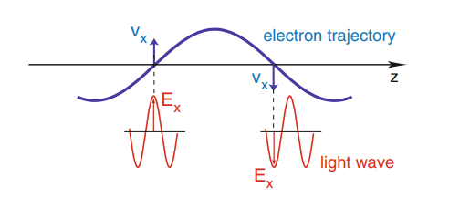
Energy Transfer between Electron beam and light wave
Basic concept of FEL
$v_{x}\left(z\right)=\frac{cK}{γ}cosk_{u}z$: electron
$E_{x}=E_{0}cos(k_{l}z−ω_{l}t+ψ_{0})$ :incident light

Slide 6
Low gain
The electric field of the light wave exerts a force on the electron, $\vec{F}$
$$\frac{dW}{dt}=\vec{v}⋅\vec{F}=−ev_{x}E_{x}$$
$$=−\frac{ecK}{γ}cos{(k}_{u}z)E_{0}cos(k_{l}z−ω_{l}t+ψ_{0})$$
$=−\frac{ecKE_{0}}{2γ}cos⁡(ψ)−\frac{ecKE_{0}}{2γ}cos⁡(X)$
$$ψ=\left(k_{l}+k_{u}\right)z−ω_{l}t+ψ_{0}$$
$$X=\left(k_{l}−k_{u}\right)z−ω_{l}t+ψ_{0}$$
Ponderomotive phase
(Phase velocity>c), neglected term
$E_{x}=E_{0}cos(k_{l}z−ω_{l}t+ψ_{0})$ :incident light
$$(z=\overline{v_{z}}t)$$
$$v_{x}\left(z\right)=\frac{cK}{γ}cosk_{u}z$$
Condition for stationary phase $\frac{dψ}{dt}=\left(k_{l}+k_{u}\right)\overline{v_{z}}t−ω_{l}t+ψ_{0}=0$
$$\text{→}λ=\frac{λ_{u}}{2γ^{2}}(1+\frac{K^{2}}{2})$$
same as the undulator radiation condition!

Slide 7
Low gain
$$\frac{dW}{dt}=−\frac{ecKE_{0}}{2γ}cos⁡(ψ)$$
$E_{x}=E_{0}cos(k_{l}z−ω_{l}t+ψ_{0})$ :incident light
-:light wave
-:electron trajectory

Slide 8
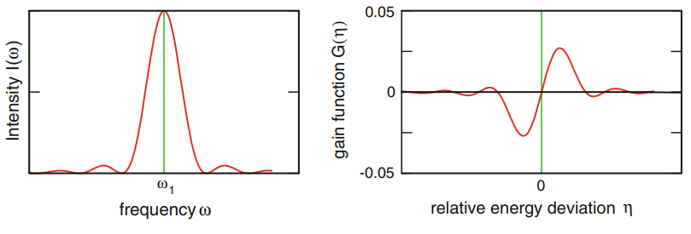
FEL Pendulum Equations
$η=\frac{W−W_{r}}{W_{r}}=\frac{γ−γ_{r}}{γ_{r}}$ :energy deviation
$$\frac{dW}{dt}=−\frac{ecKE_{0}}{2γ}cos⁡(ψ)$$
$$↔\frac{dη}{dz}=\frac{eE_{0}K}{2mc^{2}γ_{r}^{2}}cosψ$$
$$\frac{dψ}{dt}=\left(k_{l}+k_{u}\right)\overline{v_{z}}t−ω_{l}t+ψ_{0}≈2k_{u}cη$$
$$↔\frac{dψ}{dz}=2k_{u}η$$
$$(ε=\frac{eE_{0}K}{2mc^{2}γ_{r}^{2}})$$
Solving the equation using the perturbation method
$$θ=θ_{0}+εθ_{1}\left(z\right)+ε^{2}θ_{2}\left(z\right)+⋯$$
$$η=η_{0}+εη_{1}\left(z\right)+ε^{2}η_{2}\left(z\right)+⋯$$
$$G≡−\frac{Δu}{u}=\frac{<Δγ>mc^{2}}{γmc^{2}}$$
$$=−\frac{πe^{2}{\hat{K}}^{2}N_{u}^{3}λ_{u}^{2}n_{e}}{4ε_{0}mc^{2}γ_{r}^{3}}\frac{d}{dx}\left(\frac{\sin^{2}{x}}{x^{2}}\right), (x=πN_{u}\frac{ω−ω_{r}}{ω_{r}})$$
second order eq
$$N_{u}↑ →sharpness↑ →G↑$$
Derivative of line shape function
Gain이 커지려면 undulator 길이가 늘어남 $→$Microbunching, $E_{0}$ increasing

Slide 9
High gain(1D)
Microbunching
$$v_{z}\left(z\right)=1−\frac{1}{2γ^{2} }\left(1+\frac{K^{2}}{2}\right)−\frac{K^{2}}{4γ^{2}}\cos{\frac{4π}{λ_{u}}z}$$
Incident light
$$γ>γ_{r}→\text{energy} \text{transfer} \text{from} \text{electrons} \text{to} \text{light}→γ↓ →v_{z}↓$$
$$\tilde{E_{x}}(z,t)=\tilde{E_{x}}\left(z\right)exp⁡[i(k_{l}z−ω_{l}t)]$$
$$γ<γ_{r}→\text{energy} \text{transfer} \text{from} \text{light} \text{to} \text{electron}→γ↑ →v_{z}↑$$
Electron-light interaction
$$\tilde{ρ}\left(ψ,z\right)=ρ_{0}+\tilde{ρ_{1}}\left(z\right)e^{iψ}$$
$$\tilde{j_{z}}\left(ψ,z\right)=j_{0}+\tilde{j_{1}}\left(z\right)e^{iψ}$$
$$ψ=\left(k_{l}+k_{u}\right)z−ω_{l}t+ψ_{0}$$
Modulation으로 인한 effect 고려해야 함
Energy modulation & Density modulation

Slide 10
High gain(1D)
Radiation Field
$$\left[∇^{2}−\frac{1}{c^{2}}\frac{∂^{2}}{∂t^{2}}\right] \vec{E}=μ_{0}\frac{∂\vec{j}}{∂t}+\frac{1}{ε_{0}}∇ρ$$
$$\tilde{ρ}\left(ψ,z\right)=ρ_{0}+\tilde{ρ_{1}}\left(z\right)e^{iψ}$$
$$\tilde{j_{z}}\left(ψ,z\right)=j_{0}+\tilde{j_{1}}\left(z\right)e^{iψ}$$
$$\left[\frac{∂^{2}}{∂z^{2}}−\frac{1}{c^{2}}\frac{∂^{2}}{∂t^{2}}\right] \tilde{E_{x}}=μ_{0}\frac{∂ \tilde{j_{x}}}{∂t}$$
$$\frac{d\tilde{E_{x}}}{dz}=−\frac{μ_{0}cK}{4γ_{r}}⋅\tilde{j_{1}}(z)$$
For x component:
$$sol) \tilde{E_{x}}\left(z,t\right)=\tilde{E_{x}}\left(z\right)exp⁡[i(k_{l}z−ω_{l}t)]$$
?
Slowly varying amplitude($SVA)$ approximation
$$| \tilde{E_{x}}′(z)|λ_{l}≪|\tilde{E_{x}}(z)|$$
$$| \tilde{E_{x}}′′(z)|λ_{l}≪|\tilde{E_{x}}′(z)|$$
$$\frac{d\tilde{E_{x}}}{dz}=−\frac{iμ_{0}}{2k_{l}}\frac{∂\tilde{j_{x}}}{∂t}⋅exp⁡[−i\left(k_{l}z−ω_{l}t\right)]$$
$$\tilde{j_{x}}=\tilde{ρ}v_{x},\tilde{j_{z}}=\tilde{ρ}v_{z}$$

Slide 11
High gain(1D)
Space charge field
$$∇⋅\vec{E}=\frac{ρ}{ε_{0}}$$
$\tilde{ρ_{1}}e^{iψ}$ generates a periodic longitudinal field
$$\frac{d\tilde{E_{z}}(z,t)}{dz}=\frac{{\tilde{ρ}}_{1}(z)}{ε_{0}}exp⁡[i(\left(k_{l}+k_{u}\right)z−ω_{l}t)]$$
$$\tilde{E_{z}}(z)=−\frac{{iμ}_{0}c^{2}}{ω_{l}}⋅\tilde{j_{1}}(z)$$
$$\tilde{E_{z}}\left(z,t\right)=\tilde{E_{z}}\left(z\right)exp⁡[i(k_{l}z−ω_{l}t)]$$
Slowly varying amplitude($SVA)$ approximation
$$| \tilde{E_{x}}′(z)|λ_{l}≪|\tilde{E_{x}}(z)|$$
$$| \tilde{E_{x}}′′(z)|λ_{l}≪|\tilde{E_{x}}′(z)|$$

Slide 12
Coupled First-Order Equations
Result of Maxwell equation (under modulation)
$$\frac{dψ}{dz}=2k_{u}η$$
$$\frac{d\tilde{E_{x}}}{dz}=−\frac{μ_{0}cK}{4γ_{r}}⋅\tilde{j_{1}}(z)$$
From phase equation:
Radiation field
$$\frac{dη}{dz}=\frac{eE_{0}K}{2mc^{2}γ_{r}^{2}}cosψ$$
$$\tilde{E_{z}}(z)=−\frac{{iμ}_{0}c^{2}}{ω_{l}}⋅\tilde{j_{1}}(z)$$
From $\frac{dW}{dt}=\vec{v}⋅\vec{F}$:
Space charge field
$$\frac{dW}{dt}=v_{x}F_{x}:$$
$${\left[\frac{dη}{dz}\right]}_{l}=−\frac{e\hat{K}}{2mc^{2}γ_{r}^{2}}Re\{{\tilde{E}}_{x}e^{iψ}\}$$
$$\frac{dW}{dt}=v_{z}F_{z}:$$
$${\left[\frac{dη}{dz}\right]}_{sc}=−\frac{e}{mc^{2}γ_{r}^{2}}Re\{{\tilde{E}}_{z}e^{iψ}\}$$
Energy deviation due to interaction between space charge field and electron
$\frac{dη}{dz}=−\frac{e}{mc^{2}γ_{r}}Re\{\left(\frac{\hat{K}\tilde{E_{x}}}{2γ_{r}}+\tilde{E_{z}}\right)e^{iψ}$}
$\tilde{j_{1}}\left(z\right),$ modulated current만 알면 모두 알 수 있음!

Slide 13
Coupled First-Order equations
Longitudinal distribution of electron in microbunch
$$S\left(ψ\right)=\sum_{n=1}^{N}{δ(ψ−ψ_{n})}$$
$S\left(ψ\right)$ can be expanded in a real Fourier series
$$S\left(ψ\right)=\frac{c_{0}}{2}+Re\{\sum_{k=1}^{∞}{c_{k}exp⁡(ikψ)\}}$$
First at the dc current density, $j_{0}$
$$c_{k}=\frac{1}{π}\int_{0}^{2π}{S(ψ)}\exp\left(−ikψ\right)dψ$$
$$j_{0}=−ecn_{e}, {(n}_{e}=\frac{N}{A_{b}λ_{l}}) ,(\frac{c_{0}}{2}=\frac{N}{2π})→j_{0}=−ec\frac{2π}{A_{b}λ_{l}}⋅\frac{c_{0}}{2}$$
Modulation current, $\tilde{j_{1}}$ (first harmonic term)
$$j_{1}=−ec\frac{2π}{A_{b}λ_{l}}⋅c_{1}=j_{0}\frac{2}{N}\sum_{n=1}^{N}{exp⁡(−iψ_{n})}$$

Slide 14
Coupled First-Order equations
The complete set of coupled first-order equations
$$\frac{dψ_{n}}{dz}=2k_{u}η_{n}$$
Describe time evolution of the
phase($ψ$), energy deviation($η_{n}$), modulated current density($j_{1}$),
amplitude of the light wave($\tilde{E_{x}}$)
$\frac{dη_{n}}{dz}=−\frac{e}{mc^{2}γ_{r}}Re\{\left(\frac{\hat{K}\tilde{E_{x}}}{2γ_{r}}−\frac{iμ_{0}c^{2}}{ω_{l}}⋅\tilde{j_{1}}\right)e^{iψ_{n}}$}
$$j_{1}=j_{0}\frac{2}{N}\sum_{n=1}^{N}{exp⁡(−iψ_{n})}$$
$$\frac{d\tilde{E_{x}}}{dz}=−\frac{μ_{0}cK}{4γ_{r}}⋅\tilde{j_{1}}(z)$$
2N+2 coupled differential, algebraic equations

Slide 15
Third-Order equations
Under mono-energetic condition, $η_{1}=η_{2}=⋯=η_{N}$
assume periodic initial phases: $ψ_{n}\left(0\right)≡φ_{n}=2π\frac{n}{N}$
$$ψ_{n}\left(z\right)=φ_{n}+2k_{u}ηz+Re\{\tilde{a}\left(z\right)e^{iφ_{n}}\}$$
$$η_{n}\left(z\right)=η+Re\{\tilde{b}\left(z\right)e^{iφ_{n}}\}$$
$Γ={\left[\frac{μ_{0}\tilde{K}e^{2}k_{n}n_{e}}{4γ_{r}^{3}m}\right]}^{\frac{1}{3}}$: gain parameter
$k_{p}=\sqrt{\frac{2λ_{l}}{λ_{u}}}\frac{ω_{p}^{∗}}{c}$: space charge parameter
$${\tilde{E_{x}}}^{′′′}+i 4k_{u}η{\tilde{E_{x}}}^{′′}+\left(k_{p}^{2}−4k_{u}^{2}η^{2}\right){\tilde{E_{x}}}^{′}−iΓ^{3}\tilde{E_{x}}=0$$
$ω_{p}^{∗}=\sqrt{\frac{n_{e}e^{2}}{γ_{r}ε_{0}m}}:$ plasma frequency
(If the electron beam is on resonance and space charge force is small,)
($η=0, k_{p}=0)$
$${\tilde{E_{x}}}^{′′′}−iΓ^{3}\tilde{E_{x}}=0$$

Slide 16
Third-Order equations
$${\tilde{E_{x}}}^{′′′}−iΓ^{3}\tilde{E_{x}}=0$$
$\tilde{E_{x}}$는 다음과 같은 3개의 trial solution의 선형조합으로 표현 가능
$$\tilde{E_{x}}\left(z\right)=c_{1}V_{1}\left(z\right)+c_{2}V_{2}\left(z\right)+c_{3}V_{3}\left(z\right), { V}_{j}\left(z\right)=exp⁡(α_{j}z)$$
$$(α_{1}=\frac{\left(i+\sqrt{3}\right)}{2}Γ, α_{2}=\frac{\left(i−\sqrt{3}\right)}{2}Γ, α_{3}=−iΓ)$$
Initial condition(z=0)
$\left(\begin{aligned}\tilde{E_{x}}\left(0\right) \\ \tilde{E_{x}′}\left(0\right) \\ \tilde{E_{x}}′′\left(0\right)\end{aligned}\right)=\left(\begin{matrix}1 & 1 & 1 \\ α_{1} & α_{2} & α_{3} \\ α_{1}^{2} & α_{2}^{2} & α_{3}^{2}\end{matrix}\right)$ $\left(\begin{aligned}c_{1} \\ c_{2} \\ c_{3}\end{aligned}\right)$
FEL process가 다음과 같은 incident plane light wave로 시작하고 initial modulation없다고 하면,
$$E_{x}\left(z,t\right)=E_{in}cos(k_{l}z−ω_{l}t)$$
$$\tilde{j_{1}}\left(0\right)=0, so {\tilde{E_{x}}}^{′}(0)$$
$\left(\begin{aligned}\tilde{E_{x}}\left(0\right) \\ \tilde{E_{x}′}\left(0\right) \\ \tilde{E_{x}}′′\left(0\right)\end{aligned}\right)=$ $\left(\begin{aligned}E_{in} \\ 0 \\ 0\end{aligned}\right)→c_{1}=c_{2}=c_{3}=\frac{E_{in}}{3}$
$$\tilde{E_{x}}\left(z\right)=\frac{E_{in}}{3}(exp\left(\frac{i+\sqrt{3}}{2}Γz\right)+exp\left(\frac{i−\sqrt{3}}{2}Γz\right)+exp(−iΓz))$$

Slide 17
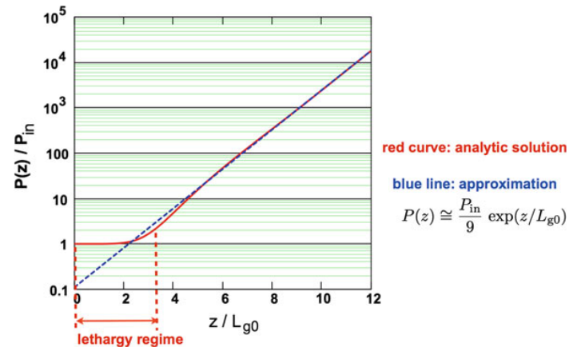
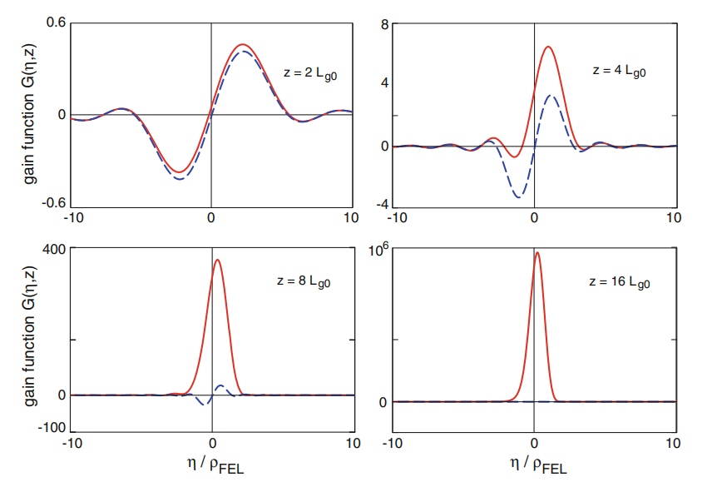
Third-Order equations
$$\tilde{E_{x}}\left(z\right)=\frac{E_{in}}{3}(exp\left(\frac{i+\sqrt{3}}{2}Γz\right)+exp\left(\frac{i−\sqrt{3}}{2}Γz\right)+exp(−iΓz))$$
Dominating term, when $Γ z≫1$
Exponential growth!
$\left|\tilde{E_{x}}\left(z\right)\right|≈\frac{E_{in}}{3}\exp\left(\frac{1}{2L_{g0}}z\right),$
$L_{g0}≡\frac{1}{\sqrt{3}Γ}$: power gain length
Gain function을 다음과 같이 쓰고 low gain과 비교
$$G\left(η,z\right)={\left|\frac{\tilde{E_{x}}\left(η,z\right)}{E_{in}}\right|}^{2}−1$$

Slide 18
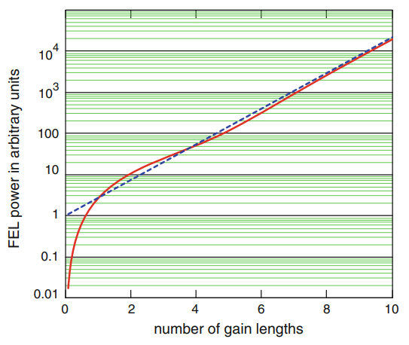
Third-Order-equations
FEL process starts with initial periodic charge density modulation
(There is no external Lightwave)
$$\tilde{j_{z}}\left(ψ,z\right)=j_{0}+\tilde{j_{1}}\left(z\right)e^{iψ}$$
$\left(\begin{aligned}\tilde{E_{x}}\left(0\right) \\ \tilde{E_{x}′}\left(0\right) \\ \tilde{E_{x}}′′\left(0\right)\end{aligned}\right)=$ $\left(\begin{aligned}0 \\ −1 \\ i 2k_{u}η\end{aligned}\right)\frac{μ_{0}c\tilde{K}}{4γ_{r}}\tilde{j_{1}}(0)$
Exponential growth
$$\tilde{E_{x}}\left(z\right)=c_{1}V_{1}\left(z\right)+c_{2}V_{2}\left(z\right)+c_{3}V_{3}\left(z\right), { V}_{j}\left(z\right)=exp⁡(α_{j}z)$$
Periodic initial density modulation

Slide 19
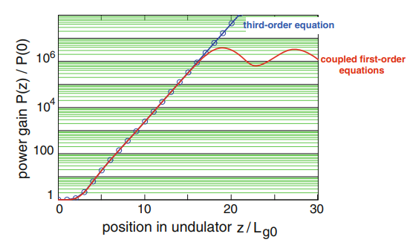
Saturation

Slide 20
SASE
Incident light (seed) or initial modulation leads to an exponential growth process.
$\left(\begin{aligned}\tilde{E_{x}}\left(0\right) \\ \tilde{E_{x}′}\left(0\right) \\ \tilde{E_{x}}′′\left(0\right)\end{aligned}\right)=$ $\left(\begin{aligned}E_{in} \\ 0 \\ 0\end{aligned}\right)$
$\left(\begin{aligned}\tilde{E_{x}}\left(0\right) \\ \tilde{E_{x}′}\left(0\right) \\ \tilde{E_{x}}′′\left(0\right)\end{aligned}\right)=$ $\left(\begin{aligned}0 \\ −1 \\ i 2k_{u}η\end{aligned}\right)\frac{μ_{0}c\tilde{K}}{4γ_{r}}\tilde{j_{1}}(0)$
Seed
Initial modulation
SASE means Self-Amplified Spontaneous Emission(no seed)
Shot noise(white noise) makes initial modulation.
$$\tilde{j_{1}}\left(0\right)=\sqrt{\frac{eI_{0}Δω}{π}}\frac{1}{A_{b}}$$

Slide 21
SASE-shot noise
Consider relativistic electrons that are randomly distributed along the bunch and call N numbers of electrons in the time interval T. Then $\dot{N}=\frac{N}{T}$ is the average number of electrons per unit time.
$I_{0}=e\dot{N}$: absolute magnitude of dc beam current
$$I\left(t\right)=e \sum_{j=1}^{N}{δ(t−t_{j})}, t,t_{j}∈\left[−\frac{T}{2},\frac{T}{2}\right], (T≫1)$$
$$i_{T}\left(ω\right)=e\sum_{j=1}^{N}{exp (iωt_{j})}$$
$$<I\left(t\right)>=\frac{eN}{T}≡I_{0}$$
The Fourier transform of $I\left(t\right)$
S$\left(ω\right)=\lim_{T→∞}{\frac{1}{πT}{\left|i_{T}\left(ω\right)\right|}^{2}}=\frac{eI_{0}}{π}$
Spectral density function
Constant
Independent of frequency
(Characteristic feature of white noise)
$$I_{rms}^{2}=<I{\left(t\right)}^{2}>=\frac{1}{T}\int_{−\frac{T}{2}}^{\frac{T}{2}}{{\left|I\left(t\right)\right|}^{2}dt}=\lim_{T→∞}\frac{1}{T}\int_{ω_{0}−\frac{Δω}{2}}^{ω_{0}+\frac{Δω}{2}}{{\left|i_{T}\left(ω\right)\right|}^{2}dω}=S\left(ω\right)Δω=\frac{eI_{0}}{π}Δω$$
$$\tilde{j_{1}}\left(z=0\right)=\frac{\sqrt{I_{rms}^{2}}}{A_{b}}=\sqrt{\frac{eI_{0}Δω}{π}}\frac{1}{A_{b}}$$
Random distribution makes initial modulation

Slide 22
SASE-shot noise
A long bunch can be subdivided into sections that are each one coherence length long. In the SASE process the microbunching takes place independently in different sections which then radiate incoherently.
The longitudinal coherence of SASE radiation is poor.
The straightforward solution is seeding external laser(coherent source).

Slide 23
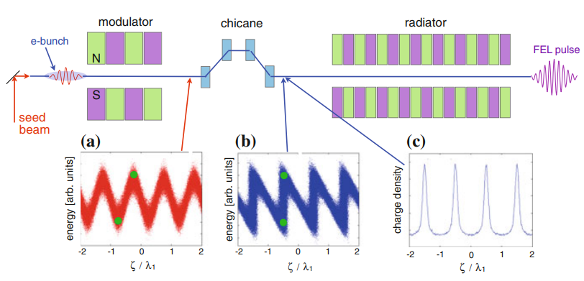
High-Gain Harmonic Generation(HGHG)
$$λ_{1}$$
The precondition is a seed beam of sufficient power to generate an energy modulation well above the energy spread of the electron beam.
Density modulation is formed where high/low energy electrons take different length of path in chicane.
The Fourier expansion of $ρ$ contains higher harmonics with angular frequency $ω_{n}=nω_{1}$

Slide 24
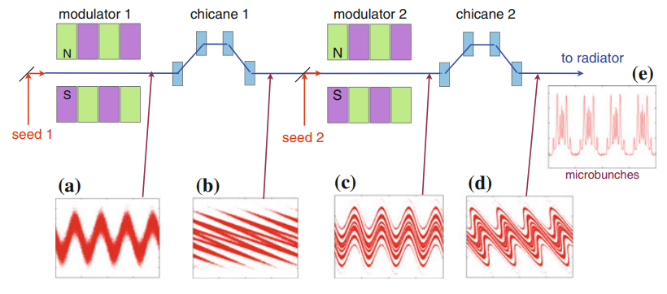
Echo-Enabled Harmonic Generation(EEHG)
Generating microbunches with a considerable substructure
Can generate much higher harmonic numbers than HGHG, ${ω=n}_{1}ω_{1}+{n_{2}ω}_{2}$

Slide 25
Self-Seeding(X-ray region)
For X-rays, suitable seed lasers are presently not available.
SASE radiation (undulator 1)
Radiation passes through a monochromator, electron beam passes a magnetic bypass.
The magnetic bypass is adjusted such that the emerging electron and radiation pulse have a good temporal overlap.
Microbunching from first undulator is washed out in the magnetic bypass.

Slide 26
Reference
Peter Schmüser, Martin Dohlus, Jörg Rossbach, Christopher Behrens , Free-Electron Lasers in the Ultraviolet and X-Ray Regime, 2nd ed. (Springer International Publishing, Switzerland, 2014).
Moohyun Yoon, Lecture Notes on PHYS683, DIVISION OF ADVANCED NUCLEAR ENGINEERING, POSTECH.

