Slide 1
Studies of Longitudinal feedback system (LFS)
25. 05. 16
Geunwoo Kim

Slide 2
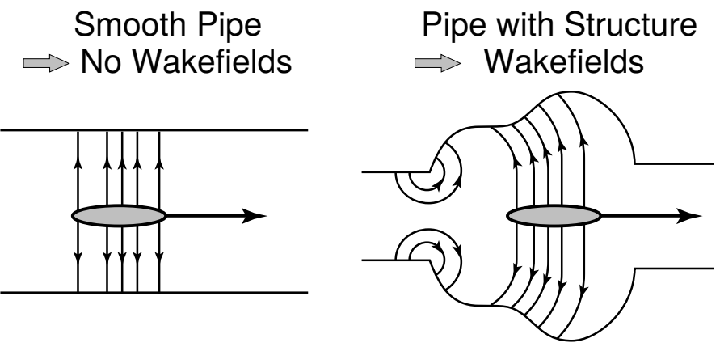
Introduction
Wakefield
Wakefield is generated when the beam passes through an arbitrary structure.
It affects the beam's movement, causing it to transition into coupled motion via higher-order mode.
→ Causing Coupled Bunch Mode Instability (CMBI).
Long-range wakefield
2

Slide 3
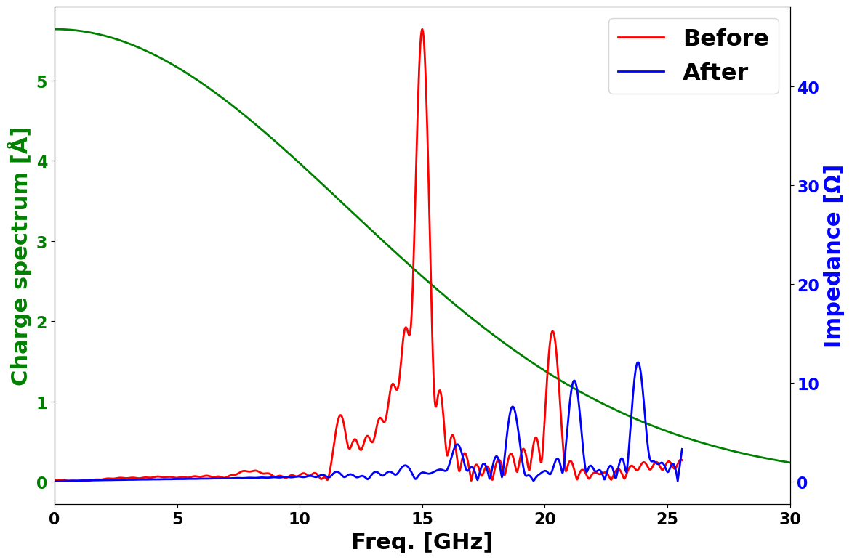
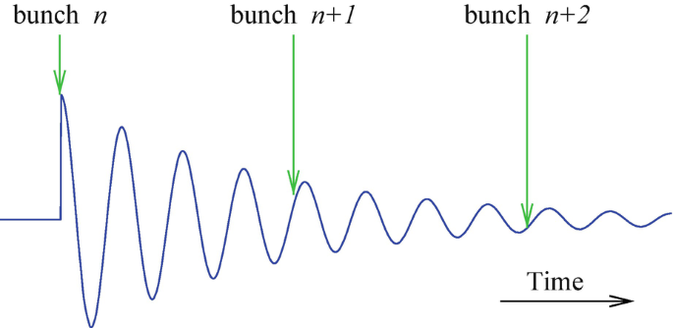
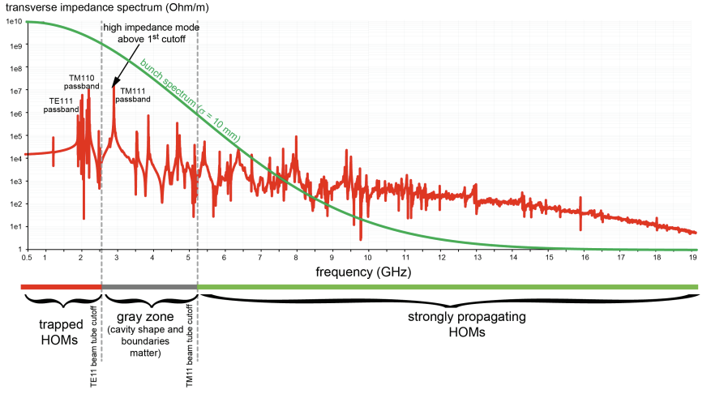
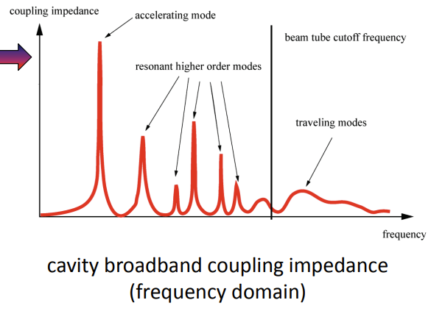
Introduction
Higher-Order Mode (HOM)
Higher-order mode
3

Slide 4
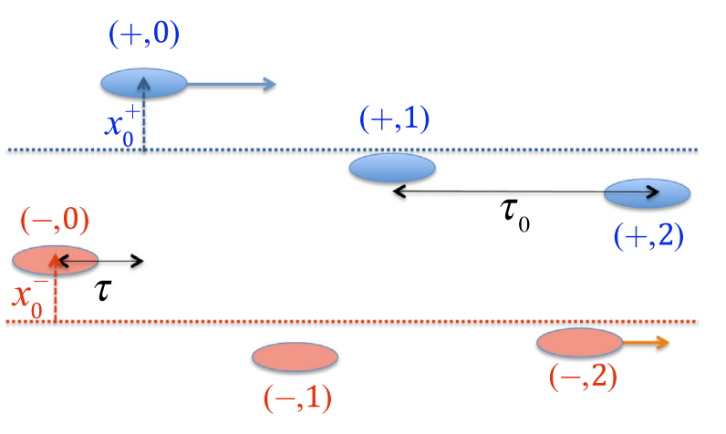
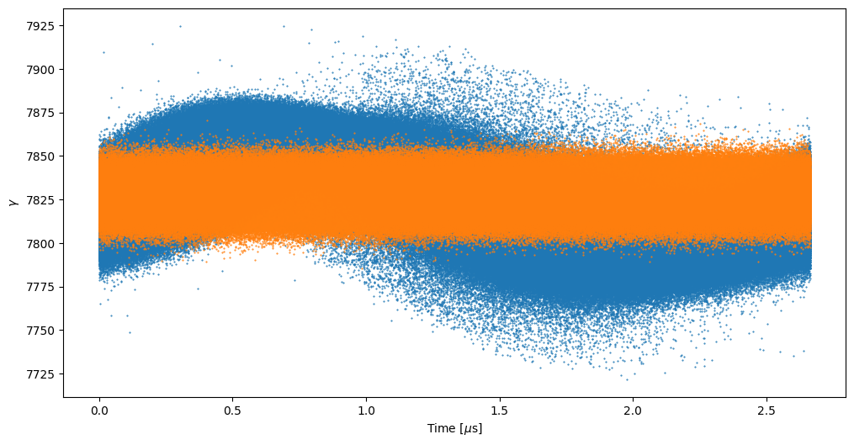
Introduction
Coupled Bunch Mode Instability (CBMI)
$Δφ=μ\frac{360°}{n_{b}}$ where μ is mode number
From Y. Park
$$τ$$
$$…$$
$$μ=0$$
Longitudinal phase space
From Y. Park
$$μ=1$$
$$…$$
Stable beam
$$μ=2$$
$$…$$
Bunch index
Mode 1 coupled bunch instability
4

Slide 5
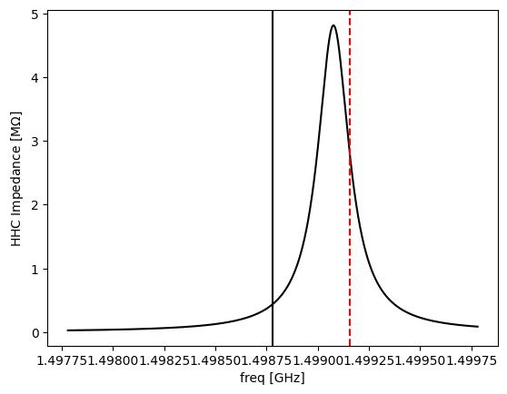
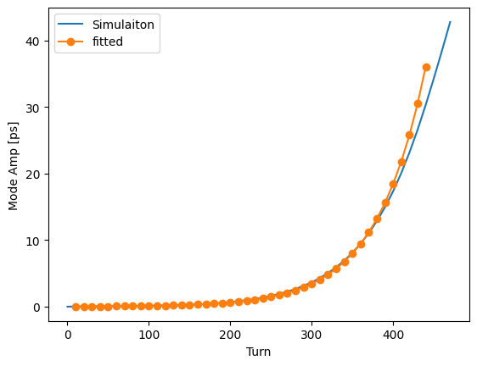
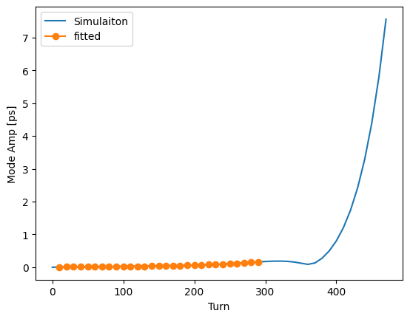
Introduction
Optimal detuning (~300 kHz, 24 ID, 400 mA)
$$μ=1$$
Growth rate depends on mode number μ. → Beam loss occurs
Max(I_{beam}) is limited.
f_{rev} ~ 375 kHz ↔ detuning Δf ~ 300 kHz
From beam
From cavity
$$3f_{rf}$$
$$τ_{g}^{−1}=\frac{eαI}{4πE_{0}ν_{s}}\left\{\sum_{p=0}^{∞}{\left(\left(pM+μ\right)ω_{0}+ω_{s}\right)Re\left[Z\left(\left(pM+μ\right)ω_{0}+ω_{s}\right)\right]}\right\}$$
$$f_{0}$$
(Korea-4GSR) 24ID, 7HHC, 400 mA
Mode 1
τ_{g}⁻¹ = 6282.331 1/s
Mode 2
τ_{g}⁻¹ = 3946.8 1/s
5

Slide 6
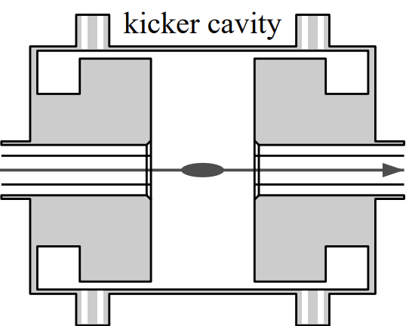
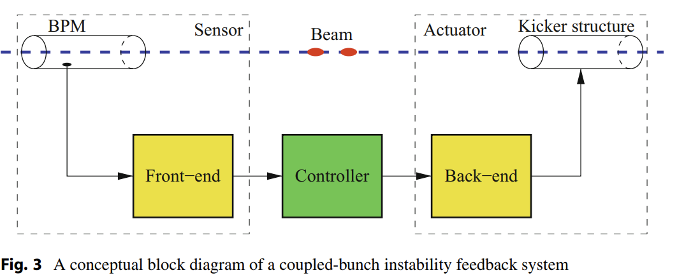
Longitudinal feedback system (LFS)
Overview of LFS
Bunch by Bunch feedback system
Suppression wakefield effects for each bunch
Broadband amplifier should be used.
Transverse feedback loop
6

Slide 7
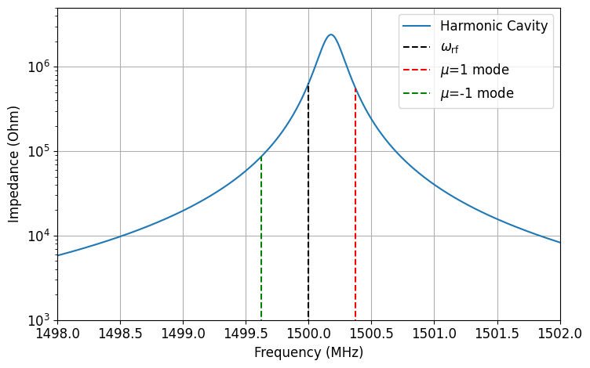
Longitudinal feedback system (LFS)
Main parameters
Central freq.
$[p⋅f_{RF}+\left(p+\frac{1}{2}\right)⋅f_{RF}]/2=1.625 GHz$ ; corresponding freq. for μ=1.
Wider bandwidth (BW: f_{RF}/2 = 250 MHz)
i.e., Low Q-factor (~5)
From beam
$$τ_{g}^{−1}=\frac{eαI}{4πE_{0}ν_{s}}\left\{\sum_{p=0}^{∞}{\left(\left(pM+μ\right)ω_{0}+ω_{s}\right)Re\left[Z\left(\left(pM+μ\right)ω_{0}+ω_{s}\right)\right]}\right\}$$
μ=1 freq.
7

Slide 8
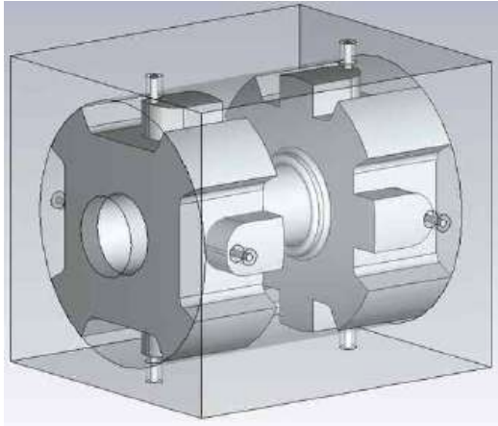
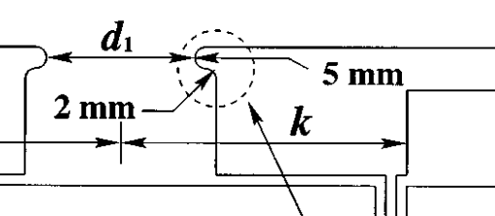
Longitudinal feedback system (LFS)
Main parameters
Filling time 1.27 ns < 2 ns (less than bunch spacing)
Shunt impedance: related to costs
Making more input/output ports
Adding nose cone structure
$$Q_{L}=\frac{f_{c}}{BW}$$
$$τ=\frac{1}{π⋅BW}$$
$$R_{s}≈\frac{R}{Q}⋅\frac{2f_{c} }{BW}$$
Unwanted !
Only 2 ports are used among 8 ports.
The others are terminated 50 Ω.
Nose cone
TM₀₁₀
Korea-4GSR LFS (TDR)
8
Notes:
기본적으로 Pillbox cavity

Slide 9
Longitudinal feedback system (LFS)
Nose cone
HOM
Three types of LFS
ALS (Coaxial electrodes)
DAΦNE (Waveguide-overloaded)
Bessy II (Combined with the others)
TM₀₁₀
HOM
9
Notes:
기본적으로 Pillbox cavity

Slide 10
Longitudinal feedback system (LFS)
Main parameters
Filling time 1.27 ns < 2 ns (less than bunch spacing)
Shunt impedance: related to costs
Making more input/output ports
Adding nose cone structure
$$Q_{L}=\frac{f_{c}}{BW}$$
$$τ=\frac{1}{π⋅BW}$$
$$R_{s}≈\frac{R}{Q}⋅\frac{2f_{c} }{BW}$$
Unwanted !
Only 2 ports are used among 8 ports.
The others are terminated 50 Ω.
Nose cone
TM₀₁₀
Korea-4GSR LFS (TDR)
10
Notes:
기본적으로 Pillbox cavity

Slide 11
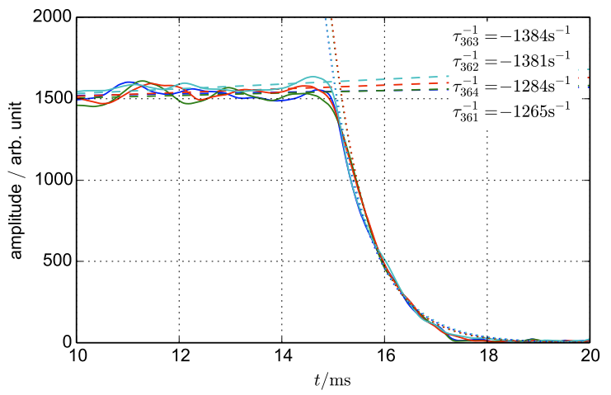
Longitudinal feedback system (LFS)
Damping rate (BESSY-II)
$$\frac{1}{τ_{d}}=\frac{f_{RF}α}{2ν_{s}E/e}⋅G$$
where $G=ΔU/Δφ$.
Damping rate: $τ_{d}^{−1}=1.33 {ms}^{−1}$
Operation verified @ $I = 350 mA$w/ LFS ($250 mA$w/o LFS)
11

Slide 12
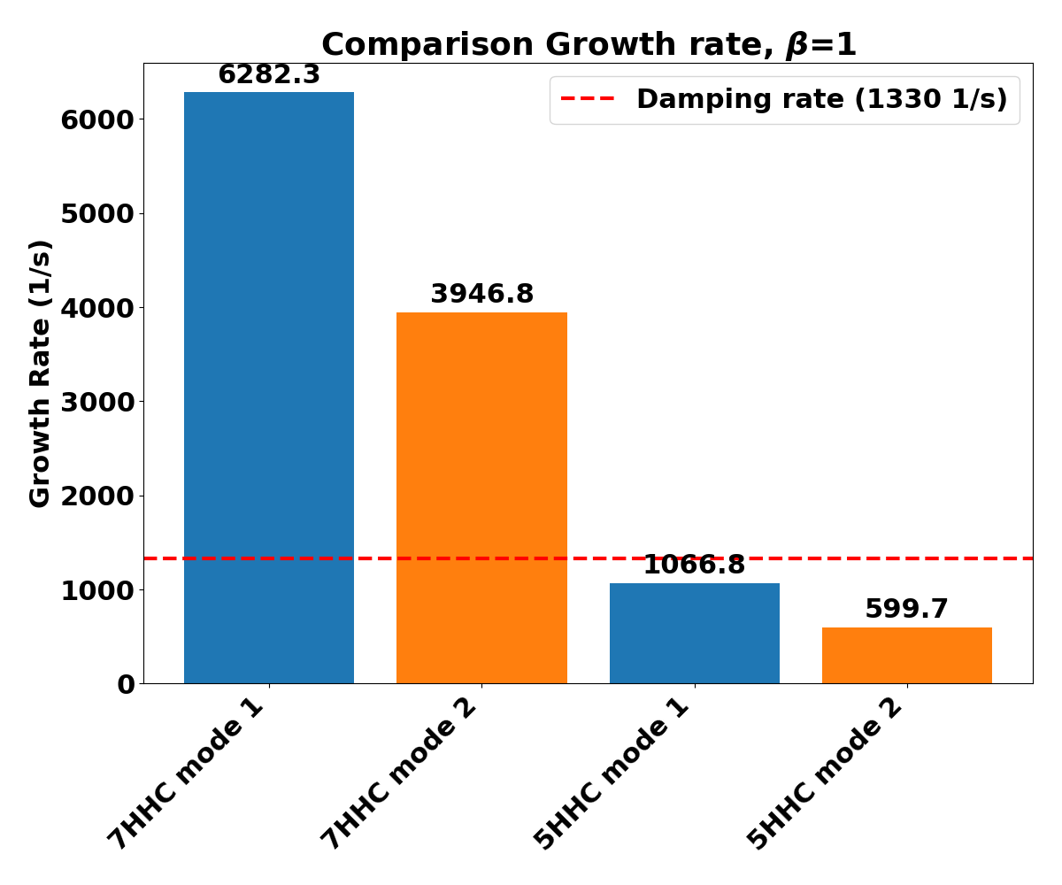
Application to Korea-4GSR lattice
7 HHC and 5HHC operation
Both cases operate in brightness mode
For the 5 HHC case, It can be used w/ single LFS. (9 ID)
However, for 7 HHC case, cannot be damp far enough.
Insert more LSF ? (X, not recommened…)
Inject uneven filling pattern beam…
12

Slide 13
Summary
Introduce how CMBI effect to beam motion
Understand basic knowledge of LFS.
Apply BESSY II’s LFS case to Korea-4GSR status.
13

