Slide 1
20250516 Group Meeting
Minseo Jeong

Slide 2
Index
Current process of multi-objective Bayesian optimization(MOBO)
UED experiment plan(with IBS)

Slide 3
Input parameter: Strength of solenoids, bunch charge, RF gun phase, source beam size
Objective parameter: Beam size, bunch length, normalized emittance, energy spread, q-resolution, (+energy)
Parameter | Range
Charge | [50fC, 100fC]
Source beam size | [20μm, 100μm]
RF gun phase | [-80°, -30°]
Solenoid 1 strength | [0.144T, 0.18T]
Solenoid 2 strength | [0.07664T, 0.0958T]

Slide 4
Surrogate model: Gaussian process
Kernel: Matern function with v=5/2
Initial sample point: 16
Acquisition function: Upper confidence bound hypervolume improvement(UCB-HVI)
Number of iteration: 100~400

Slide 5
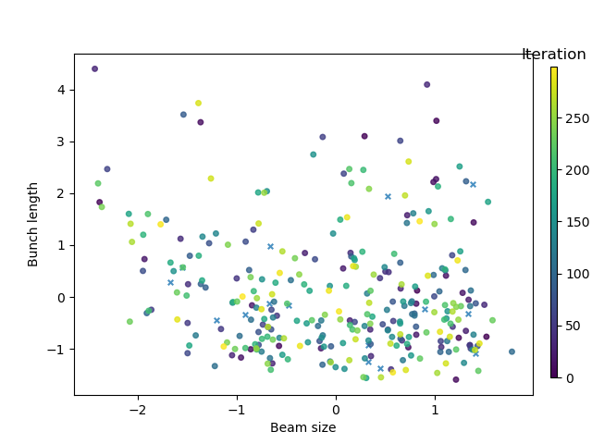
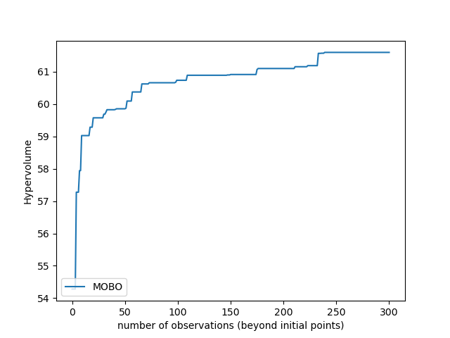
Acquisition function: expected hypervolume improvement(EHVI)
Objective: beam size, bunch length
Mean and standard derivation of beam size and bunch length:
[48.2μm, 18.6μm], [178fs, 45.8fs]

Slide 6
Future Plan
Comparison with other optimization method
(e.g. random process, NSGA-II)
Application to eLabs-Gun I facility
- Objective variables can be changed
R. Roussel et al. Phys. Rev. Accel. Beams 27. (2024).

Slide 7
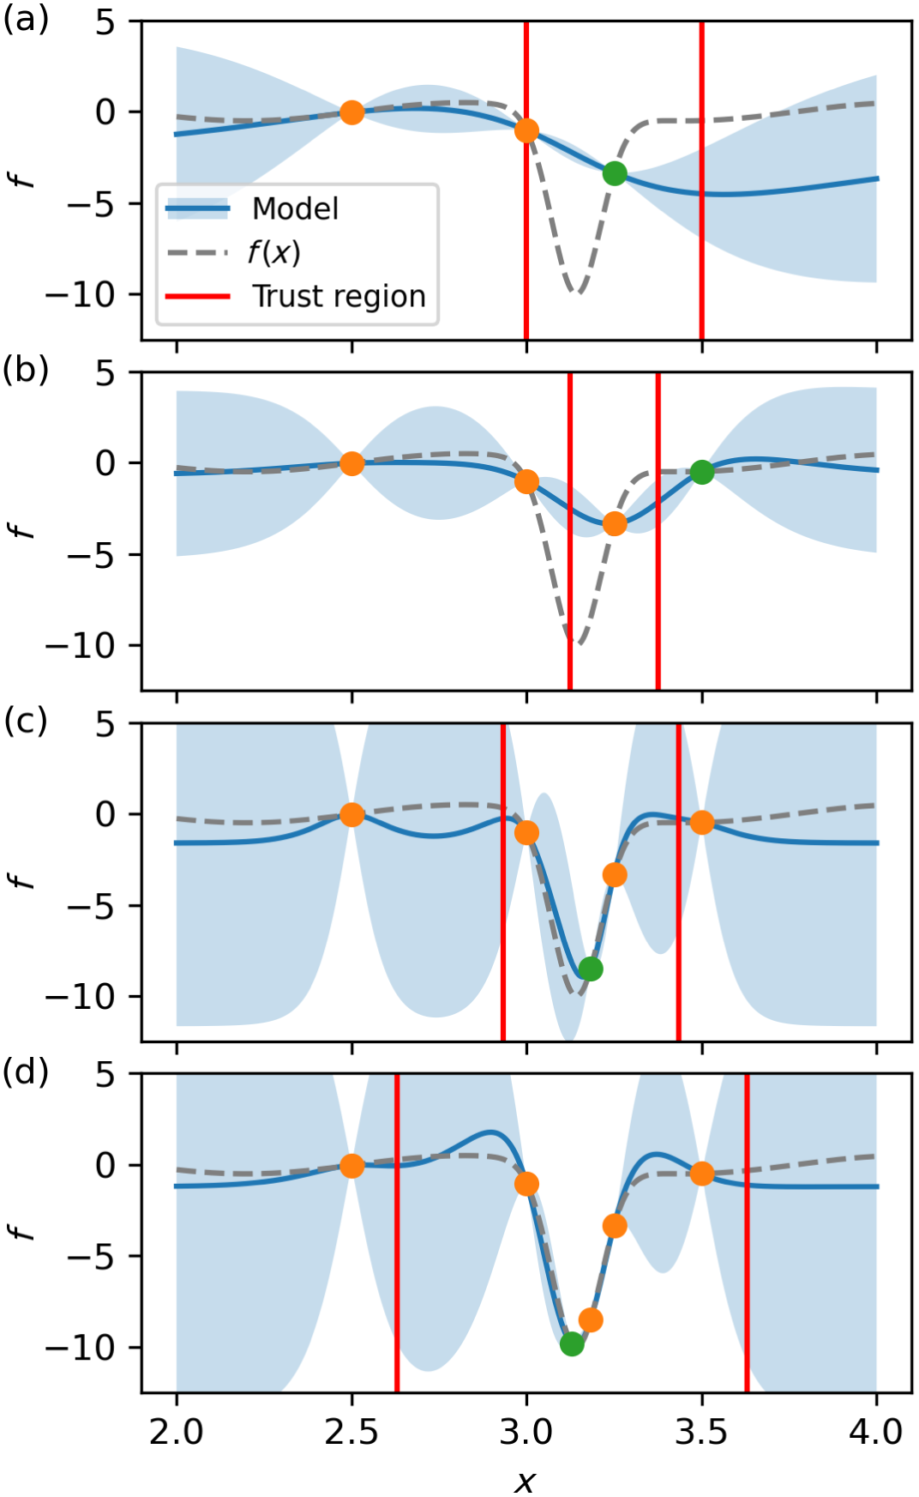
Future Plan(Optional)
Trust region Bayesian optimization(TuRBO): An algorithm that restricts optimization of the acquisition function to within a so-called trust region
Trust region is centered at the best previously observed measurement so far during optimization
As optimization progresses, the location and size of the trust region are continuously updated
R. Roussel et al. Phys. Rev. Accel. Beams 27. (2024).

Slide 8
UED Experiment
Gas UED experiment(static)
Solid UED experiment(time-resolved)

Slide 9
UED Experiment

Slide 10
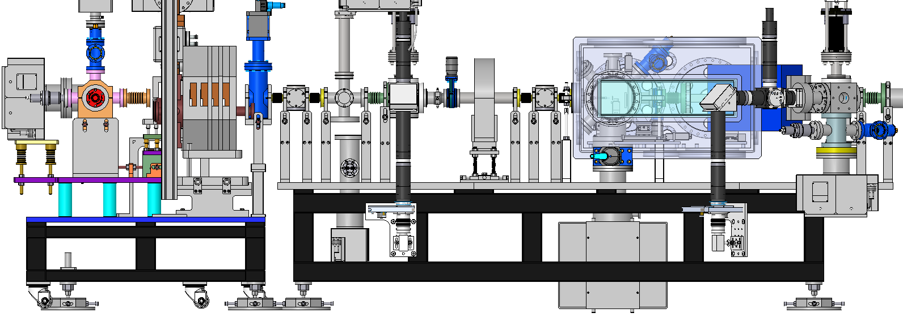
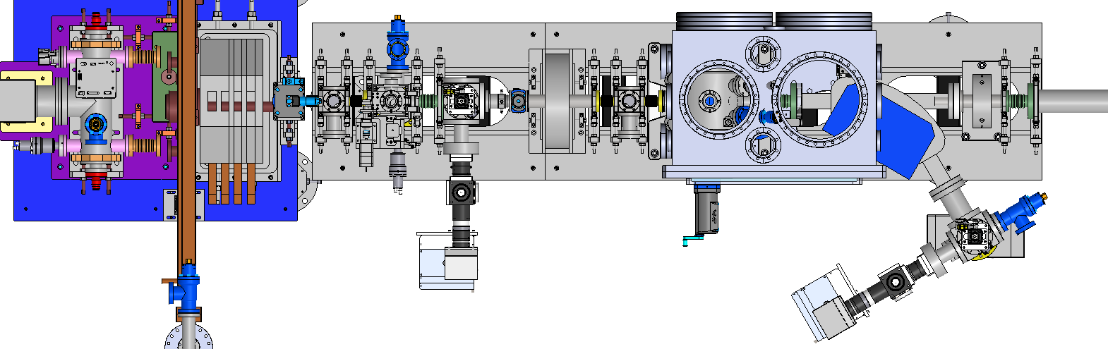
Layout
Side view
Beam
Top view

Slide 11
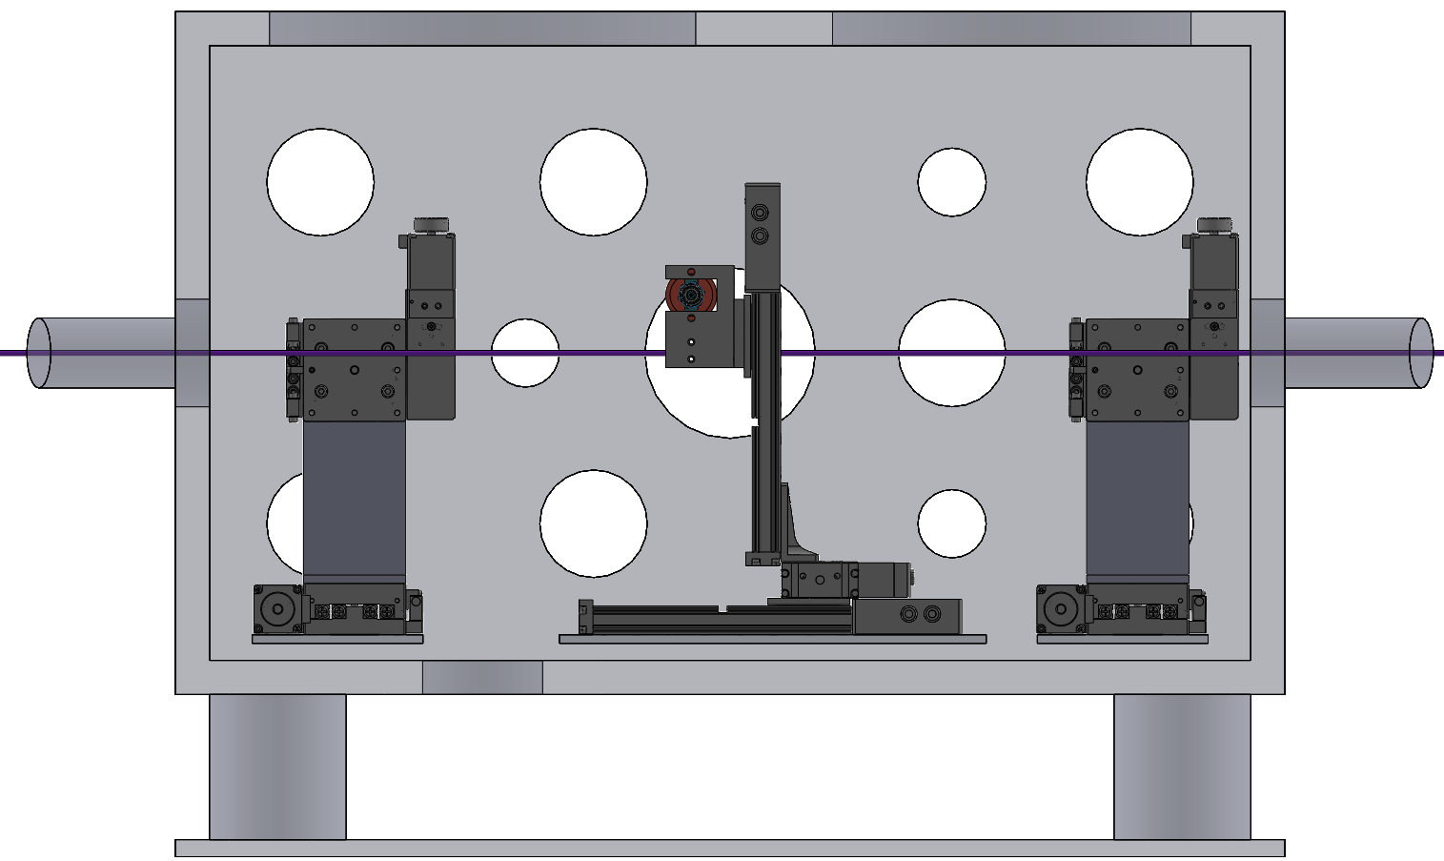
Side view
TMP
CRYO
400mm
XY-Stage
(Capillary)
XYZ-Stage
(Sample)
XY-Stage
(Laser mask)
320mm
Drain port
650mm

Slide 12
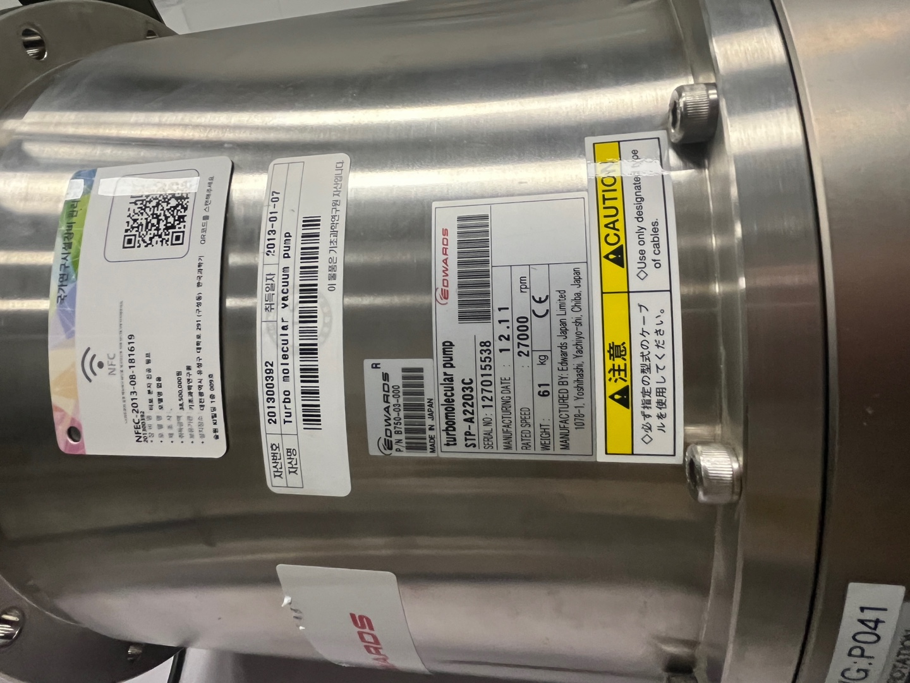
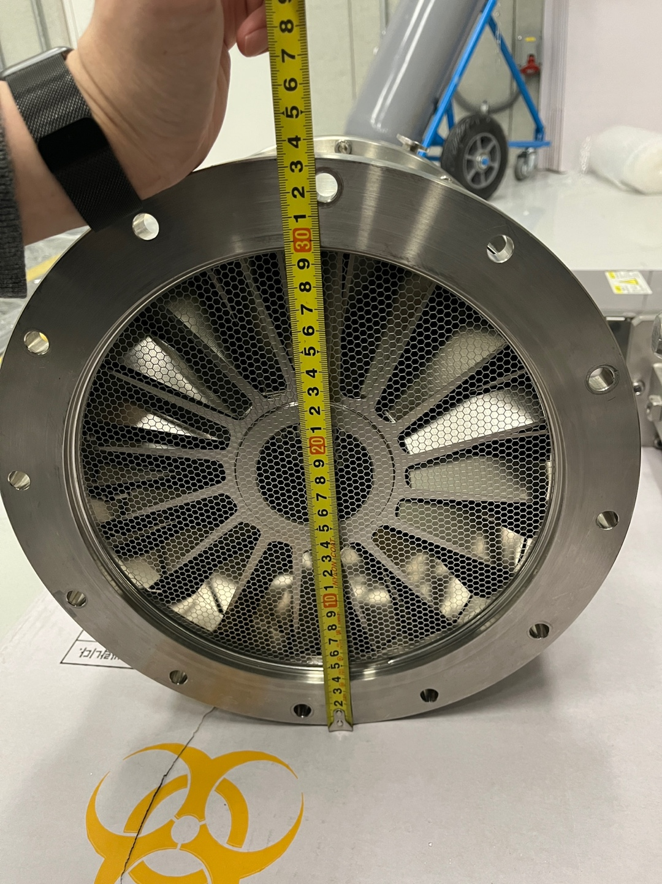
Gas UED Experiment
To maintain different vacuum condition between gun and vacuum chamber, capillary and turbo chamber is installed

Slide 13
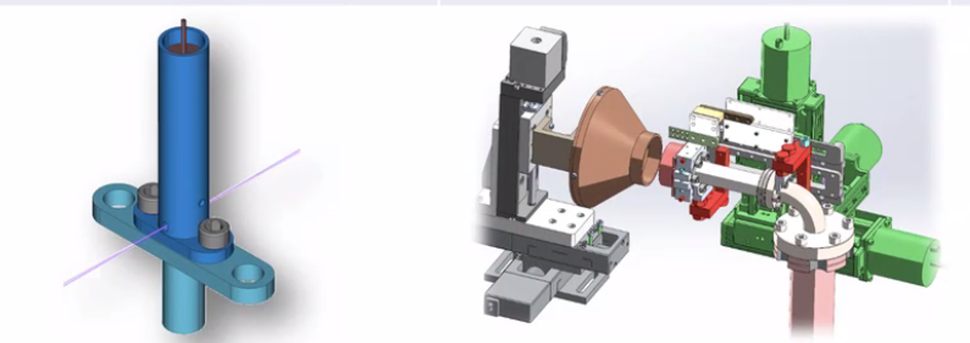
Gas UED Experiment
Sample delivery protocol
 | Flow cell | Slit jet
Appearance | Gas | Powder/crystalline
Temperature | Ambient | 50~300°C
Pressure | 0.5~5Torr | ~1Torr
Consumption | <100mL | <150g
Rep. rate | CW

Slide 14
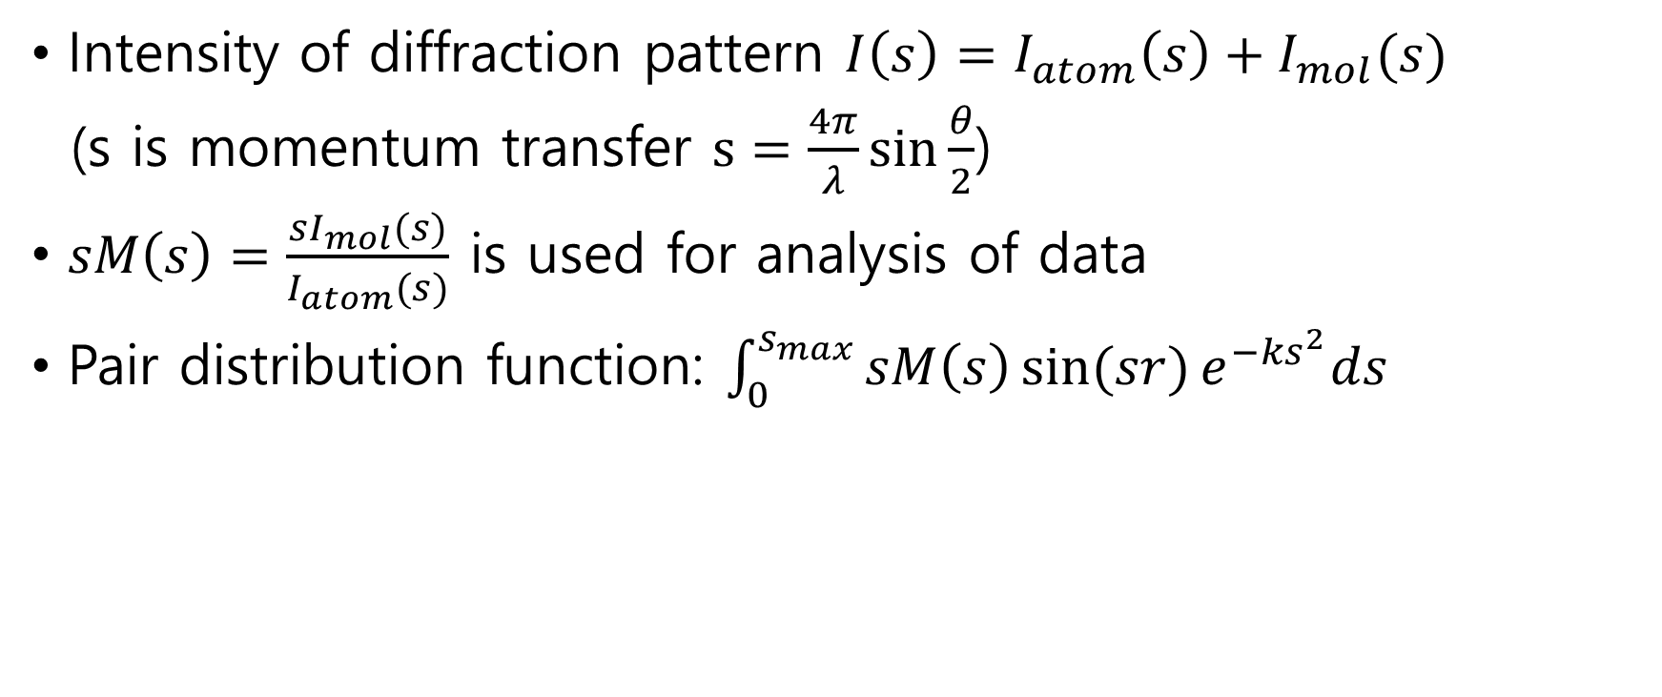
Gas UED Experiment
Intensity of diffraction pattern $I\left(s\right)=I_{atom}\left(s\right)+I_{mol}(s)$
(s is momentum transfer $s=\frac{4π}{λ}\sin{\frac{θ}{2}}$)
$sM\left(s\right)=\frac{sI_{mol}(s)}{I_{atom}(s)}$ is used for analysis of data
Pair distribution function: $\int_{0}^{s_{max}}{sM\left(s\right)\sin{(sr)}e^{−{ks}^{2}}ds}$
X.Shen et al., Struct. Dyn. 6, 054305 (2019)

Slide 15
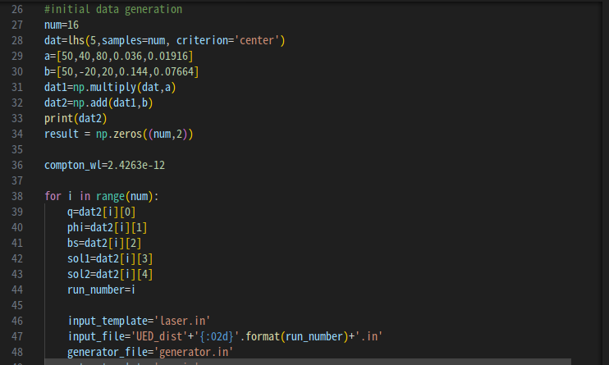
Appendix-MOBO Code

Slide 16
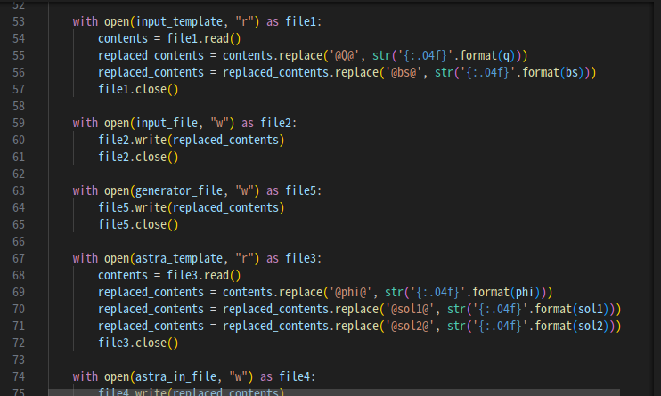
Appendix-MOBO Code

Slide 17
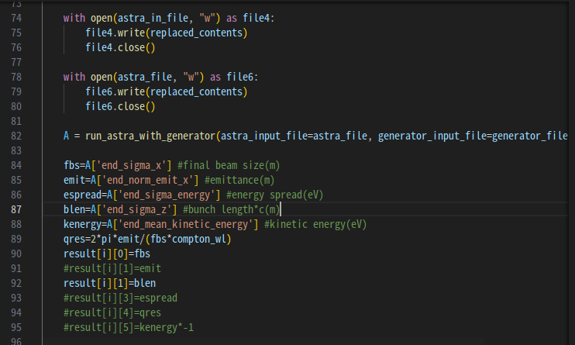
Appendix-MOBO Code

Slide 18
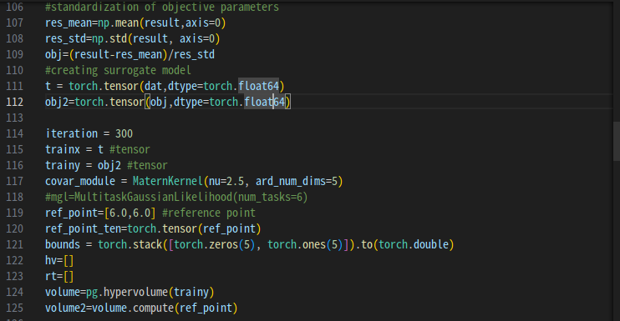
Appendix-MOBO Code

Slide 19
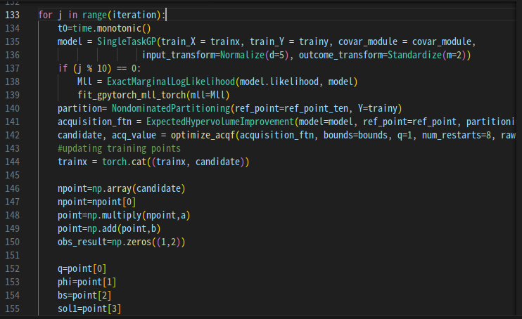
Appendix-MOBO Code

