Slide 1
Theories derived from Haissinski equation and their applications to electron storage rings
2025-04-03, Pohang, South Korea
Young Min Park
Division of Advanced Nuclear Engineering (DANE), POSTECH

Slide 2
Wake field & Impedance
Electro magnetic fields induced by the beam are refereed to as wake fields due to the fact that they are left mainly behind the traveling charge. – L.Palumbo, CERN. LNF-94/041
Leading particle
Wake
$$W\left(z\right)=−\frac{ΔU\left(z\right)}{qq_{front}}=−\frac{1}{q_{front}}\int_{−\frac{L}{2}}^{\frac{L}{2}}{E_{s}\left(s,t=\frac{s−z}{c}\right)ds}$$
Trailing particle
$$Z\left(k\right)=\frac{1}{c}\int_{−∞}^{∞}{dkW\left(z\right)e^{−ikz}}$$
Structure
In reality, (not a point charge)
$$ΔU\left(z\right)=Ne^{2}\int_{−∞}^{∞}{W\left(z−z^{′}\right)λ\left(z′\right)dz^{′}}, where \int_{−∞}^{∞}{λ\left(z\right)dz=1}$$
2

Slide 3
Potential well distortion
Equation of motion
$$\frac{dz}{ds}=−ηδ, \frac{dδ}{ds}=\frac{ω_{s}^{2}}{ηc^{2}}z−\frac{1}{EC_{0}}\left(Ne^{2}\int_{−∞}^{∞}{W\left(z−z^{′}\right)λ\left(z′\right)dz^{′}}\right)$$
$$\frac{∂ℋ}{∂p}=\frac{dz}{ds},$$
$$\frac{∂ℋ}{∂q}=−\frac{dp}{ds}$$
Hamiltonian
Wake field term
$$ℋ\left(z,δ\right)=−\frac{η}{2}δ^{2}−\frac{ω_{s}^{2}}{2ηc^{2}}z^{2}+\frac{Ne^{2}}{EC_{0}}\int_{0}^{z}{dz^{′′}\int_{−∞}^{∞}{W\left(z^{′′}−z^{′}\right)λ\left(z′\right)dz^{′}}}$$
W/O wake
With wake
Due to wake filed term
Centroid shift
Bunch lengthening (Or shortening)
Peak position change
$$V\left(z\right)$$
$$V\left(z\right)$$
$$z$$
$$z$$
3

Slide 4
Vlasov-Fokker Plank equation
VFP
$$D$$
$$C$$
$$p$$
$ψ\left(q,p\right)→$phase-space distribution
$$Δp$$
Quantum excitation
$$q$$
$$A$$
$$Δq$$
$$B$$
$$\frac{dψ\left(q,p,s\right)}{ds}=\frac{∂ψ\left(q,p,s\right)}{∂s}+\frac{∂q}{∂s}\frac{∂ψ\left(q,p,s\right)}{∂q}+\frac{∂p}{∂s}\frac{∂ψ\left(q,p,s\right)}{∂p}=Difussion\&Damping=\frac{2}{ct_{d}}\frac{∂}{∂δ}\left[δψ+σ_{δ}^{2}\frac{∂ψ}{∂δ}\right]$$
Conservative term
Radiation damping
In equilibrium(s-independent)
$$δψ+σ_{δ}^{2}\frac{∂ψ}{∂δ}→0, ψ\left(z,δ\right)=Aλ\left(z\right)\exp\left(−\frac{δ^{2}}{2σ_{δ}^{2}}\right)$$
$$z^{′}\frac{dλ\left(z\right)}{dz}−δ^{′}\frac{δ}{σ_{δ}^{2}}λ\left(z\right)=−ηδ\frac{dλ\left(z\right)}{dz}−\left[\frac{ω_{s}^{2}}{ηc^{2}}z−\frac{1}{EC_{0}}\left(Ne^{2}\int_{−∞}^{∞}{W\left(z−z^{′}\right)λ\left(z^{′}\right)dz^{′}}\right)\right]\frac{δ}{σ_{δ}^{2}}λ\left(z\right)=0$$
$$\frac{dλ\left(z\right)}{dz}+\left[\frac{z}{σ_{z0}^{2}} −\frac{Ne^{2}}{ησ_{δ}^{2}E_{0}C}\int_{−∞}^{∞}{W\left(z−z^{′}\right)λ\left(z^{′}\right)dz^{′}}\right]λ\left(z\right)=0$$
$$Δp$$
$$σ_{z0}=−\frac{cησ_{δ}}{ω_{s}},$$
$$I=\frac{Ne^{2}σ_{z0}}{E_{0}C_{0}ησ_{δ}^{2}}$$
$$∴λ\left(z\right)=A\exp\left[−\frac{z^{2}}{2σ_{z0}^{2}}+\frac{I}{σ_{z0}}\int_{0}^{z}{dz^{′′}\int_{−∞}^{∞}{W\left(z^{′′}−z^{′}\right)λ\left(z^{′}\right)dz^{′}}}\right]$$
Haissinski equation
4

Slide 5
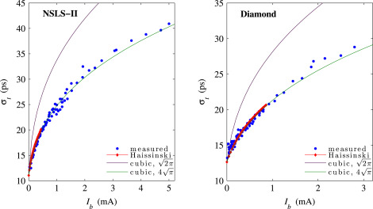
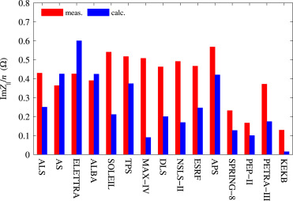
Introduction
Previous theory
$${\left(\frac{σ_{z}}{σ_{z0}}\right)}^{3}−\left(\frac{σ_{z}}{σ_{z0}}\right)=\frac{cNe^{2}cL}{\sqrt{2π}ησ_{z0}σ_{δ}^{2}E}$$
[1] B.W.Zotter, Potential-well bunch lengthening
Zotter’s cubic equation is not self-consistent and is valid only when a pure inductance can approximate the longitudinal total impedance of the ring.
In real machine, discrepancy between simulations and experiments was conducted.
$${\left(\frac{Z}{n}\right)}_{eff}=\frac{\int_{−∞}^{∞}{\frac{Z\left(ω\right)}{n}\tilde{λ}\left(ω\right){\tilde{λ}}^{∗}\left(ω\right)dω}}{\int_{−∞}^{∞}{\tilde{λ}\left(ω\right){\tilde{λ}}^{∗}\left(ω\right)dω}}, n=\frac{ω}{ω_{0}}$$
Derive equations for center of mass, peak position, longitudinal profile, bunch length.
Show Zotter’s cubic equation is a special case of our theory.
Theory test with real machines.
[2] V. Smaluk, Impedance computations and beam-based measurements: A problem of discrepancy
5

Slide 6
Theories derived from Haissinski equation
Centroid shift
$$𝒲\left(z\right)=\int_{−∞}^{∞}{W\left(z−z^{′}\right)λ\left(z′\right)dz^{′}}$$
$$\int_{−∞}^{∞}{ }dz$$
$$\frac{dλ\left(z\right)}{dz}+\frac{1}{σ_{z0}^{2}}\left[z−Iσ_{z}𝒲\left(z\right)\right]λ\left(z\right)=0$$
$$\int_{−∞}^{∞}{zλ\left(z\right)dz}−Iσ_{z0}\int_{−∞}^{∞}{λ\left(z\right)𝒲\left(z\right)}=0$$
$$z_{c}=Iσ_{z0}κ_{∥}$$
$κ_{∥}$ called longitudinal loss factor
Changed $I→0$, and slope of change of $z_{c}$ can be measured experimentally ​$⇒k_{∥0}\left(mesurement\right)$
When $I→0,$ the bunch distribution retains its original Gaussian shape with $σ_{z0}$​, and the loss factor can be calculated as:
$$k_{∥0}\left(theory\right)=\int_{−∞}^{∞}{λ\left(z\right)𝒲\left(z\right)dz=\int_{−∞}^{∞}{\tilde{λ}\left(k\right){\left[ℱ\left(𝒲\right)\right]}^{∗}dk}}=\frac{c}{2π}\int_{−∞}^{∞}{Z\left(k\right)\tilde{λ}\left(k\right){\tilde{λ}}^{∗}\left(k\right)dk}=\frac{c}{π}\int_{0}^{∞}{Re\left[Z\left(k\right)\right]e^{−k^{2}σ_{z0}^{2}}dk}$$
$$m_{1}={\left.\frac{dz_{c}}{dI}\right|}_{0}={\left.σ_{z0}\frac{d\left(Iκ_{∥}\right)}{dI}\right|}_{0}=σ_{z0}{\left.\left(k_{∥}\left(I\right)+I\frac{dk_{∥}}{dI}\right)\right|}_{0}=σ_{z0}k_{∥}\left(0\right)$$
Difference between $k_{∥0}\left(mesurement\right)$ and $k_{∥0}\left(theory\right)→$ gap between real part of theoretical and actual impedance
6

Slide 7
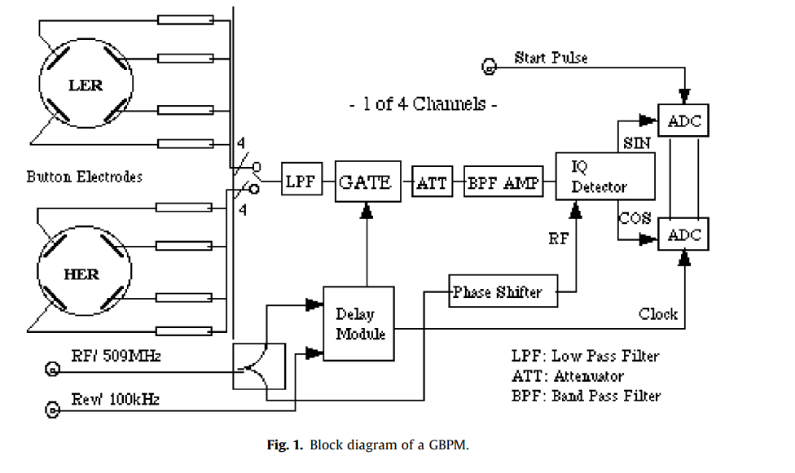
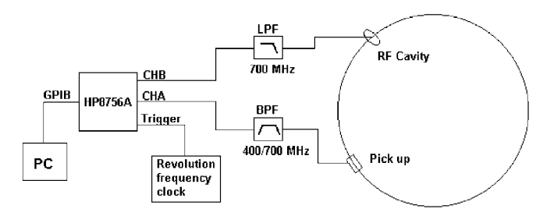
Theories derived from Haissinski equation
Centroid shift measurement
$$A\sin\left(ω_{rf}t+φ\right)→I\sin\left(ω_{rf}t\right)+Q\cos\left(ω_{rf}t\right)$$
[1] R.H.A. Farias, Oscilloscope measurement of the synchronous phase shift in an electron storage ring, PRAB01
[2] T. Ieiri, Beam dynamics measurements using a gated beam-position monitor at KEKB, NIM-A (2009)
Beam pick-up signal vs RF cavity signal $→$ $φ_{beam}−φ_{cav}→φ_{sync}$
7

Slide 8
Theories derived from Haissinski equation
Peak position
$$\frac{dλ\left(z\right)}{dz}→0$$
$$\frac{dλ\left(z\right)}{dz}+\frac{1}{σ_{z0}^{2}}\left[z−Iσ_{z0}𝒲\left(z\right)\right]λ\left(z\right)=0$$
$$z_{m}=Iσ_{z0}𝒲\left(z_{m}\right)$$
Changed $I→0$, and slope of peak position $z_{m}$ can be measured experimentally
When $I→0,$ the bunch distribution retains its original Gaussian shape with $σ_{z0}$​, and $m_{2}$can be calculated as:
$$m_{2}\left(theory\right)=σ_{z0}𝒲\left(0\right)=σ_{z0}\int_{−∞}^{∞}{W\left(−z^{′}\right)λ\left(z^{′}\right)dz^{′}}=\int_{−∞}^{∞}{W\left(z^{′}\right)λ\left(z^{′}\right)dz^{′}}=\frac{c}{π}\int_{−∞}^{∞}{Re\left[Z\left(k\right)\right]e^{−k^{2}σ_{z0}^{2}/2}dk}$$
$$m_{2}\left(measure\right)={\left.\frac{dz_{m}}{dI}\right|}_{0}={\left.σ_{z0}\frac{d\left(Iz_{m}\right)}{dI}\right|}_{0}=σ_{z0}{\left.\left(𝒲\left(z_{m}\right)+I𝒲^{′}\left(z_{m}\right)\right)\right|}_{0}=σ_{z0}𝒲\left(0\right)$$
Difference between $m_{2}\left(mesurement\right)$ and $m_{2}\left(theory\right)→$ gap between real part of theoretical and actual impedance
8

Slide 9
Theories derived from Haissinski equation
Peak position measurement/ Bunch length measurement
BPM Measured $I\left(t\right)→\frac{dλ\left(t\right)}{dt}$ Position of $I\left(t\right)→0⇒peak position$
BPM zero-crossing signal
Streak camera (~ps resolution)
9

Slide 10
Theories derived from Haissinski equation
Bunch lengthening
$$×z and \int_{−∞}^{∞}{ }dz$$
$$\frac{dλ\left(z\right)}{dz}+\frac{1}{σ_{z0}^{2}}\left[z−Iσ_{z0}𝒲\left(z\right)\right]λ\left(z\right)=0$$
$$\int_{−∞}^{∞}{ }\left(z\frac{dλ\left(z\right)}{dz}+\frac{z^{2}}{σ_{z0}^{2}}λ\left(z\right)−\frac{I}{σ_{z0}}𝒲\left(z\right)zλ\left(z\right)\right)dz$$
$$∴\frac{σ_{z}^{2}}{σ_{z0}^{2}}−1−\frac{cI}{2πσ_{z0}}Z_{∥}^{eq}=0, Z_{∥}^{eq}=−i\int_{−∞}^{∞}{dkZ\left(k\right)\left(\tilde{λ}\left(k\right)e^{−ikz_{c}}\right)\frac{d}{dk}{\left(\tilde{λ}\left(k\right)e^{−ikz_{c}}\right)}^{∗}}$$
Appendix
Changed $I→0$, and slope of $x=\frac{σ_{z}}{σ_{z0}}$ can be measured experimentally
When $I→0,$ the bunch distribution retains its original Gaussian shape with $σ_{z0}$​, and $m_{3}$can be calculated as:
$$m_{3}\left(theory\right)=\frac{c}{4πσ_{z0}}⋅Z_{∥}^{eq}\left(0\right)=\frac{c}{4πσ_{z0}}⋅\left(−2σ_{z0}^{2}\int_{0}^{∞}{dkIm\left(Z\left(k\right)\right)ke^{−k^{2}σ_{z0}^{2}}}\right)$$
$$m_{3}\left(measure\right)={\left.\frac{dx}{dI}\right|}_{I=0}=\frac{1}{2x\left(0\right)}\frac{c}{2πσ_{z0}}Z_{∥}^{eq}\left(0\right)=\frac{c}{4πσ_{z0}}⋅Z_{∥}^{eq}\left(0\right)$$
Difference between $m_{3}\left(mesurement\right)$ and $m_{3}\left(theory\right)→$ gap between imaginary part of theoretical and actual impedance
10

Slide 11
Theories derived from Haissinski equation
Inverse problem
$$λ\left(z\right)=A\exp\left[−\frac{z^{2}}{2σ_{z0}^{2}}+\frac{I}{σ_{z0}}\int_{0}^{z}{dz^{′′}𝒲\left(z^{′′}\right)}\right]→\frac{dλ\left(z\right)}{dz}=λ\left(z\right)⋅\left[−\frac{z}{σ_{z0}^{2}}+\frac{I}{σ_{z0}}𝒲\left(z\right)\right]$$
$$𝒲\left(z\right)=\frac{σ_{z0}}{I}\left(\frac{1}{λ\left(z\right)}\frac{dλ\left(z\right)}{dz}+\frac{z}{σ_{z0}^{2}}\right)$$
$$Z\left(k\right)=\frac{1}{cλ\left(k\right)}ℱ^{−1}\left(𝒲\left(z\right)\right)=\frac{σ_{z}}{Icλ\left(k\right)}ℱ^{−1}\left(\frac{1}{λ\left(z\right)}\frac{dλ\left(z\right)}{dz}+\frac{z}{σ_{z0}^{2}}\right)$$
If the bunch distribution is accurately measured, the impedance can be extracted from it.
The inverse problem(deconvolution) is ill-posed, meaning it is highly sensitive to measurement errors.
High-frequency impedance components are difficult to obtain reliably.
11

Slide 12
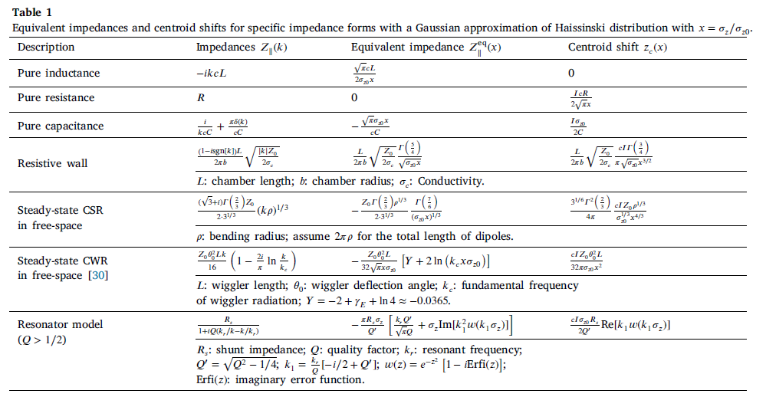
Explicit expressions for specific impedance
Equivalent impedance and Centroid shifts for specific impedance
12

Slide 13
Explicit expressions for specific impedance
Compare with Zotter’s equation
$$∴\frac{σ_{z}^{2}}{σ_{z0}^{2}}−1−\frac{cI}{2πσ_{z0}}Z_{∥}^{eq}=0, Z_{∥}^{eq}=−i\int_{−∞}^{∞}{dkZ\left(k\right)\left(\tilde{λ}\left(k\right)e^{−ikz_{c}}\right)\frac{d}{dk}{\left(\tilde{λ}\left(k\right)e^{−ikz_{c}}\right)}^{∗}}$$
Assume $\tilde{λ}\left(k\right)→Gaussian distribution e^{−k^{2}σ_{z}^{2}/2}$
$$\left(\tilde{λ}\left(k\right)e^{−ikz_{c}}\right)\frac{d}{dk}{\left(\tilde{λ}\left(k\right)e^{−ikz_{c}}\right)}^{∗}→\tilde{λ}\left(k\right)\left[i\frac{d}{dk}{\tilde{λ}}^{∗}\left(k\right)+z_{c}{\tilde{λ}}^{∗}\left(k\right)\right]=\left(−i2kσ_{z}^{2}\right)⋅e^{−k^{2}σ_{z}^{2}}$$
$$Z_{∥}^{eq}=−2σ_{z}^{2}\int_{0}^{∞}{dk Im\left[Z\left(k\right)\right]ke^{−k^{2}σ_{z}^{2}}}$$
If we assume purely inductive impedance
$$Z\left(k\right)=−ikcL→Z_{∥}^{eq}=2σ_{z}^{2}cL\int_{0}^{∞}{dk k^{2}e^{−k^{2}σ_{z}^{2}}}=2σ_{z}^{2}cL⋅\frac{\sqrt{π}}{4σ_{z}^{3}}=\frac{cL\sqrt{π}}{2σ_{z}}$$
$$\frac{σ_{z}^{2}}{σ_{z0}^{2}}−1−\frac{cI}{2πσ_{z0}}Z_{∥}^{eq}=0→\frac{σ_{z}^{3}}{σ_{z0}^{3}}−\frac{σ_{z}}{σ_{z0}}−\frac{c^{2}IL}{4\sqrt{π}σ_{z0}^{2}}=0→{\left(\frac{σ_{z}}{σ_{z0}}\right)}^{3}−\left(\frac{σ_{z}}{σ_{z0}}\right)=\frac{cNe^{2}cL}{\sqrt{2π}ησ_{z0}σ_{δ}^{2}E}$$
$$L_{eff}→\frac{2σ_{z0}}{\sqrt{π}c}Z_{∥0}^{eq}$$
We can get Zotter’s cubic equation, but is is not appropriate for comparison with experimental data.
13

Slide 14
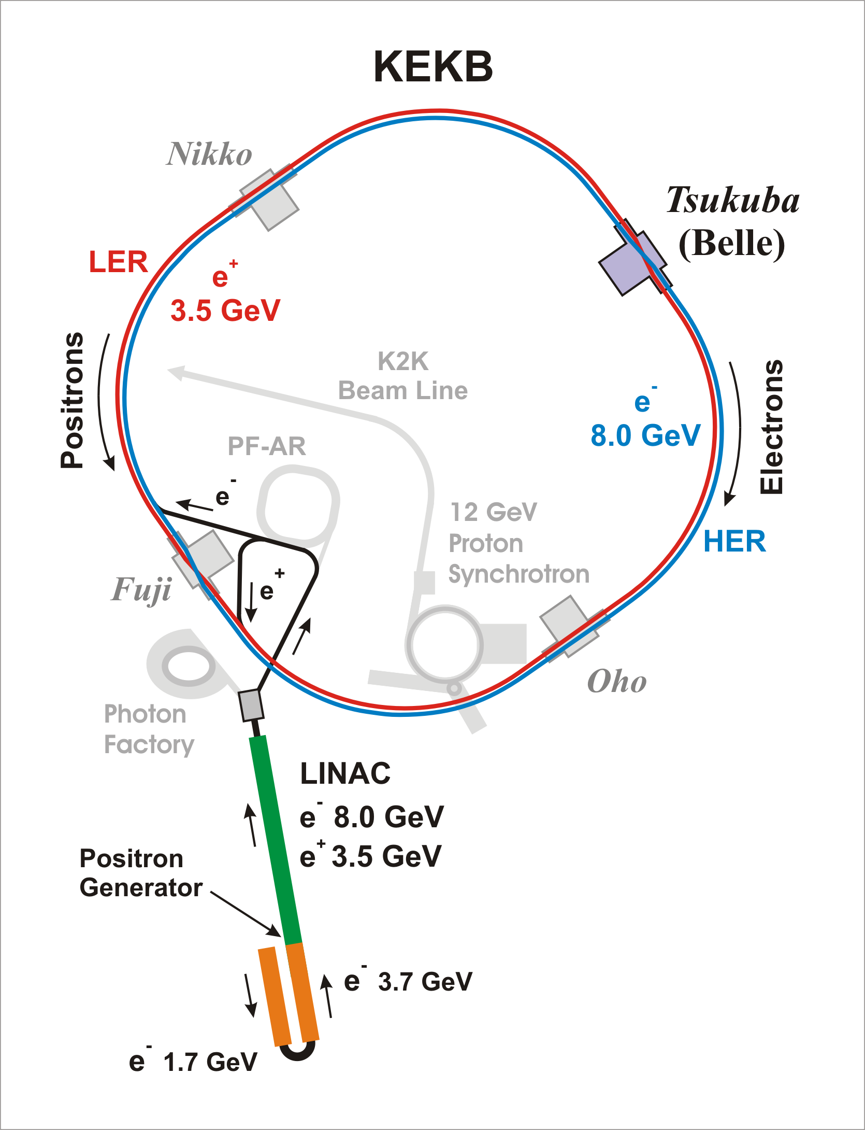
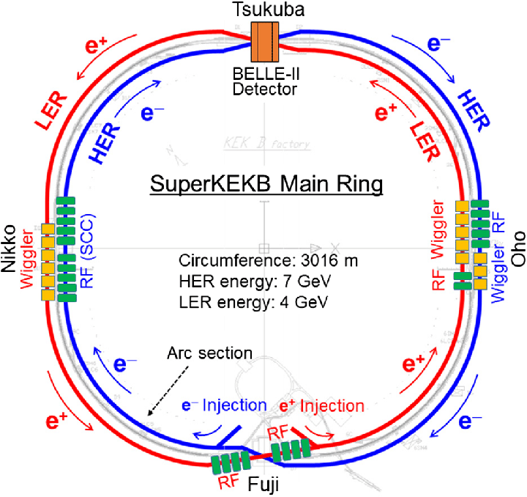
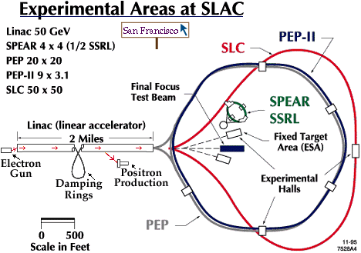
Applications to real machines
SLC damping ring
KEKB low energy ring
Super-KEKB LER
~1998
~2010
2018~
14

Slide 15
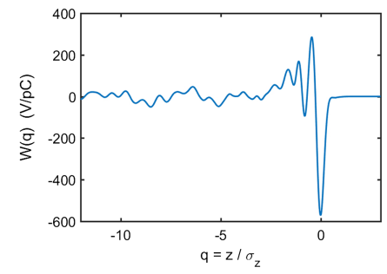
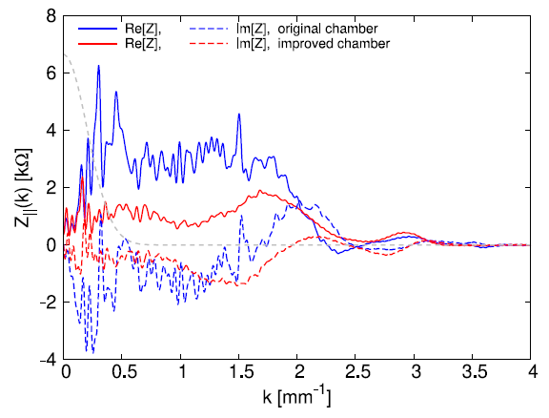
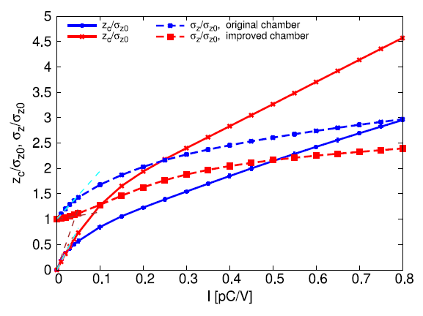
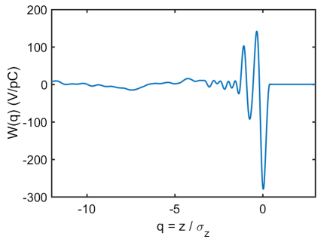
Applications to real machines
SLC damping ring
Original chamber
Improved chamber
[1] R. Warnock, Numerical solution of the Haissinski equation for the equilibrium state of a stored electron beam, PRAB 21.
15

Slide 16
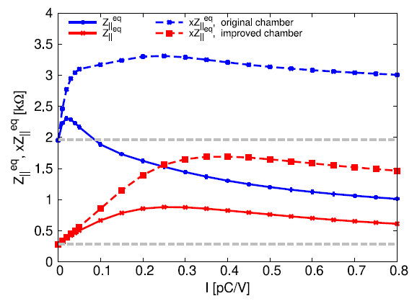
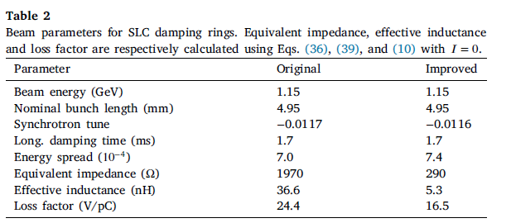
Applications to real machines
SLC damping ring
Suggested equation
$$\frac{σ_{z}^{2}}{σ_{z0}^{2}}−1−\frac{cI}{2πσ_{z0}}Z_{∥}^{eq}=0$$
Zotter’s equation
$${\left(\frac{σ_{z}}{σ_{z0}}\right)}^{3}−\left(\frac{σ_{z}}{σ_{z0}}\right)=\frac{cNe^{2}cL}{\sqrt{2π}ησ_{z0}σ_{δ}^{2}E}$$
$$Z_{∥}^{eq}=−2σ_{z}^{2}\int_{0}^{∞}{dk Im\left[Z\left(k\right)\right]ke^{−k^{2}σ_{z}^{2}}},L_{eff}→\frac{2σ_{z0}}{\sqrt{πc}}Z_{∥}^{eq}$$
16

Slide 17
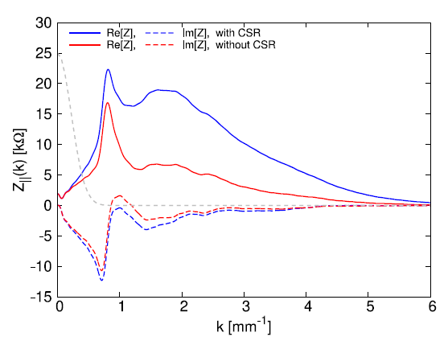
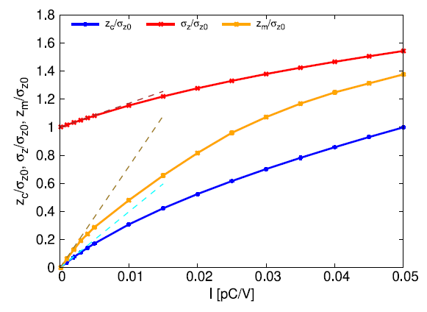
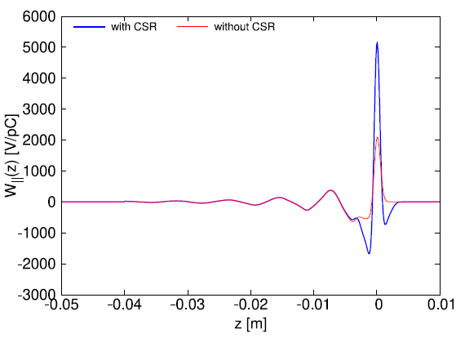
Applications to real machines
KEKB low energy ring
[1] D. Zhou, Simulation of microwave instability in LER of KEKB and Super KEKB
17

Slide 18
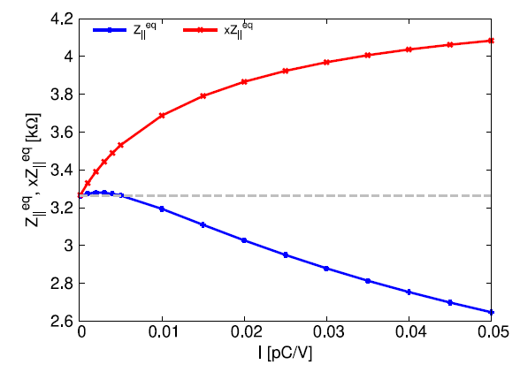
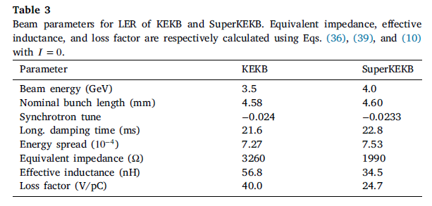
Applications to real machines
KEKB low energy ring
Zotter’s equation
$${\left(\frac{σ_{z}}{σ_{z0}}\right)}^{3}−\left(\frac{σ_{z}}{σ_{z0}}\right)=\frac{cNe^{2}cL}{\sqrt{2π}ησ_{z0}σ_{δ}^{2}E}$$
Suggested equation
$$\frac{σ_{z}^{2}}{σ_{z0}^{2}}−1−\frac{cI}{2πσ_{z0}}Z_{∥}^{eq}=0$$
$$Z_{∥}^{eq}=−2σ_{z}^{2}\int_{0}^{∞}{dk Im\left[Z\left(k\right)\right]ke^{−k^{2}σ_{z}^{2}}},L_{eff}→\frac{2σ_{z0}}{\sqrt{πc}}Z_{∥}^{eq}$$
18

Slide 19
Applications to real machines
KEKB low energy ring
Measured effective inductance = $90 nH$
Why those discrepancy occur?
Systematic errors in streak camera
Supplementary bunch lengthening induced by resistive impedance
$$Z_{∥}^{eq}=−2σ_{z}^{2}\int_{0}^{∞}{dk Im\left[Z\left(k\right)\right]ke^{−k^{2}σ_{z}^{2}}}, L_{eff}→\frac{2σ_{z0}}{\sqrt{πc}}Z_{∥}^{eq}$$
$$↓$$
$$Z_{∥}^{eq}=−i\int_{−∞}^{∞}{dkZ\left(k\right)\left(\tilde{λ}\left(k\right)e^{−ikz_{c}}\right)\frac{d}{dk}{\left(\tilde{λ}\left(k\right)e^{−ikz_{c}}\right)}^{∗}}$$
19

Slide 20
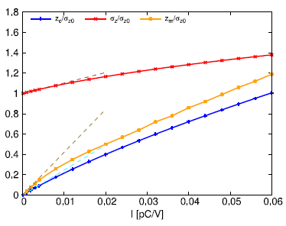
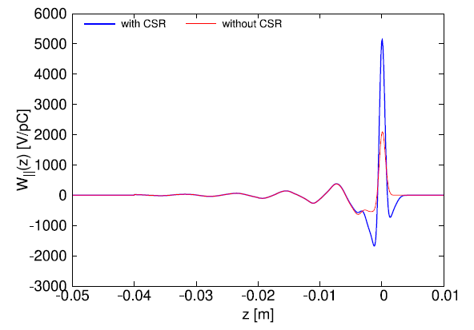
Applications to real machines
Super-KEKB
$$∴λ\left(z\right)=A\exp\left[−\frac{z^{2}}{2σ_{z0}^{2}}+\frac{I}{σ_{z0}}\int_{0}^{z}{dz^{′′}\int_{−∞}^{∞}{W\left(z^{′′}−z^{′}\right)λ\left(z^{′}\right)dz^{′}}}\right]$$
[1] D. Zhou, Simulation of microwave instability in LER of KEKB and Super KEKB
20

Slide 21
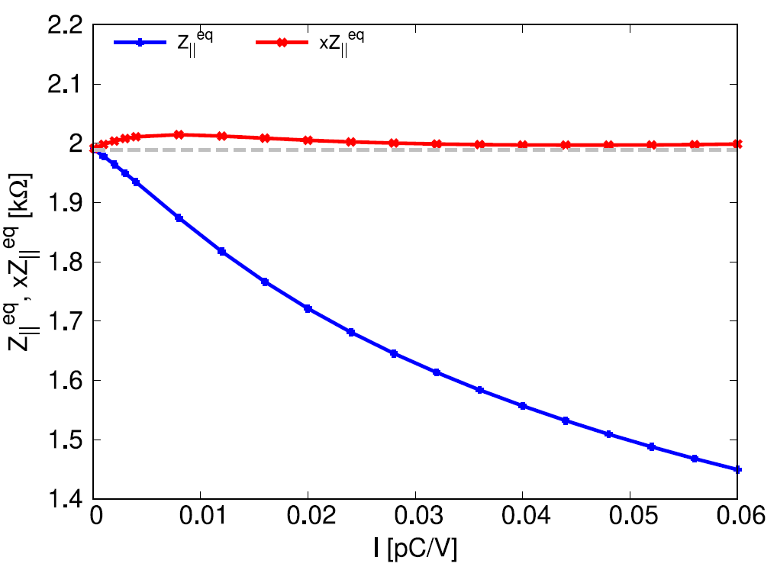
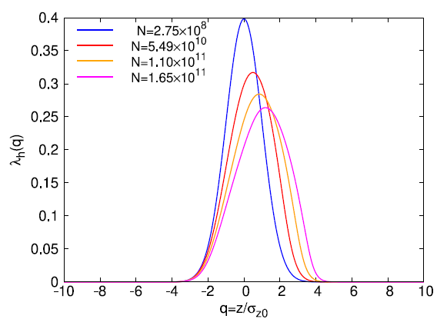
Applications to real machines
SuperKEKB
Zotter’s equation
$${\left(\frac{σ_{z}}{σ_{z0}}\right)}^{3}−\left(\frac{σ_{z}}{σ_{z0}}\right)=\frac{cNe^{2}cL}{\sqrt{2π}ησ_{z0}σ_{δ}^{2}E}$$
Suggested equation
$$\frac{σ_{z}^{2}}{σ_{z0}^{2}}−1−\frac{cI}{2πσ_{z0}}Z_{∥}^{eq}=0$$
Inductive impedance dominates bunch lengthening
Calculated by Hassinski equation
21

Slide 22
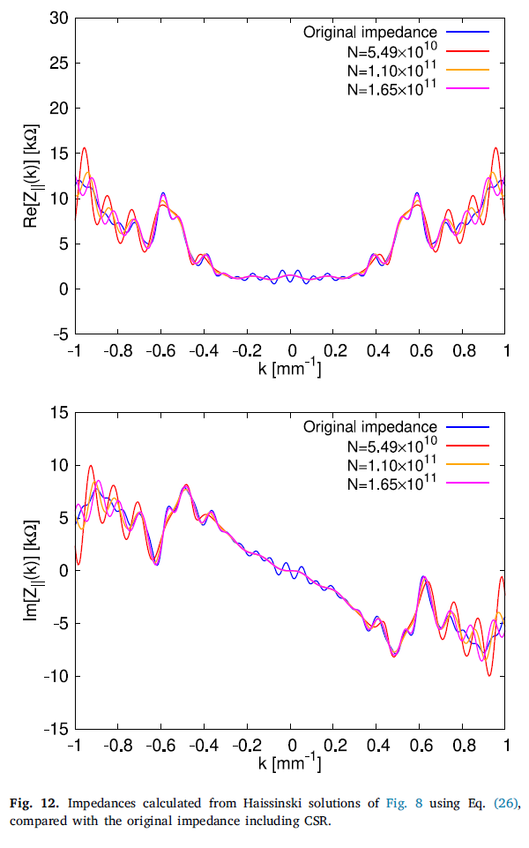
Applications to real machines
Super-KEKB (Inverse problem of Haissinski equation)
$$Z\left(k\right)=\frac{σ_{z}}{Icλ\left(k\right)}ℱ^{−1}\left(\frac{1}{λ\left(z\right)}\frac{dλ\left(z\right)}{dz}+\frac{z}{σ_{z0}^{2}}\right)$$
22

Slide 23
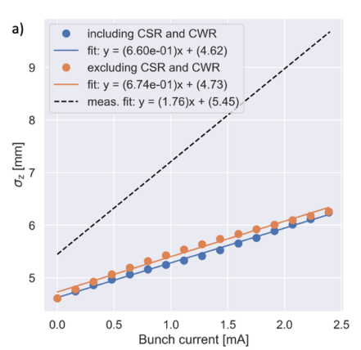
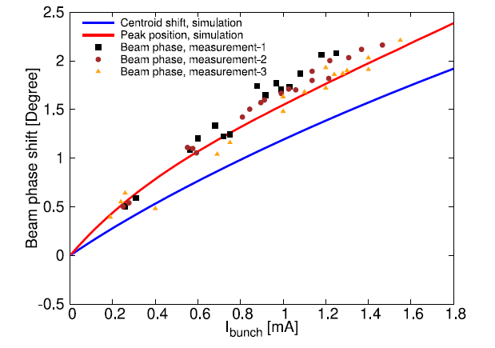
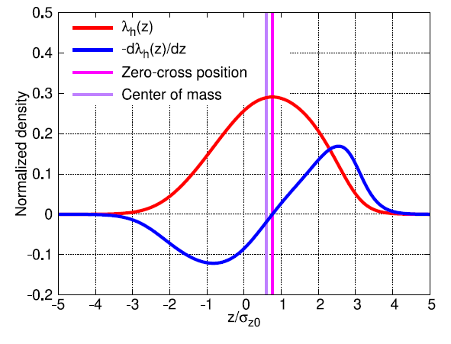
Applications to real machines
SuperKEKB discrepancy
$z_{p}$ matched well with simulation and measurement($Re\left(Z\right)$ is good.)
Streak camera error?
Missing inductive impedance?
Find alternative methods to measure bunch length
[1] T. Ishibashi, Impedance modelling and single-bunch collective instability simulations for the SuperKEKB main rings
23

Slide 24
Conclusion
Using the Haïssinski equation a self-consistent stationary solution of the Vlasov–Fokker–Planck equation, we can derive analytical expressions for intensity-dependent beam observables such as centroid shift, bunch lengthening, and equivalent impedance.
The study emphasizes the importance of matching beam-based measurements with impedance calculations, highlighting the practical use of the derived formulas for interpreting experimental data.In particular, streak camera and BPM measurements can provide useful information for evaluating loss factors and extracting equivalent or frequency-dependent impedances.
This approach enables more reliable comparisons between simulations and measurements and may help identify missing impedance sources in storage ring models.
24

Slide 25
Thank you for your attention!
25

Slide 26
Appendix Bunch lengthening
Bunch lengthening
$$×z and \int_{−∞}^{∞}{ }dz$$
$$\frac{dλ\left(z\right)}{dz}+\frac{1}{σ_{z0}^{2}}\left[z−Iσ_{z0}𝒲\left(z\right)\right]λ\left(z\right)=0$$
$$\int_{−∞}^{∞}{ }\left(z\frac{dλ\left(z\right)}{dz}+\frac{z^{2}}{σ_{z0}^{2}}λ\left(z\right)−\frac{I}{σ_{z0}}𝒲\left(z\right)zλ\left(z\right)\right)dz$$
$$\left(1\right)→\int_{−∞}^{∞}{z\frac{dλ\left(z\right)}{dz}dz}=\int_{−∞}^{∞}{\left\{\frac{d}{dz}\left(zλ\left(z\right)\right)−λ\left(z\right)\right\}dz}→−1$$
$$\left(2\right)→\int_{−∞}^{∞}{\frac{z^{2}}{σ_{z0}^{2}}λ\left(z\right)dz}=\int_{−∞}^{∞}{\left[\left(\frac{z^{2}−z_{c}^{2}}{σ_{z0}^{2}}\right)+\left(\frac{z_{c}^{2}}{σ_{z0}^{2}}\right)\right]λ\left(z\right)dz}=→\frac{σ_{z}^{2}}{σ_{z0}^{2}}+\left(\frac{z_{c}^{2}}{σ_{z0}^{2}}\right)$$
$$\left(3\right)→Iσ_{z0}\int_{−∞}^{∞}{z𝒲\left(z\right)λ\left(z\right)dz}=\frac{I}{σ_{z0}}\left\{\int_{−∞}^{∞}{\left(z−z_{c}\right)𝒲\left(z\right)λ\left(z\right)dz}+z_{c}\int_{−∞}^{∞}{𝒲\left(z\right)λ\left(z\right)dz}\right\}=\frac{I}{σ_{z0}}\int_{−∞}^{∞}{\left(z−z_{c}\right)𝒲\left(z\right)λ\left(z\right)dz}+\frac{z_{c}^{2}}{σ_{z0}^{2}}$$
$$∴\frac{σ_{z}^{2}}{σ_{z0}^{2}}−1−\frac{cI}{2πσ_{z0}}Z_{∥}^{eq}=0, Z_{∥}^{eq}=\frac{2π}{c}\int_{−∞}^{∞}{dz\left(z−z_{c}\right)λ\left(z\right)𝒲\left(z\right)}=\frac{2π}{c}\int_{−∞}^{∞}{dz\left(z−z_{c}\right)λ\left(z\right)𝒲\left(z\right)}$$
$$→Z_{∥}^{eq}=\int_{−∞}^{∞}{dz𝒲\left(z\right)zλ\left(z\right)}−z_{c}\int_{−∞}^{∞}{dz𝒲\left(z\right)λ\left(z\right)}=−z_{c}\int_{−∞}^{∞}{dkZ\left(k\right)\tilde{λ}\left(k\right){\tilde{λ}}^{∗}\left(k\right)}−i\int_{−∞}^{∞}{dkZ\left(k\right)\tilde{λ}\left(k\right)\frac{d}{dk}\left({\tilde{λ}}^{∗}\left(k\right)\right)}=−\int_{−∞}^{∞}{dkZ\left(k\right)\tilde{λ}\left(k\right)\left(i\frac{d}{dk}\left({\tilde{λ}}^{∗}\left(k\right)\right)+z_{c}{\tilde{λ}}^{∗}\left(k\right)\right)}$$
$$\tilde{λ}\left(k\right)\left(i\frac{d}{dk}\left({\tilde{λ}}^{∗}\left(k\right)\right)+z_{c}{\tilde{λ}}^{∗}\left(k\right)\right)=\tilde{λ}\left(k\right)e^{−ikz_{c}}\left(i\frac{d}{dk}\left({\tilde{λ}}^{∗}\left(k\right)\right)e^{ikz_{c}}+z_{c}{\tilde{λ}}^{∗}\left(k\right)e^{ikz_{c}}\right)=i\tilde{λ}\left(k\right)e^{−ikz_{c}}\frac{d}{dk}\left({\tilde{λ}}^{∗}\left(k\right)e^{ikz_{c}}\right)$$
$$→Z_{∥}^{eq}=−i\int_{−∞}^{∞}{dkZ\left(k\right)\left(\tilde{λ}\left(k\right)e^{−ikz_{c}}\right)\frac{d}{dk}{\left(\tilde{λ}\left(k\right)e^{−ikz_{c}}\right)}^{∗}}$$
26

