Slide 1
Limitations and solutions of beam size measurements via interferometry at ALBA
May. 02, 2025
Woojin Song

Slide 2
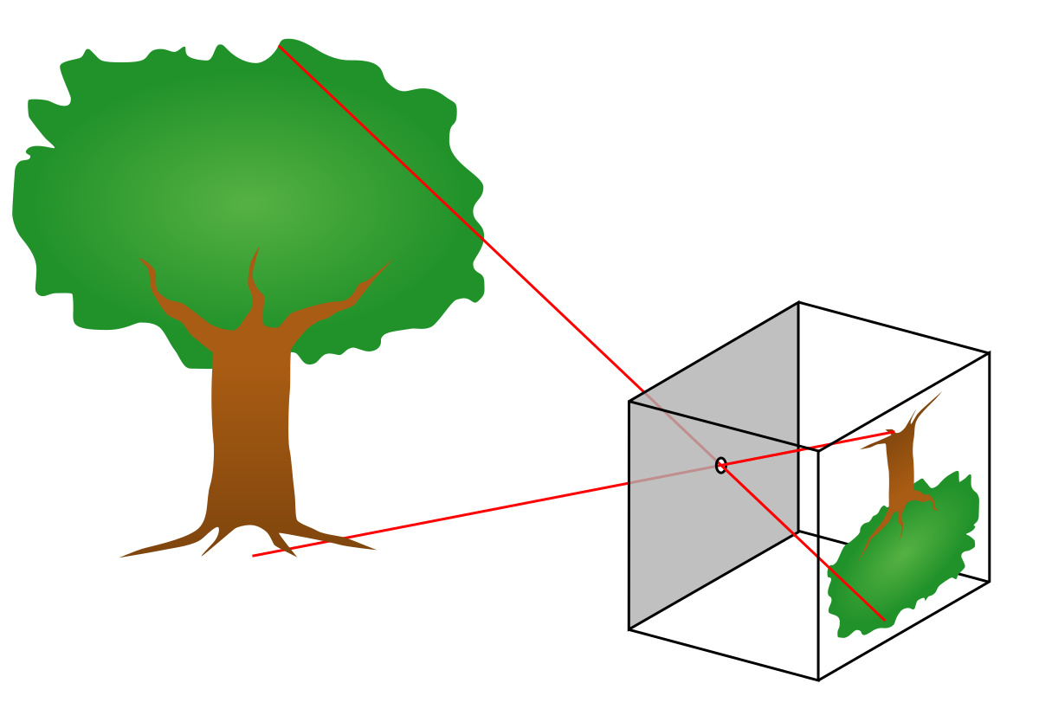
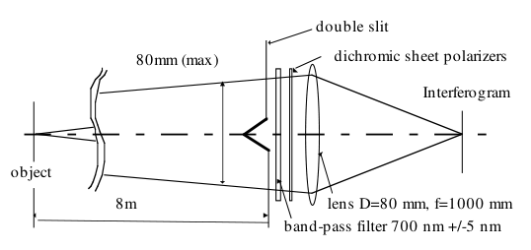
Interferometer
Toshiyuki Mitsuhashi (1997)
A beam size measurement method that replaces conventional X-ray pinhole measurements.
→ Synchrotron Radiation (SR) InterFerometer (IF)
Determine the spatial coherence of visible light synchrotron radiation using the Citterrut-Zernike theorem.
→ Fourier transform the profile of the beam in spatial dimension. → Visibility
Basic structure of interferometer
Pinhole camera

Slide 3
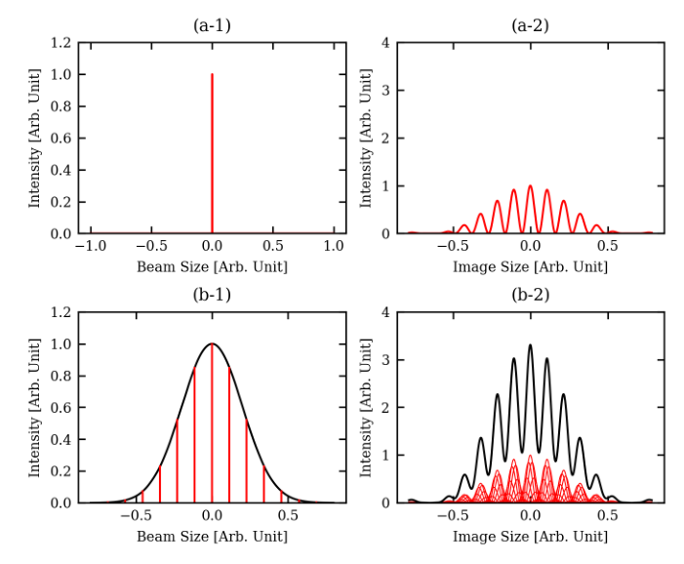
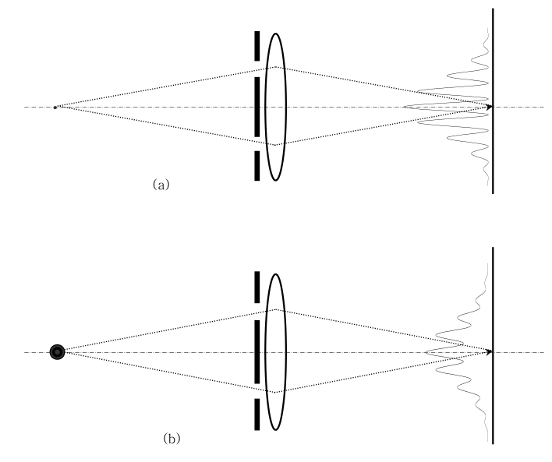
Interferometer

Slide 4
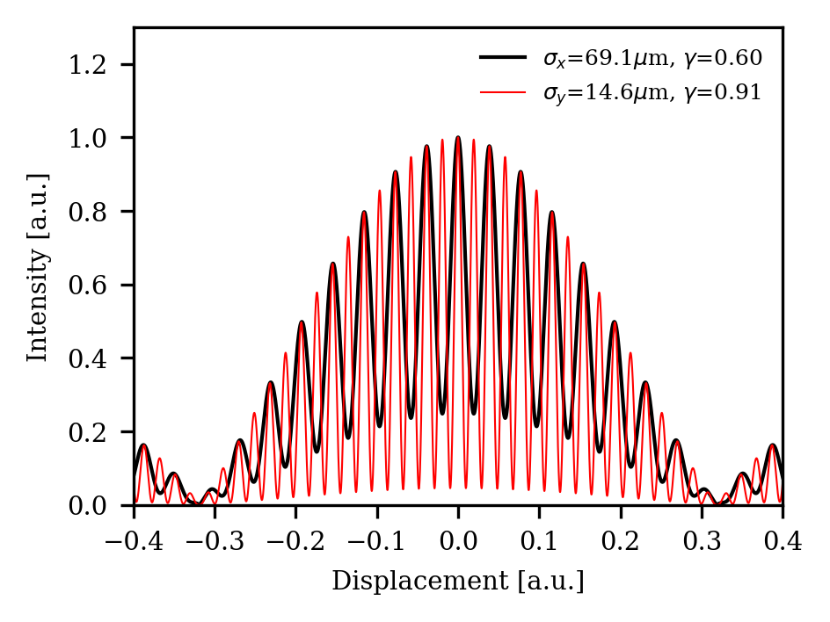
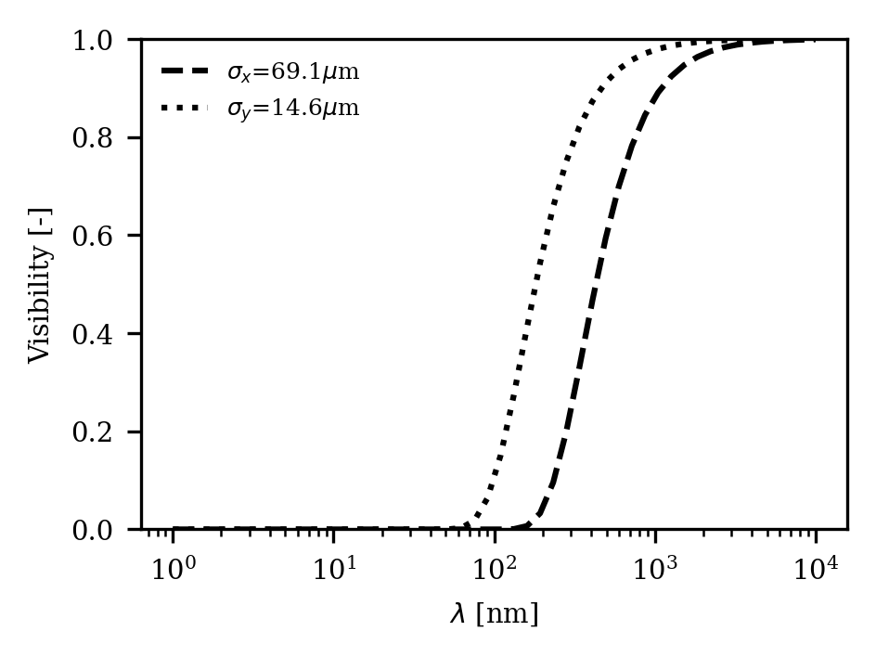
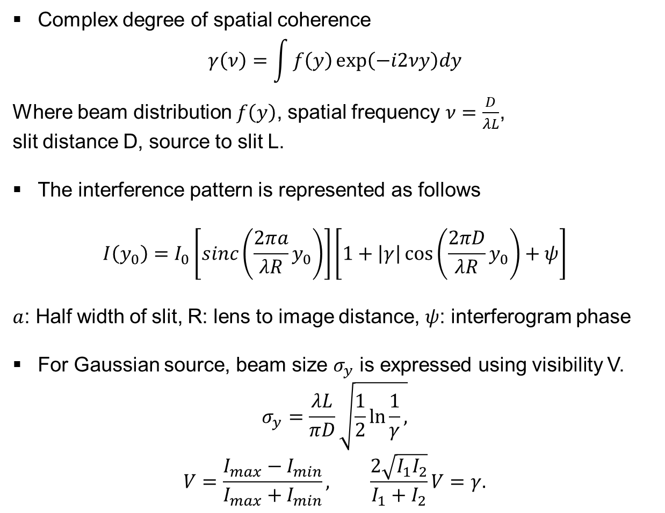
Interferometer
Complex degree of spatial coherence
$$γ\left(ν\right)=\int{f\left(y\right)\exp\left(−i2νy\right)dy}$$
Where beam distribution $f\left(y\right)$, spatial frequency $ν=\frac{D}{λL}$,
slit distance D, source to slit L.
The interference pattern is represented as follows
$$I\left(y_{0}\right)=I_{0}\left[sinc\left(\frac{2πa}{λR}y_{0}\right)\right]\left[1+\left|γ\right|\cos\left(\frac{2πD}{λR}y_{0}\right)+ψ\right]$$
$a$: Half width of slit, R: lens to image distance, $ψ$: interferogram phase
For Gaussian source, beam size $σ_{y}$ is expressed using visibility V.
$$σ_{y}=\frac{λL}{πD}\sqrt{\frac{1}{2}\ln{\frac{1}{γ}},}$$
$$V=\frac{I_{max}−I_{min}}{I_{max}+I_{min}}, \frac{2\sqrt{I_{1}I_{2}}}{I_{1}+I_{2}}V=γ.$$
Contrast

Slide 5
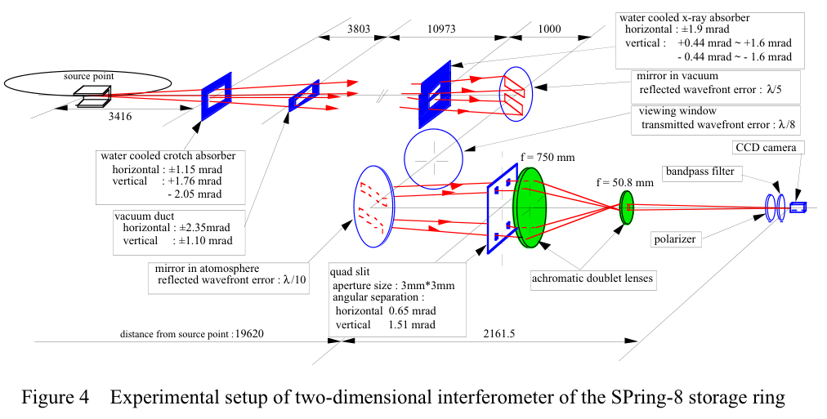
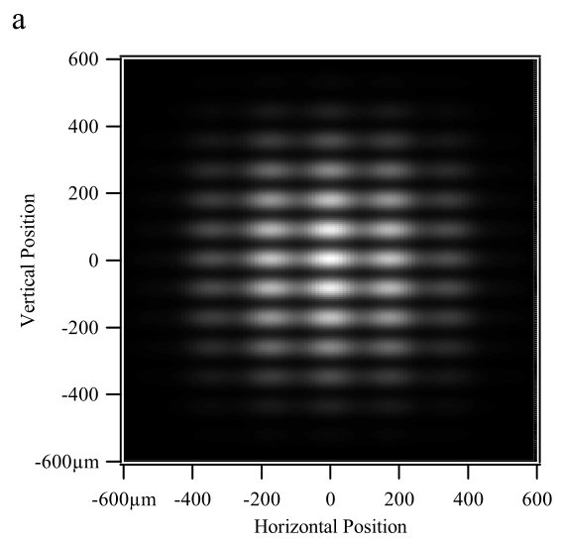
2-Dimensional Interferometer

Slide 6
Measurement Error
Advancing of Interferometer
Improvements to Reduce Measurement Error (or Measure Smaller Beams)
Causes of measurement error
Error caused by a distorted wavefront in the optics (Mirror, view port, Lens...).
Phase difference created by intensity imbalance caused by diffraction.
Mechanical vibration or beam vibration.
Errors caused by the readout device (camera - resolution, ADC bit depth) and errors in the image processing.

Slide 7
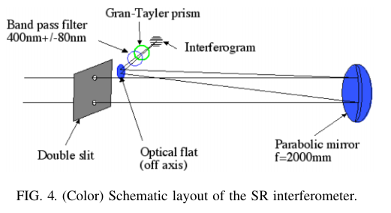
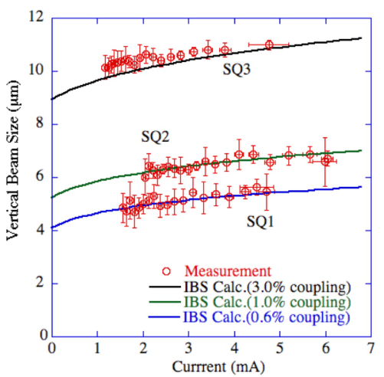
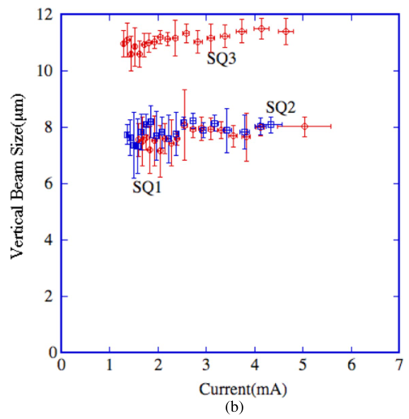
Measurement Error
1. Error caused by a distorted wavefront in the optics (Mirror, view port, Lens...)
- T. Naito and T. Mitsuhashi, 2006
Errors due to objective lens dispersion.
Reduced visibility in Lambda/5 phase errors → Beam size overestimated
Herschelian optics → Method of sending light off-axis using only mirrors, no center blocking.
Reflective optics
Refractive optics

Slide 8
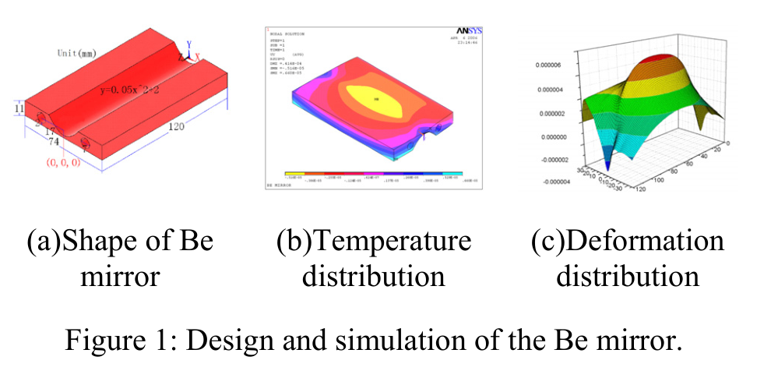
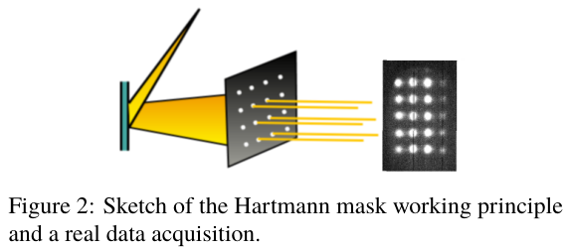
Measurement Error
1. Error caused by a distorted wavefront in the optics (Mirror, view port, Lens...)
- J. Chen, K. R. Ye and Y. B. Leng, 2012
Mirror (Be) surface thermally deformed by high power x-rays.
→ Affects interferometer measurement accuracy.
Center reaches approx. 65 °C, deformed up to 8 um.
Shack-Hartmann sensors are used to precisely measure the deformation of the mirror and correct the beam size measurement based on it.

Slide 9
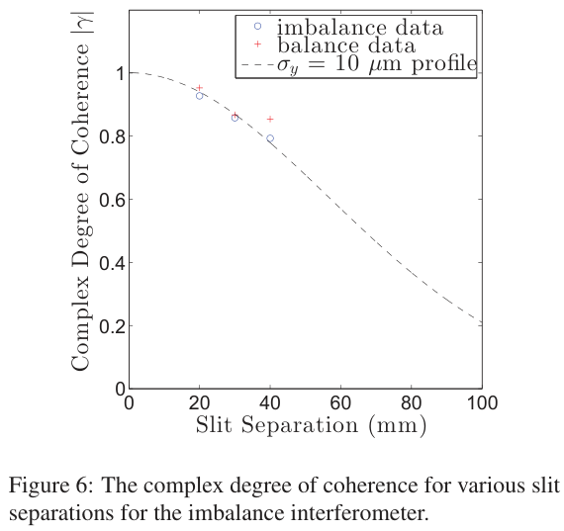
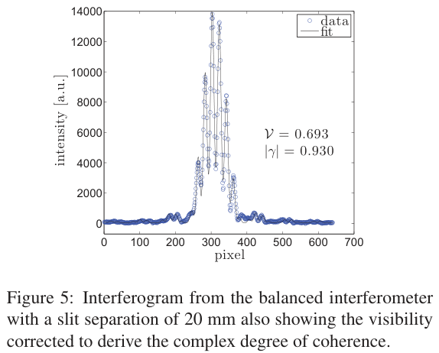
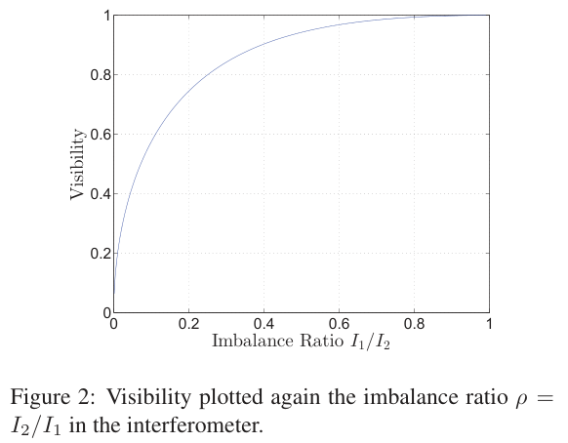

Measurement Error
$$\frac{2\sqrt{I_{1}I_{2}}}{I_{1}+I_{2}}V=γ.$$
2. Phase difference created by intensity imbalance caused by diffraction.
- M. J. Boland et al, 2012
Difference in beam intensity from both slits creates error.
This can be caused by alignment or surface imperfections.
The resulting error changes visibility.
→ Beam size measurement error ~10% or more
Use ND filters on each slit to compensate for intensity.

Slide 10
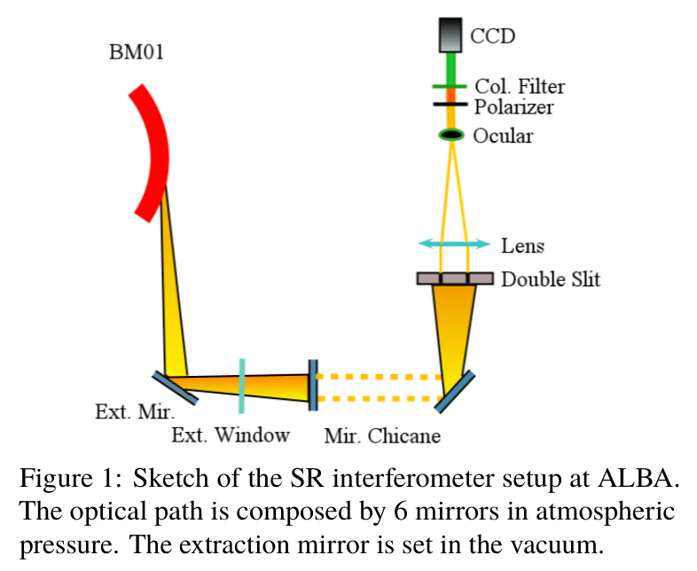
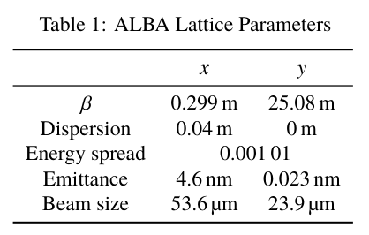
Introduction
ALBA storage ring also introduced a double-slit interferometer to measure the size of the electron beam and cross-check it with an X-ray pinhole camera.
Limitation
Interferometer was already applied in 2013, but the measurement precision was not sufficient due to several major limiting factors.
Synchrotron radiation from banding magnets
→ Passes through photon shutter, extraction mirror, vacuum window and 7 out-vacuum mirror.

Slide 11
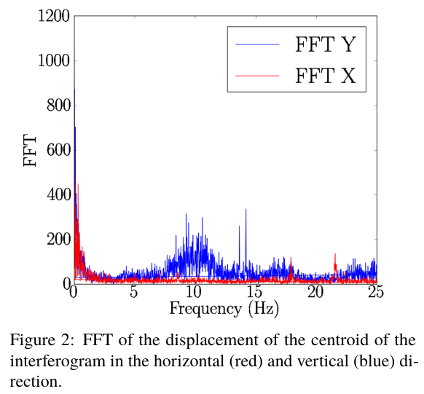
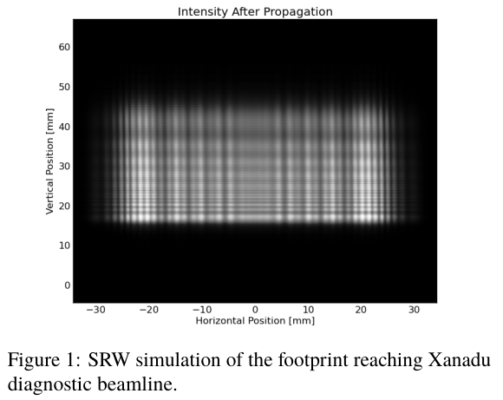
Main Limitations
Diffraction
SR passes through the optics and is partially cut off, resulting in a diffraction pattern. → Reduces visibility
Use double pinhole structure instead of double slit to pick only a small area inside the diffraction area.
→ Minimizes error due to diffraction pattern.
Vibration
Optics are sensitive to air flow, mechanical vibration, etc.
Longer exposure time results in less visibility and larger beam.
→ Minimize exposure time + image matching algorithm
(light intensity compensation)

Slide 12
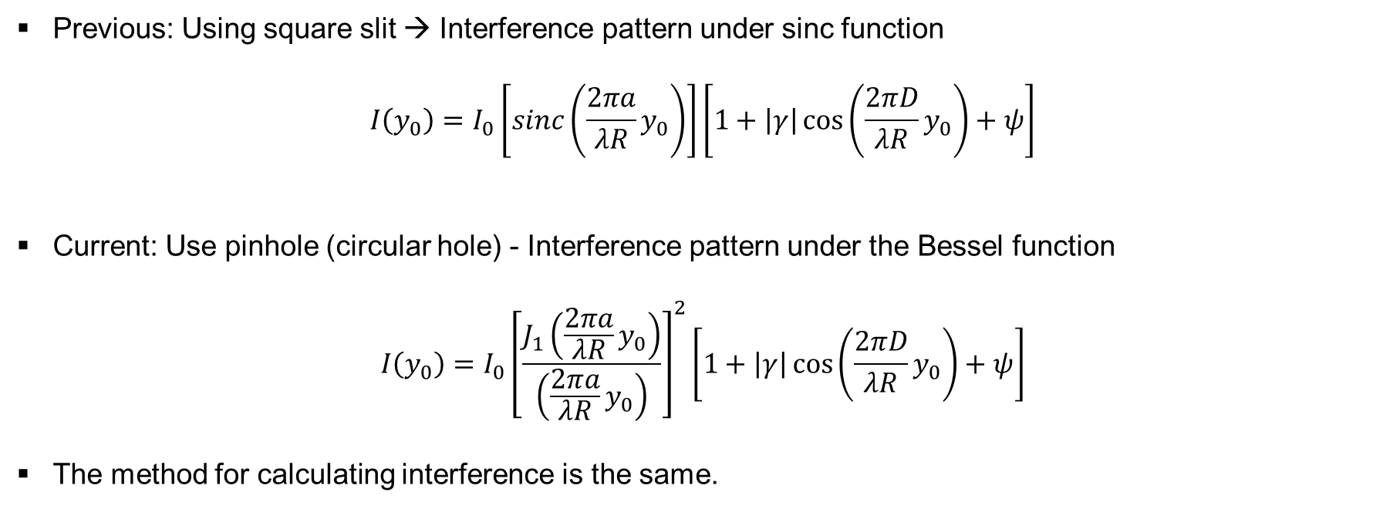
Interferometry Using Pinholes
Previous: Using square slit → Interference pattern under sinc function
$$I\left(y_{0}\right)=I_{0}\left[sinc\left(\frac{2πa}{λR}y_{0}\right)\right]\left[1+\left|γ\right|\cos\left(\frac{2πD}{λR}y_{0}\right)+ψ\right]$$
Current: Use pinhole (circular hole) - Interference pattern under the Bessel function
$$I\left(y_{0}\right)=I_{0}{\left[\frac{J_{1}\left(\frac{2πa}{λR}y_{0}\right)}{\left(\frac{2πa}{λR}y_{0}\right)}\right]}^{2}\left[1+\left|γ\right|\cos\left(\frac{2πD}{λR}y_{0}\right)+ψ\right]$$
The method for calculating interference is the same.

Slide 13
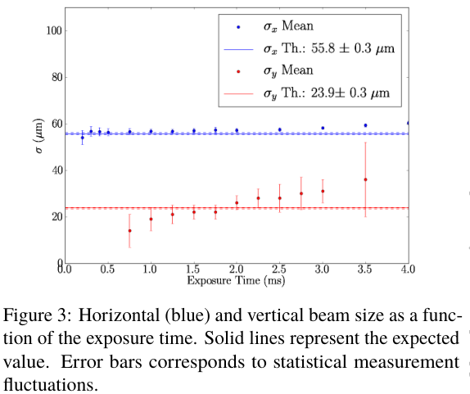
CCD Exposure Time
The effects of vibrations in the beamline are suppressed by shortening the camera exposure time.
However, if the exposure time is too short, there is not enough intensity, resulting in a worse signal-to-noise ratio.
Longer exposure times lead to overestimation of beam size due to pattern overlap caused by vibration.
Stable measurement results are seen around 1.5 ms.

Slide 14
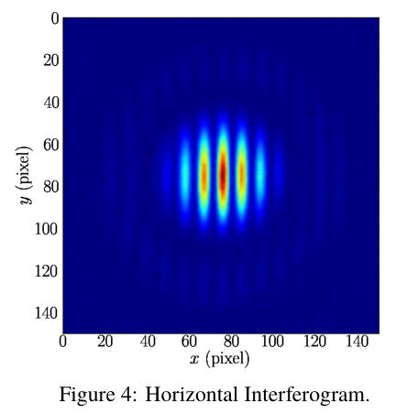
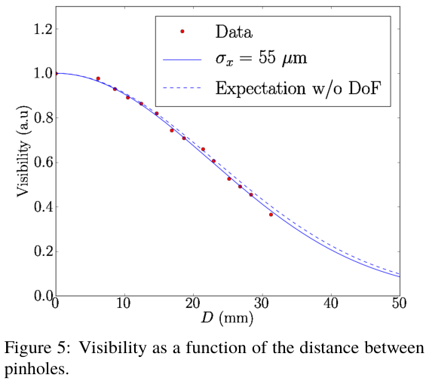
Horizontal Beam Size Measure
Measure horizontal beam size with varying pinhole interval.
Depth of field
Bending magnet curvature causes difference in position and angle of source point.
This causes blurring, so the beam size measurement result is shown including DoF.

Slide 15
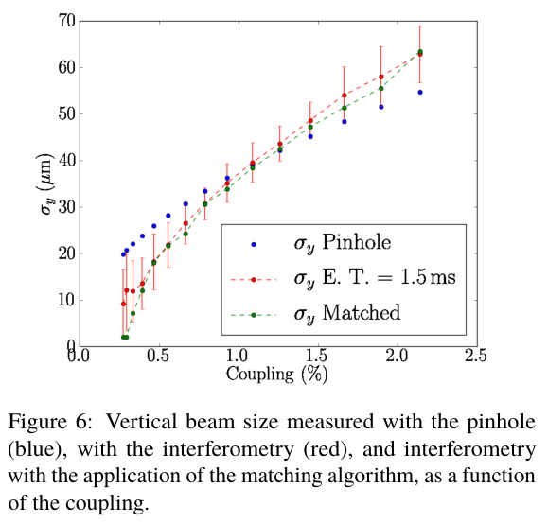
Vertical Beam Size Measure
Skew quadrupole adjustment to measure beam size with different couplings.
When the beam size is small, the interferometer measures a smaller beam compared to a pinhole camera.

Slide 16
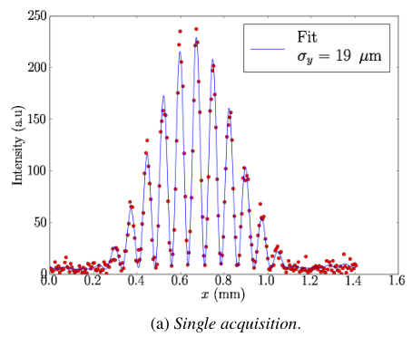
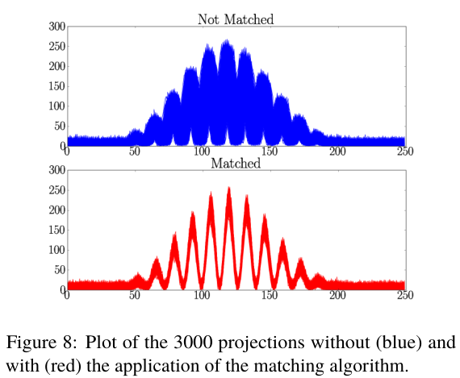
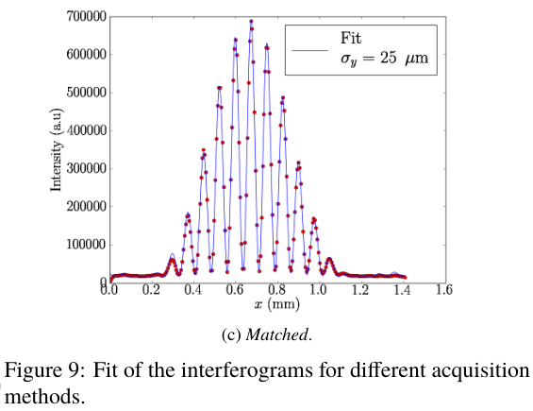
Matching Algorithm
Frame-by-frame centroid alignment and compositing of an interferogram acquired with a 100 us exposure time.
Shows significant suppression of vibration-induced effects.

Slide 17
Conclusion
The ALBA Xanadu beamline introduces dual pinholes, exposure time optimization, and high-speed image matching algorithms to overcome existing diffraction, wavefront distortion, and mechanical vibration problems.
Horizontal beam size (50 μm) measurements are now comparable to X-ray pinhole measurements, resulting in high reliability.
Vertical beam size measurement by changing the coupling.
Image matching algorithm uses very low exposure times to suppress vibration effects.

