Slide 1
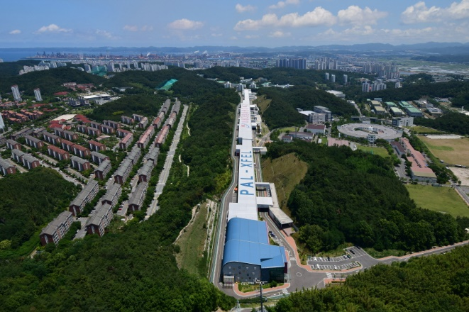
2025 KPS Spring Meeting
Robinson Instability in Active Harmonic Cavities in Korea-4GSR
Youngmin Park, Moses Chung
Division of Advanced Nuclear Engineering, POSTECH
Jimin Seok, Jaeyu Lee, Jaehyun Kim, Gyeong Su Jang
Pohang Accelerator Laboratory, POSTECH
Apr.24.2025

Slide 2
2025 KPS Spring Meeting
Index
Introduction
Basic longitudinal dynamics
Generated power
Robinson Instability
Analysis and Simulation
Summary and Future work

Slide 3
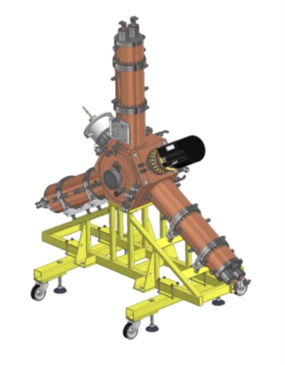
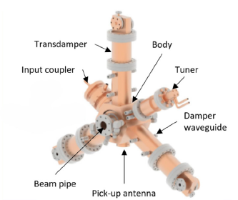
2025 KPS Spring Meeting
Korea-4GSR with higher harmonic cavity
Parameter | w/o HHC | w/HHC
Circumference (m) | $$799.297$$
Momentum compaction factor | $$7.73624⋅{10}^{−5}$$
Energy (GeV) | $$4$$
Energy spread (%) | $0.1038, 0.0886$(9ID,24ID)
Main RF voltage (MV) | $3.52, 4.24$ (9ID,24ID)
Radiation loss (MeV) | $1.449, 2.035$ (9ID,24ID)
Current (mA) | $$400$$
Harmonic number | $$1332$$
Main cavity quality factor | 29909
Main cavity $R_{s}/Q\left(Ω\right)$ | 113.68
HHC quality factor | X | 14000
HHC $R_{s}/Q\left(Ω\right)$ | X | 86
Life time (h) | 7.3, 5.82 (9IDs,24IDs) | 33.0, 29.4 (9IDs, 24IDs)
Bunch length $\left(ps\right)$ | 9.3, 7.5 (9IDs,24IDs) | 42.2, 37.7 (9IDs, 24IDs)
Radiation damping time x/y/z $\left(ms\right)$ | 8.98/14.72/10.81 (9 IDs) 7.21/10.48/6.78 (24 IDs)
EU-type 500-MHz HOM damped cavity
ALBA-type 1.5-GHz HOM damped cavity
Increases Touschek lifetime
Reduces effects of high frequency impedance
Landau damping to mitigate instabilities
Generated power of Active cavity
Robinson Instability

Slide 4
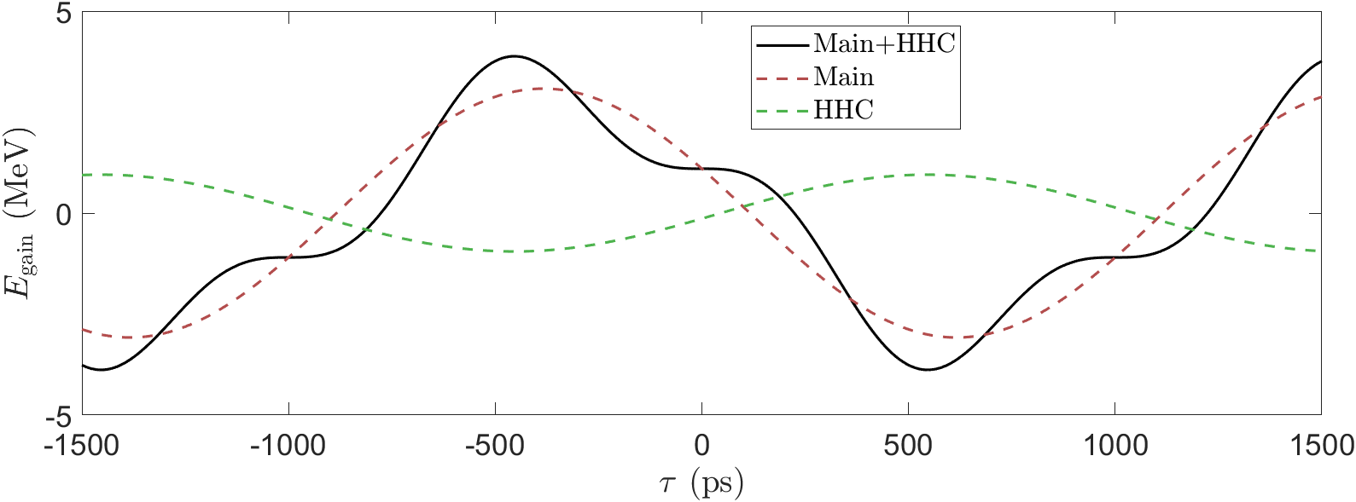
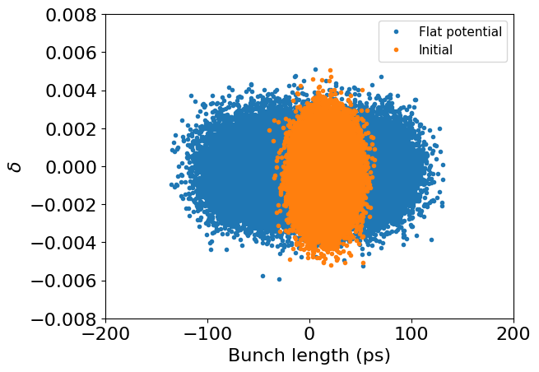
2025 KPS Spring Meeting
Basic longitudinal dynamics
HHC system:
$$V\left(τ\right)=V_{main}\sin\left(ω_{rf}τ+φ_{main}\right)+V_{HHC}\sin\left(mω_{rf}τ+φ_{HHC}\right)$$
$$V_{main,HHC} :Voltage of main\&HHC cavity, ω_{rf}:rf−frequency, τ:bunch−arrival time, φ_{main,HHC} :phase of main\&HHC cavity$$
HHC $→$ Reduce RF voltage gradient
Flat potential condition:
$$V\left(0\right)=\frac{U_{0}}{e}, V^{′}\left(0\right)=0, V^{′′}\left(0\right)=0 ⇒ \sin{φ_{1}}=\frac{m^{2}}{m^{2}−1}\frac{U_{0}}{eV_{1}}, \tan{φ_{2}}=\frac{\tan{φ_{1}}}{m}, V_{2}=\frac{V_{1}\sin{φ_{1}}}{m^{2}\sin{φ_{2}}}$$
4 times bunch lengthening with 3rd harmonic cavity

Slide 5
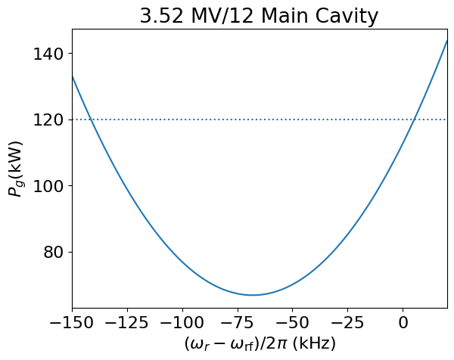
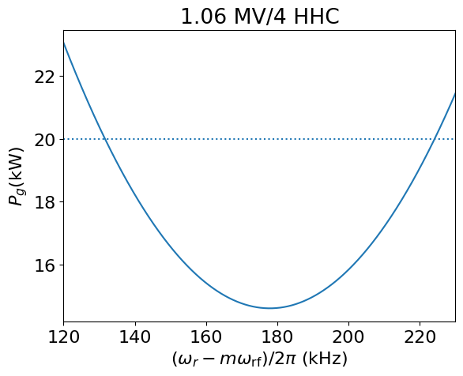
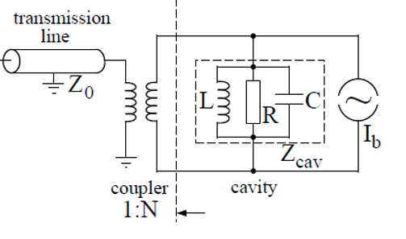
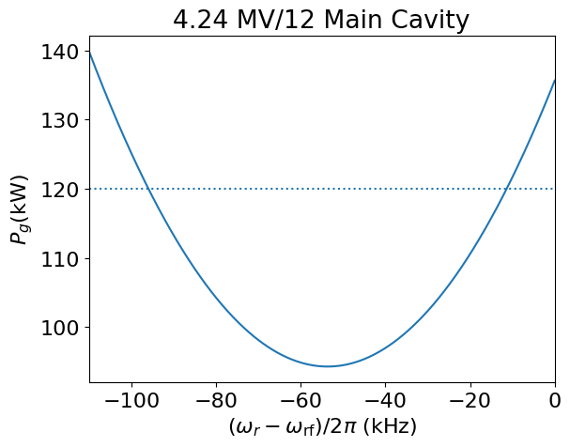
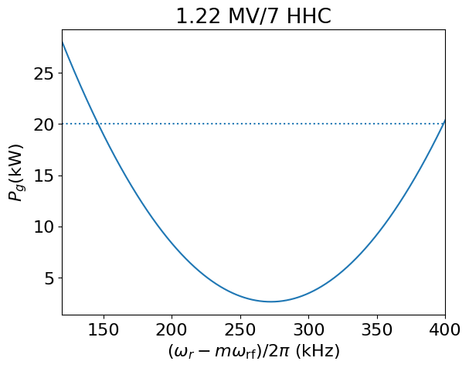
2025 KPS Spring Meeting
Generated power
$$9 IDs$$
$$Im$$
$$V_{cav}$$
$$\frac{2R_{s}FI_{0}}{\left(1+β\right)}$$
$$ψ$$
$$Re$$
Feasible operation
Feasible operation
$$ψ$$
$$V_{g}$$
$$V_{b}$$
$$φ_{s}$$
$$V_{b}$$
$$V_{cav}$$
$$\frac{2βV_{for}}{β+1}$$
Optimal tuning
$$V_{g}$$
$$24 IDs$$
In an active harmonic cavity $→$consider both generator voltage & beam induced voltage.
The required generator power $P_{g}$ varies with tuning angle $ψ$
$ψ$ is determined by the detuning between the cavity resonant frequency ($ω_{1}$) and rf frequency ($ω_{rf}$)
$$\tan{ψ}=\frac{2Q_{0}}{1+β}⋅\left(\frac{ω_{r}−ω_{rf}}{ω_{rf}}\right)⇒\frac{2R_{s}FI_{0}}{\left(1+β\right)V_{cav}}\cos{φ_{s}}$$
$$R_{s} :Shunt impedance per one cavity, β:coupling factor, F:bunch form factor, φ_{s} :cavity phase, Q:quality factor$$
Main cav $→ψ<0$, HHC cav $→ψ>0$
Feasible operation
Optimum condition
Feasible operation
Optimal tuning

Slide 6
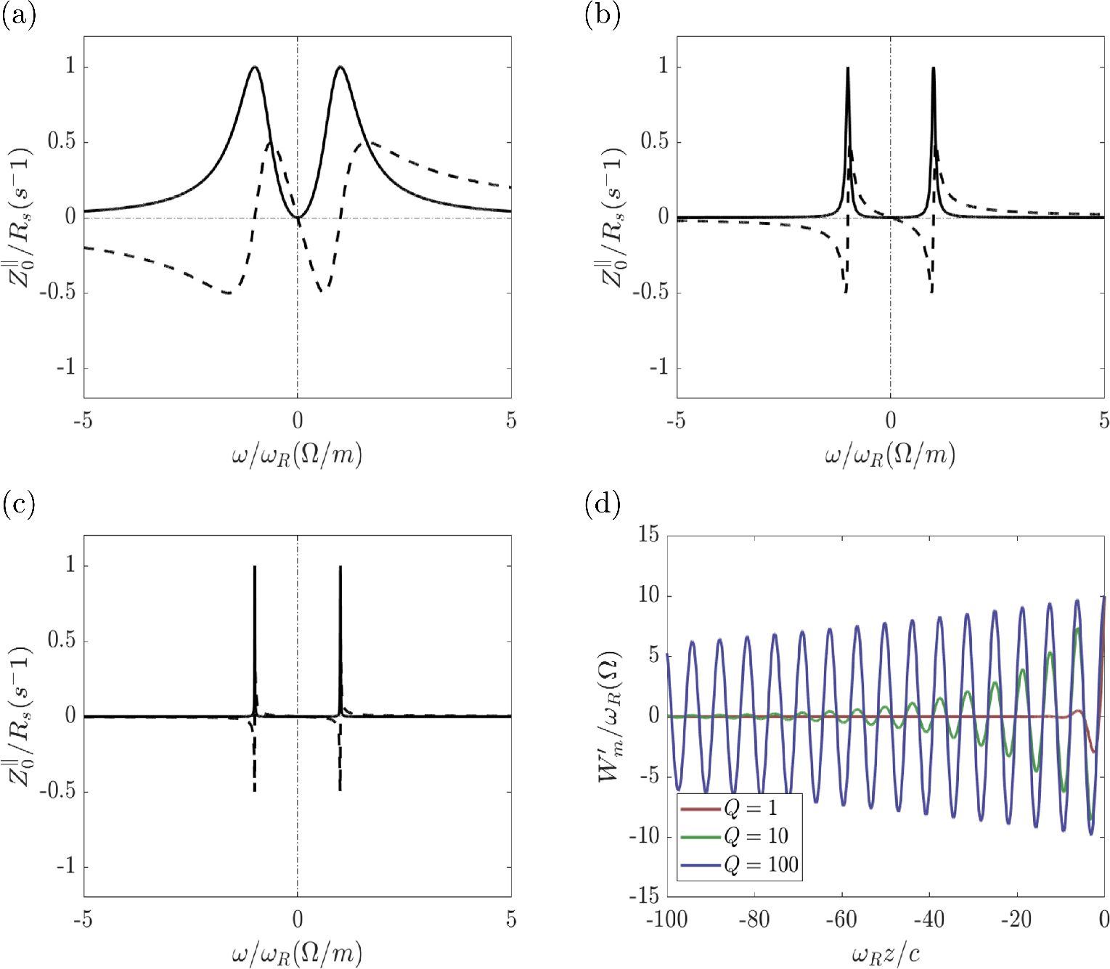
2025 KPS Spring Meeting
Wakefield in cavity
$$Q=1$$
$$Q=10$$
A charged particle passing through a cavity-like structure generates a wake field, which affects the trailing particles.
Cavity impedance expression:
$$Z^{∥}\left(ω\right)=\frac{R_{s}}{1+iQ\left(\frac{ω_{r}}{ω}−\frac{ω}{ω_{r}}\right)}$$
Narrow impedance → long-range wake field → occurs multi-bunch instability
$$\frac{d^{2}z_{n}}{dt^{2}}+ω_{s}z_{n}=\frac{Ne^{2}αc}{E_{0}T_{0}}\sum_{k=−∞}^{n}{\int_{z}^{∞}{dz_{k}^{′}ρ\left(z_{k}^{′}\right)W_{0}′(kC−nC+z_{n}−z_{k}^{′})}}$$
In the above transition, $ψ>0$ leads to beam instability, known as Robinson instability.
$$Q=100$$

Slide 7
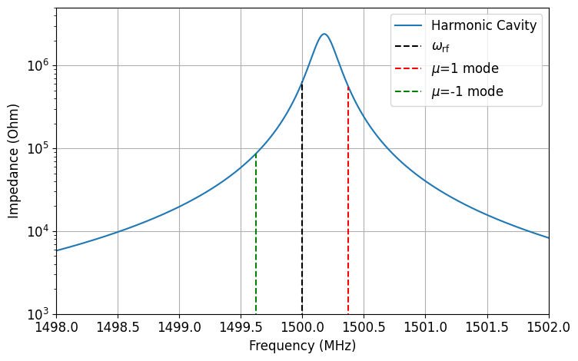
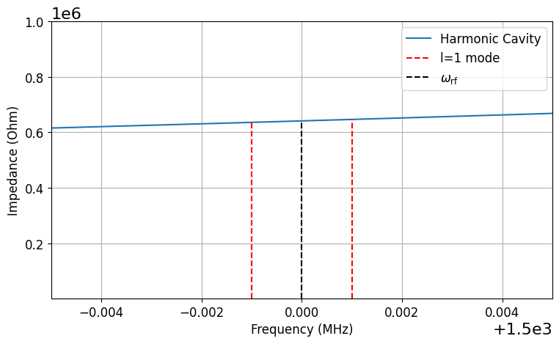
2025 KPS Spring Meeting
Robinson Instability in HHC
AC Robinson
$$τ$$
$$…$$
$$μ=0$$
Multiple bunches oscillate with phase difference as $\frac{2πμ}{h}$
Impedance at $ω_{rf}+μω_{0}$ affects $μ$^{th} mode oscillation amplitude
$ω_{0}≈ω_{r}−ω_{rf}$ cause strong $μ=1$ coupled bunch instability
$$μ=1$$
$$…$$
$$ω_{0}$$
$$μ=2$$
$$…$$
Bunch index
DC Robinson
$$δ$$
$$l=1$$
Synchrotron oscillation described by longitudinal mode index $l$
Impedance shifts the frequencies of synchrotron modes
Coupling between each modes causes rapid growth of instability
$$l=2$$
$$ω_{s}$$
$$l=3$$
$$τ$$

Slide 8
2025 KPS Spring Meeting
Bosch model
$${\left(Ω^{\left(l,μ\right)}−iα_{R}^{\left(l,μ\right)}\right)}^{2}−{\left(lω_{s}\right)}^{2}=i\frac{αeω_{0}^{2}I}{πE}⋅\frac{l{\left(ω_{0}σ_{τ}\right)}^{2l−2}}{2^{l}\left(l−1\right)!}⋅\sum_{n=±1,3}{{\left(nh+μ\right)}^{2μ−1}{F_{nM+μ}}^{2}Z\left(nhω_{0}+μω_{0}+Ω\right)}$$
Determine $I_{0}$
[1]
Set $φ_{main}, φ_{HHC},V_{HHC}$
$Ω^{\left(l,μ\right)}$: Mode frequency of the beam oscillation
$α_{R}^{\left(l,μ\right)}$: Damping rate
$α_{R}>0$: stable(damping)
$α_{R}<0$: Unstable (growth)
Zero frequency instability occurs when beam-induced voltage > restoring force. (Equilibrium phase instability, Static Robinson instability)
$$ω_{s}^{2}<\frac{αeIω_{g}}{ET_{0}}⋅\frac{{\left(ω_{g}σ_{t}\right)}^{2l−2}}{2^{l−1}l!}\left[R_{1}F_{ω_{rf}}^{2}\sin{2ψ_{Main}}+m^{2μ_{0}−1}R_{HHC}F_{mω_{rf}}^{2}\sin{2ψ_{HHC}}\right]$$
$Ω^{\left(1,0\right)}≈Ω^{\left(2,0\right)}⇒$ Dipole-quadrupole mode coupling
$\left|α_{R}^{\left(0,μ\right)}\right|>τ_{z}^{−1}⇒μ$^{th} coupled bunch instability
Compute $σ_{τ}$
Determine feasible detuning range
Zero frequency instability
Check DC Robinson instability and mode coupling
Check $μ=1$ coupled bunch instability
[1] R. A. Bosch et al., “Robinson instabilities with a higher harmonic cavity”, PRAB, (2001)

Slide 9
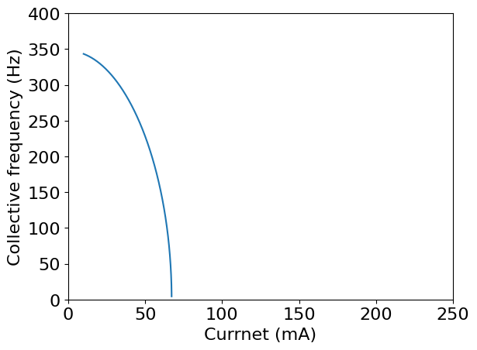
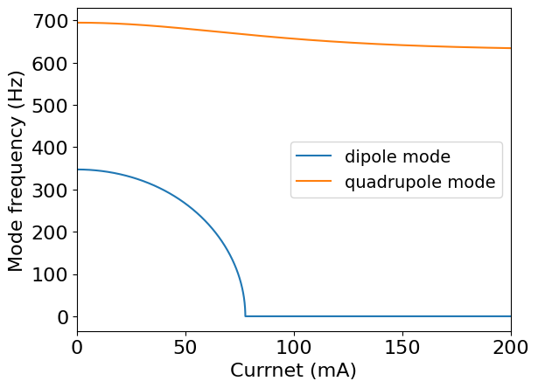
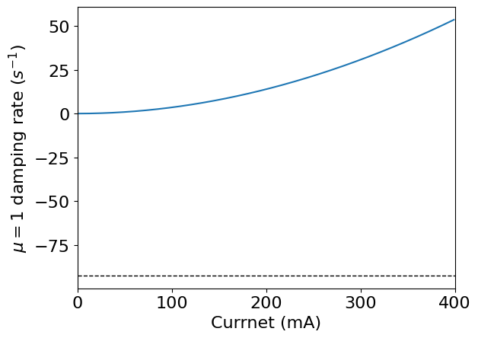
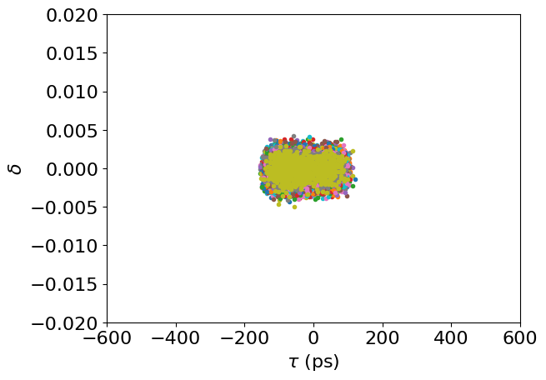
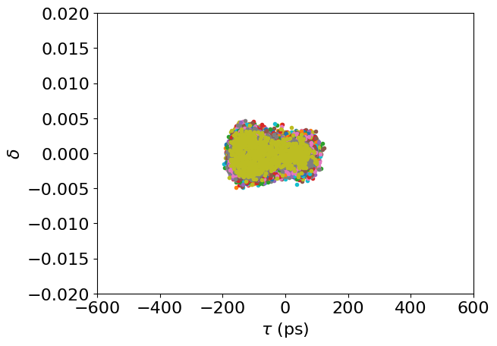
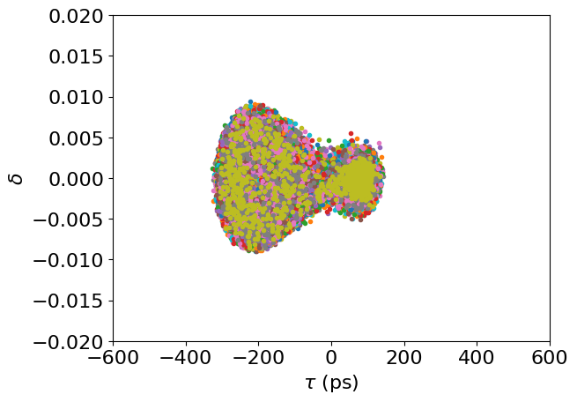
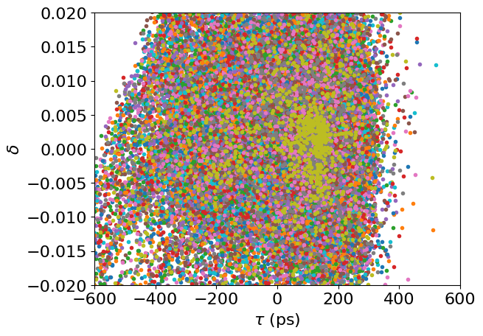
2025 KPS Spring Meeting
Bosch analysis compared with Simulation
9 IDs, 1 HHC, Optimal tuning / Change currents
Zero freq.
Mode coupling
Coupled bunch.
Beam loss occurs
$$τ_{z}^{−1}=92.5 s^{−1}$$
50 mA
70 mA
120 mA
160 mA
No stable fixed point at $τ=0$ (double-hump-like distribution)
Distance between two islands increases → beam loss occurs
Simulation with 1000 macroparticles/ 10000 Turns

Slide 10
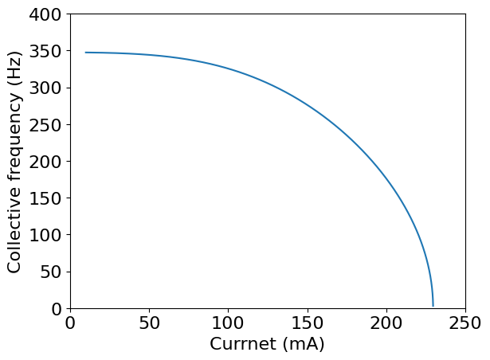
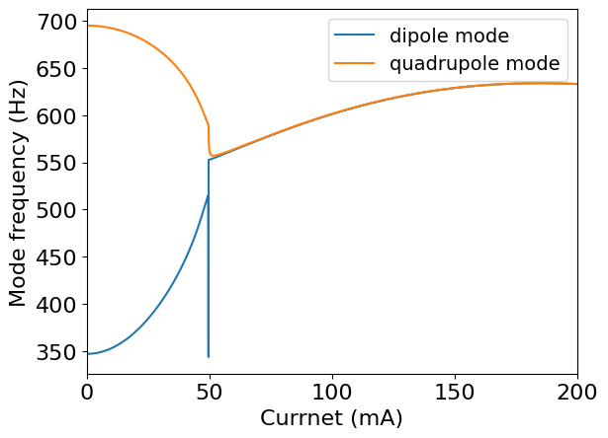
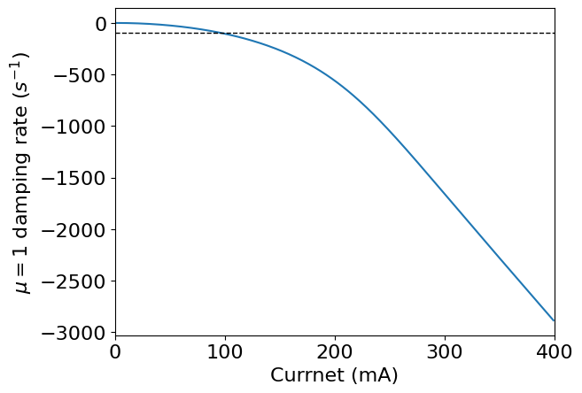
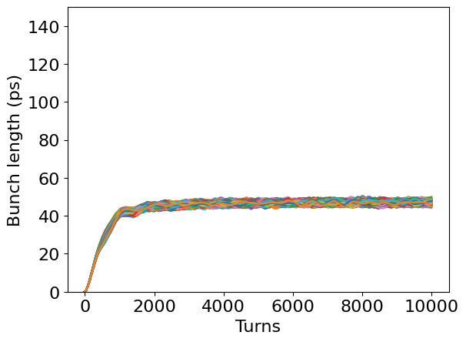
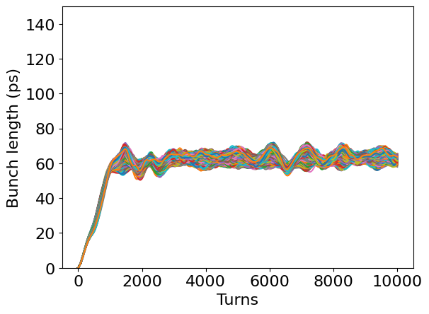
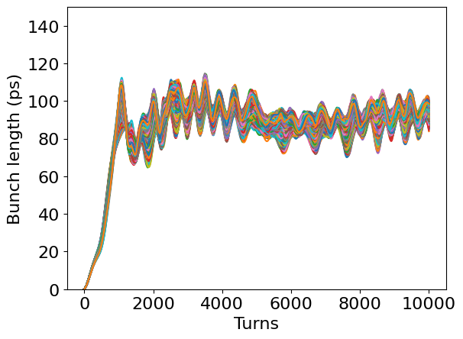
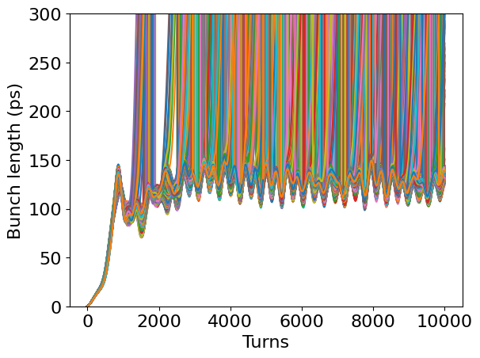
2025 KPS Spring Meeting
Bosch analysis compared with Simulation
9 IDs, 4 HHC, Optimal tuning / Change currents
Zero freq.
Mode coupling
Coupled bunch.
$$τ_{z}^{−1}=92.5 s^{−1}$$
Beam loss occurs
30 mA
50 mA
70 mA
90 mA
Mode coupling induces oscillation of bunch length
Oscillation amplitude grows → beam loss occurs
Simulation with 1000 macroparticles/ 10000 Turns

Slide 11
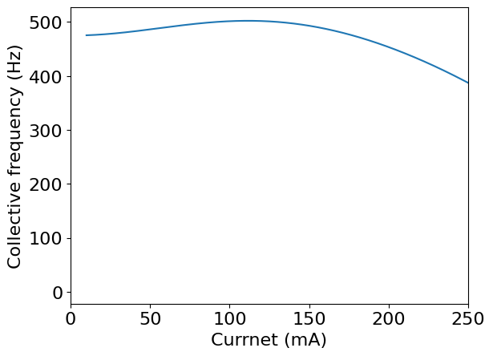
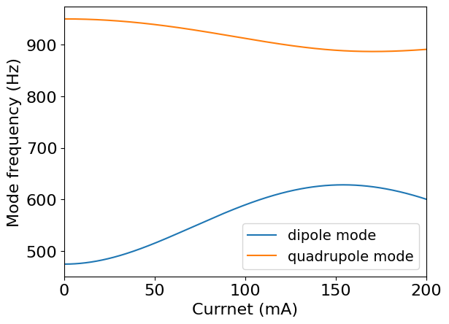
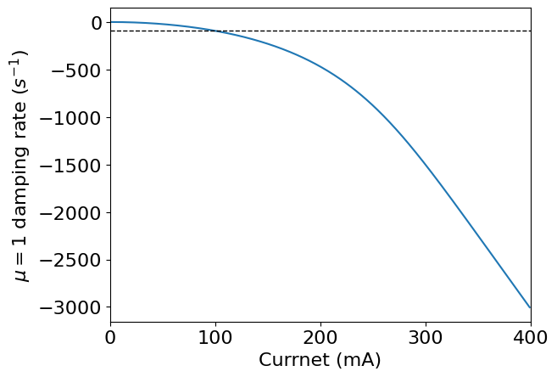
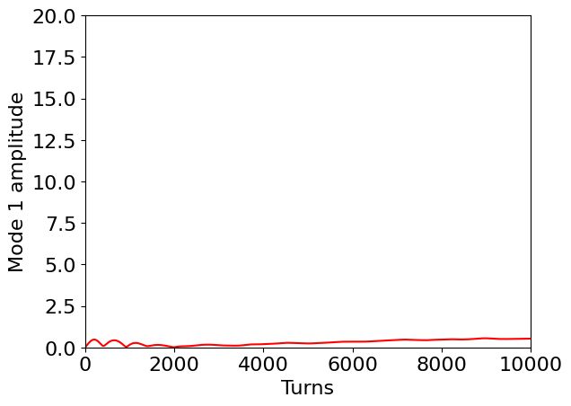
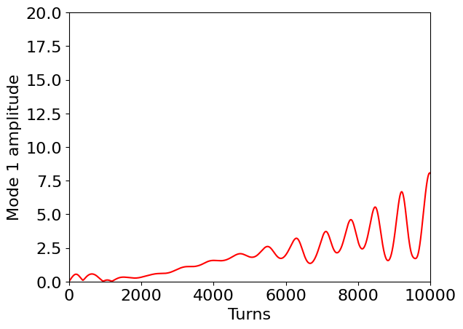
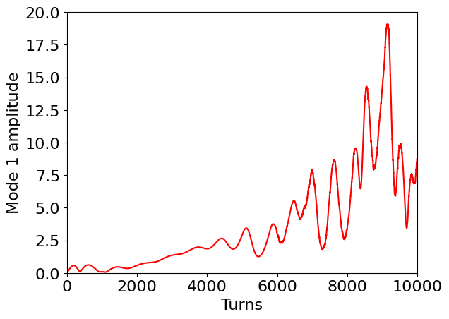
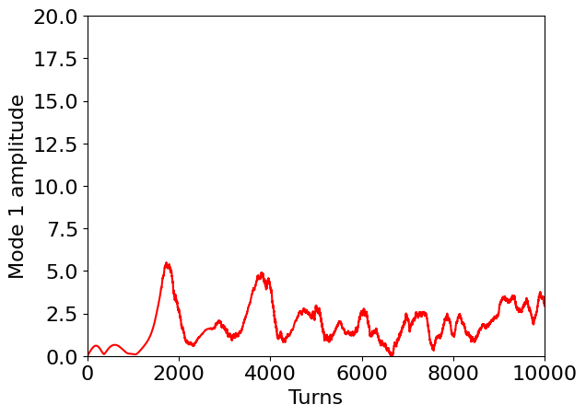
2025 KPS Spring Meeting
Bosch analysis compared with Simulation
9 IDs, 4 HHC, Non-Flat Potential/ Change currents
Zero freq.
Mode coupling
Coupled bunch.
$$τ_{z}^{−1}=92.5 s^{−1}$$
Beam loss occurs
Beam loss occurs
Beam loss occurs
Beam loss occurs
80 mA
100 mA
110 mA
140 mA
Coupled-bunch instability leads to growth in the oscillation amplitude of the $μ=1$ mode
Oscillation amplitude grows → beam loss occurs
Simulation with 1000 macroparticles/ 10000 Turns

Slide 12
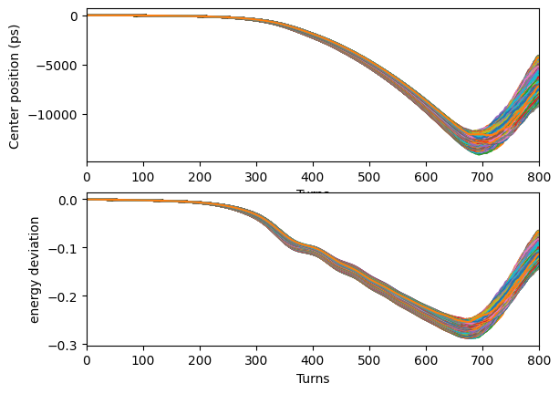
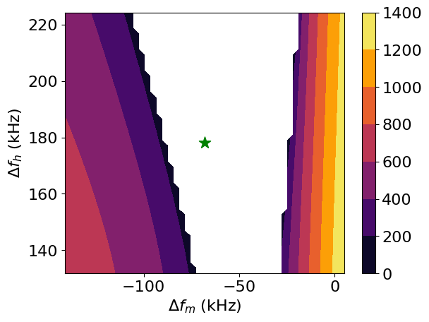
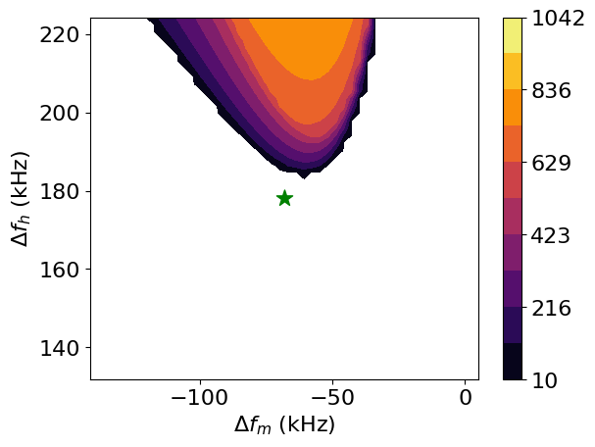
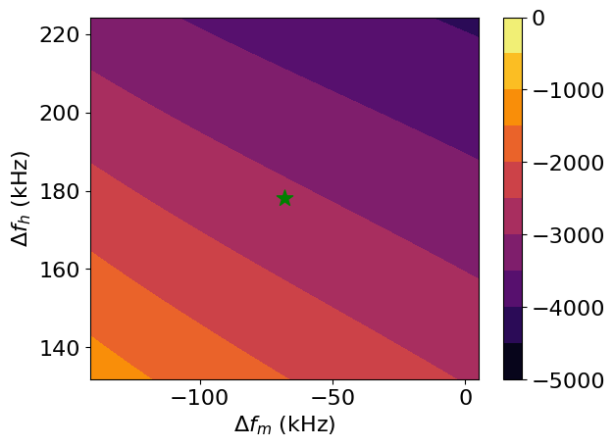
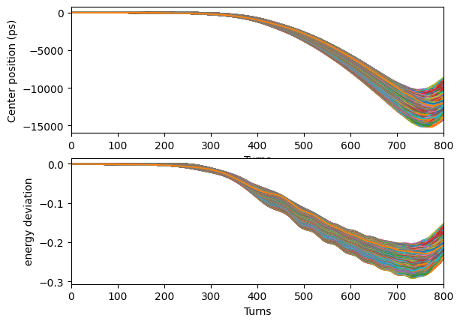
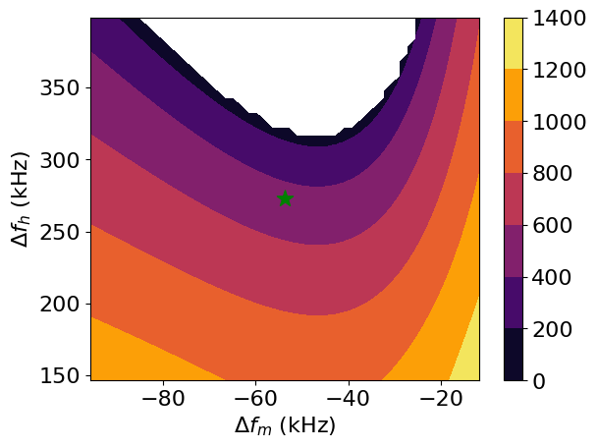
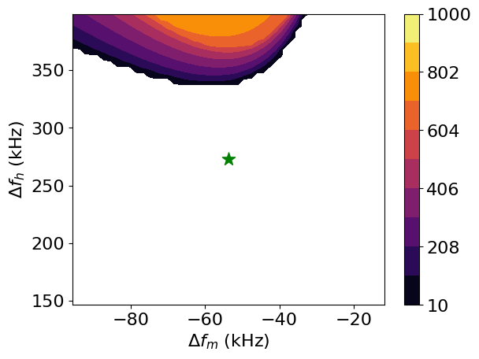
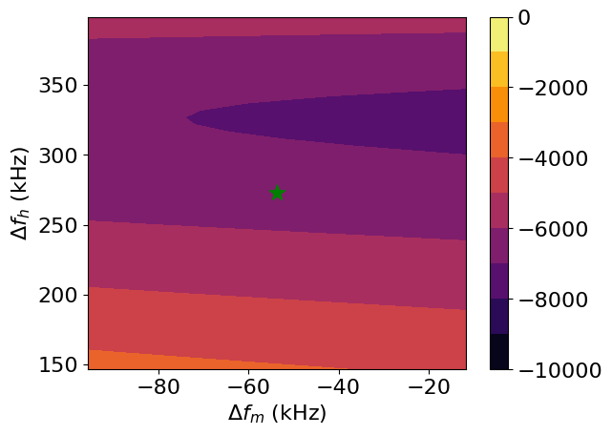
2025 KPS Spring Meeting
Bosch analysis compared with Simulation
Simulation at Optimal points
1000 macroparticles per bunch
9 IDs, 4 HHC, 400 mA
Zero freq.
Mode coupling
$$Ω^{\left(1,0\right)}−Ω^{\left(2,0\right)}$$
$$(Hz)$$
$μ=1$ Coupled Bunch.
$$(s^{−1})$$
$$α^{\left(0,1\right)} \left(s^{−1}\right)$$
24 IDs, 7 HHC, 400 mA
Zero freq.
Mode coupling
$$Ω^{\left(1,0\right)}−Ω^{\left(2,0\right)}$$
$$(Hz)$$
$μ=1$ Coupled Bunch.
$$α^{\left(0,1\right)} \left(s^{−1}\right)$$
$$(s^{−1})$$

Slide 13
2025 KPS Spring Meeting
Summary and Future work
Summary
Active harmonic cavity installation requires careful consideration of generator power and Robinson instability.
At 400 mA, the main issue with the ALBA-type HHC is the $μ=1$ coupled-bunch instability driven by large detuning due to the low quality factor.
A stable operating point must additionally account for both zero-frequency instability and mode coupling.
Future Work
Further study is needed on ALBA-type HHC, especially under non-flat potential conditions.
Additional investigations will be conducted using high-Q active cavities (e.g., ESRF-type) and passive harmonic cavities.
Evaluating beam stability under feedback system remains an essential next step.

Slide 14
2025 KPS Spring Meeting
Thank you for your attention!

Slide 15
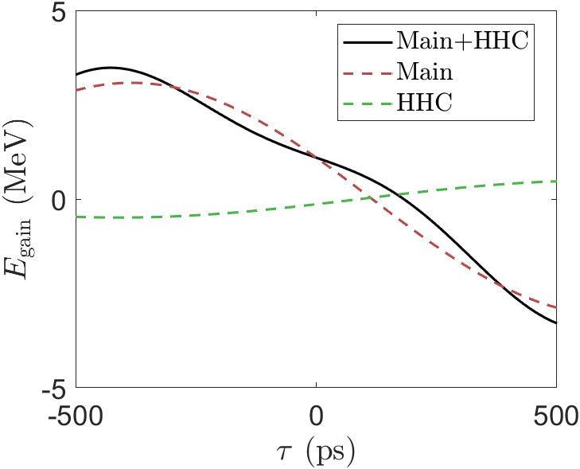
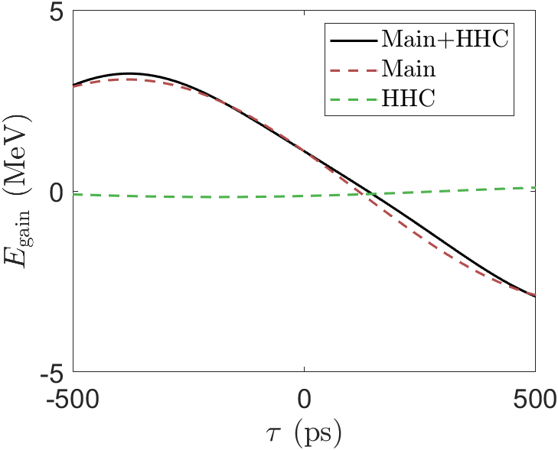
2025 KPS Spring Meeting
$$ξ=1$$
Appendix. NFP
In a double RF system using an HHC, the total voltage is given by:
$$V\left(τ\right)=V_{main}\sin\left(ω_{rf}τ+φ_{main}\right)+V_{HHC}\sin\left(mω_{rf}τ+φ_{HHC}\right)$$
$$V_{main,HHC} :Voltage of main\&HHC cavity, ω_{rf}:rf−frequency, τ:bunch−arrival time, φ_{main,HHC} :phase of main\&HHC cavity$$
HHC reduces the voltage gradient at $τ=0$, where the bunch is located, leading to bunch lengthening.
The degree of bunch lengthening can be quantified using a parameter $ξ$, defined as the ratio of the voltage gradient at $τ=0$ between the harmonic cavity and the main cavity.
$ξ=1,$ Flat potential condition
$ξ→0$, Similar to initial bunch
Smaller $ξ$leads to less bunch lengthening and requires lower HHC voltage (less number of cavities).
$$ξ=0.5$$
$$ξ=0.1$$
$$ξ=−\frac{V_{main}\cos\left(φ_{main}\right)}{mV_{HHC}\cos\left(φ_{HHC}\right)}$$
$$φ_{1}=\sin^{−1}\left(\frac{m^{2}}{m^{2}−1}\frac{U_{0}}{eV_{1}}\right) \\ φ_{2}=−\tan^{−1}\left(\frac{\tan{φ_{1}}}{mξ}\right) \\ V_{2}=\frac{V_{1}\sin{φ_{1}}}{m^{2}\sin{φ_{2}}}$$
$$V\left(0\right)=\frac{U_{0}}{e}$$
$$V^{′}\left(0\right)=ω_{rf}V_{1}\cos\left(φ_{1}\right)\left(1−ξ\right)$$
$$V^{′′}\left(0\right)=0$$

Slide 16
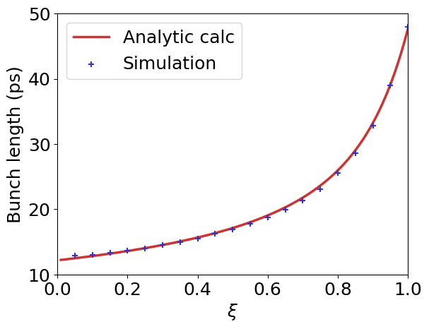
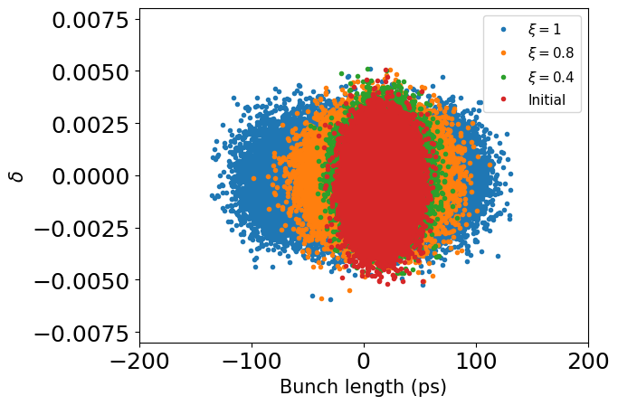
2025 KPS Spring Meeting
Appendix. NFP
The bunch length can be estimated semi-analytically using the Hamiltonian approach.
$$ℋ\left(τ,δ\right)=\frac{1}{2}αδ^{2}−\frac{e}{E_{0}T_{0}}\int_{0}^{τ}{\left(V\left(τ\right)−\frac{U_{0}}{e}\right)dτ}$$
$$α:Voltage of main\&HHC cavity, δ:momentum deviation, E_{0}:energy, T_{0}:revolution period, U_{0} :energy loss per turn$$
From the Vlasov equation, the stationary distribution must be a function of the Hamiltonian, and assuming a Gaussian distribution in energy deviation:
$$ρ\left(τ\right)∝\exp\left(−\frac{e}{T_{0}E_{0}α}\frac{\int_{0}^{τ}{\left(V\left(τ\right)−\frac{U_{0}}{e}\right)dτ}}{σ_{δ}^{2}}\right)$$
We compared the bunch length variation with respect to $ξ$ using both:
Semi-analytical formula $σ_{τ}^{2}=\int_{−∞}^{∞}{τ^{2}ρ\left(τ\right)dτ}$
Particle tracking simulation with 10,000 macro-particles/50000 turns
The comparison shows good agreement in the absence of wakefield effects.
Significant bunch lengthening can be achieved when $ξ>0.7$.
$$ξ→0.8$$
$$BL≈2.03$$

