Slide 1
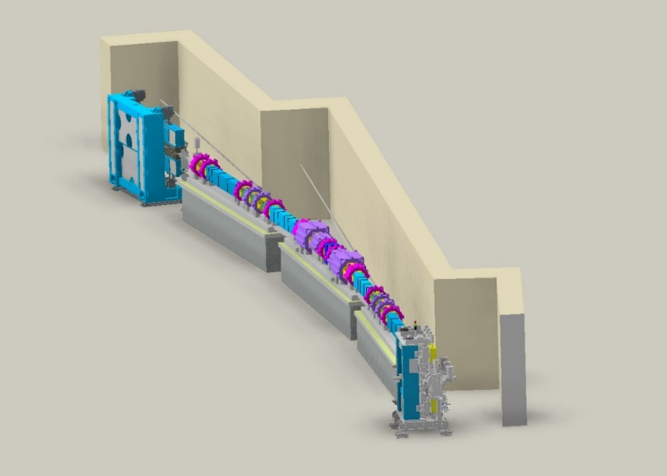
CAPHE group meeting
Objective selection for Nonlinear optimization of SR
Junha Kim
April 2025

Slide 2
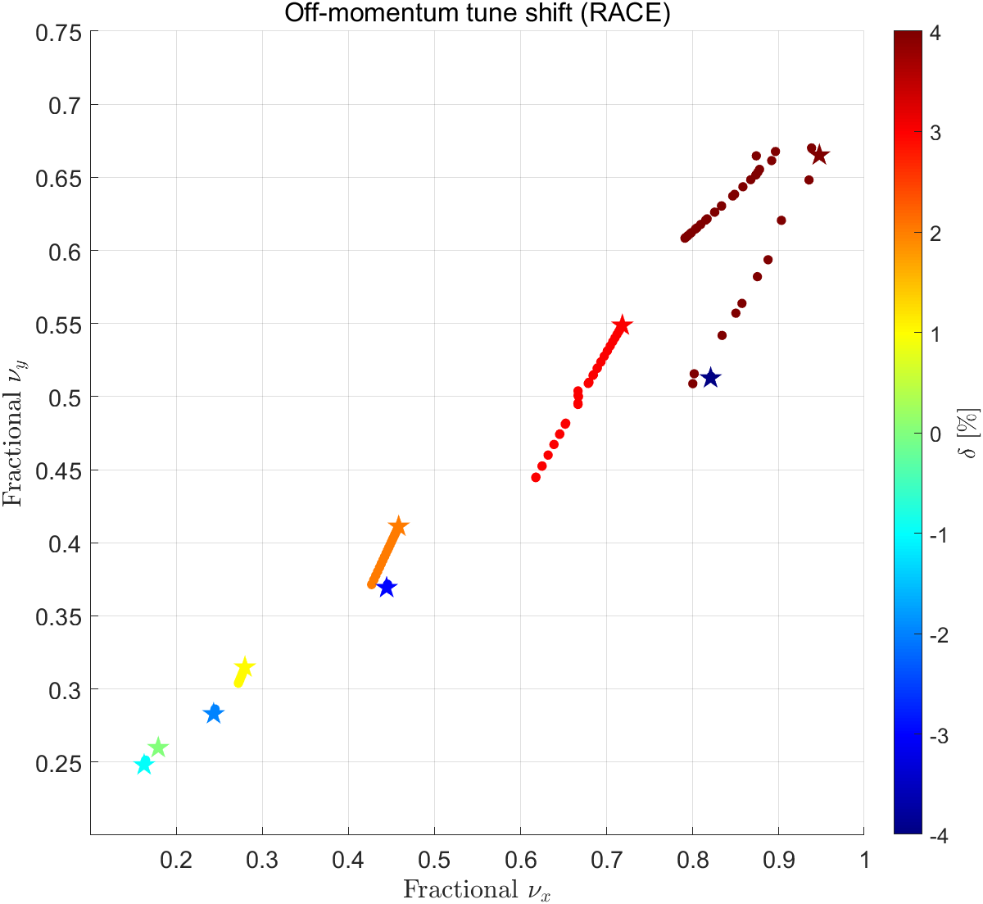
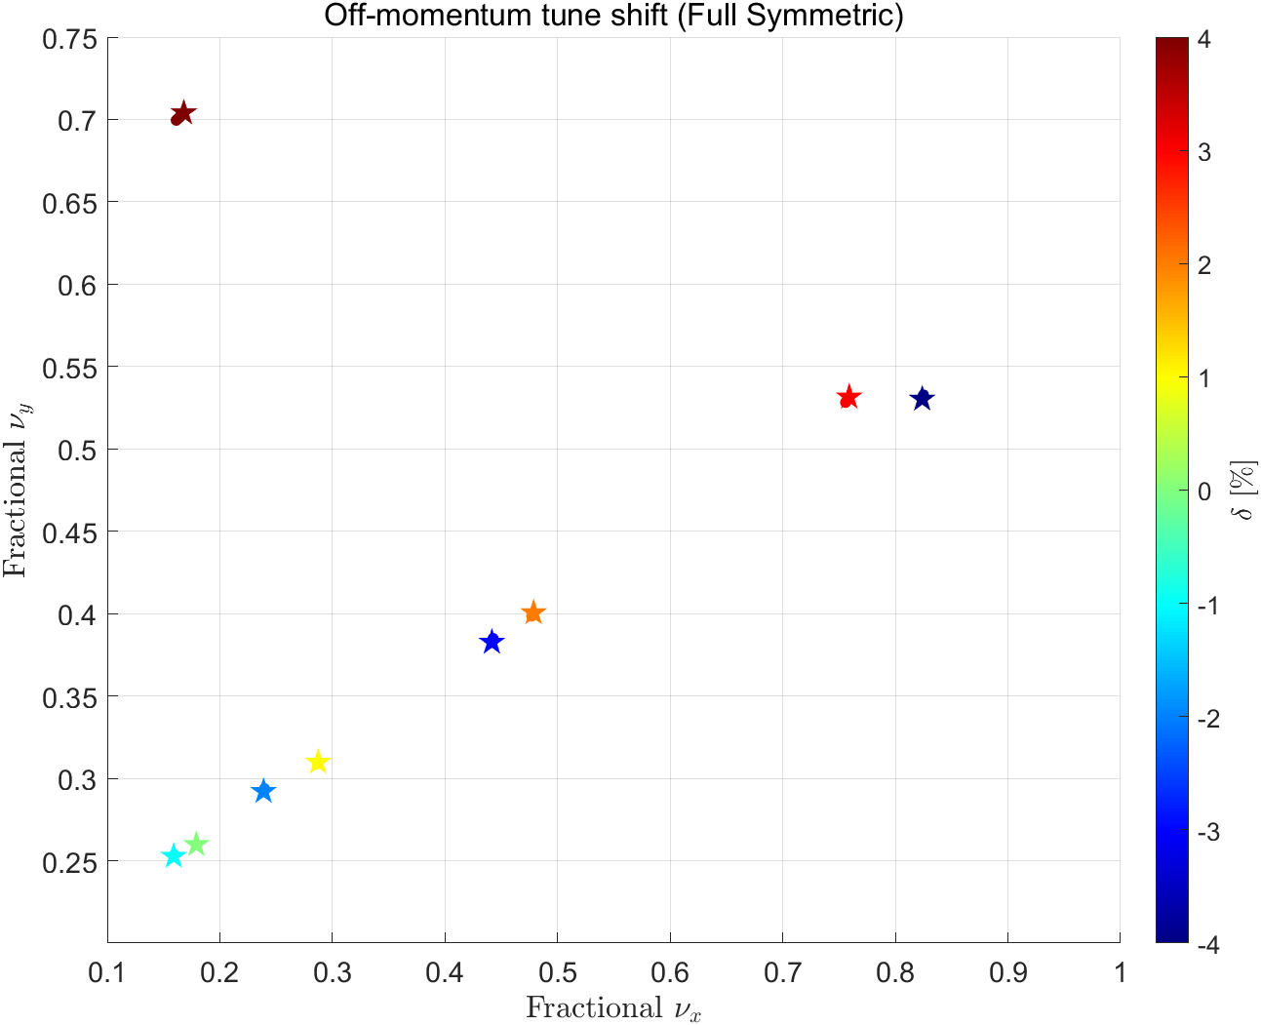
Off-momentum ADTS investigation (High-beta vs Full symmetry)- tracking
Off-momentum ADTS tracked figure.
Stars are tunes of off-momentum particles with x=0, and dots for |x|<1.5mm

Slide 3
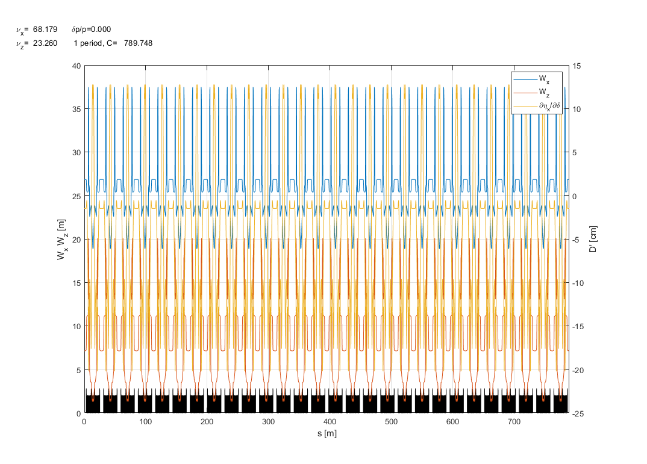
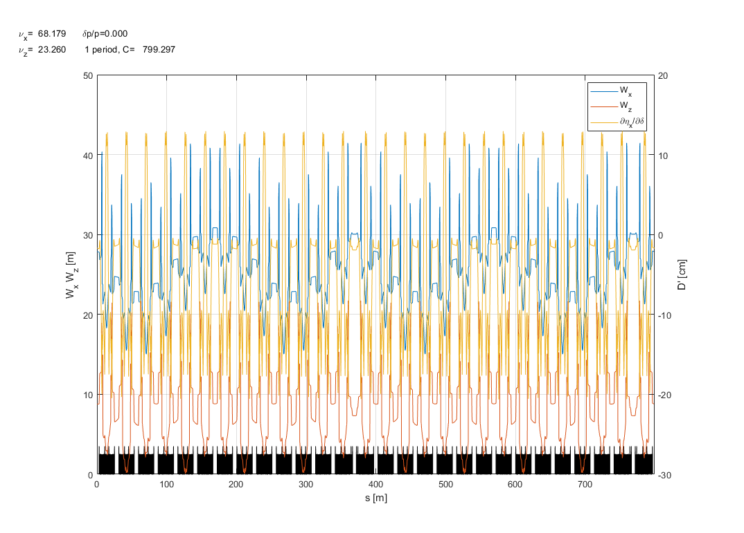
Off-momentum ADTS investigation (High-beta vs Full symmetry)- tracking
W function plot when the ring consists of 28 unit cells
W function plot when the ring consists of 26 unit cells + 2 straight section
$$ξ_{x0}=−3.9789 { ξ}_{y0}=−3.0683$$
$$ξ_{x0}=−3.9789 ,−4.1137{ ξ}_{y0}=−3.0683,−2.9467$$
$(unit cells, straight$)
If the storage ring consists of 28 unit cells, the chromaticity remains the same value across all cells. Therefore, the beta function with momentum deviation does not change along the longitudinal position.
However, our new machine shape resembles a race-track. This means the geometry is not perfectly symmetrical, causing chromaticity differences between the unit cells and the injection straight section. As a result, the W function ($\frac{dβ}{dδ}$ : beta function along with momentum deviation) fluctuates following the longitudinal position. These nonlinear effects occur as a result and affect the beam lifetime.

Slide 4
CAPHE group meeting

Slide 5
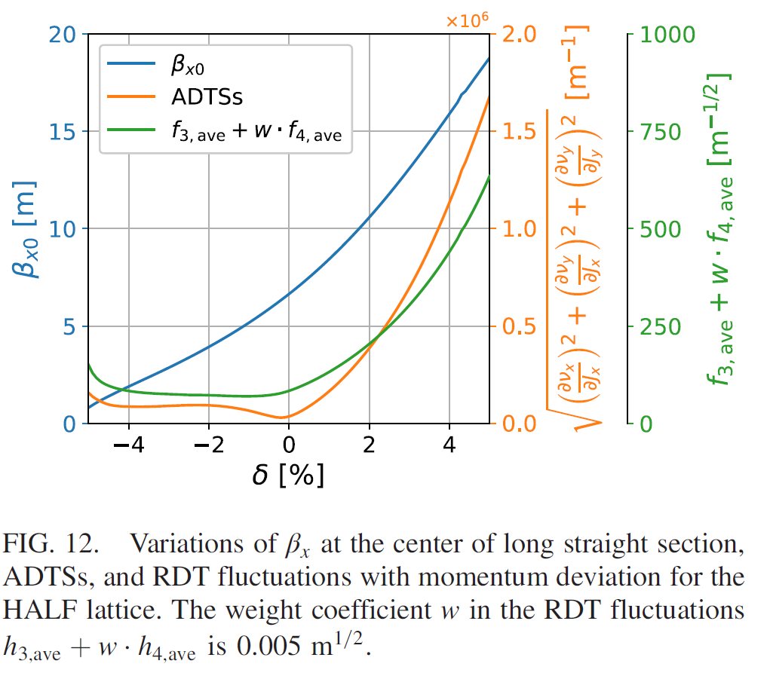
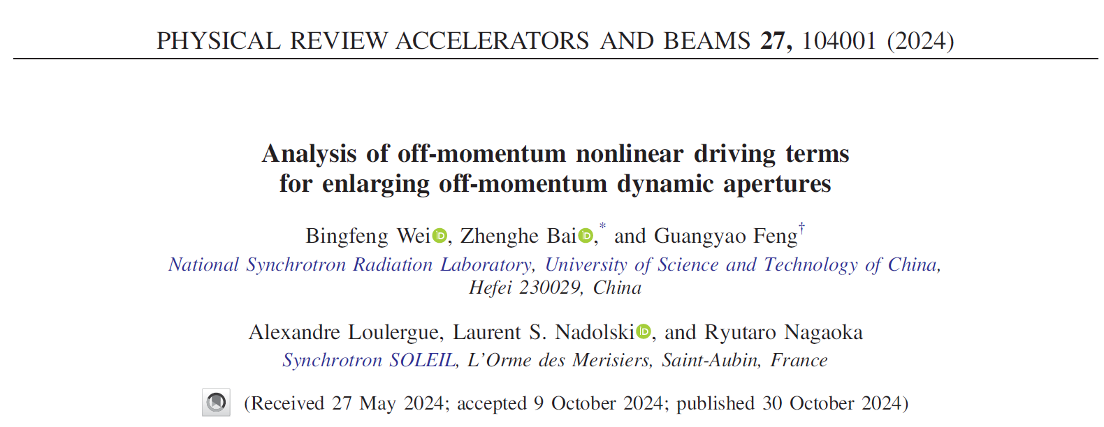
CAPHE group meeting
Relation with RDTs and their fluctuation

Slide 6
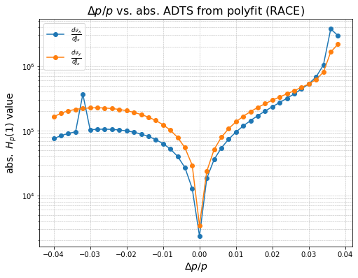
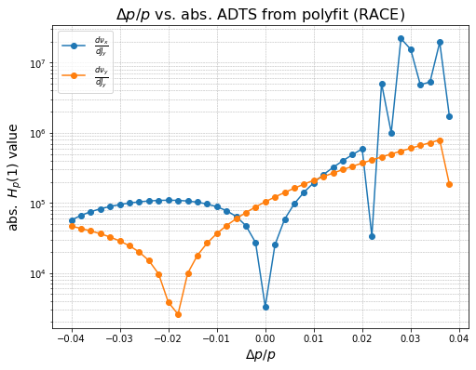
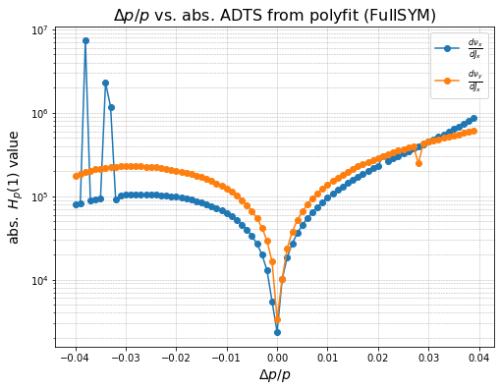
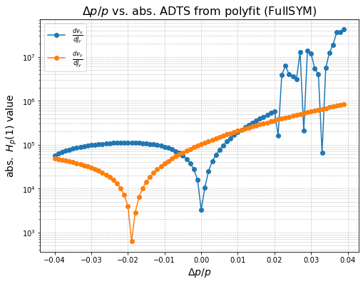
ADTS calculation with linear fitting
RACE-python
FullSYM-python

Slide 7
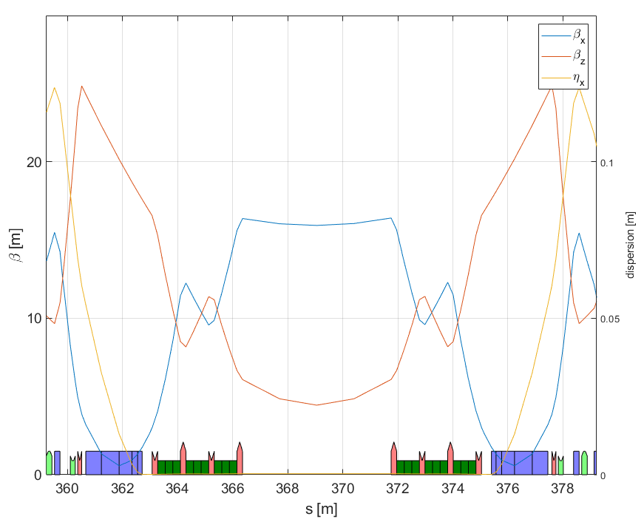
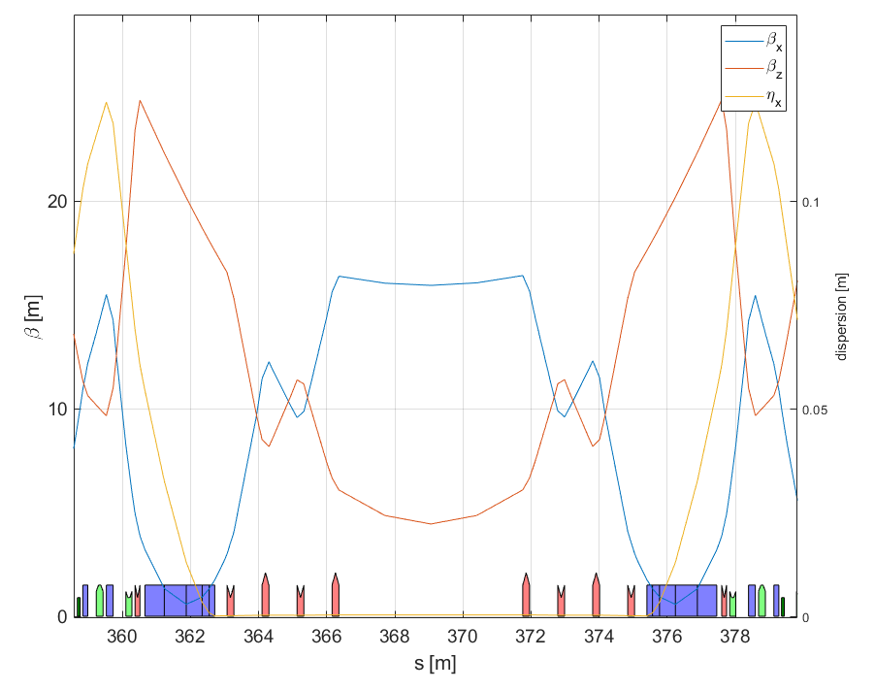
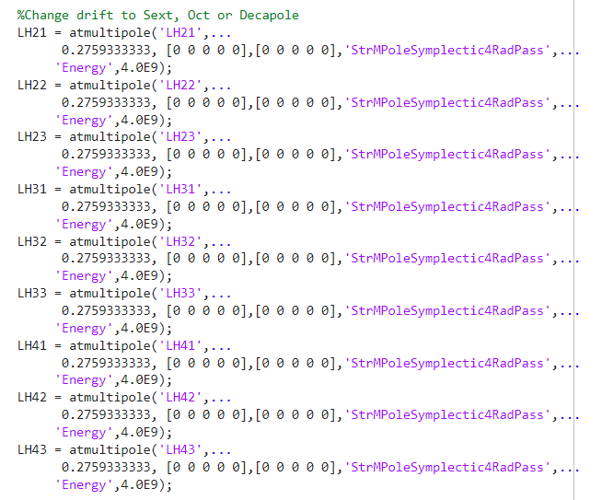
MOGA optimization result
9 families multipole in the High-beta section.

Slide 8
Variables of MOGA simulations
The total number of variables is 27.
Variables :
Sextupole strength of 9 multipoles (LH21 ~ LH43)
Octupole strength of 9 multipoles (LH21 ~ LH43)
Decapole strength of 9 multipoles (LH21 ~ LH43)
Objectives :
$on−momentum{\sqrt{{\left(\frac{dν_{x}}{dJ_{x}}\right)}^{2}+{\left(\frac{dν_{x}}{dJ_{y}}\right)}^{2}+{\left(\frac{dν_{y}}{dJ_{y}}\right)}^{2}}}_{fullSYM}−{\sqrt{{\left(\frac{dν_{x}}{dJ_{x}}\right)}^{2}+{\left(\frac{dν_{x}}{dJ_{y}}\right)}^{2}+{\left(\frac{dν_{y}}{dJ_{y}}\right)}^{2}}}_{RACE}$
$off−momentum{\sqrt{{\left(\frac{dν_{x}}{dJ_{x}}\right)}^{2}+{\left(\frac{dν_{x}}{dJ_{y}}\right)}^{2}+{\left(\frac{dν_{y}}{dJ_{y}}\right)}^{2}}}_{fullSYM}−{\sqrt{{\left(\frac{dν_{x}}{dJ_{x}}\right)}^{2}+{\left(\frac{dν_{x}}{dJ_{y}}\right)}^{2}+{\left(\frac{dν_{y}}{dJ_{y}}\right)}^{2}}}_{RACE}$
Variables :
-50 < Sextupole strength < 50
-5000 < Octupole strength < 5000
-100000 < Decapole strength < 100000
Middle of straight section
LH42
LH32
LH22
LH22
LH32
LH42
LH43
LH41
LH33
LH31
LH23
LH21
LH21
LH23
LH31
LH33
LH41
LH43

Slide 9
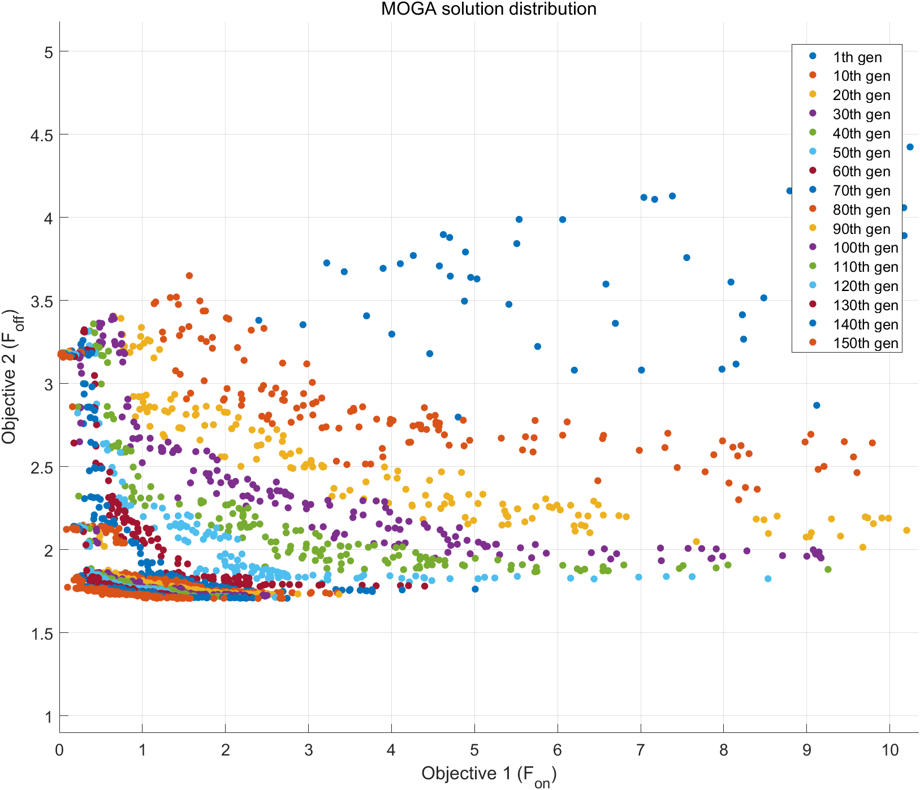
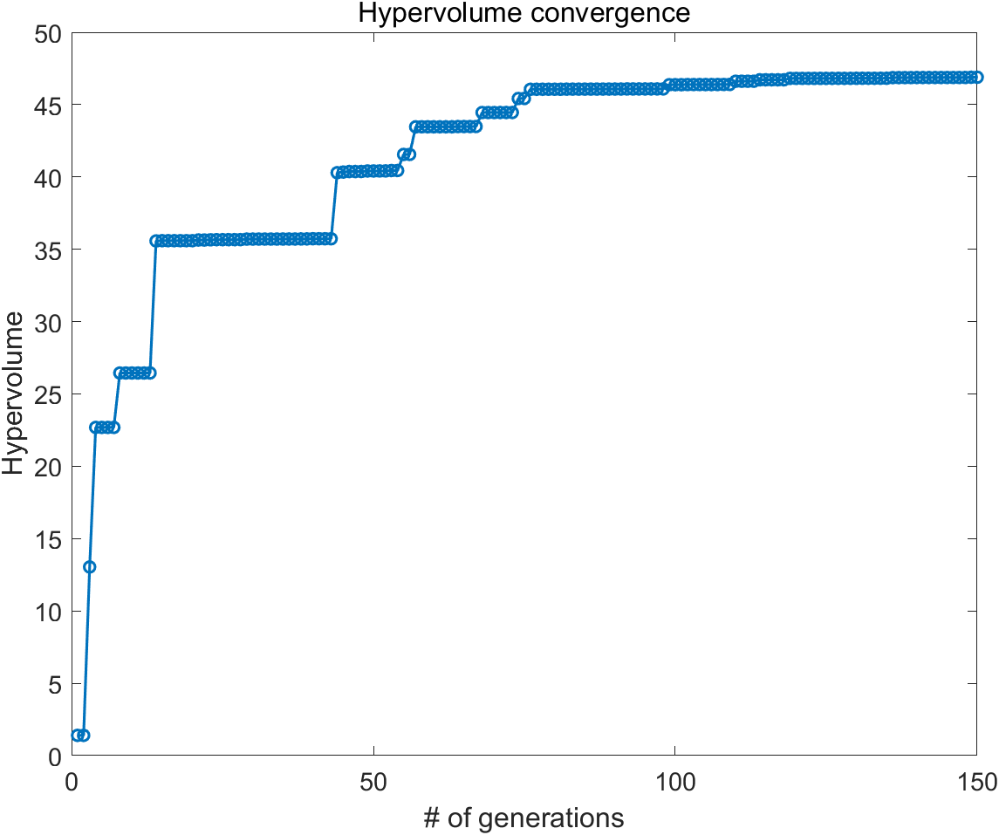
MOGA optimization result
Lattice : gen_HBIv4d1_ATinput_v3
The population size = 256
Used CPU number = 128
Total generations = 120
Number of variables = 27
9 sextupole strength
9 octupole strength
9 decapole strength
Number of objectives = 2

Slide 10
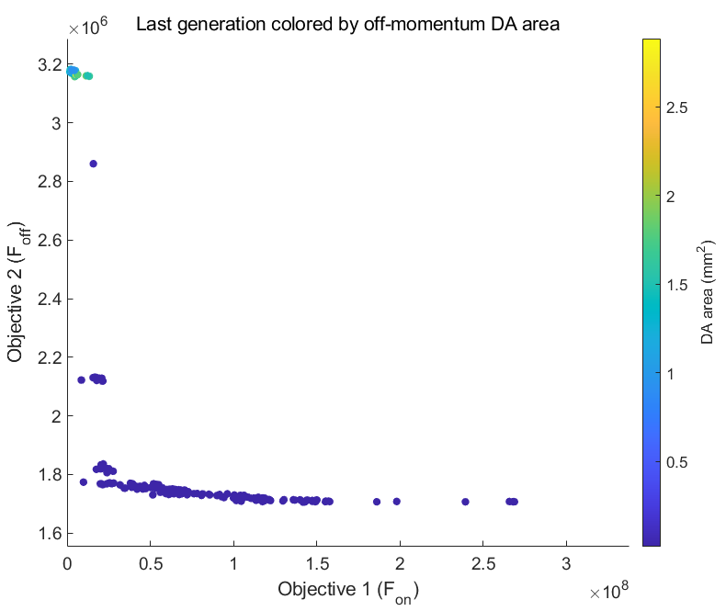
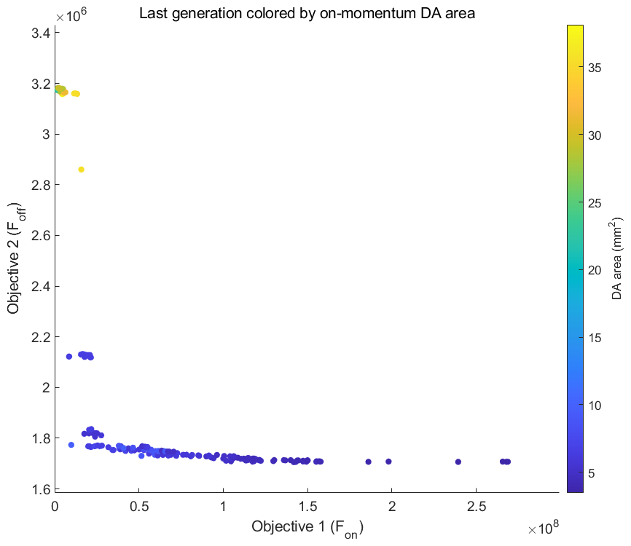
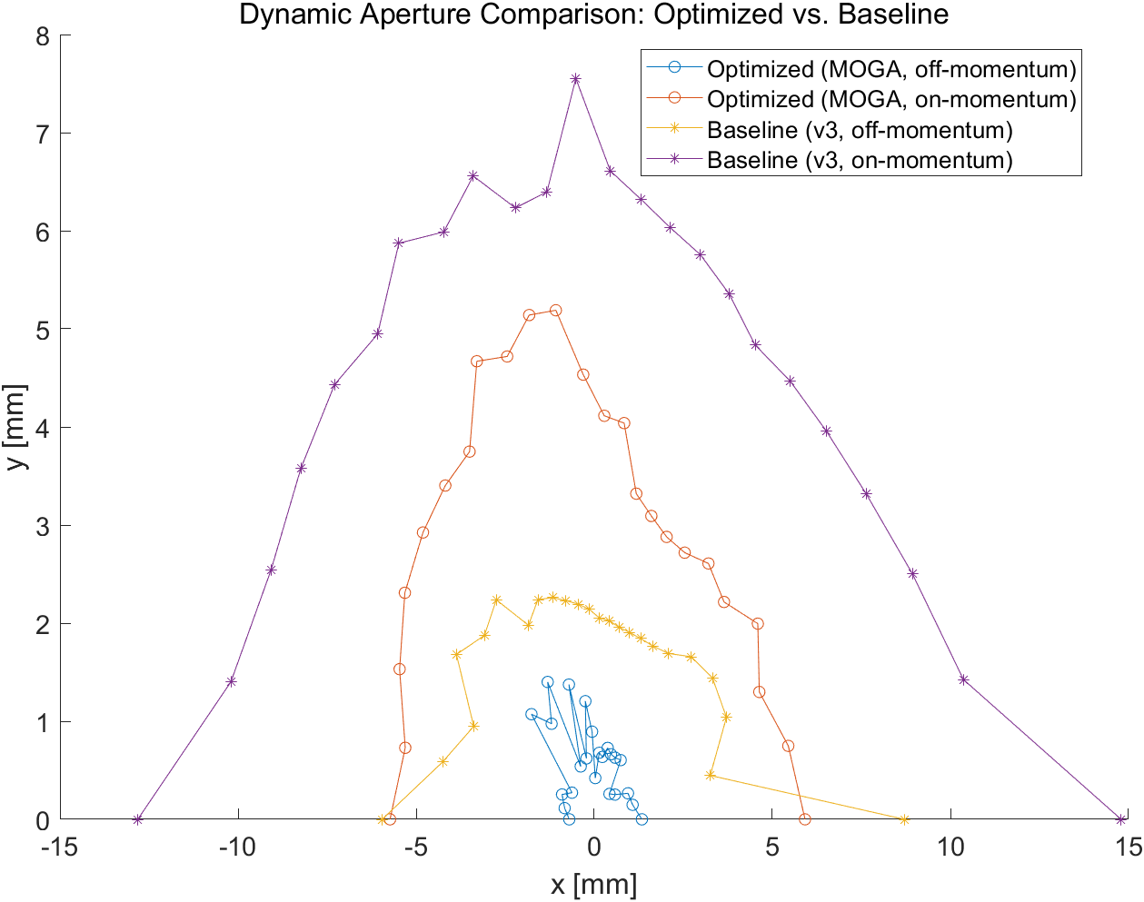
MOGA optimization result
DA area | On-momentum | Off-momentum ($δ=3.6\%$)
Original | 104.13$mm^{2}$ | 15.88$mm^{2}$
MOGA solution | 37.56$mm^{2}$ | 1.5$mm^{2}$

Slide 11
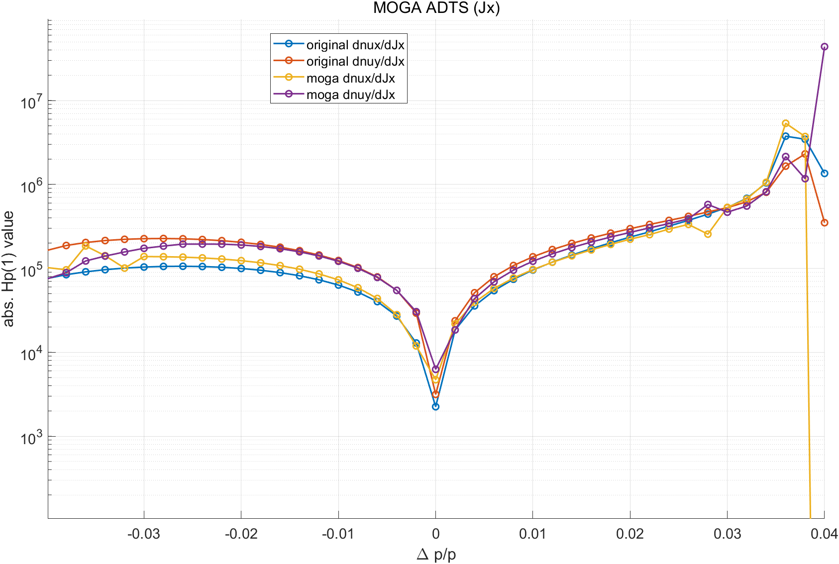
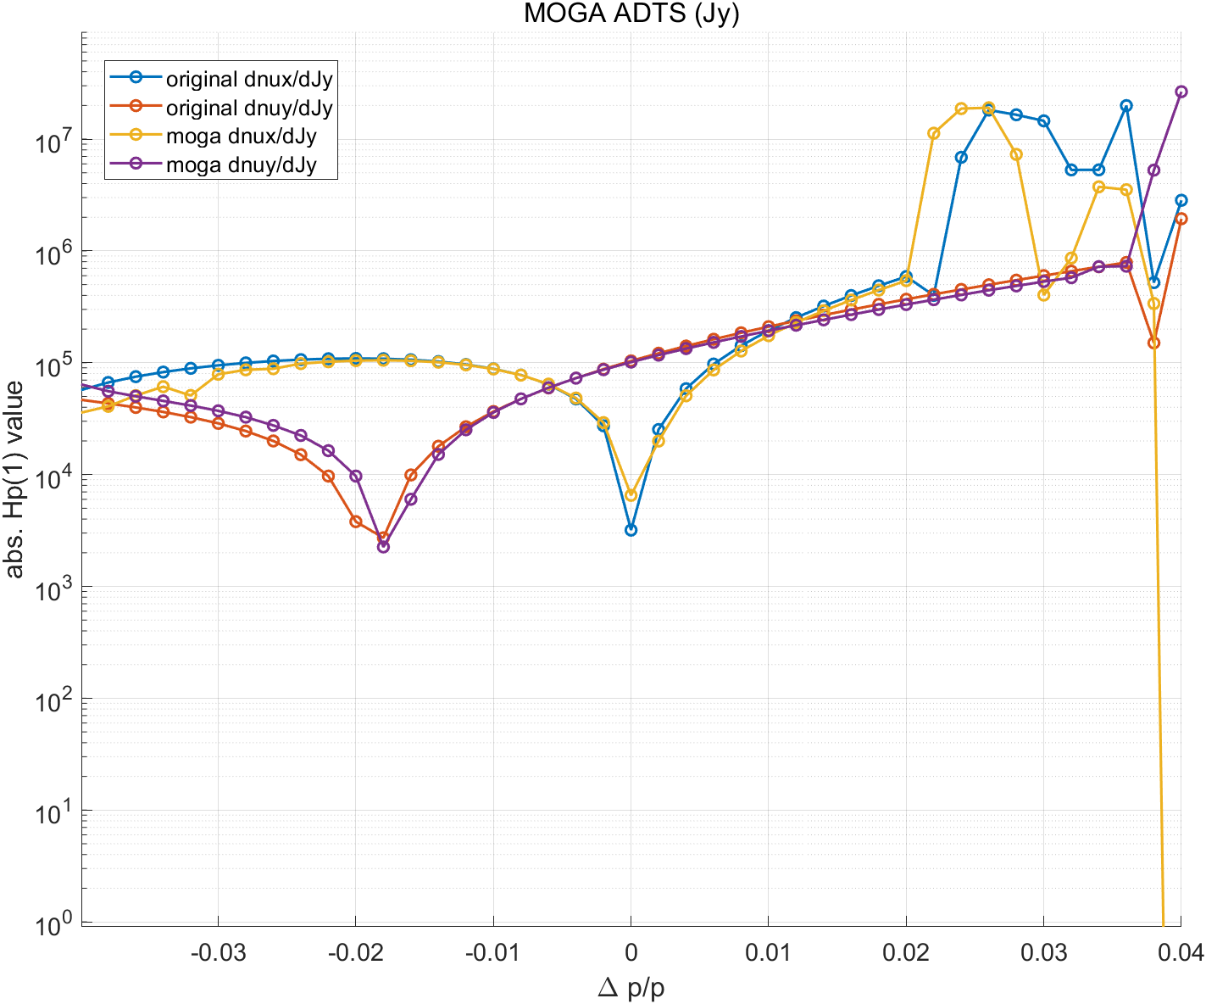
MOGA optimization result
Tune shifts | On-momentum | Off-momentum ($δ=3.6\%$)
Original ADTS ($\frac{dν_{x}}{dJ_{x}} ,\frac{dν_{y}}{{dJ}_{x}},\frac{dν_{y}}{dJ_{y}}$) | -2.247e+03 / 3.186e+03 / -1.038e+05 | -3.755e+06 / -1.950e+07/ -7.887e+05
MOGA solution ADTS ($\frac{dν_{x}}{dJ_{x}} ,\frac{dν_{y}}{dJx},\frac{dν_{y}}{dJ_{y}}$) | -1.246e+03 /-5.462e+02/ -9.010e+04 | -3.302e+06/-3.4.005e+06/-7.956e+05

Slide 12
Variables of MOGA simulations
The total number of variables is 27.
Variables :
Sextupole strength of 9 multipoles (LH21 ~ LH43)
Octupole strength of 9 multipoles (LH21 ~ LH43)
Decapole strength of 9 multipoles (LH21 ~ LH43)
Objectives :
$on−momentum$Dynamic aperture (1024 turn)
$off−momentum$ Dynamic aperture (1024 turn)
Variables :
-50 < Sextupole strength < 50
-5000 < Octupole strength < 5000
-100000 < Decapole strength < 100000
Middle of straight section
LH42
LH32
LH22
LH22
LH32
LH42
LH43
LH41
LH33
LH31
LH23
LH21
LH21
LH23
LH31
LH33
LH41
LH43

Slide 13
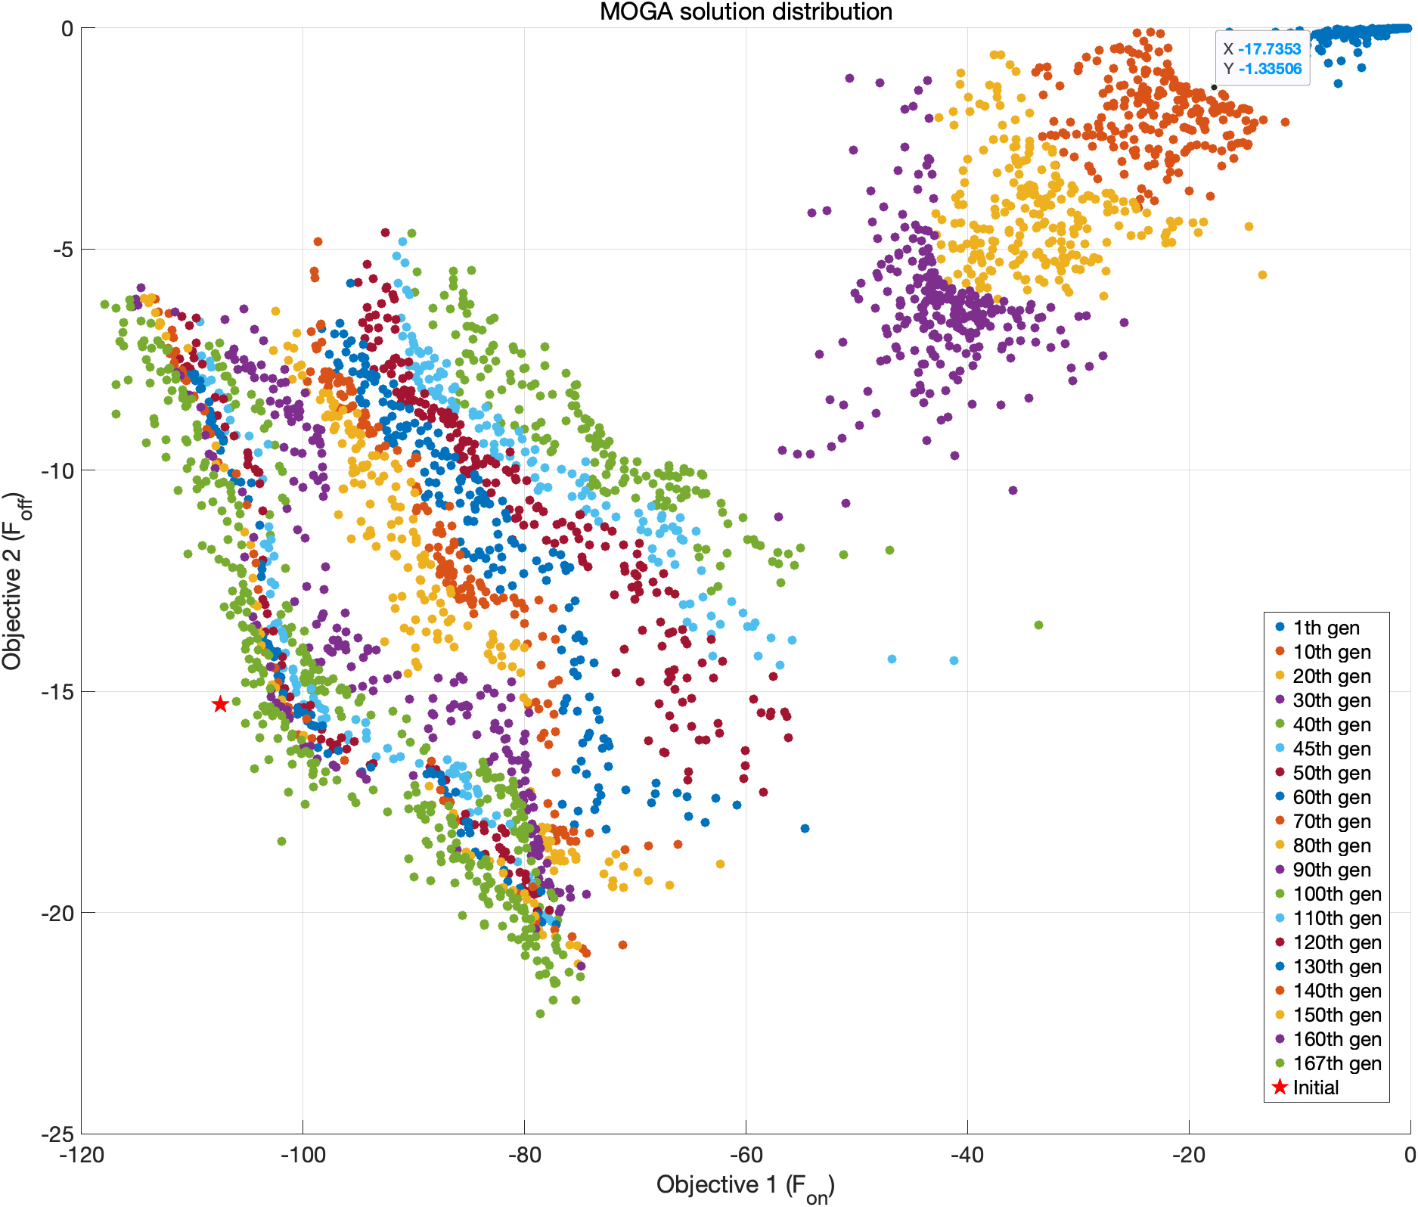
MOGA optimization result
Lattice : gen_HBIv4d1_ATinput_v3
The population size = 256
Used CPU number = 128
Total generations = 167/200
Number of variables = 27
9 sextupole strength
9 octupole strength
9 decapole strength
Number of objectives = 2
$on−momentum$Dynamic aperture (1024 turn)
$off−momentum$ Dynamic aperture (1024 turn)

Slide 14
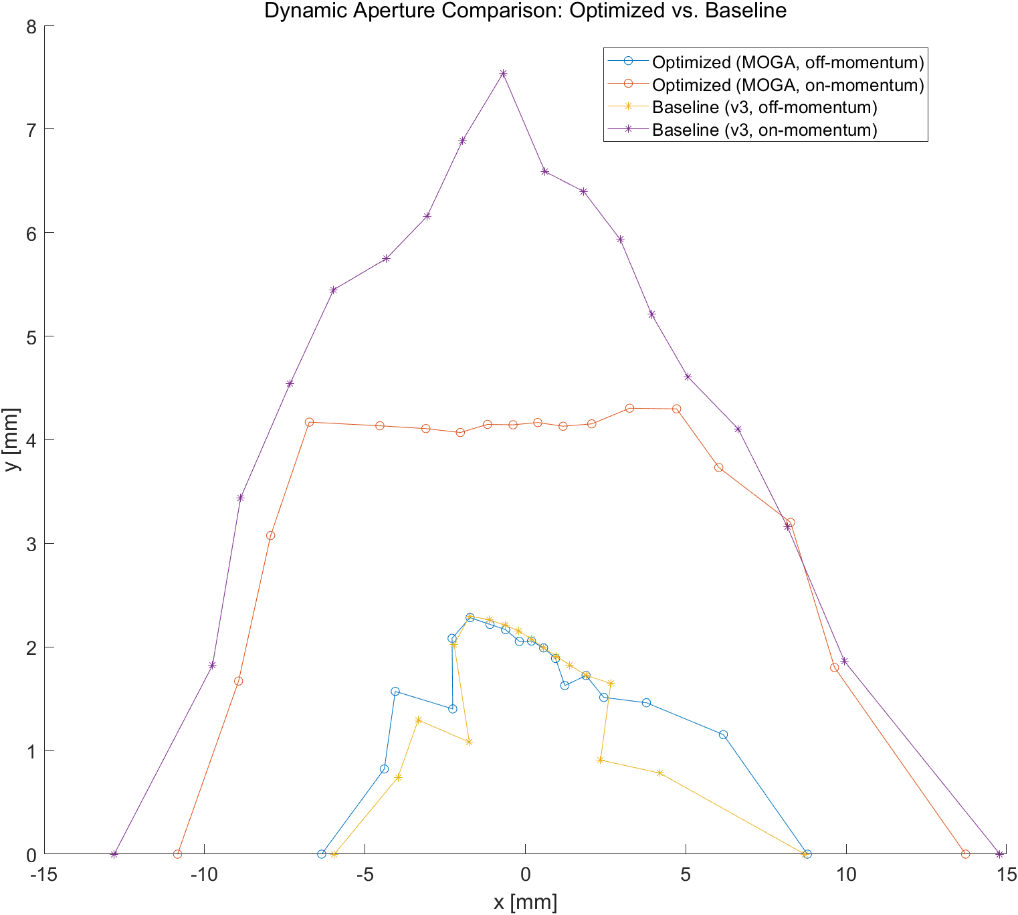
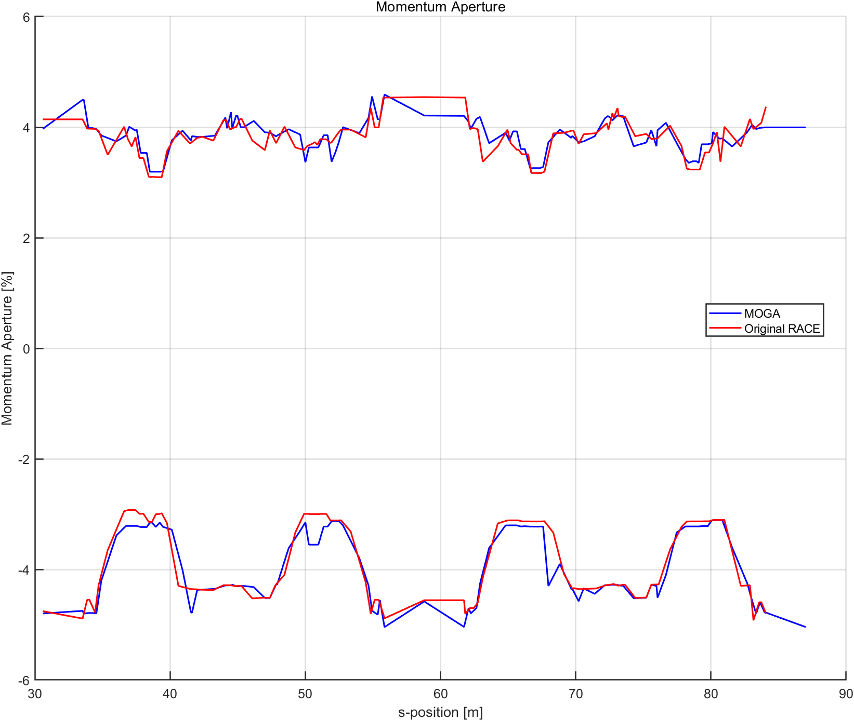
MOGA optimization result
DA area | On-momentum | Off-momentum ($δ=3.6\%$)
Original | 104.13$mm^{2}$ | 15.88$mm^{2}$
MOGA solution | $$76.16mm^{2}$$ | 19.$82mm^{2}$
Off-momentum DA increase 30% On – momentum DA decrease 30%

Slide 15
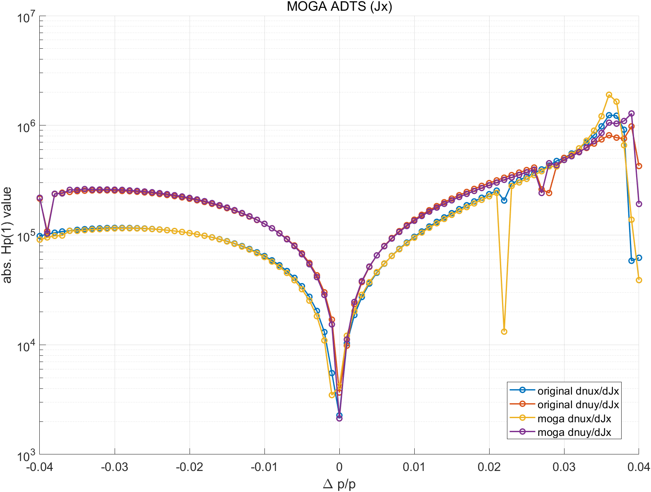
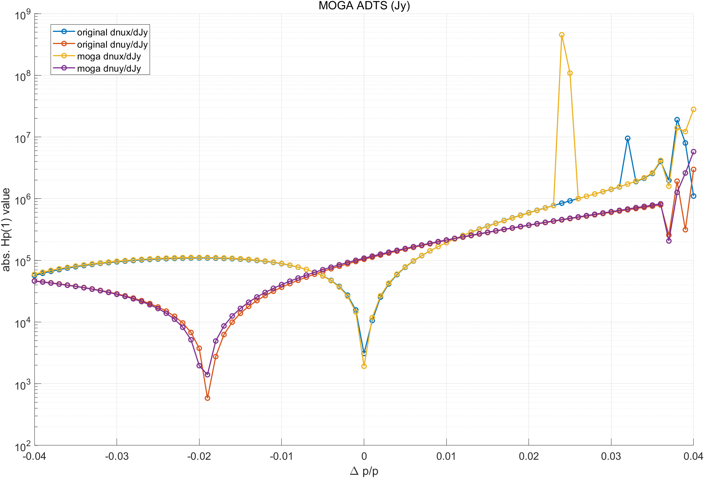
MOGA optimization result

Slide 16
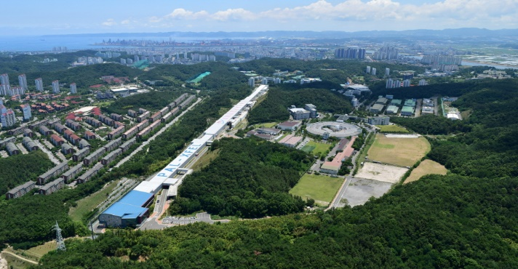
Thank you!

Slide 17
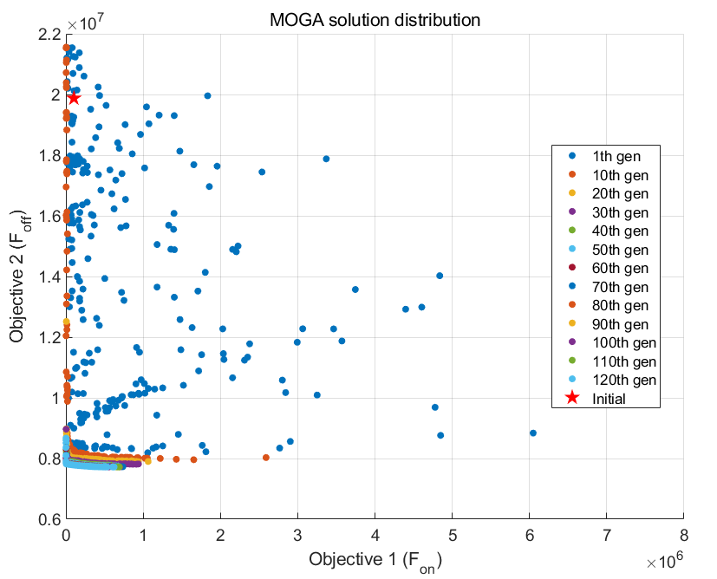
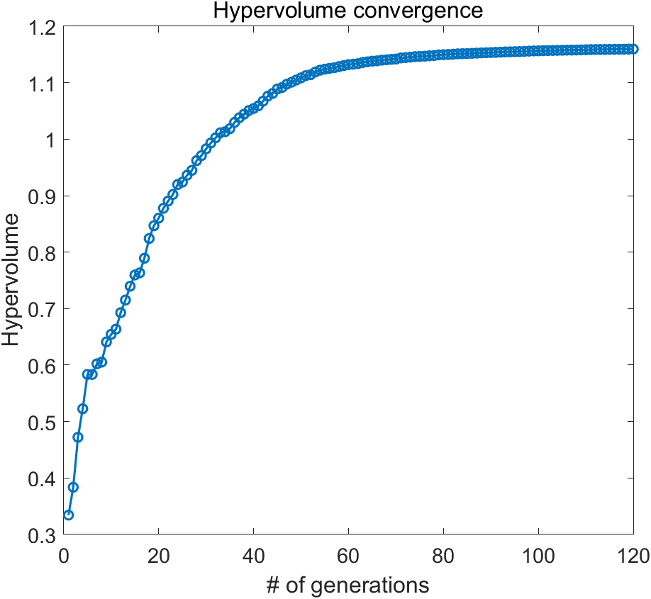
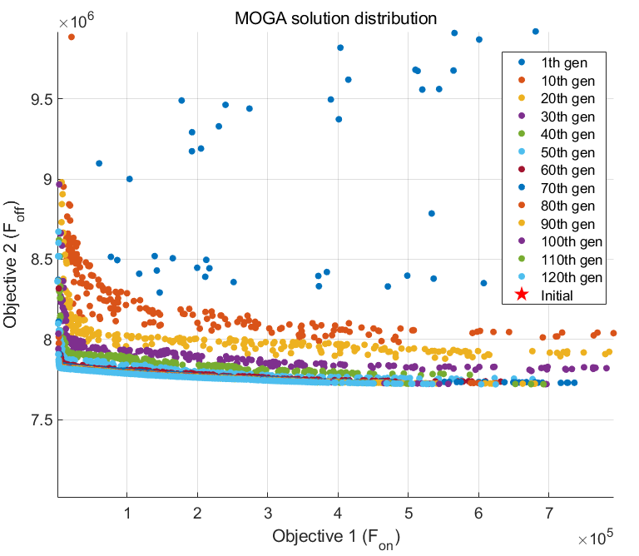
MOGA optimization result
Lattice : gen_HBIv4d1_ATinput_v3
The population size = 256
Used CPU number = 128
Total generations = 120
Number of variables = 27
9 sextupole strength
9 octupole strength
9 decapole strength
Number of objectives = 2

Slide 18
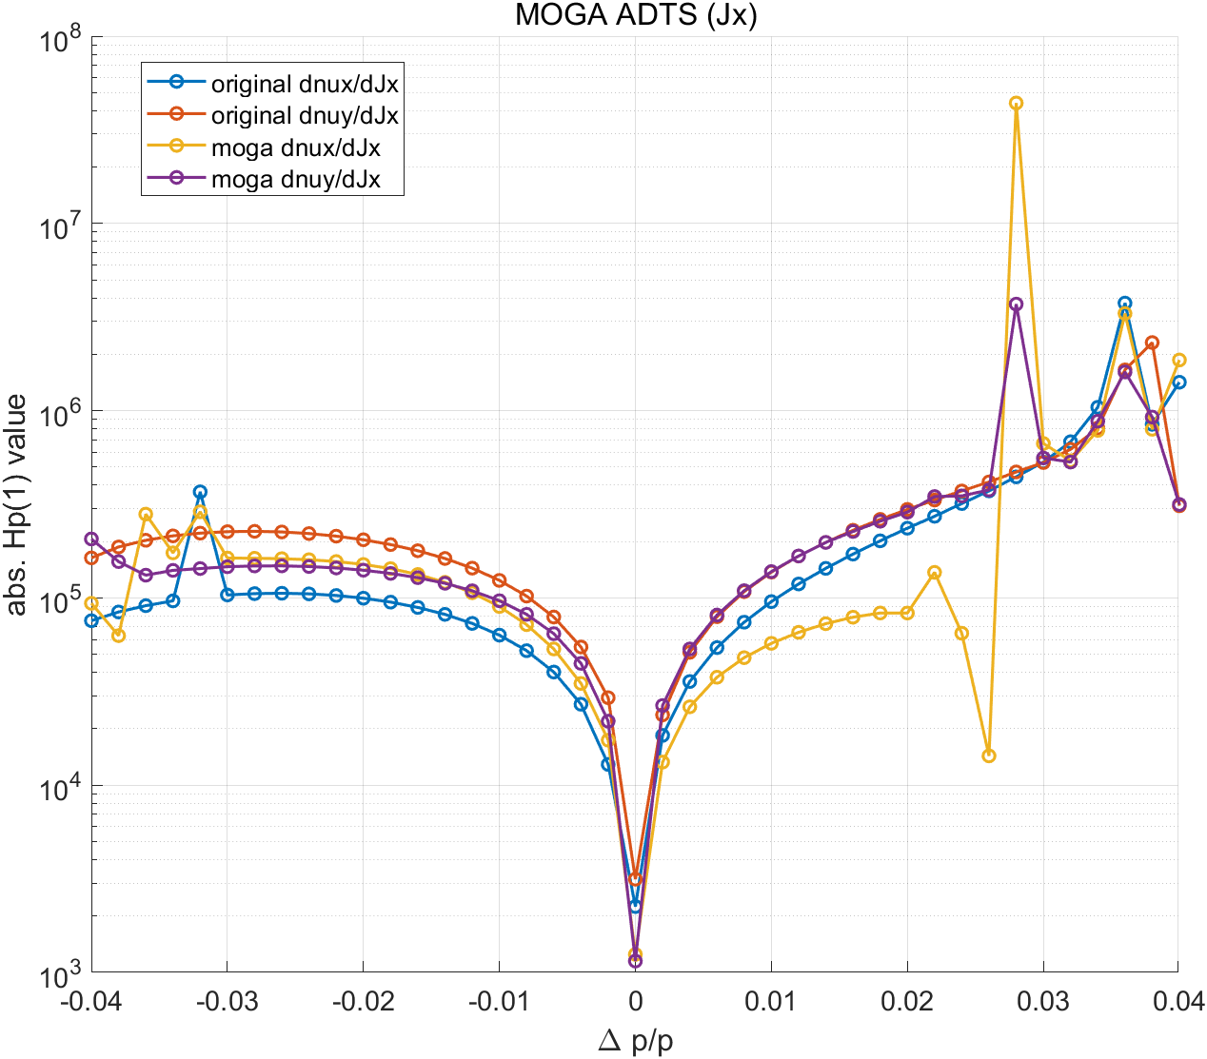
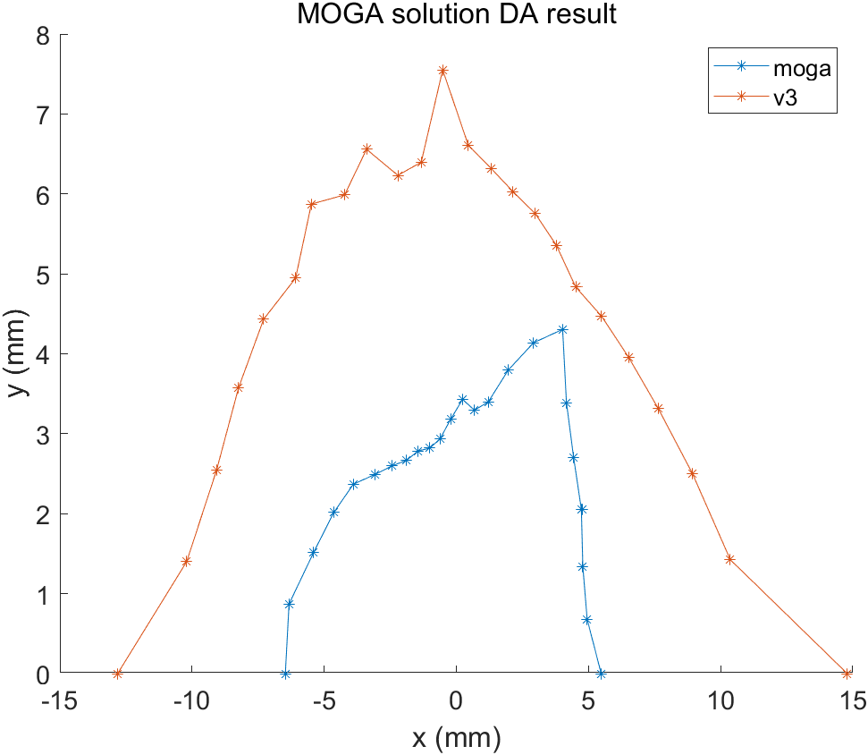
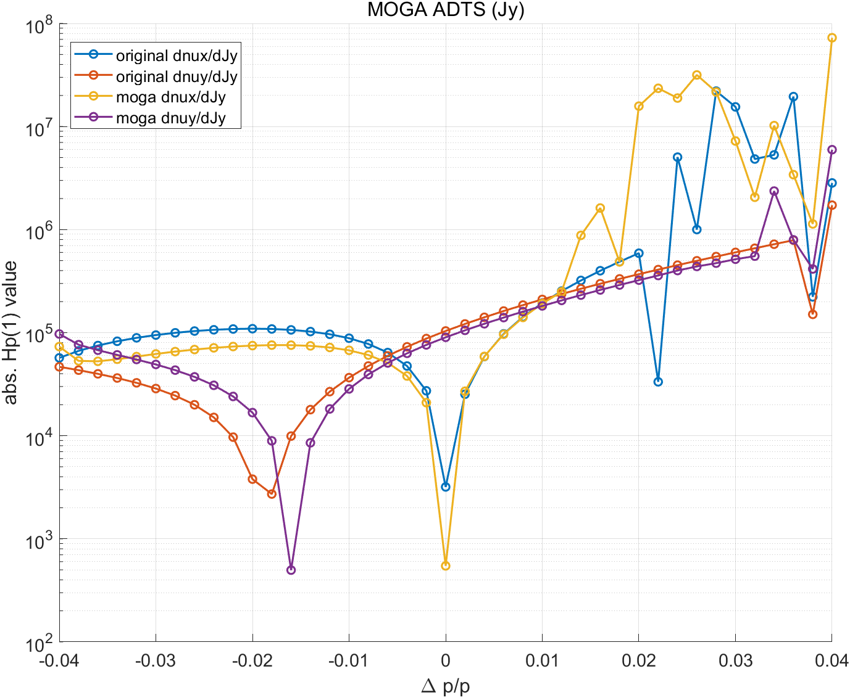
CAPHE group meeting
MOGA optimization result
Tune shifts | On-momentum | Off-momentum ($δ=3.6\%$)
Original ADTS ($\frac{dν_{x}}{dJ_{x}} ,\frac{dν_{x}}{{dJ}_{y}},\frac{dν_{y}}{dJ_{y}}$) | -2.247e+03 / 3.186e+03 / -1.038e+05 | -3.755e+06 / -1.950e+07/ -7.887e+05
MOGA solution ADTS ($\frac{dν_{x}}{dJ_{x}} ,\frac{dν_{x}}{{dJ}_{y}},\frac{dν_{y}}{dJ_{y}}$) | -1.246e+03 /-5.462e+02/ -9.010e+04 | -3.302e+06/-3.4.005e+06/-7.956e+05

Slide 19
Variables of MOGA simulations
The total number of variables is 27.
Variables :
Octupole strength of 9 multipoles (LH32)
Decapole strength of 9 multipoles (LH42)
Sextupole strength in straight-section
Octupole strength in straight-section
Unit cell
Objectives :
$on−momentum$Dynamic aperture (1024 turn)
MA data with 5 points in the ring
Variables :
-50 < Sextupole strength < 50
-5000 < Octupole strength < 5000
-100000 < Decapole strength < 100000

Slide 20
CAPHE group meeting

Slide 21
CAPHE group meeting

