Slide 1
Research Progress on Development of an Absolute Coordinate Calibration Device for Beam Profile Monitor
Friday, 11 April 2025
윤 주 환

Slide 2
1. Review of the Concept
Scintillating Screen based BPRM
Perspective Calibration
3. Experiment
Distorted Image Measurement
Image Transformation into 2D Plane
2. Experiment Setup
BPRM Stage scheme
Device Order & Setting
Device Performance Test
4. Result Analysis
Comparison of Original & Measured
1D (x, y axis) Intensity Graph Fitting
Fitting Error

Slide 3
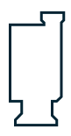
Review of the Concept
Pixel Space
Defects of the existing BPRM
Inclined scintillating screen
Inaccurate position coordinates
Resulting in distorted beam profile
Goal of the research
Restoring original screen space
Identifying real beam profile
Method of image calibration
Obtain the relationship between pixel space and real space
Transform all coordinates
CMOS Camera
YAG Screen
Real Space

Slide 4
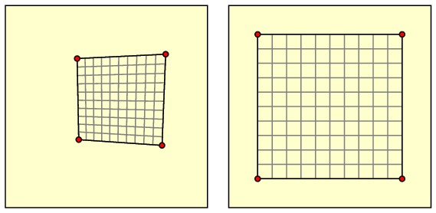
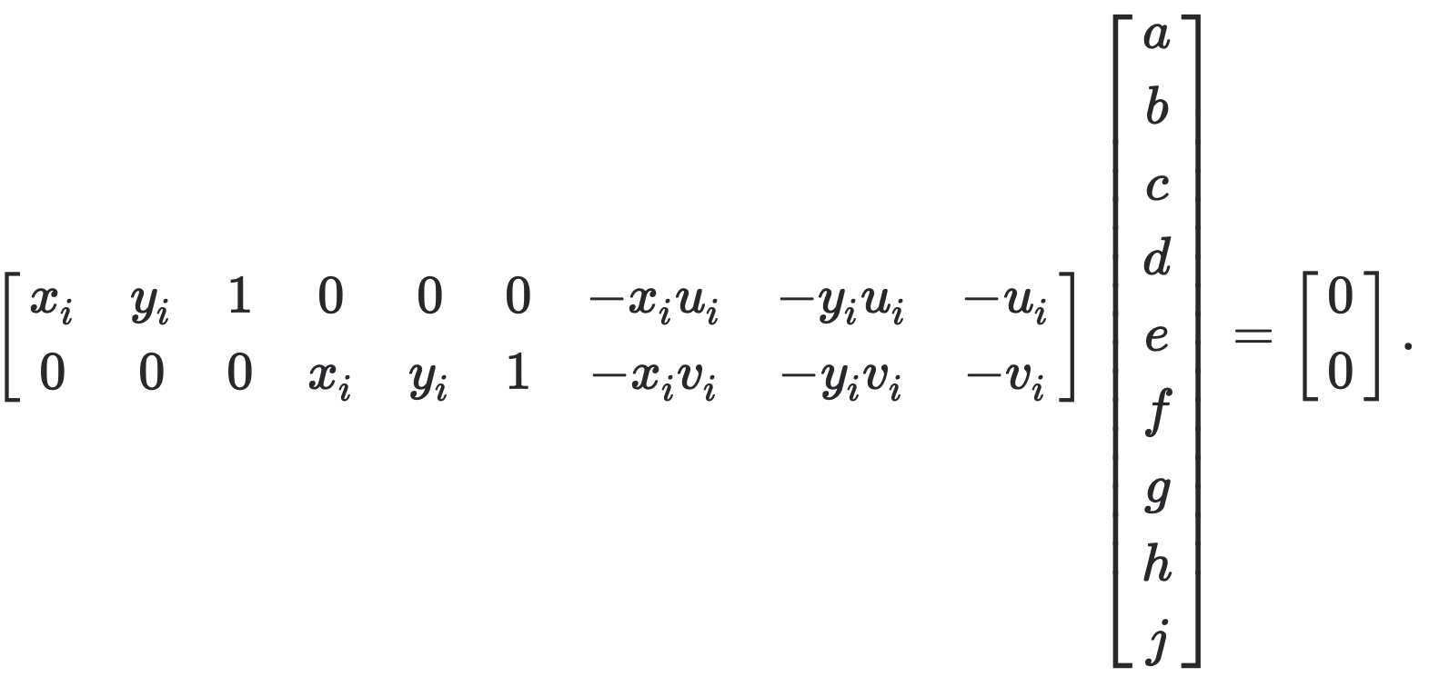
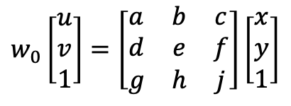
Perspective Calibration
$$w_{0}\left[\begin{matrix}u \\ v \\ 1\end{matrix}\right]=\left[\begin{matrix}a & b & c \\ d & e & f \\ g & h & j\end{matrix}\right]\left[\begin{matrix}x \\ y \\ 1\end{matrix}\right]$$
Flattening the 3D distorted image into 2D projection space.
Nominate 4 pairs of coordinate on both planes, to solve 3x3 matrix.

Slide 5
Experimental Setup
Grid plate
한 칸에 5mm
중심점(원점) 기준으로 20mm 지점까지 사용 가능
Ce:YAG single crystals
Size: 10x10x0.1mm
Thermal resistance: 790 W/m
Melting point: 2243 K
Polished surface with marking grid
Laser
YAG
Wavelength: 532 nm
Power: 500 mW
Diameter: 6.0 mm
* 슬릿 구멍으로 빔 크기 줄이기
Grid plate
Fixed focal length: 25 mm (Wide Angle)
Working distance: 100mm - ∞
Maximum distortion: 0.22 %
Lens
Ethernet control
Resolution: 10000 ppr
BK Brake (Axis-mounted)
Holding torque: 1.0 Nm
Camera
2–axis
Motor
Type: CMOS
Resolution: 1.6 Megapixels
Sensor Size (FxV): 4.97 mm × 3.73 mm
Mono (Colorless)

Slide 6
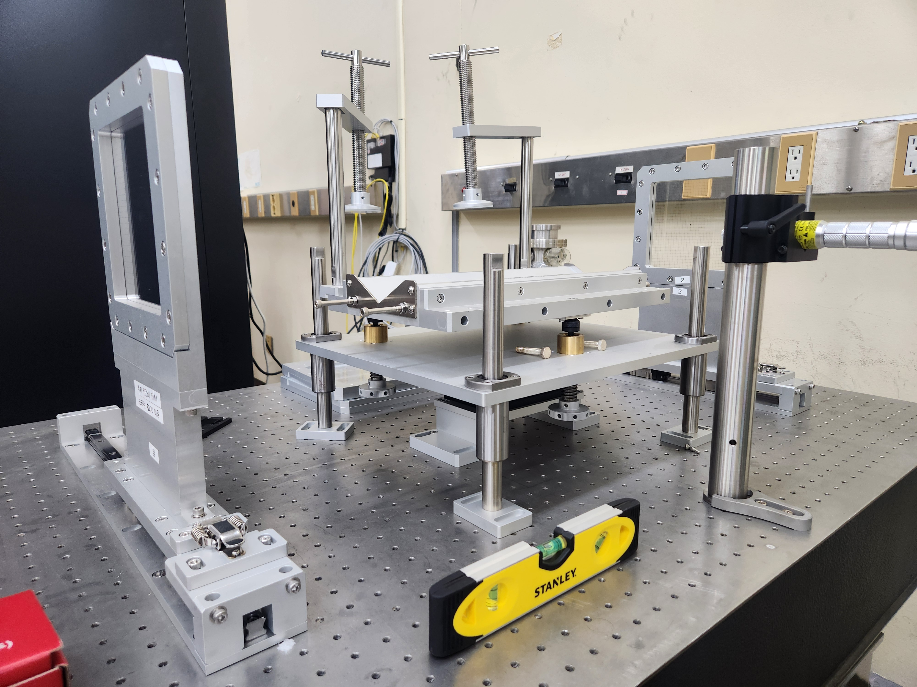
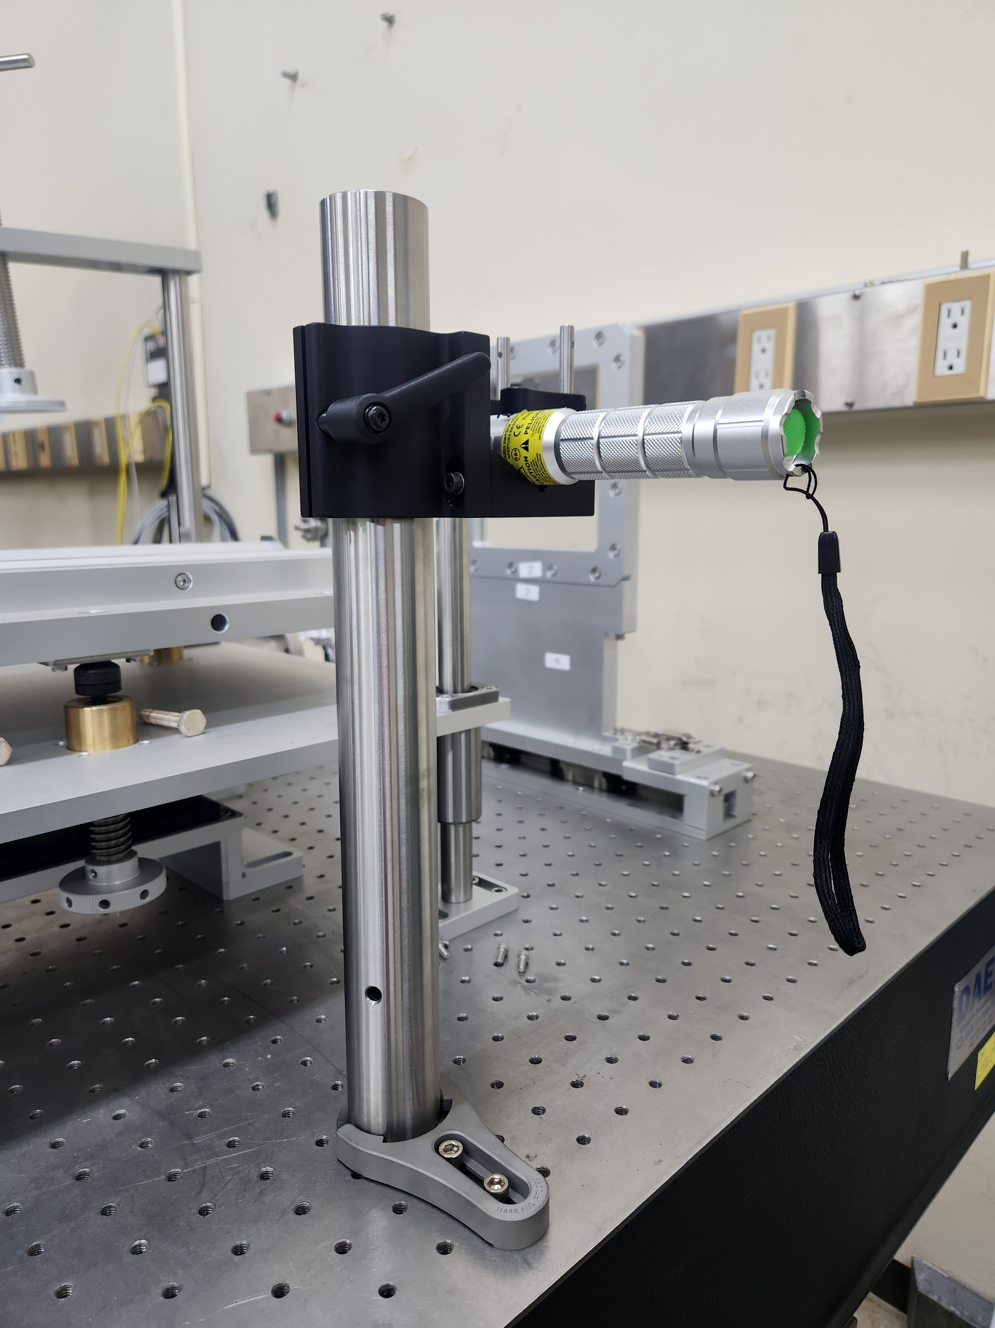

Order Laser Optics Equipment

Slide 7
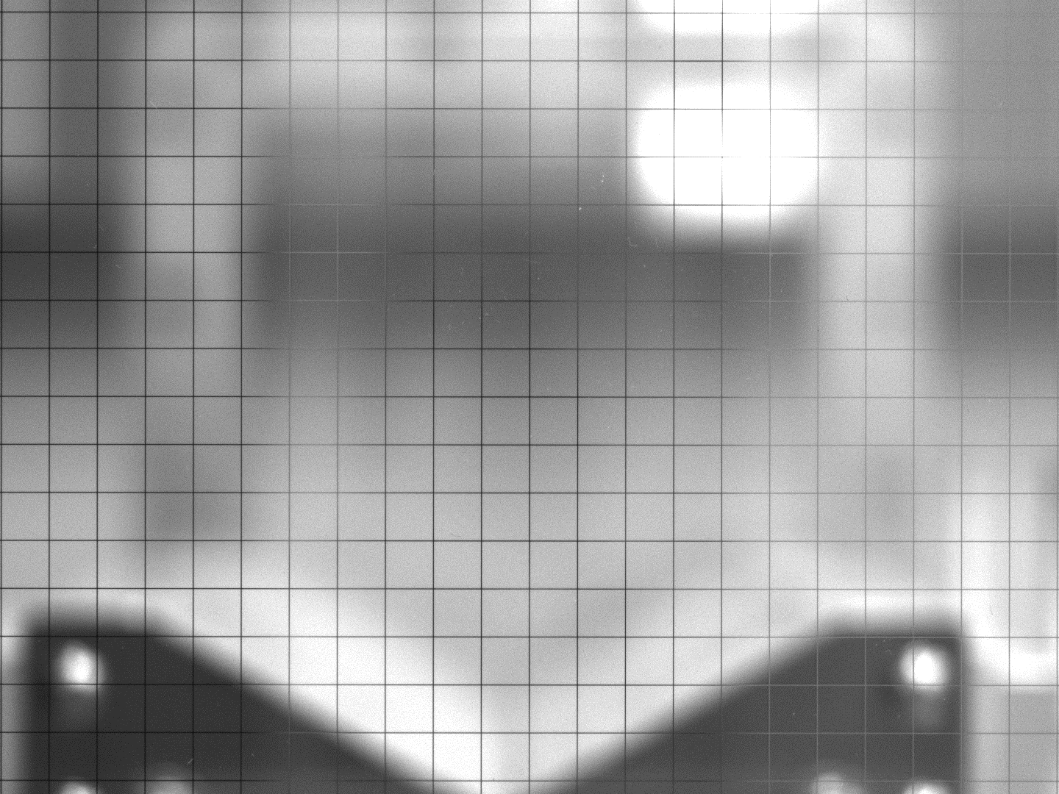
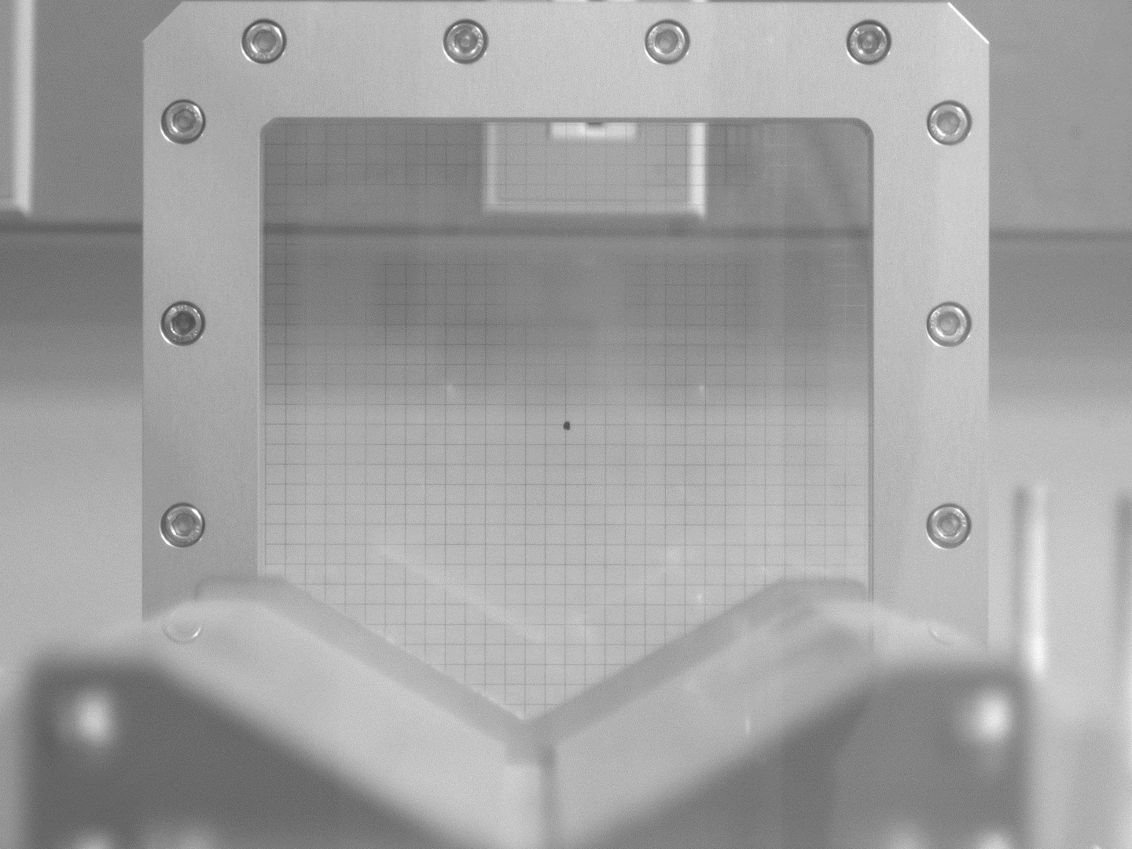
BPRM Stage Alignment
Active area in which two glass grids are linearly parallel.
The grid arrangement becomes more skewed towards the edge.

Slide 8
2-Axis Motor Repeatability
Command Position : -25000
Actual Position : -25000
Position Error : 0
Actual Velocity : 0
x 50 for each axis
Command Position : 25000
Actual Position : 25000
Position Error : 0
Actual Velocity : 0
Command Position : 0
Actual Position : 0
Position Error : 0
Actual Velocity : 0
Command Position : -25000
Actual Position : -25000
Position Error : 0
Actual Velocity : 0
Command Position : 25000
Actual Position : 25000
Position Error : 0
Actual Velocity : 0

Slide 9
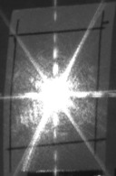
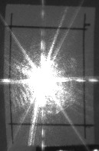
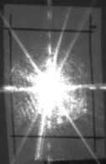
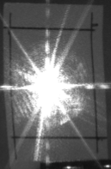
Raw Data Acquisition
. . .
N = 10
Collect motley samples of YAG screen images.
Each screen has different arrangement.

Slide 10
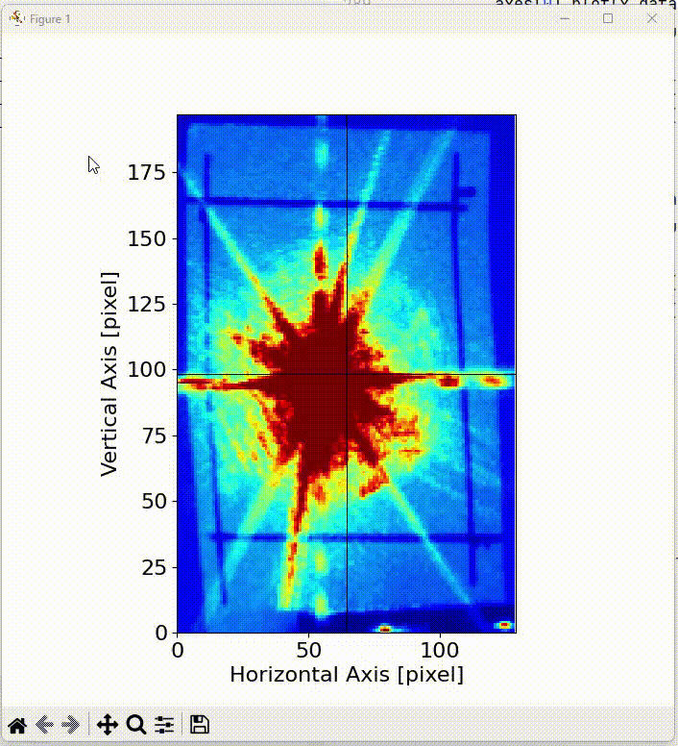
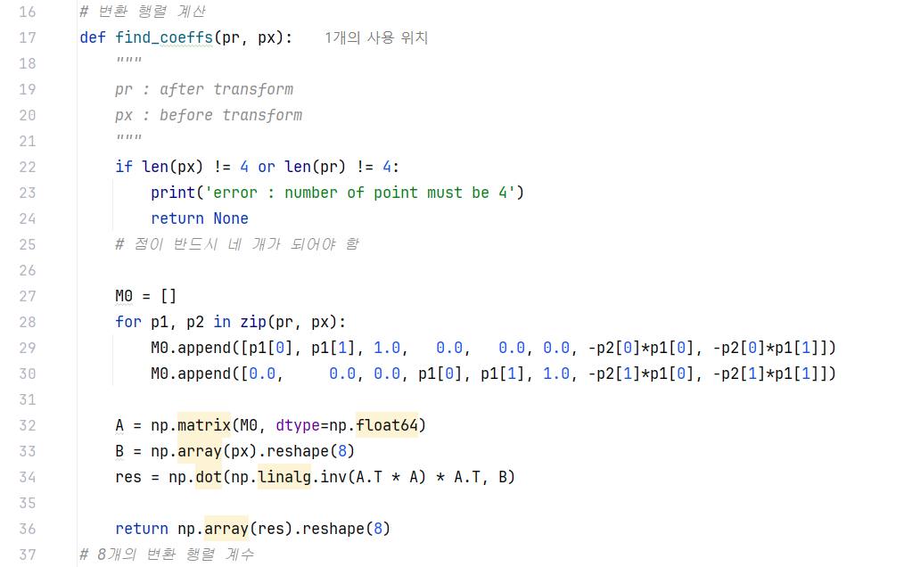
Beam Profile Monitoring Method
. . .

Slide 11
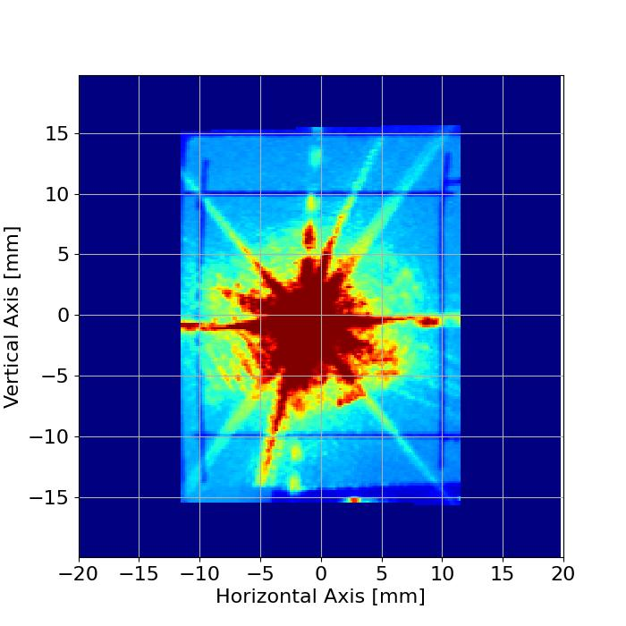
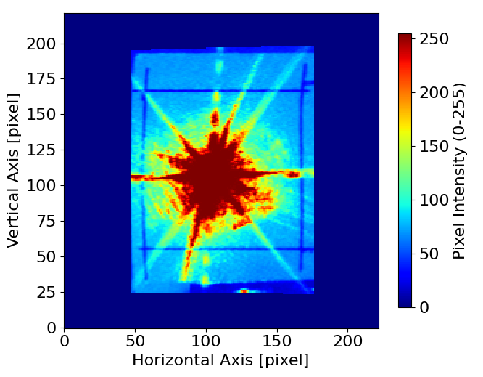
Beam Profile Monitoring Method
Real Space Image
Restored to original screen size
Projection showing transverse beam space
Pixel Space Image
Indicate the beam intensity
Can be used to plot 1D graph

Slide 12
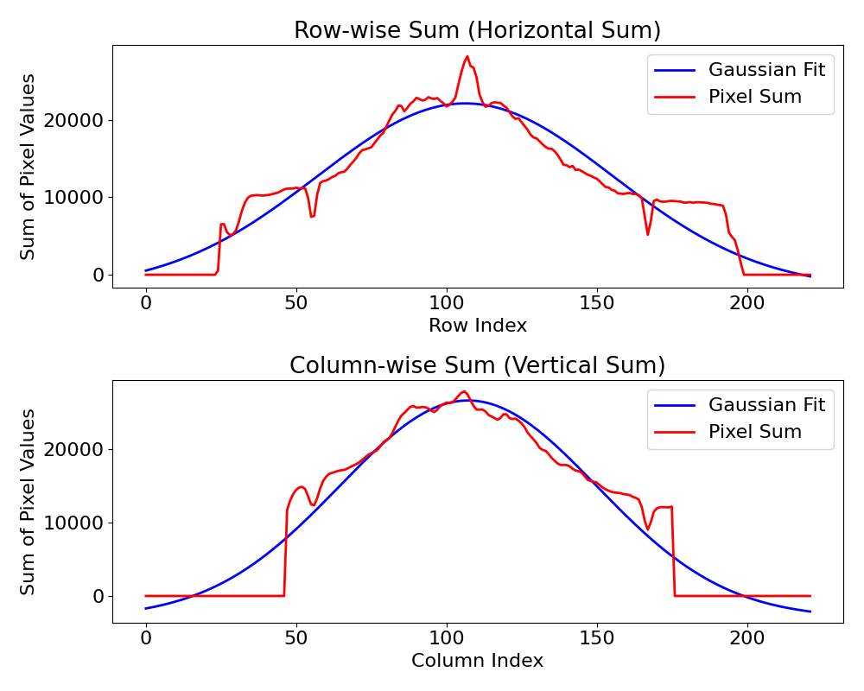
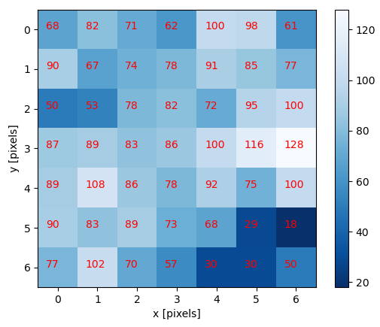
BPRM Measurement & Analysis
Read the raw image file
List up all pixel values of image
Sum pixel values along the axis
Plot them onto Gaussian graph
Adjust the graph fitting
Fitting Error
Offset (image noise)
Blank area (Outside of the screen)

Slide 13
Summary & Future Plan
BPRM Method
Perspective calibration
2D motorized BPRM stage
Beam profile graph fitting
Data Acquisition & Analysis
Utilize motorized axis when collecting 4 pairs of boundary condition coordinates
Establish the method of analyzing a set of data
Fill out and submit the paper

Slide 14
THANK YOU

