Slide 1
Study of longitudinal phase space reconstruction using ART
25. 04. 11
Geunwoo Kim

Slide 2
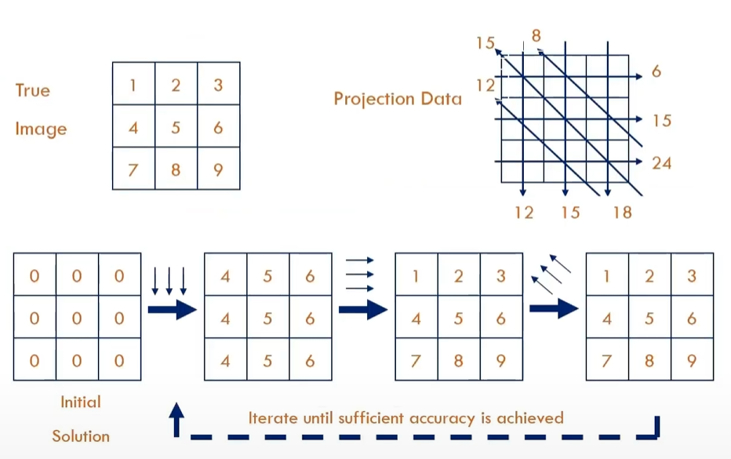
ART (Algebraic Reconstruction Technique)
Update = (|True – Estimated|) / N
2

Slide 3
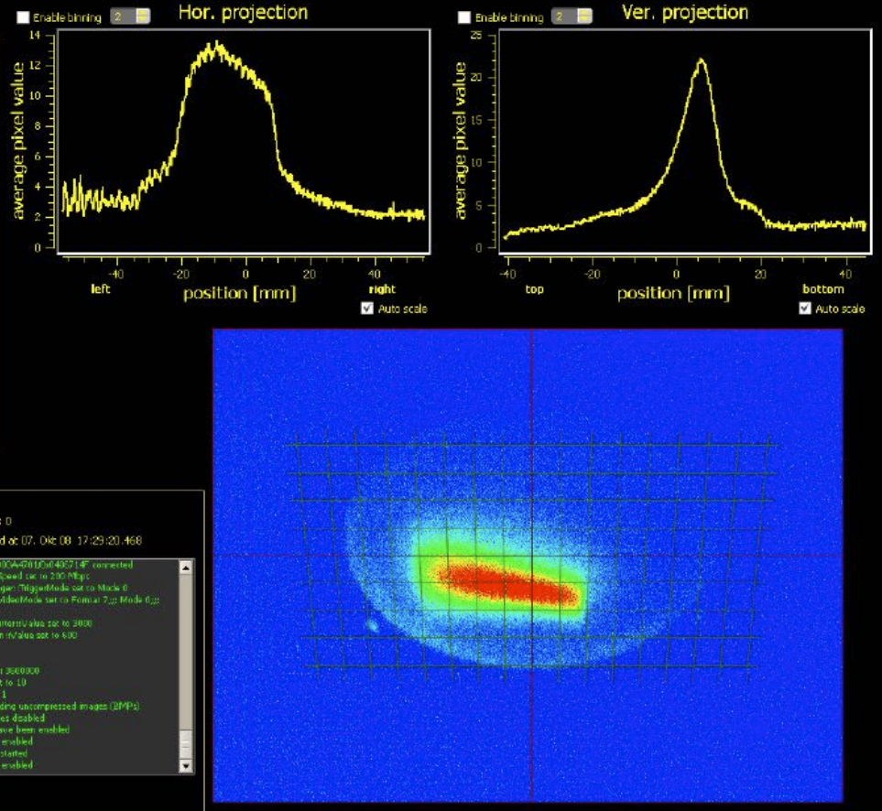
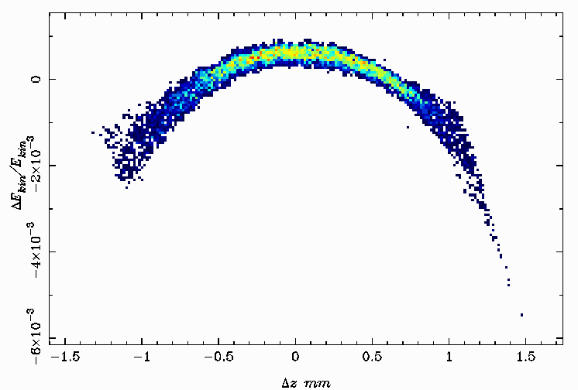
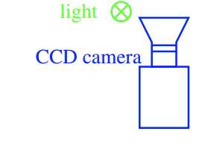
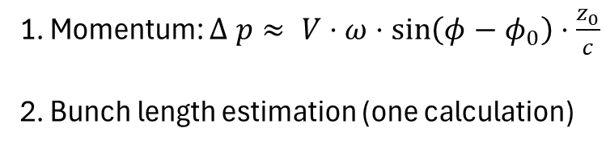
Transformation coordinates
Longitudinal phase space (z, p_{z})
How to convert coordinate?
1. Momentum: $Δ p≈ V⋅ω⋅\sin\left(φ−φ_{0}\right)⋅\frac{z_{0}}{c}$
2. Bunch length estimation (one calculation)
(x, y)
3

Slide 4
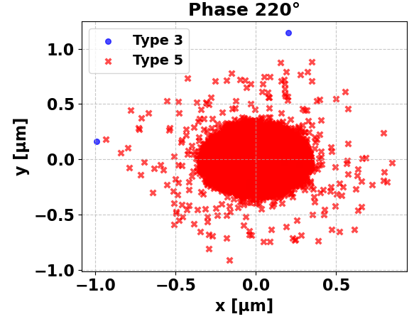
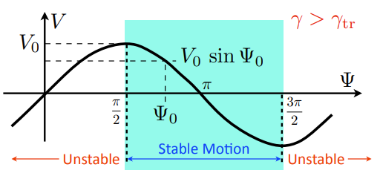
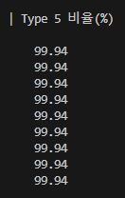
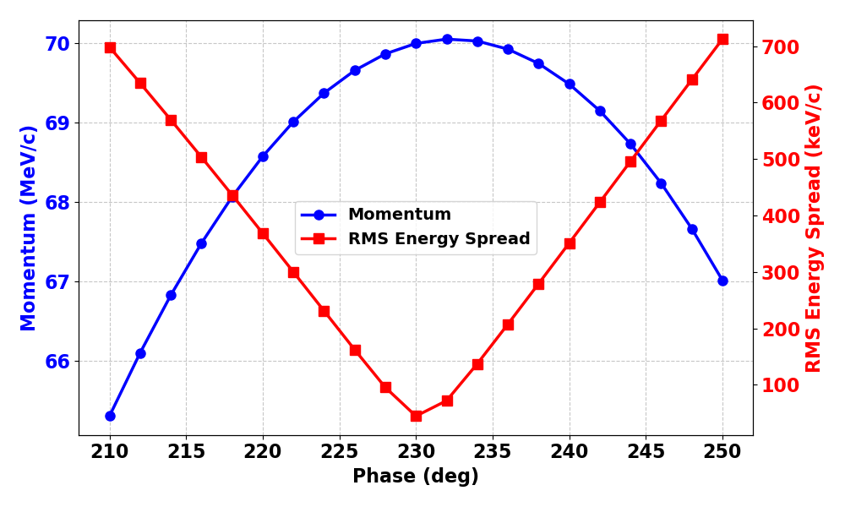
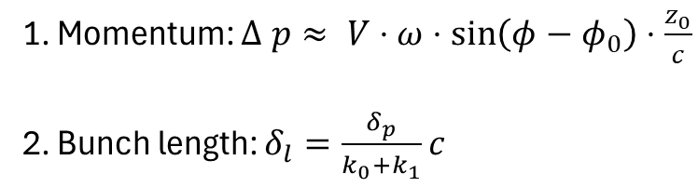
Transformation method
ASTRA simulation
Check particle loss
Momentum and energy spread
Reconstruction by using booster cavity
  Phase sweep of booster cavity
1. Momentum: $Δ p≈ V⋅ω⋅\sin\left(φ−φ_{0}\right)⋅\frac{z_{0}}{c}$
2. Bunch length: $δ_{l}=\frac{δ_{p}}{k_{0}+k_{1}}c$
momentum chirp before cavity
momentum chirp after cavity
4

Slide 5
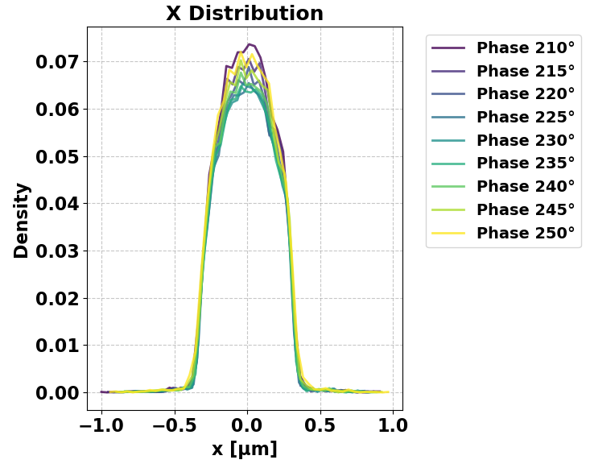
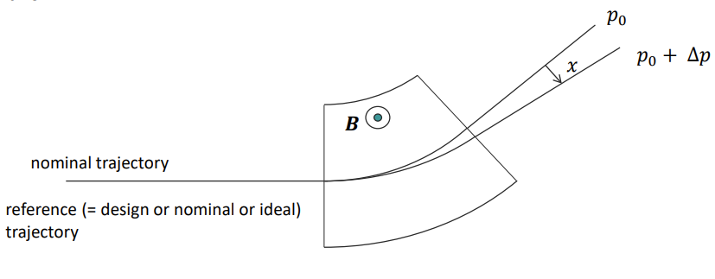
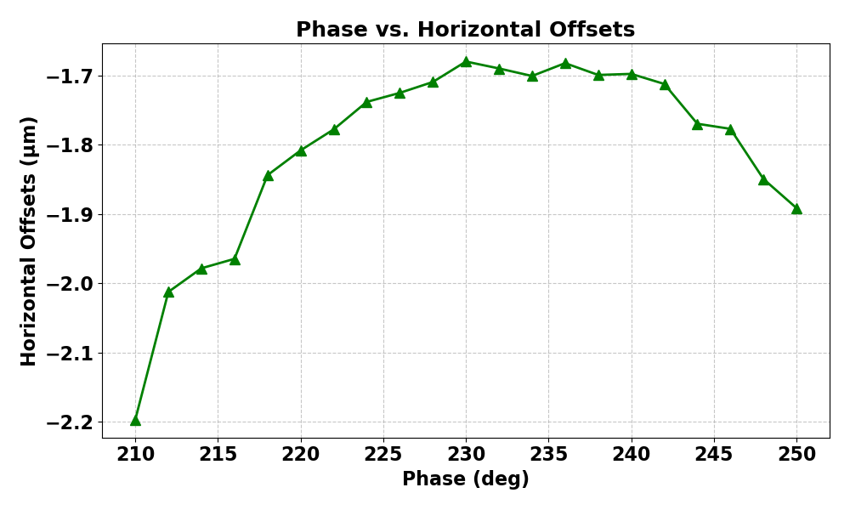

Transformation method
Issues simulation w/o dipole magnet
$$Δ p≈ V⋅ω⋅\sin\left(φ−φ_{0}\right)⋅\frac{z_{0}}{c}$$
It is difficult to observe x offset according to the phase sweep.
Cannot process tomography method w/o dipole.
Consider generating example data to verify algorithm.
Δ = ~ 0.5 μm
5

Slide 6
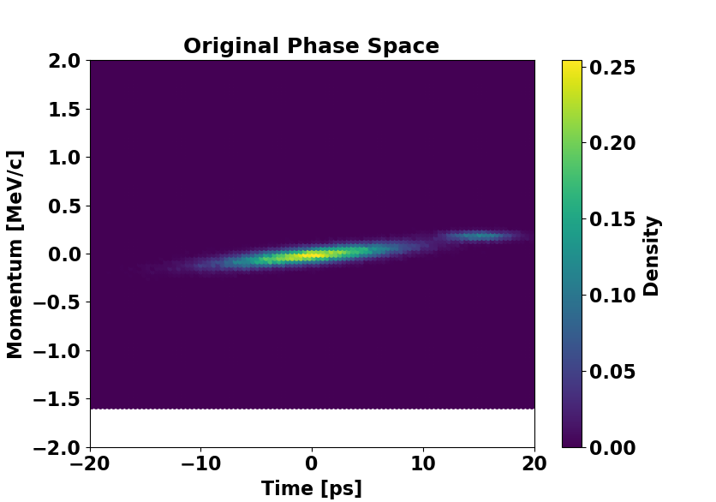
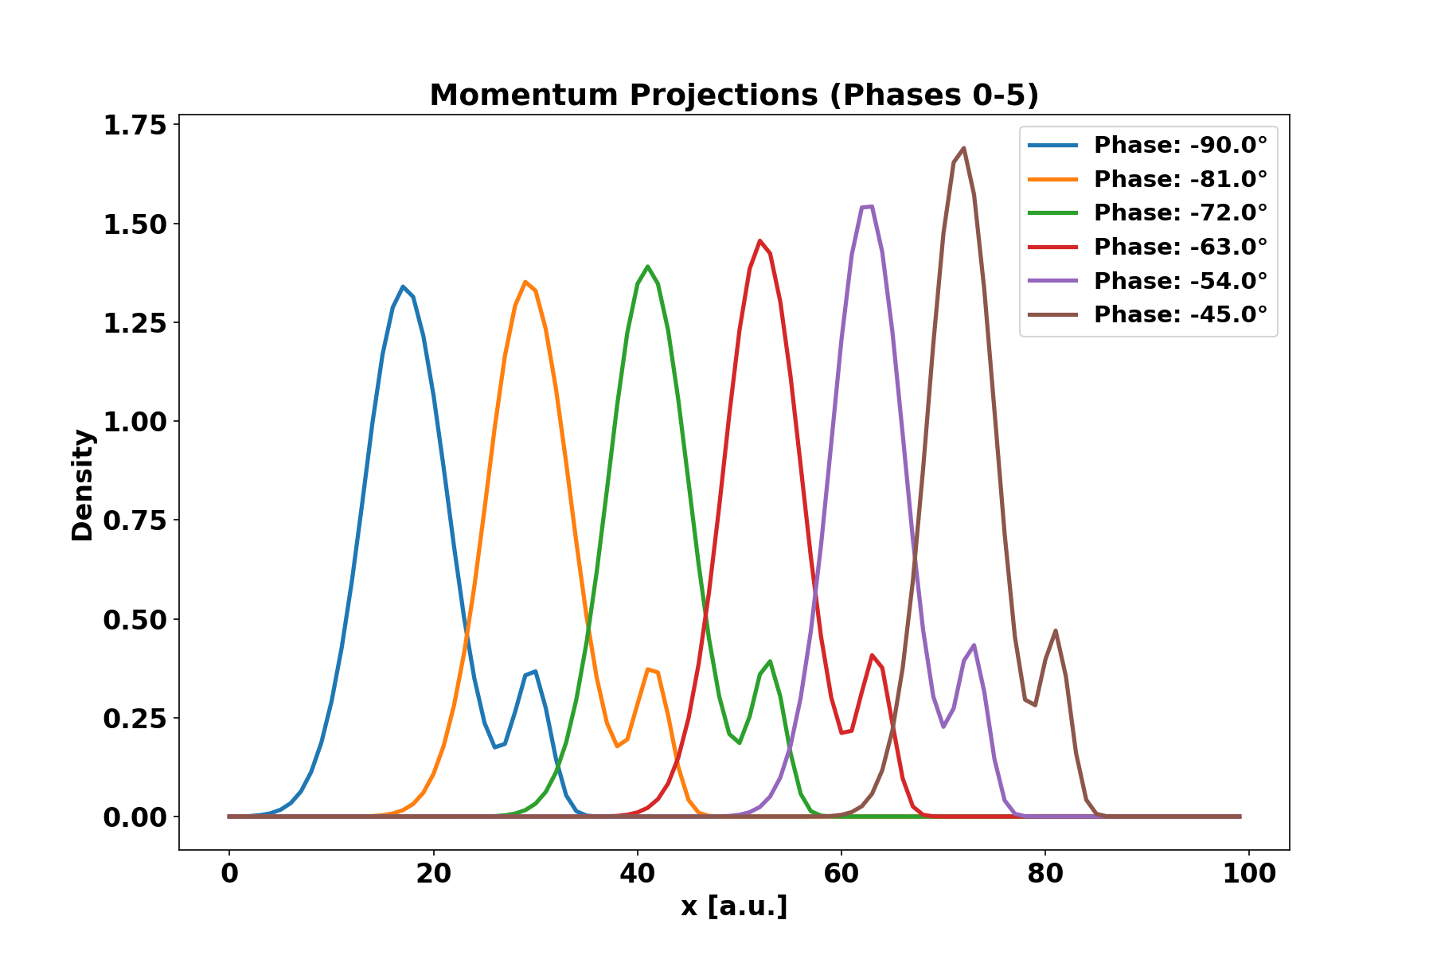
Algorithm test
Generating example file
Data requirements
x center shifting w.r.t phase
Enough amount of data to reconstruct (60 sets used in paper)
256 bins, 256 pixels (256 x 256 image)
particles 50,000
# of data = 61
-90 ~ 90 deg phase sweep data generated
6

Slide 7
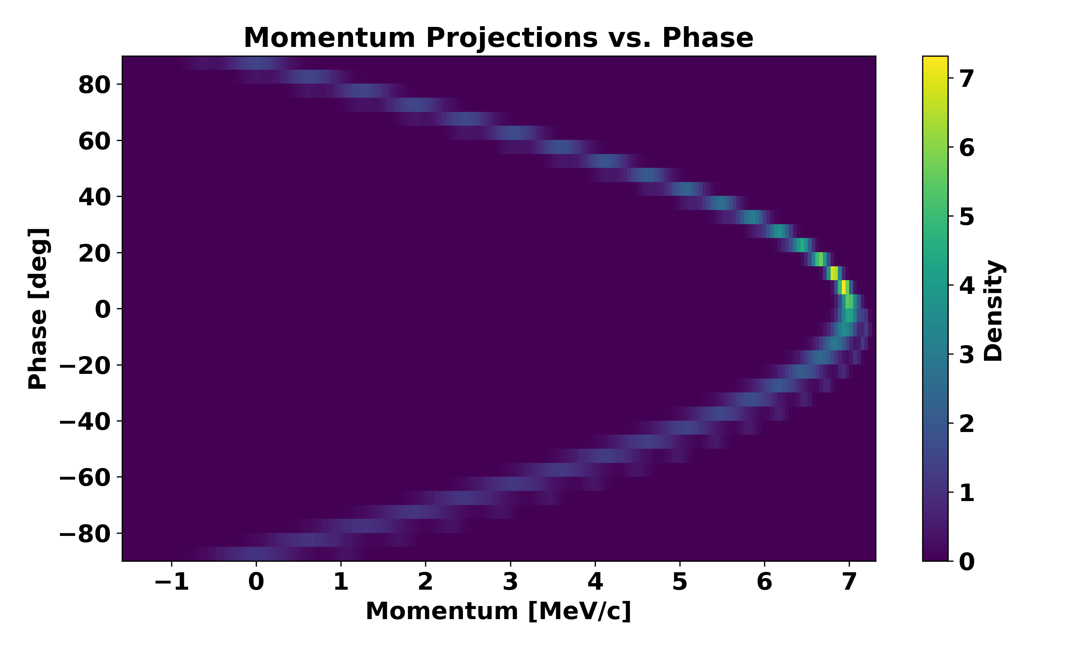
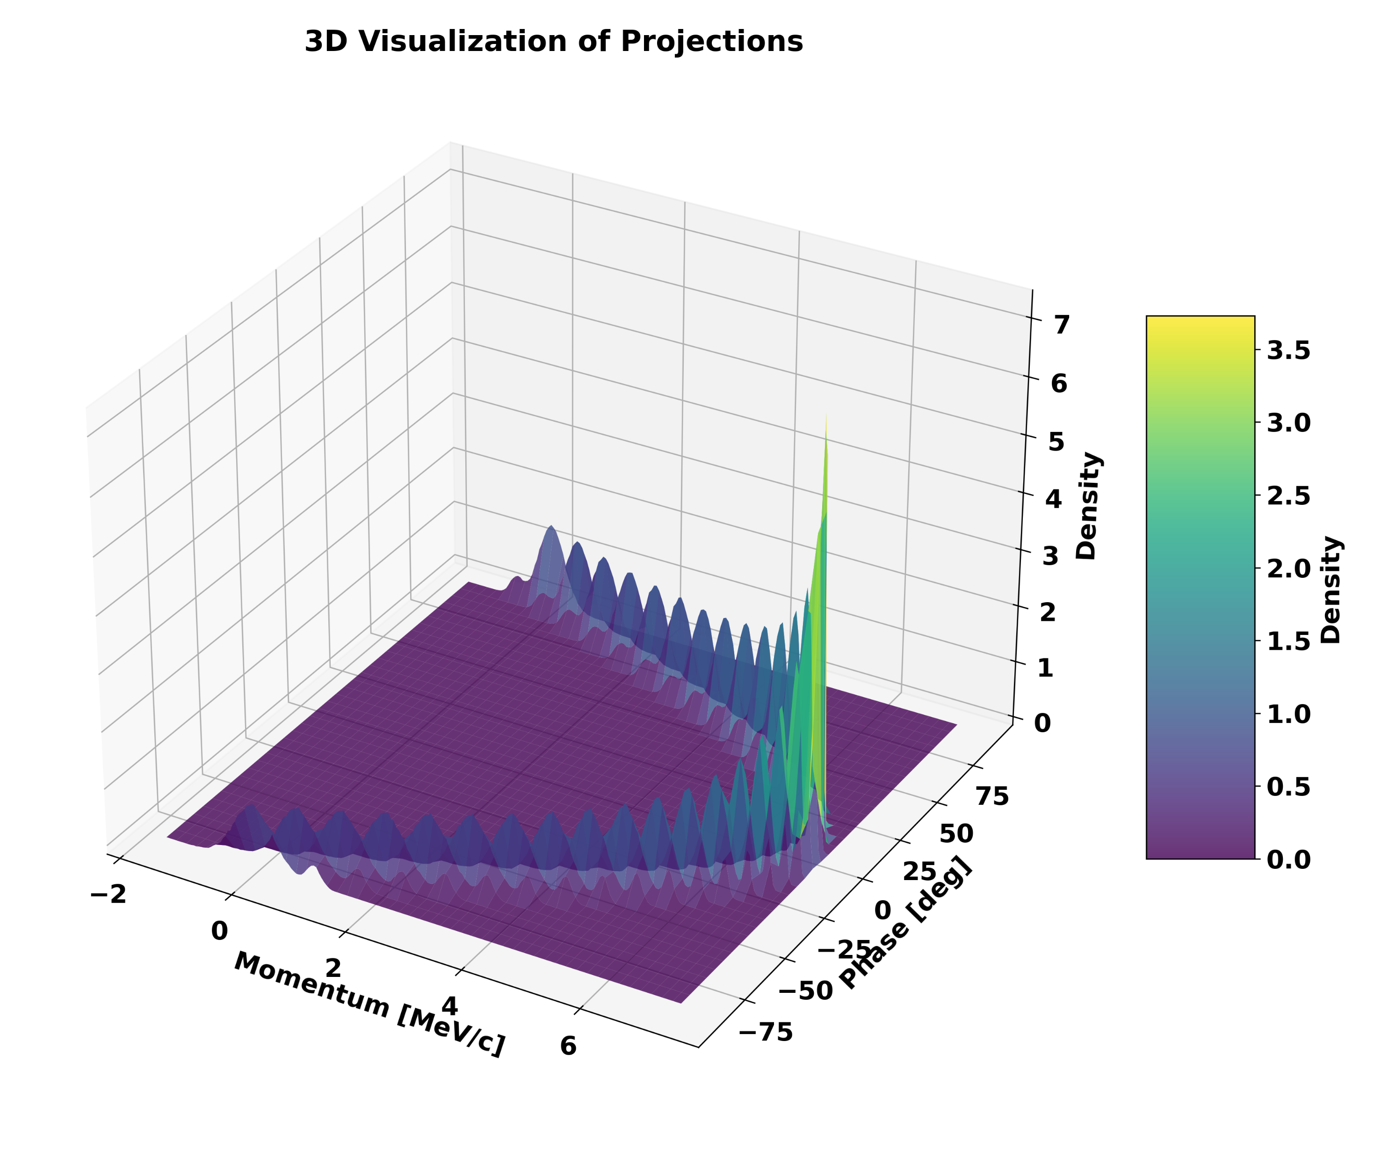
Algorithm test
Test developed ART algorithm
7

Slide 8
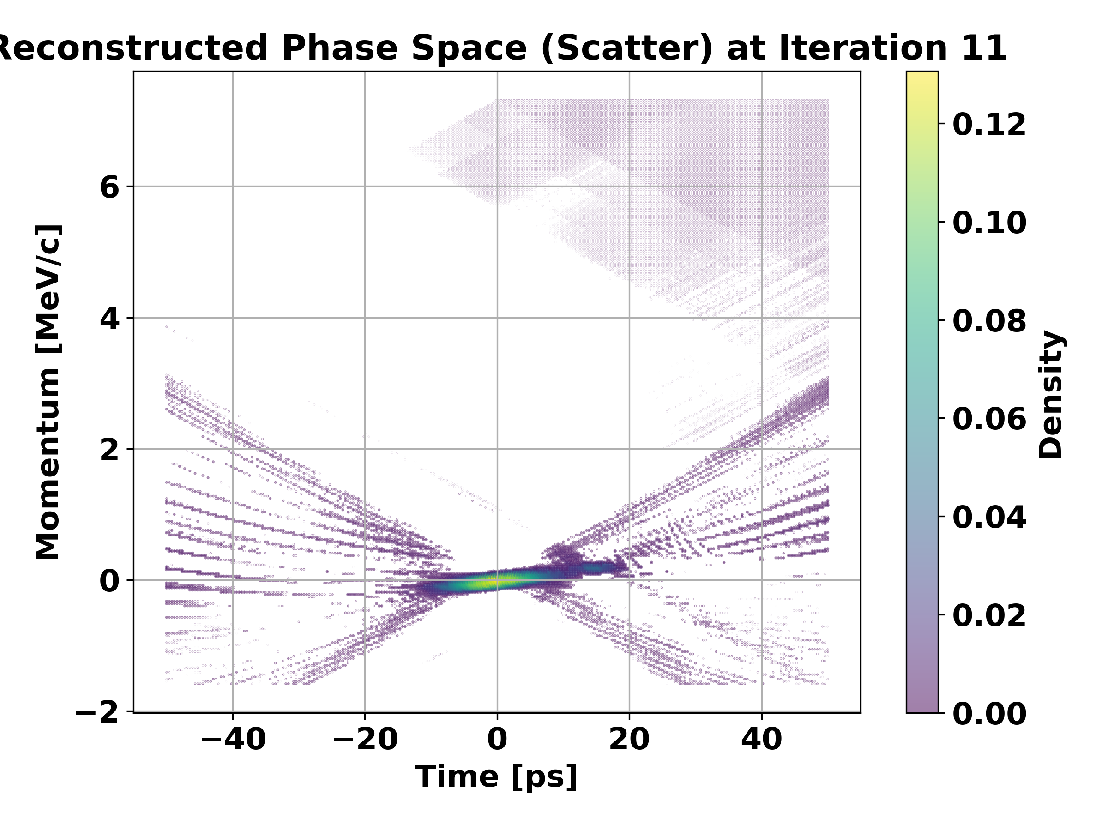
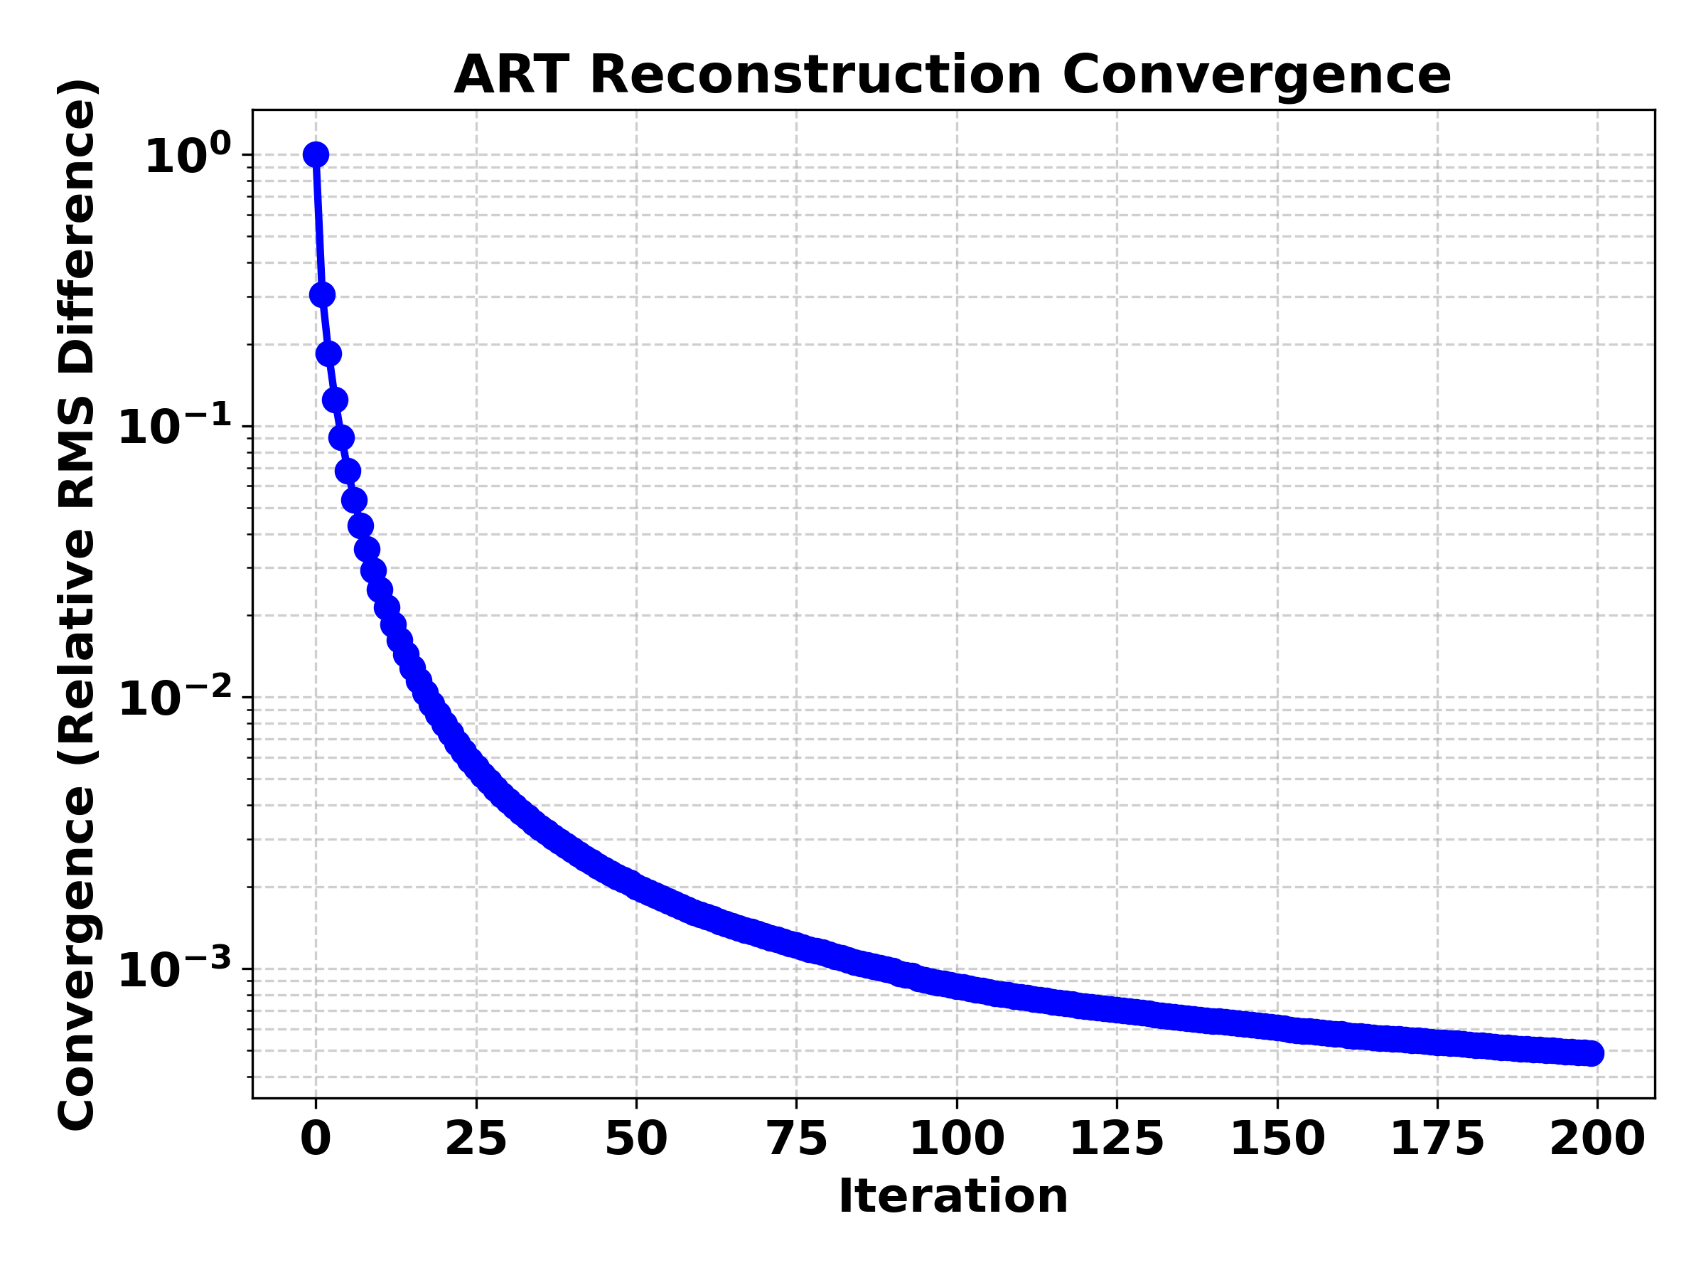
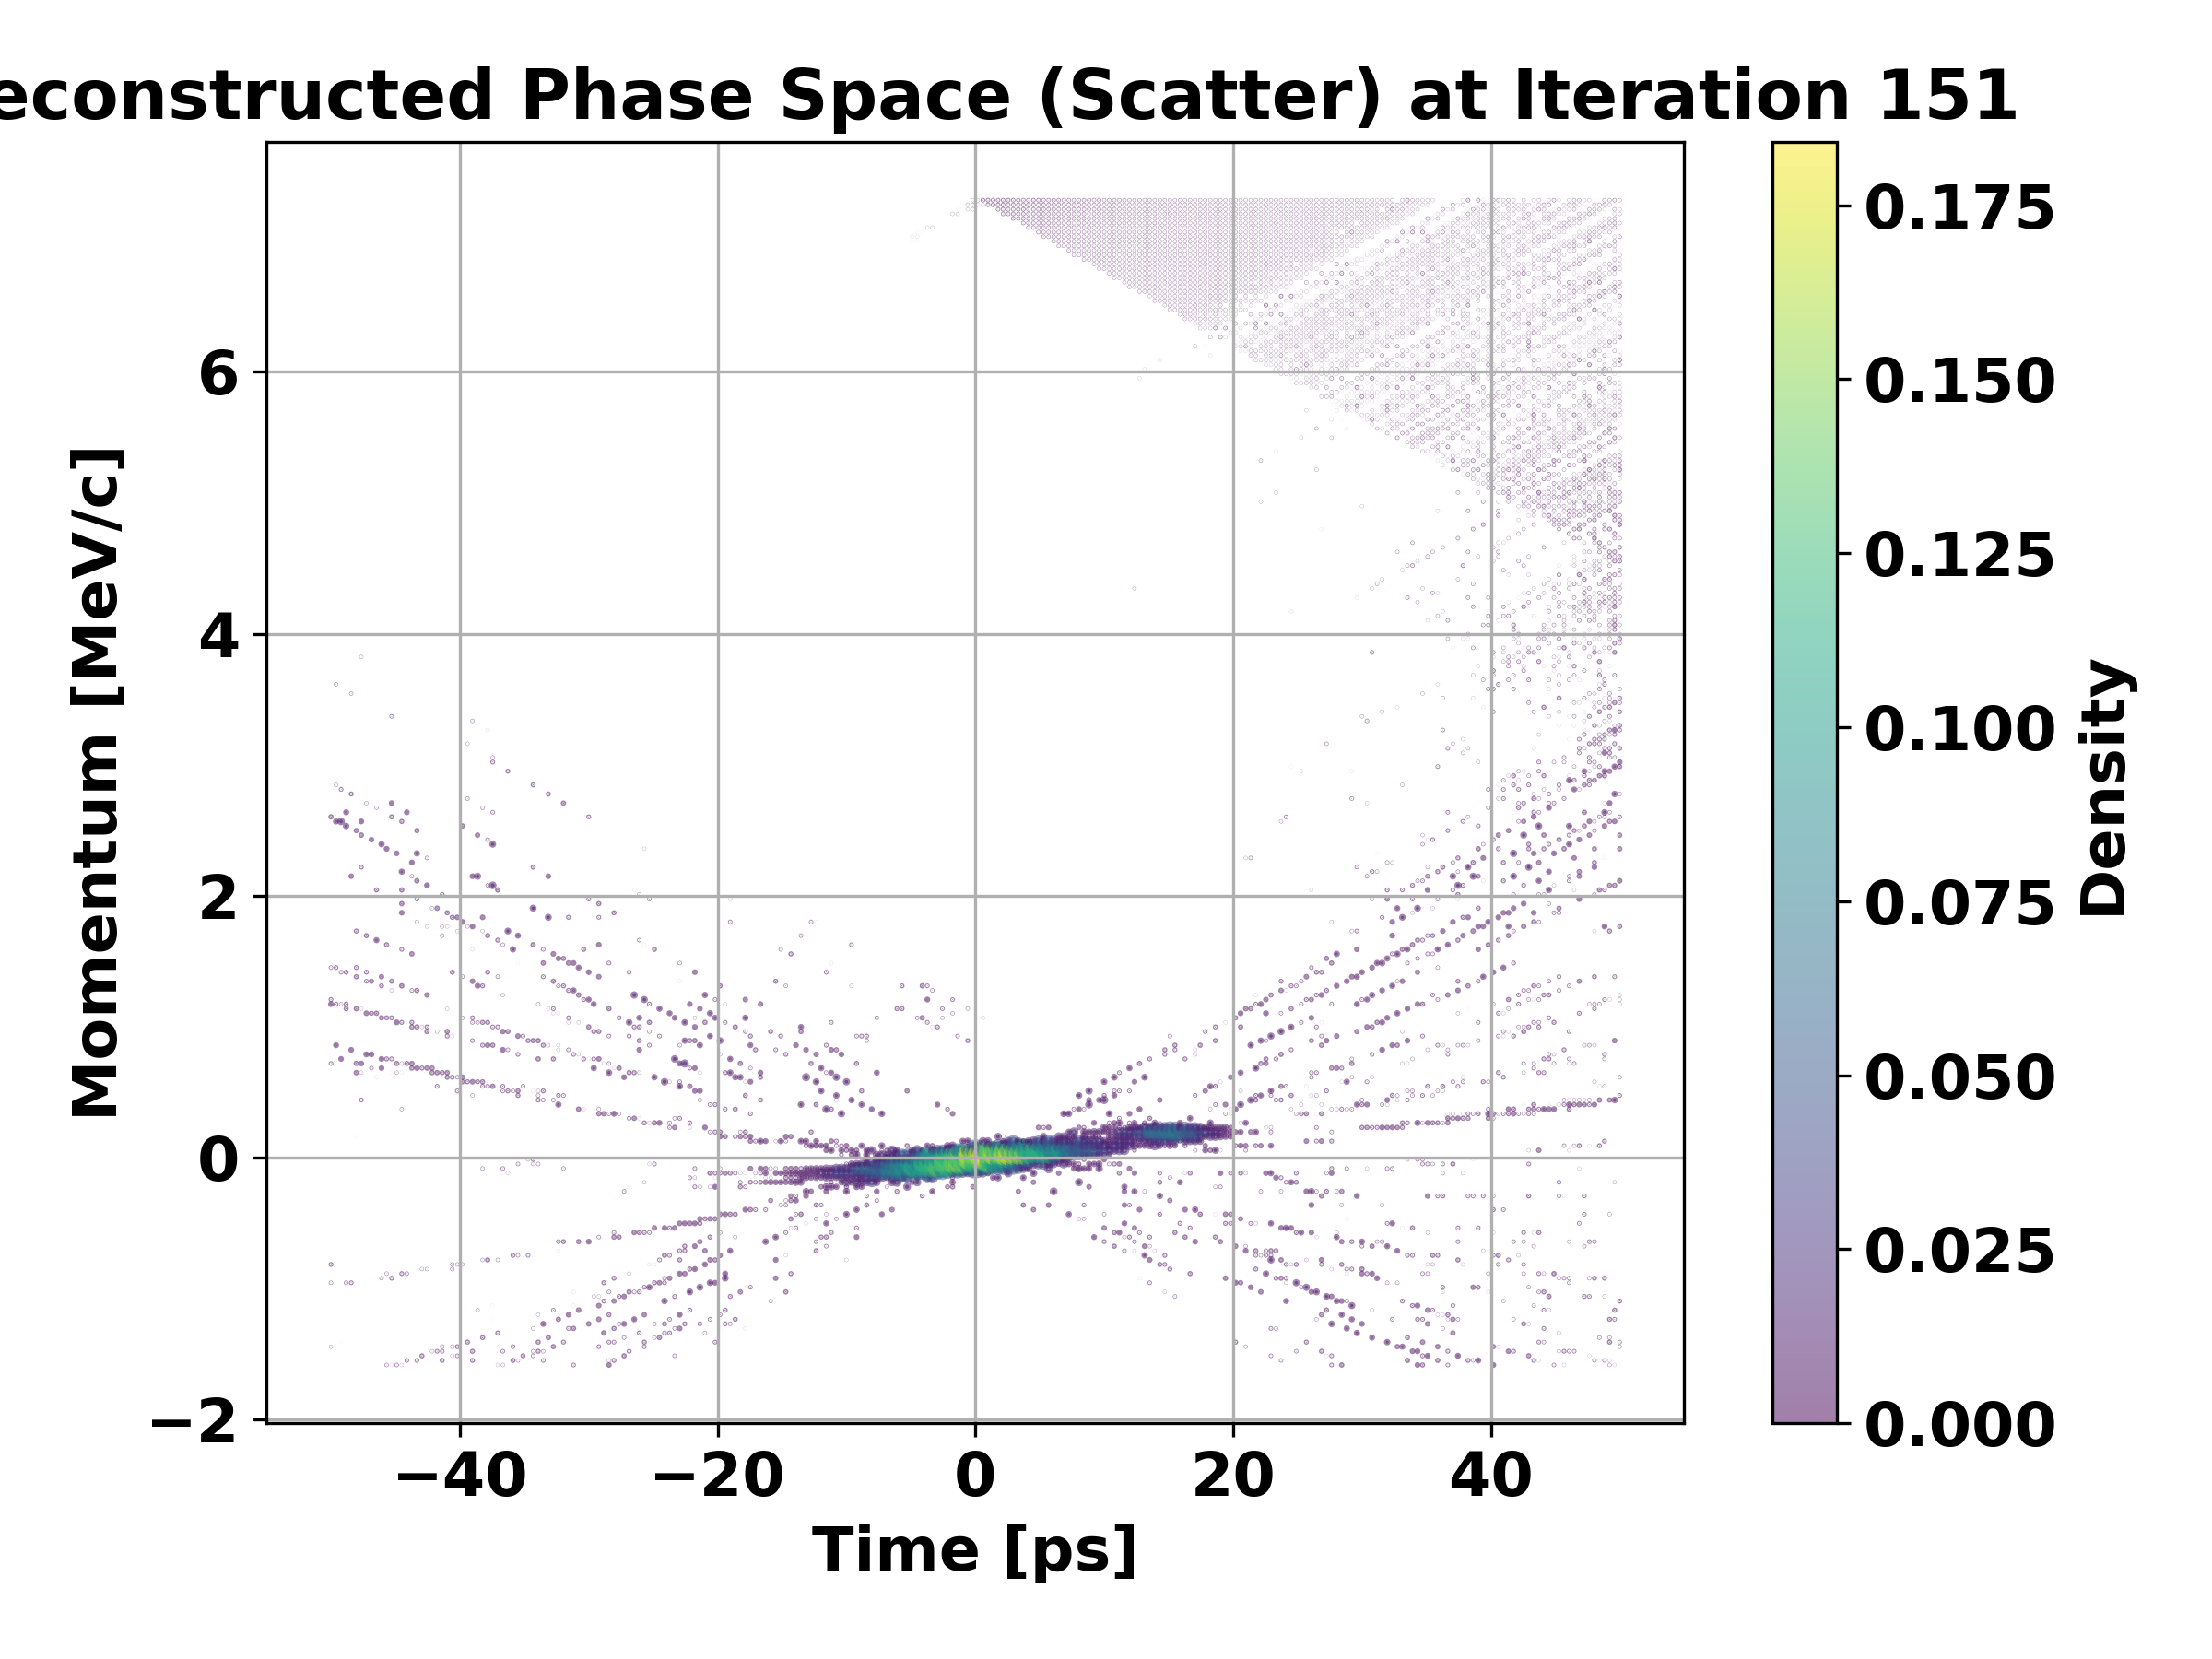
Algorithm test
Convergence 수식 넣기
Iteration: 11
Iteration: 151
8

Slide 9
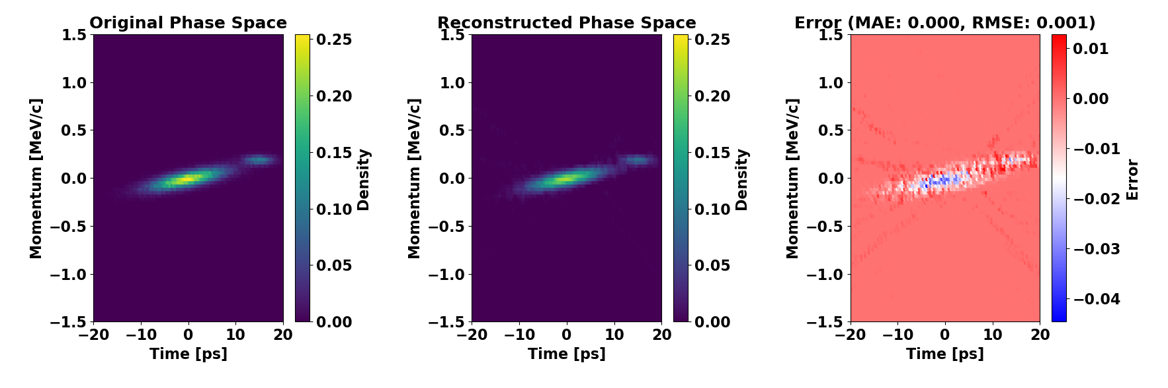
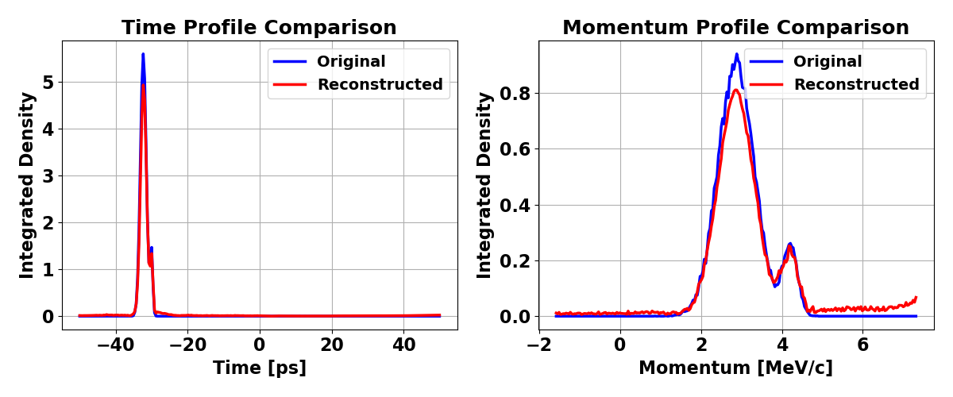
ART algorithm test
Well-matched original vs reconstruction
9

Slide 10
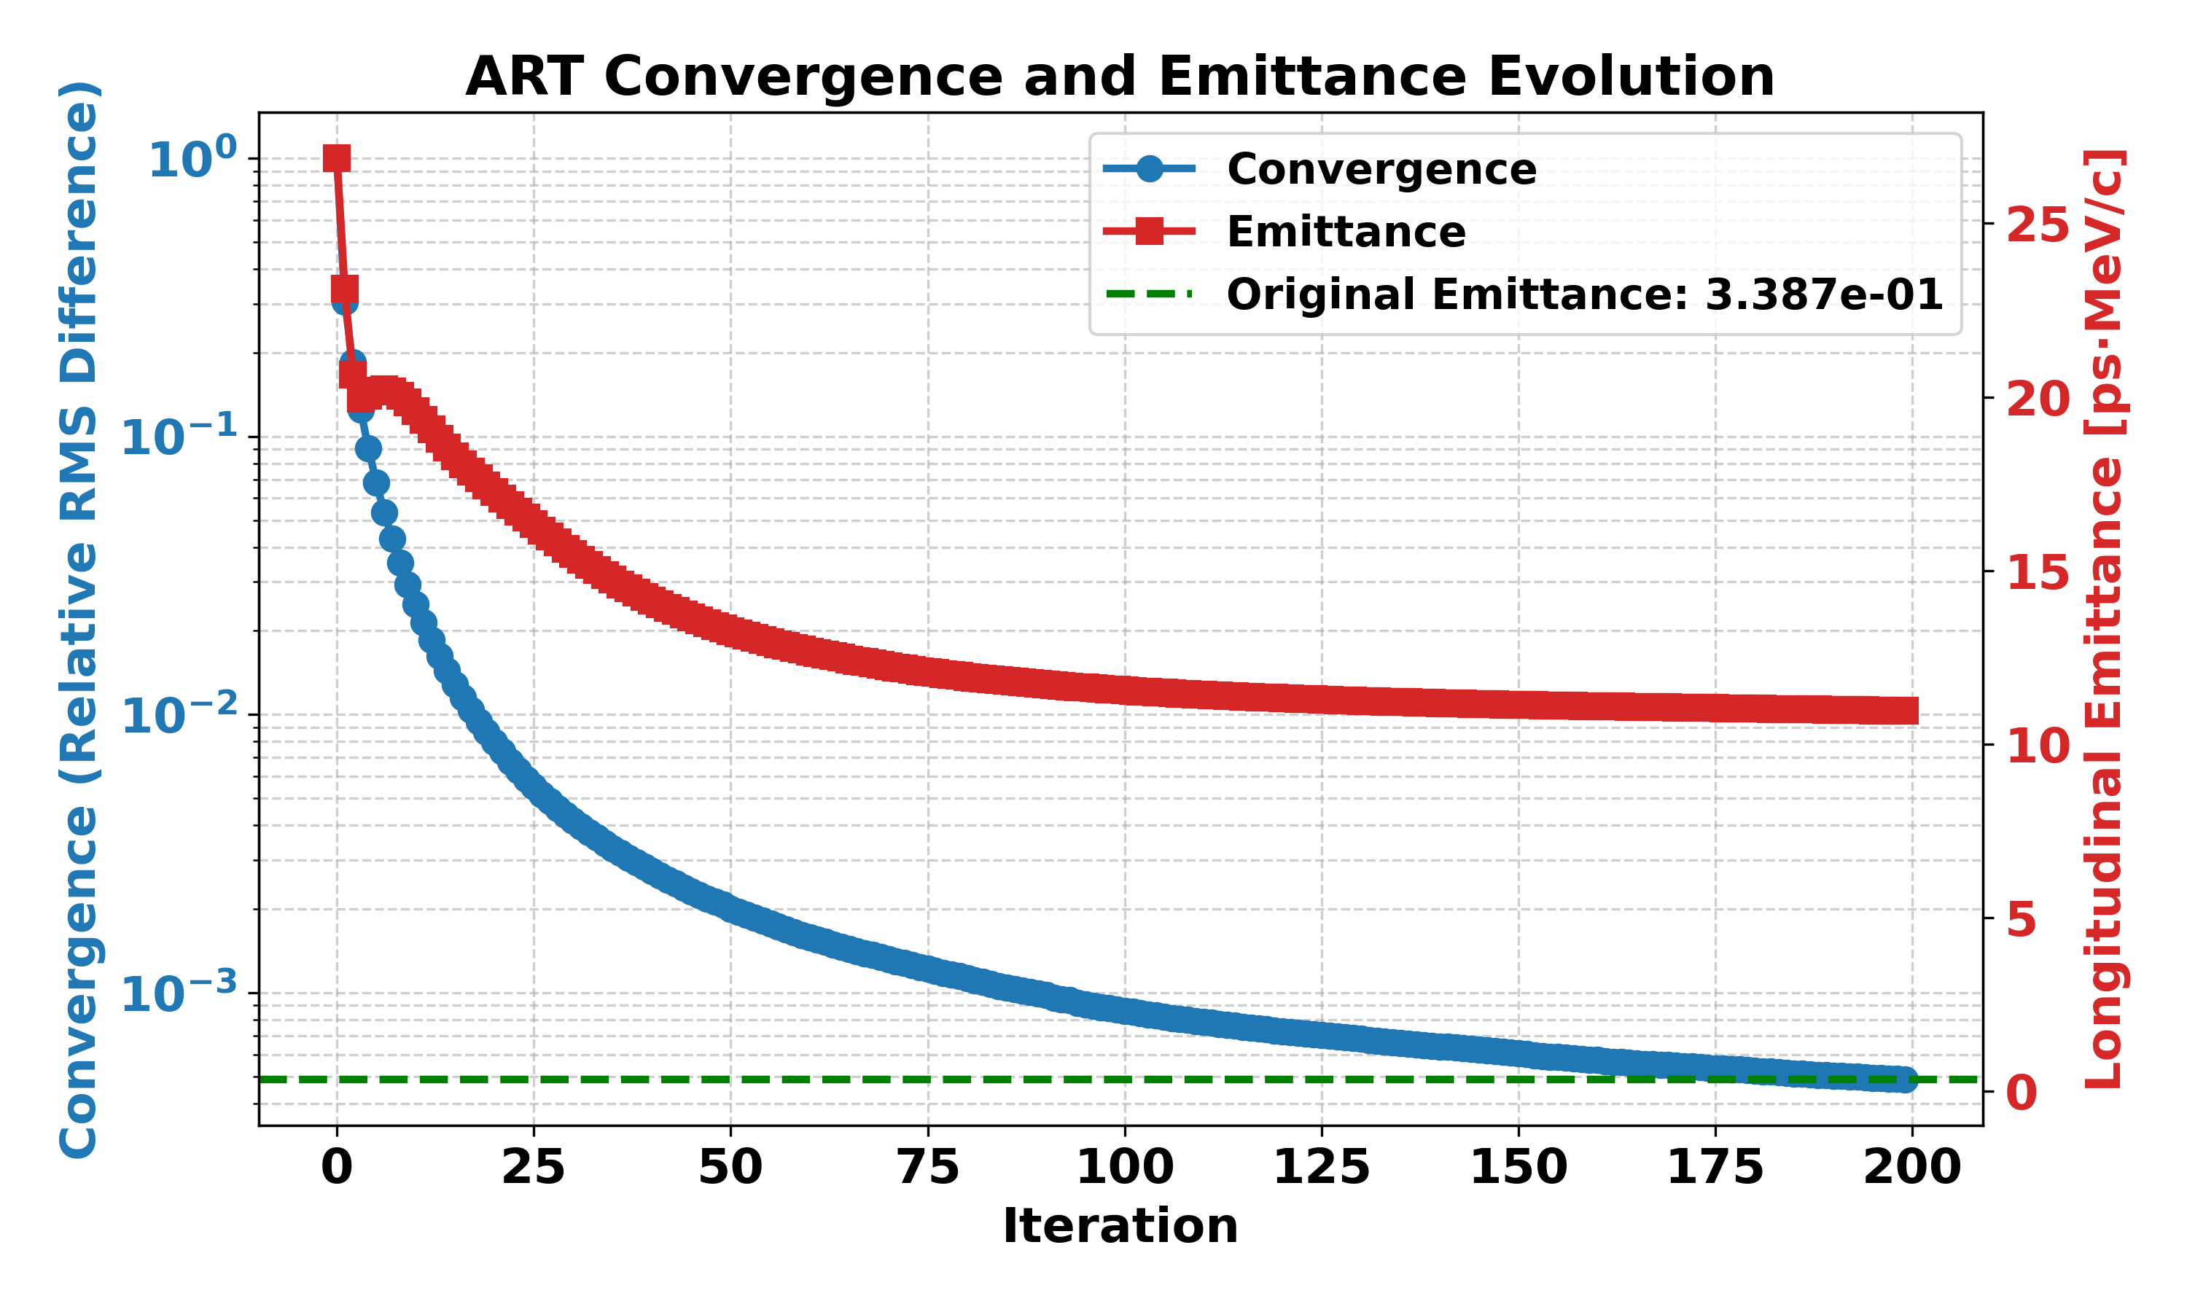

ART algorithm test
Longitudinal emittance
$$ε_{z}=\sqrt{\left\langle z^{2}\right\rangle ⋅\left\langle p_{z}^{2}\right\rangle −{\left\langle z⋅p_{z}\right\rangle }^{2}}.$$
10

Slide 11
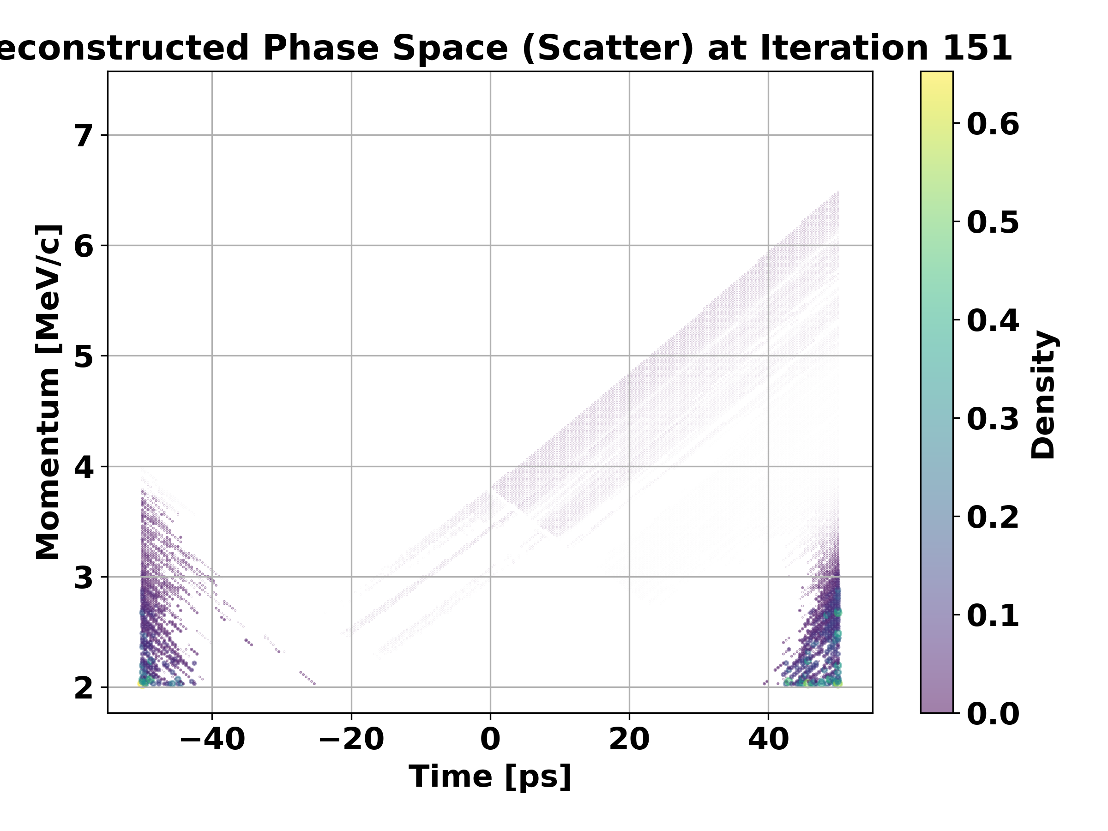
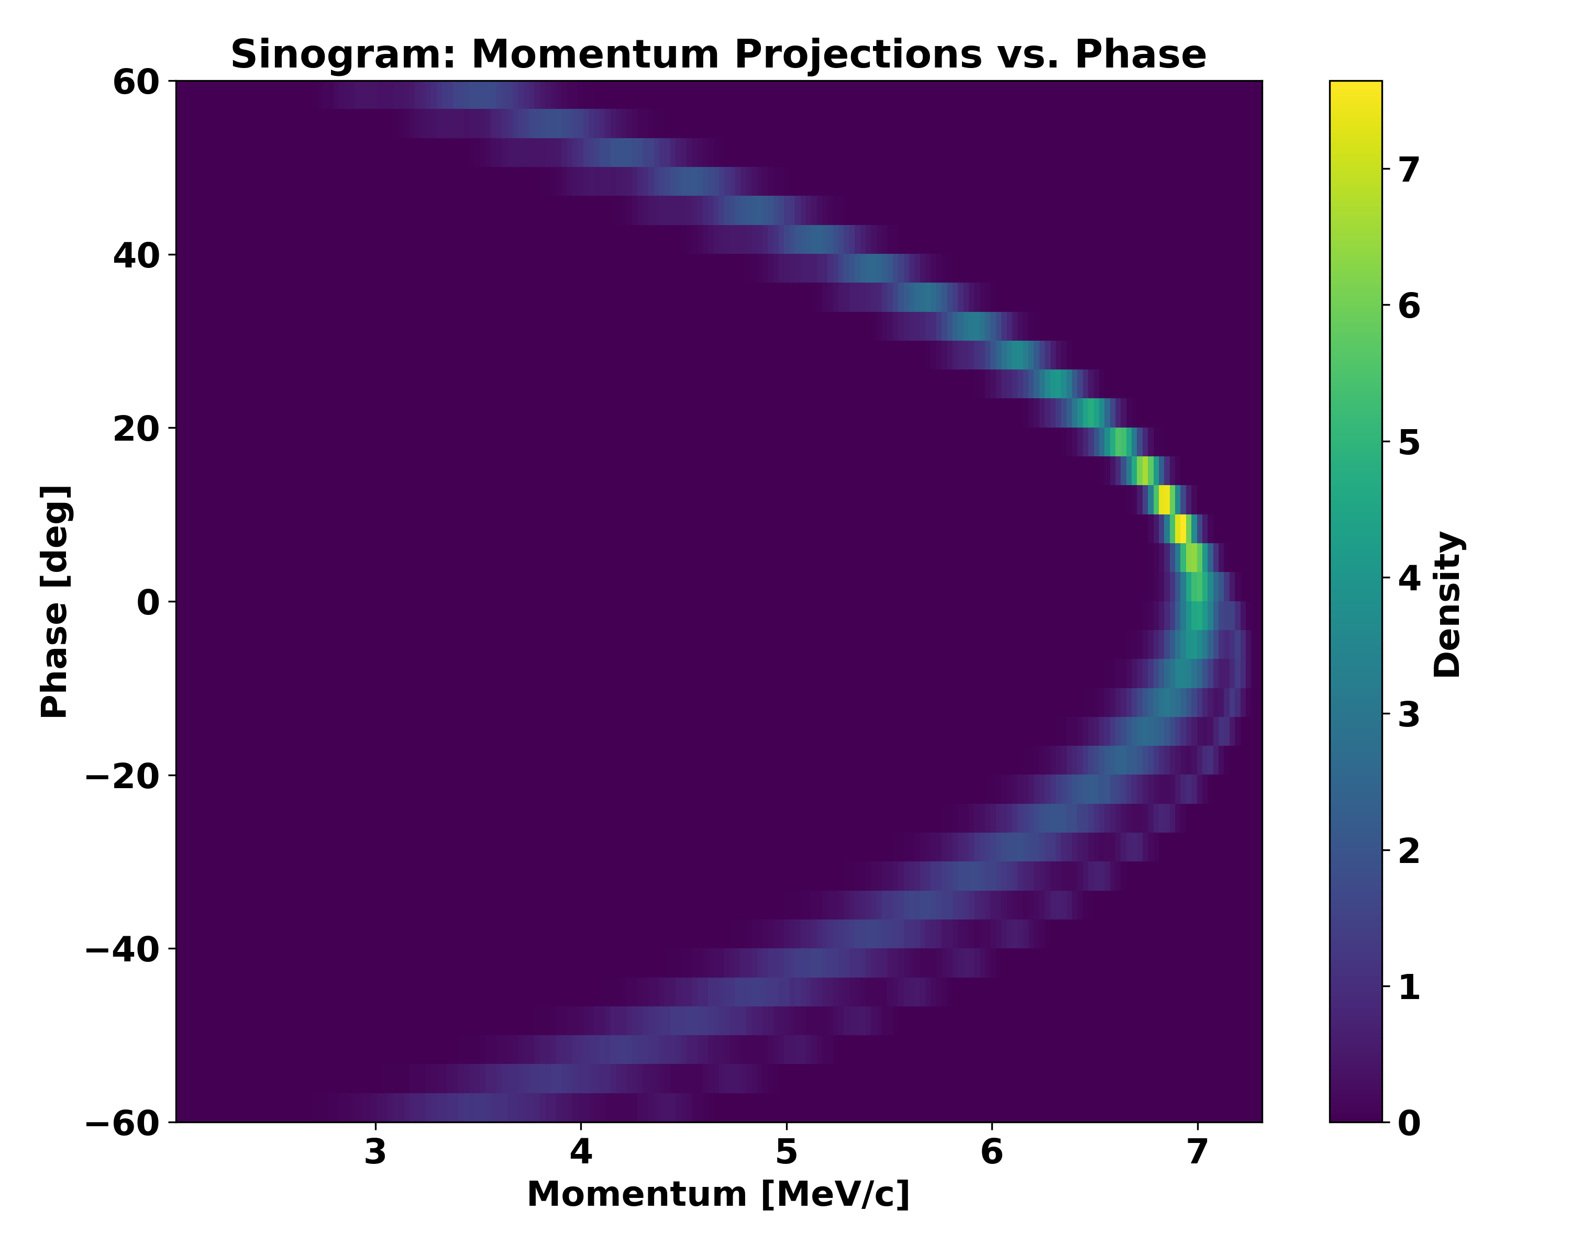
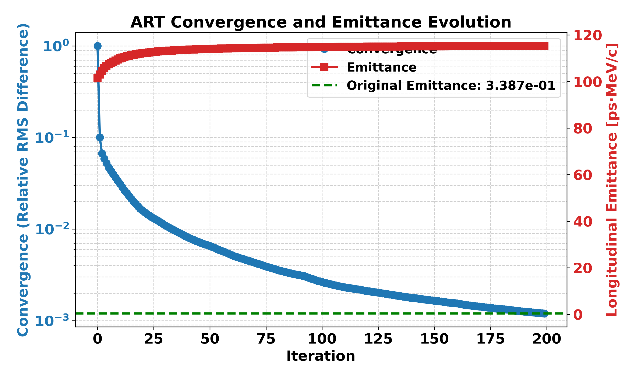
Algorithm test
Test developed ART algorithm with different angle range (-60, 60)
Not working for reduced angle range
11

Slide 12
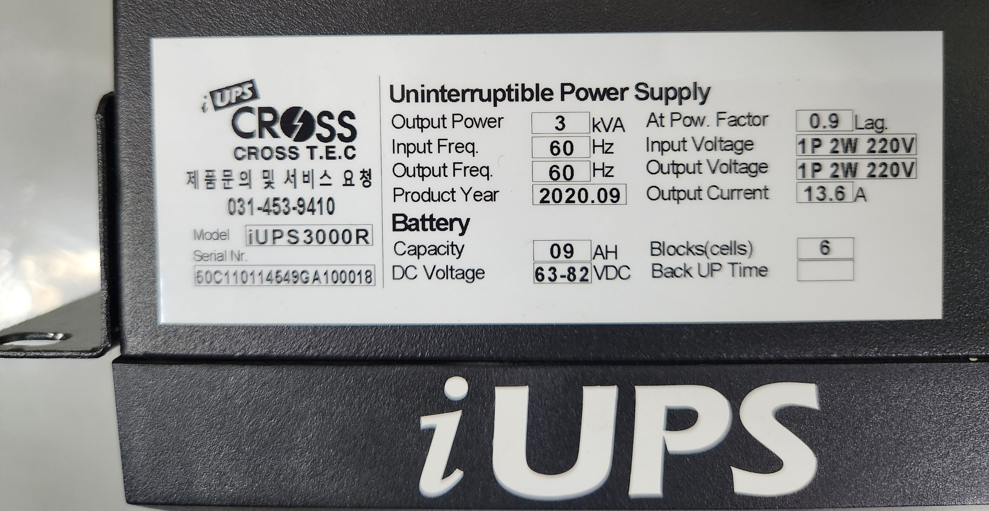
Summary & Next steps
Vacuum system
Verification of ART algorithm.
ASTRA Simulation approach w/o dipole
Dipole magnet implementation via elegant
ART Algorithm update
Beam diagnostics workshop & KPS
12

