Slide 1
20250404 Group Meeting
Minseo Jeong

Slide 2
Index
UED experiment
Current progress

Slide 3
UED Experiment
(24.12~25.03)
D. Filippetto et al. Rev. Mod. Phys. (2022).

Slide 4
UED Experiment
Beam size measurement: YAG screen
Emittance measurement: quadrupole scan
Energy measurement: dipole

Slide 5
UED Experiment
Diameter of collimator: 200μm
Type of sample: Al, Bi, MoO₃
Bunch charge: ~150fC
Measured normalized emittance: 0.0806/0.0542μm
Measured beam energy: 3.50MeV

Slide 6
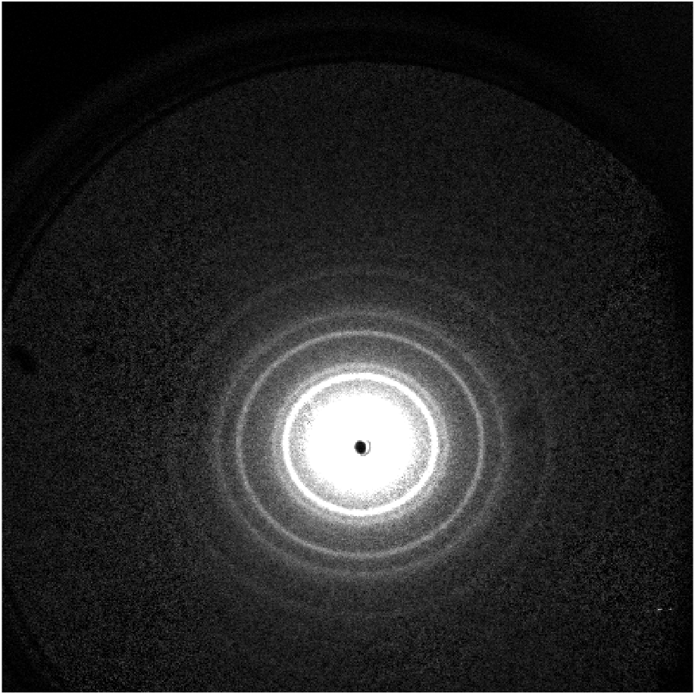
Diffraction Image of Al
-250318
(3 3 1)
(1 1 1)
(2 0 0)
(2 2 0)
(3 1 1)

Slide 7

UED Experiment
Bragg law: $d\sin{θ}≅d\frac{r}{L}=nλ$
Kinetic energy of photon: $\sqrt{{\left(pc\right)}^{2}+\left(m_{e}c^{2}\right)}−m_{e}c^{2}=\sqrt{{\left(\frac{h}{λ}c\right)}^{2}+\left(m_{e}c^{2}\right)}−m_{e}c^{2}=3.088MeV$

Slide 8
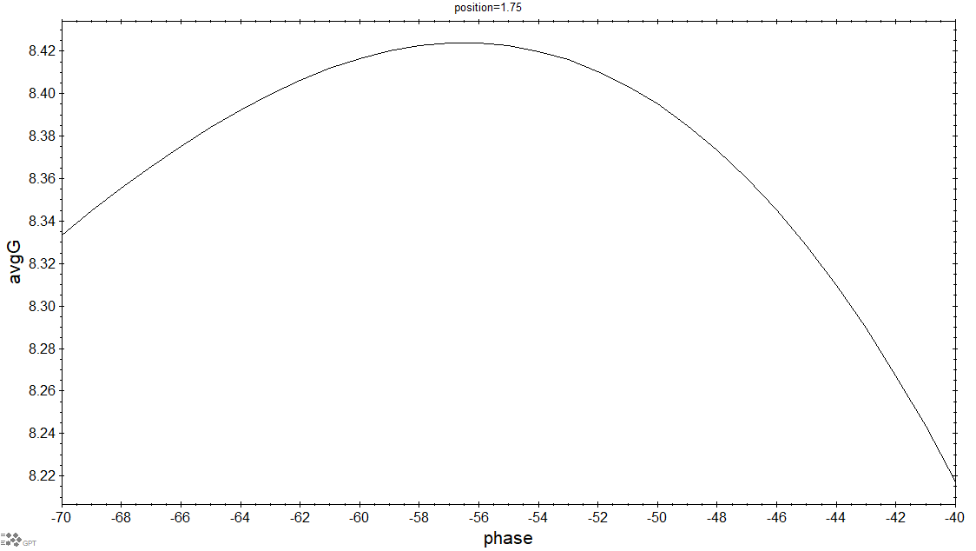
Current Progress
-Parameter Scan

Slide 9
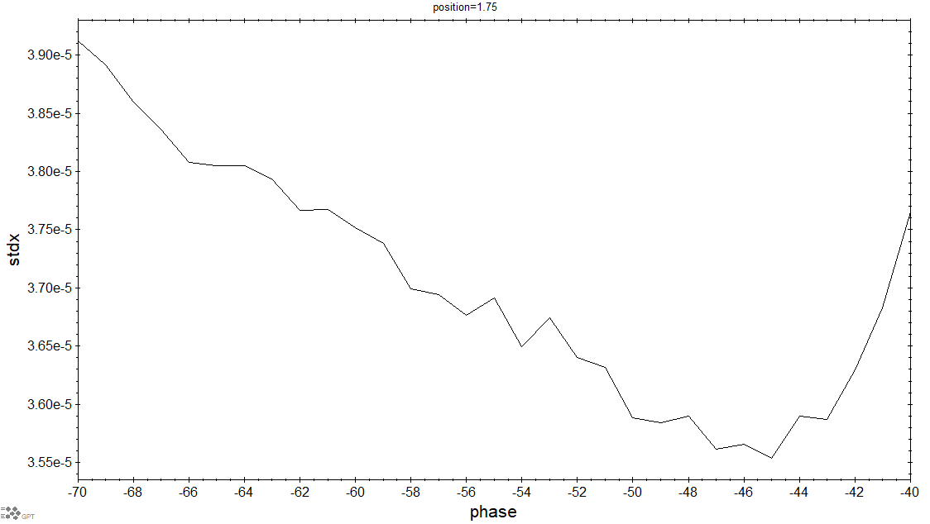
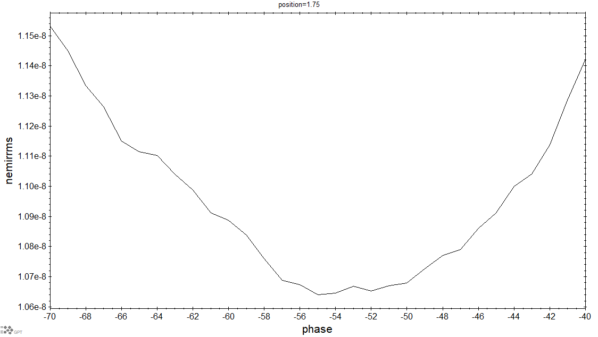
Current Progress
-Parameter Scan

Slide 10
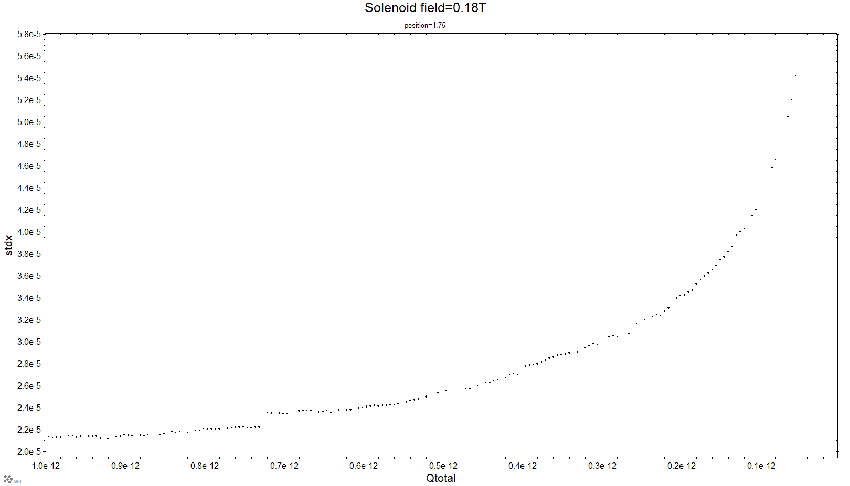
Current Progress
-Parameter Scan

Slide 11
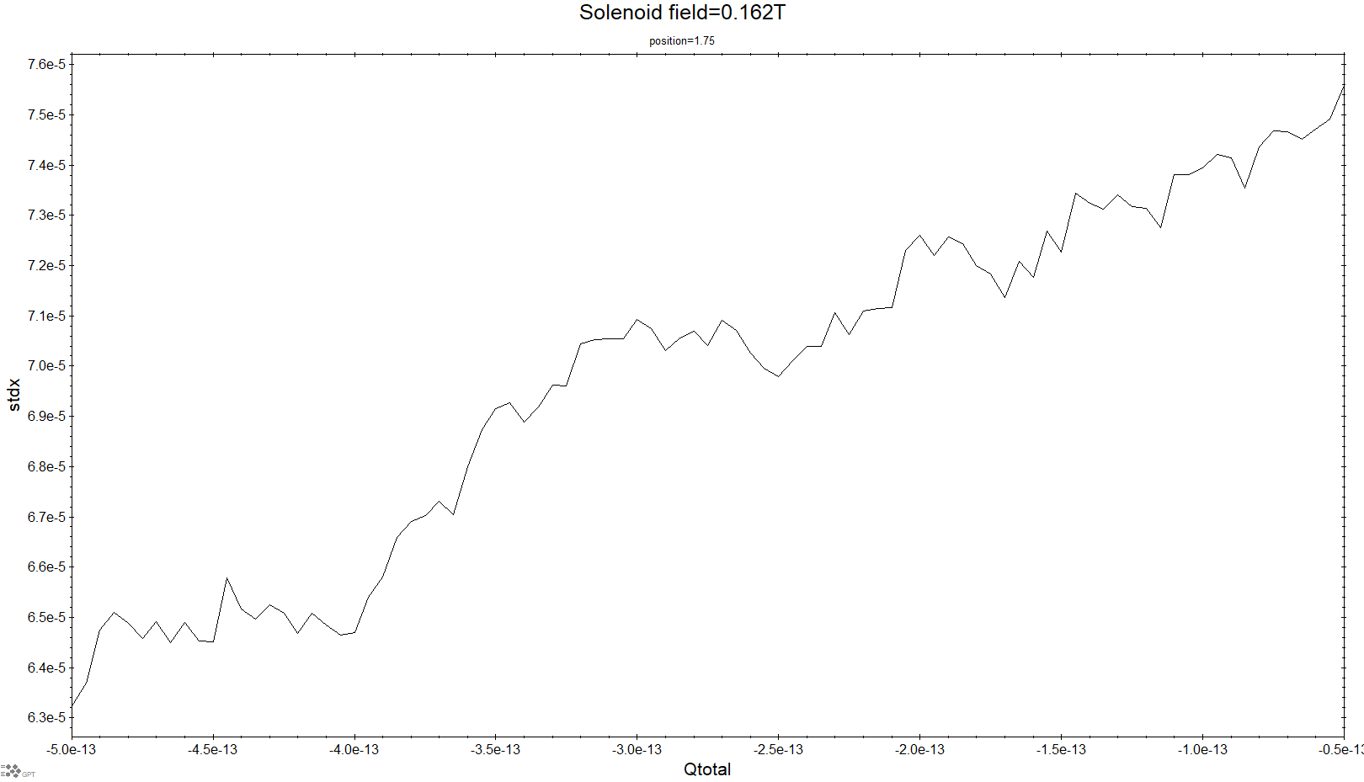
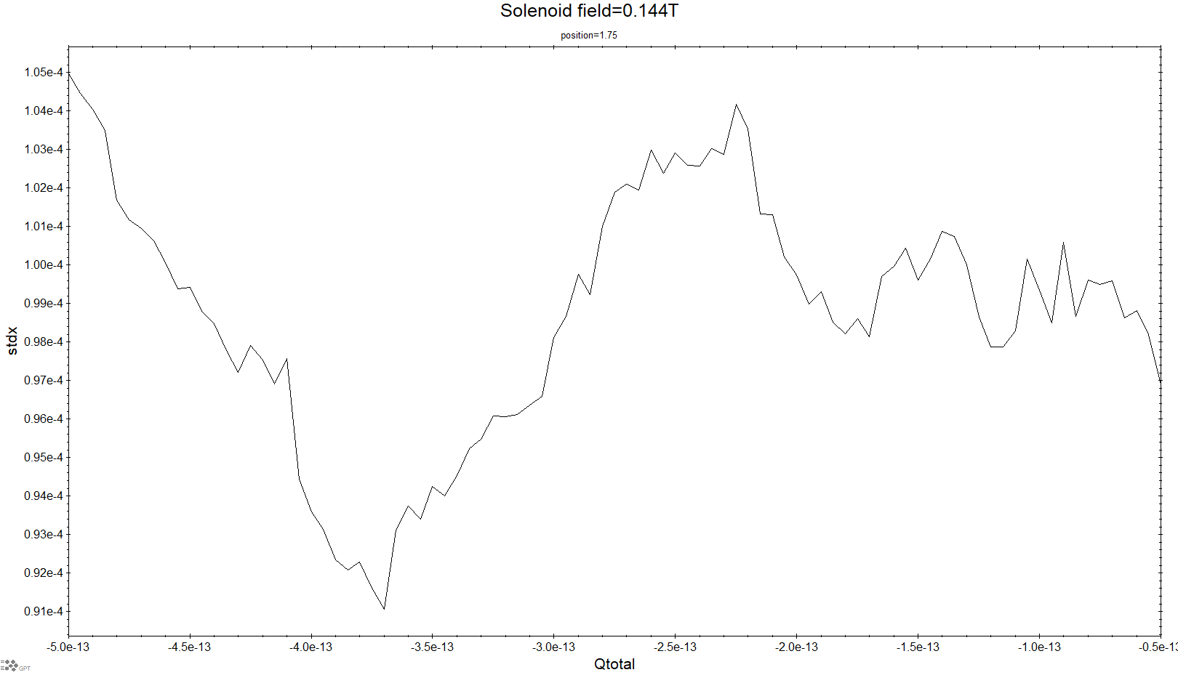
Current Progress
-Parameter Scan

Slide 12
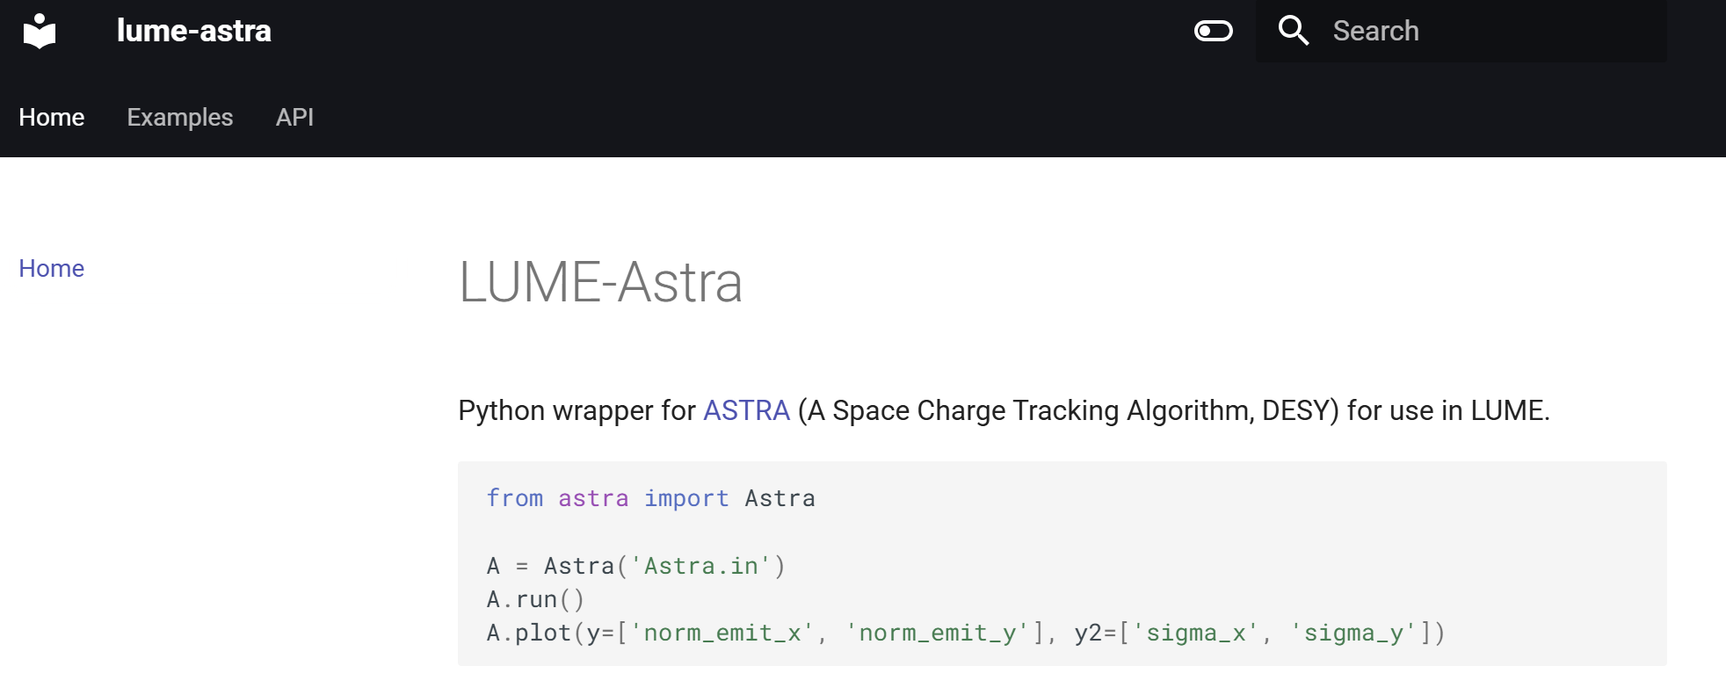
Current Progress

Slide 13
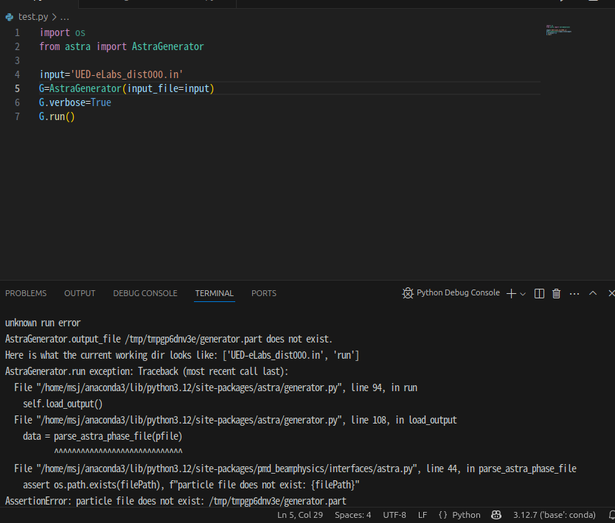
Current Progress

Slide 14
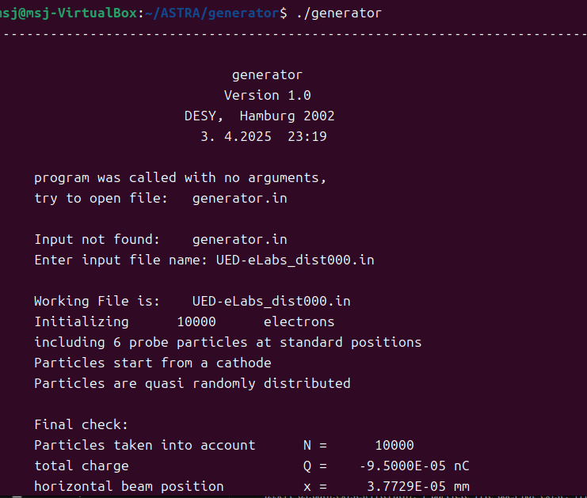
Current Progress

Slide 15
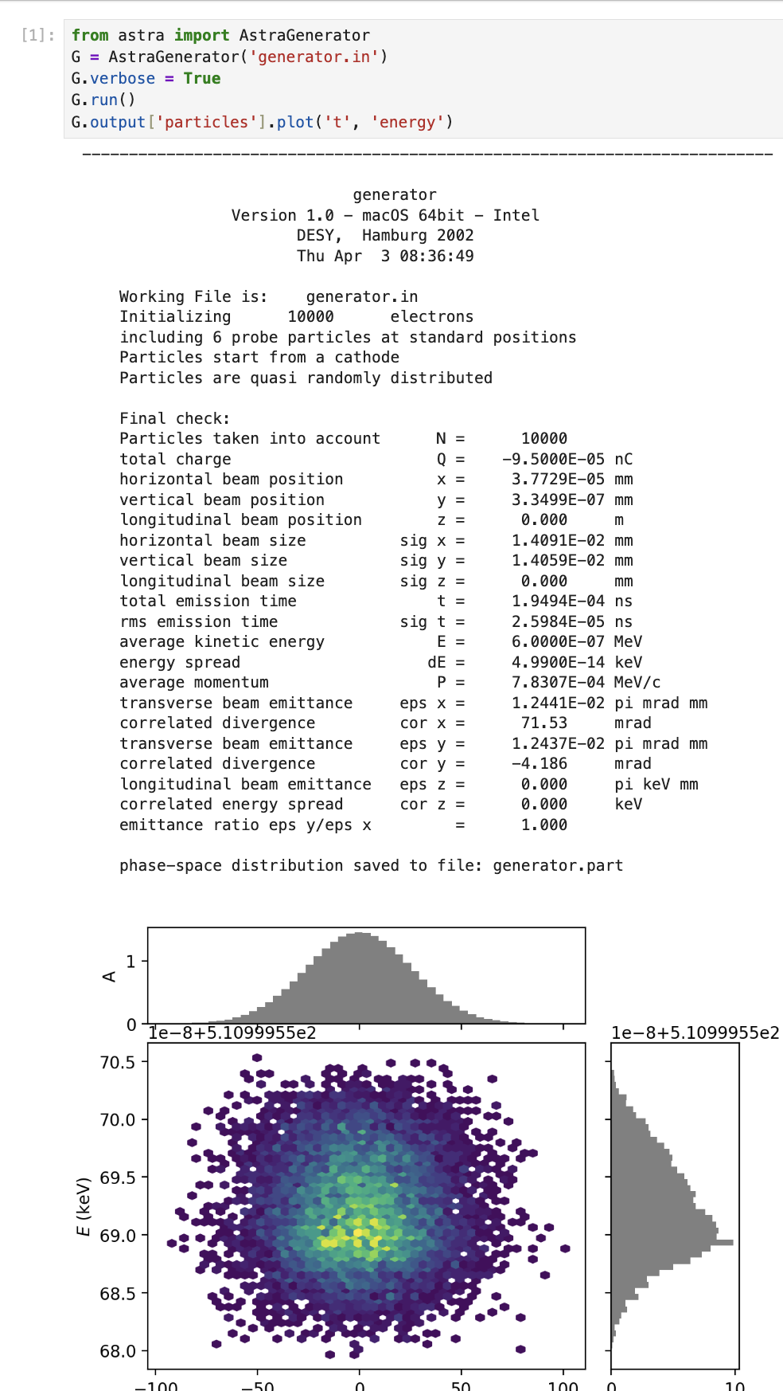
Current Progress

