Slide 1
Research Progress
Mar. 28. 2025
송우진

Slide 2
Summary of White PBPM Development
Experimental plan (Nov 01, 24 )
Set-up (Feb 02, 25)
Experiment (Previous)
  Test plan (Jan 03, 25)
  PAL-XFEL Soft X-ray beamline (Feb 02, 25)
    Data processing
    1. Data analysis – Tilted beam path
    2. Results - PSF analysis
  PLS-II BL6C (TBD)
Experiment (Alternative)
  3. Target & Method
  4. Test plan
  2nd PAL-XFEL SX beamline test
1. Background Study
2. Conceptual Design
3. Detailed Design
4. Experiment
5. Resolution (Dec 06, 24)
Expected signal strength
  Exposure time estimation
  Expected results at BL6C (TBD)
Transverse spread
Systematic error

Slide 3
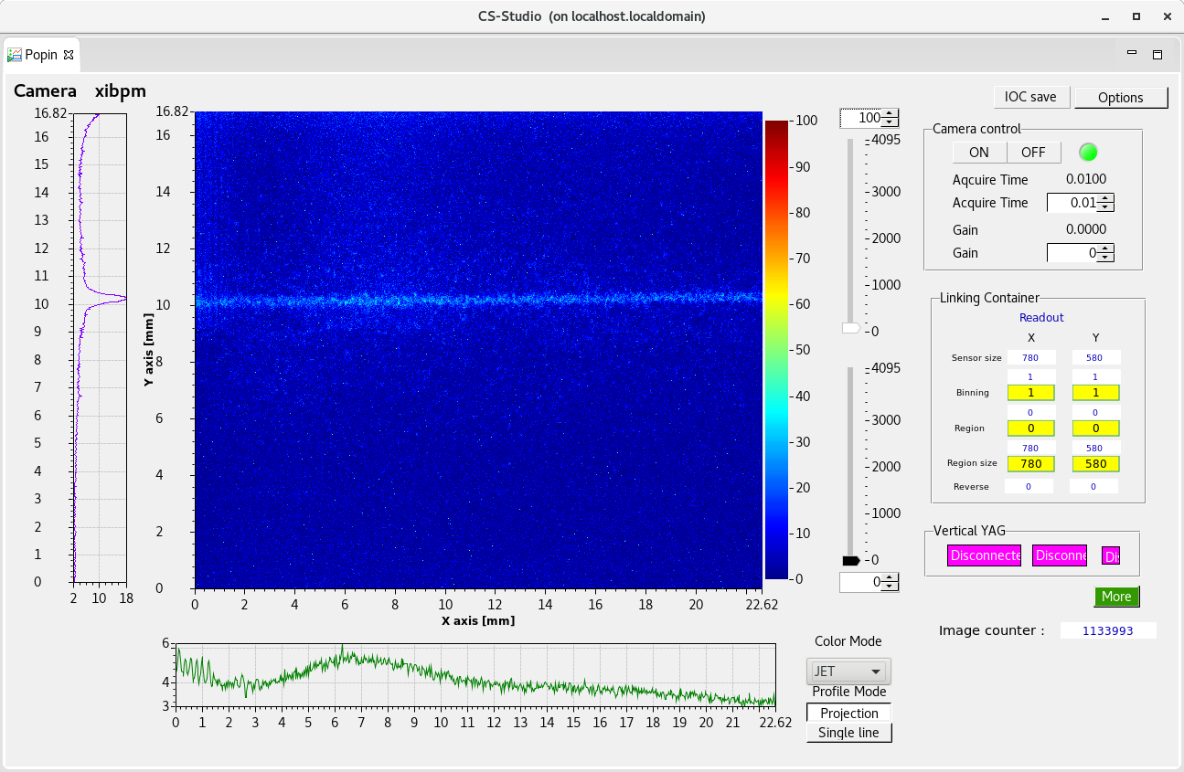
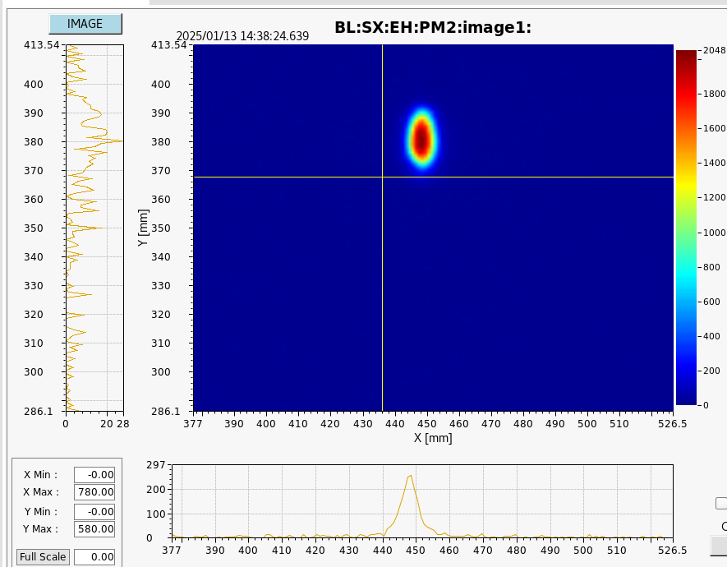
PAL-XFEL Soft X-ray beamline experiment review (Feb 14)
Image ration: 1.766
19.04 m
14.58 m
Pop-in Monitor (PM)
YAG → Reference
Grating mirror
XIBPM

Slide 4
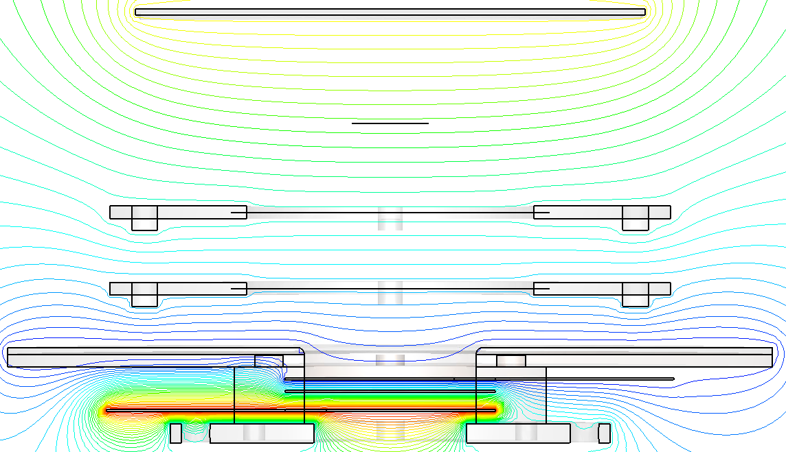
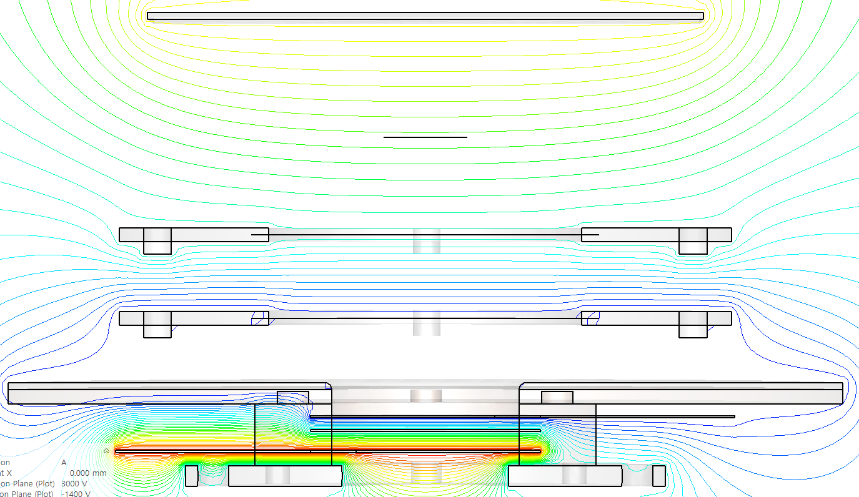
PAL-XFEL Soft X-ray beamline experiment review (Feb 14)
Experimental target
Vertical / Horizontal displacement
  → Beam path change
Point spread function (Beam size)
  Applied voltage change
  Photon beam energy change, Pink / Mono beam
Set A
Set B
By applying the same voltage to Mesh 1 as MCP-in, it is possible to mitigate the magnification increase (M=1.04).

Slide 5
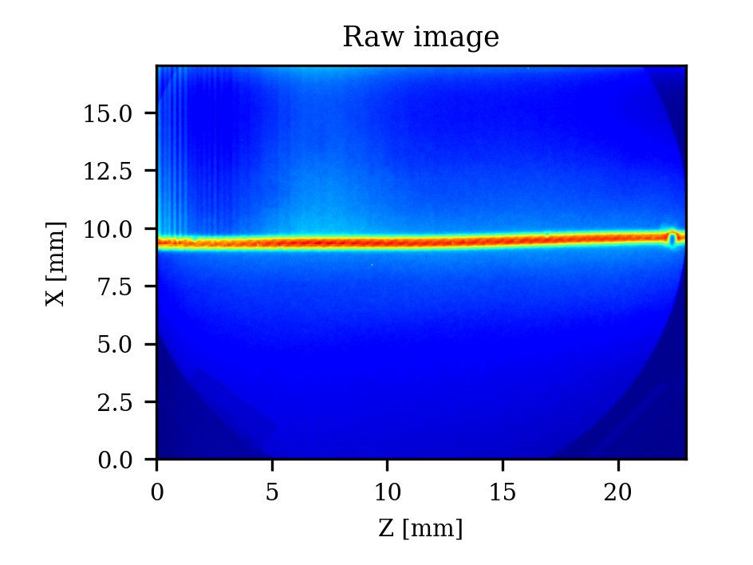
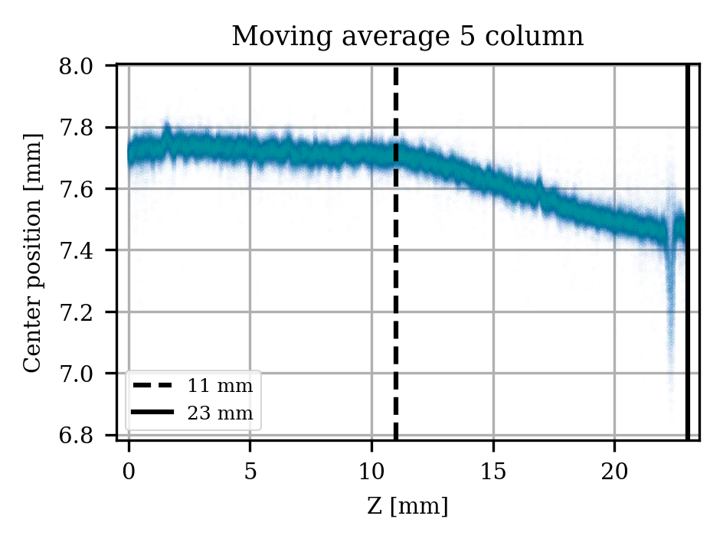
Tilted beam path?
The beam paths on either side of the center proceed in different directions.
Check the slope in the 11.06–20 mm range (the condition beyond 20 mm is not good).
Single pulse image
E field?

Slide 6
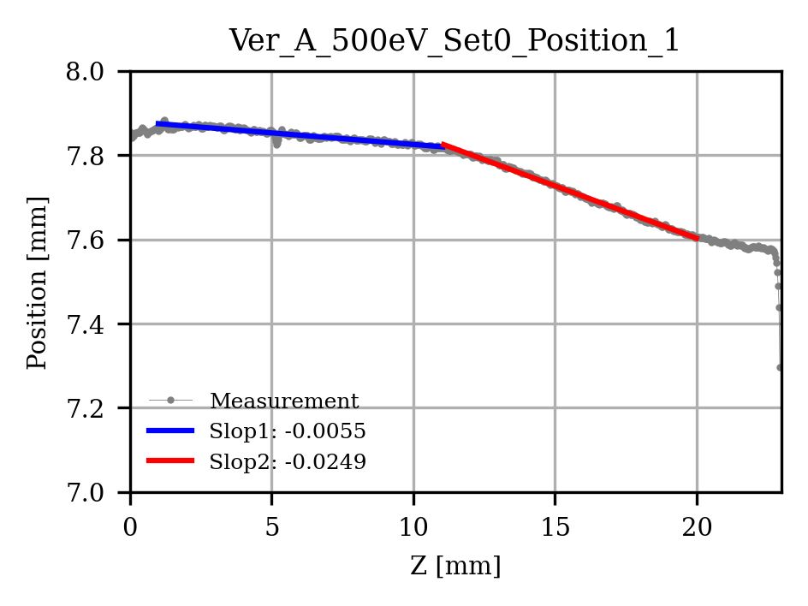
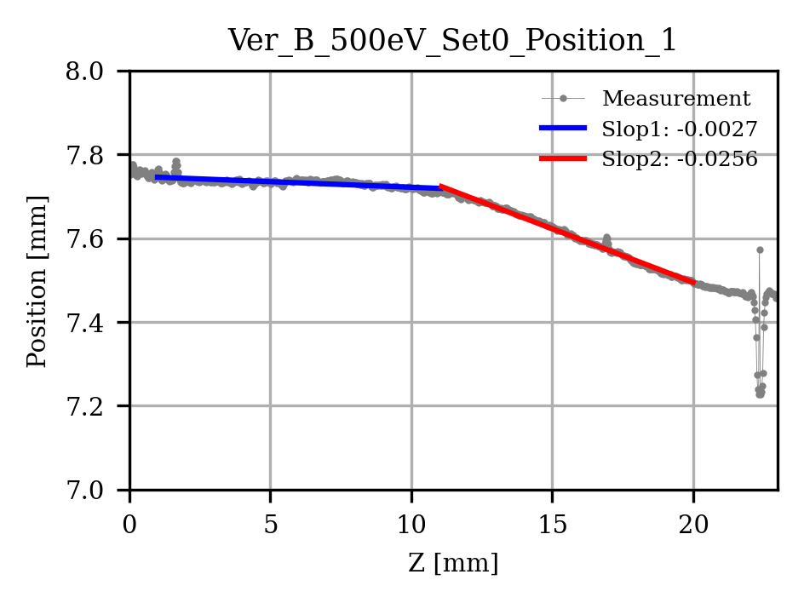
Tilted beam path?

Slide 7
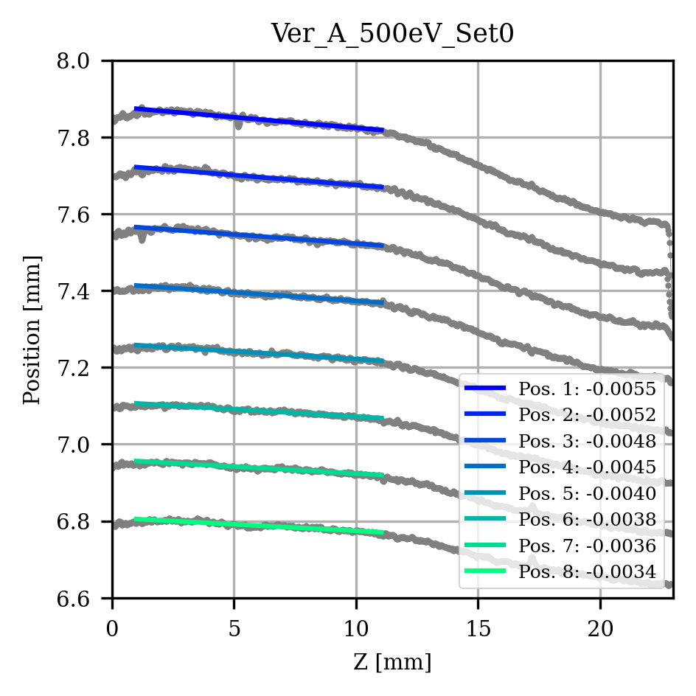
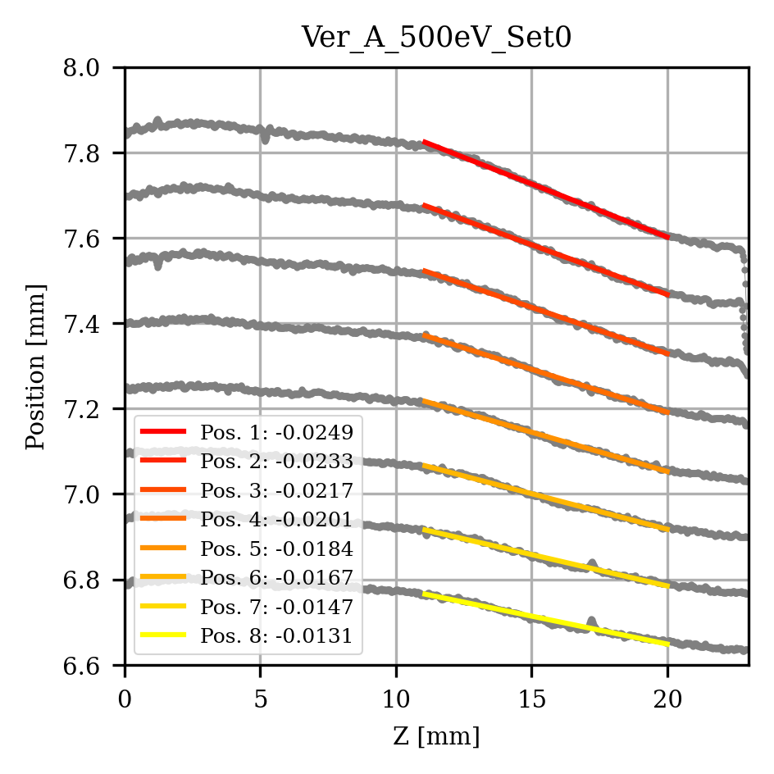
Tilted beam path?

Slide 8
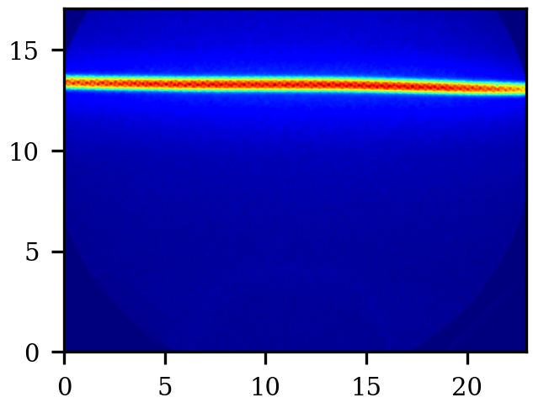
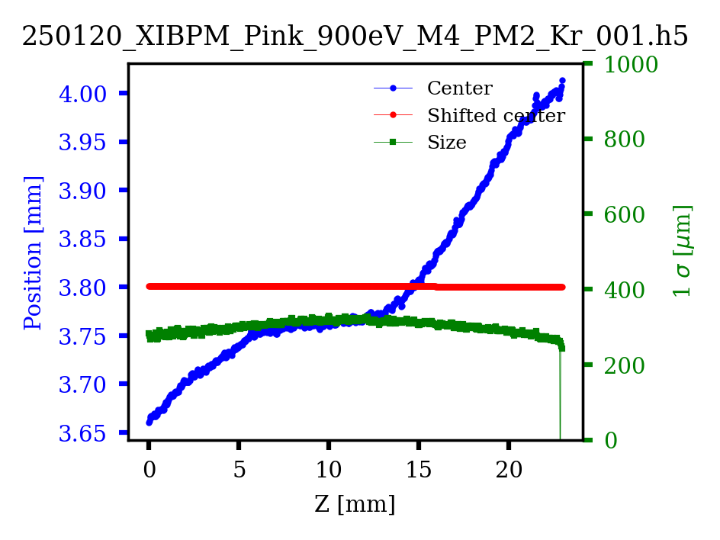
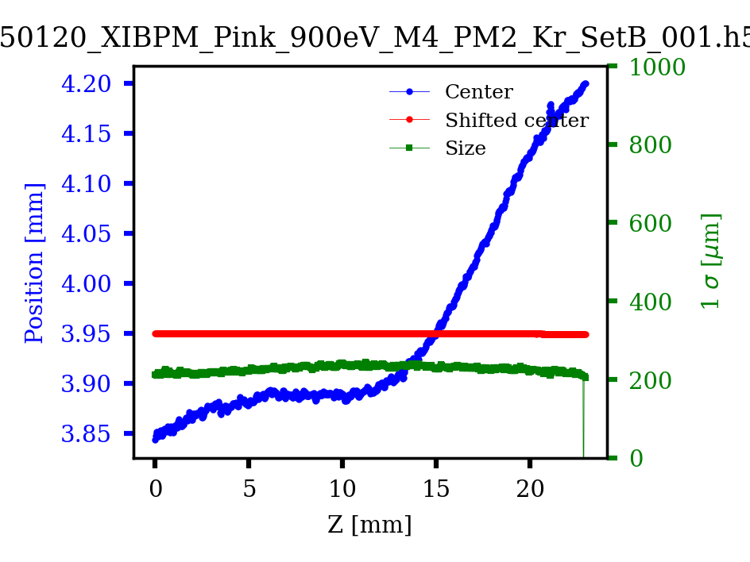
Tilted beam path?
Analysis of the cause is needed.
But it's currently on hold due to lower priority.
(the reason will be explained later)
Horizontal beam image

Slide 9
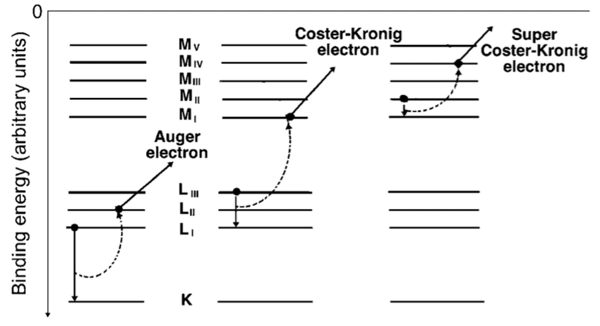
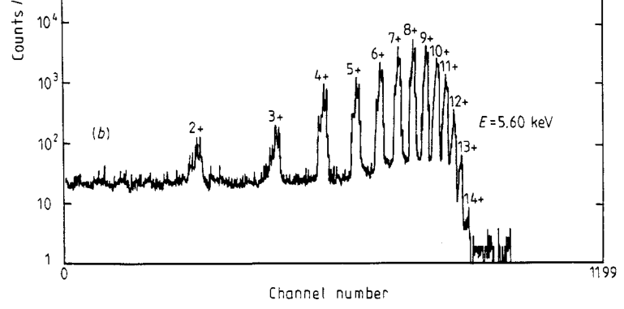
Point spread function analysis (Dec. 06, 24)
Transverse spread calculation review
Multiple photoionization
- The charge states of photo-ions generated by photon-gas interaction are distributed across a wide range.
Coster - Kroning transition
Charge state ratio of ions produced through photoionization

Slide 10
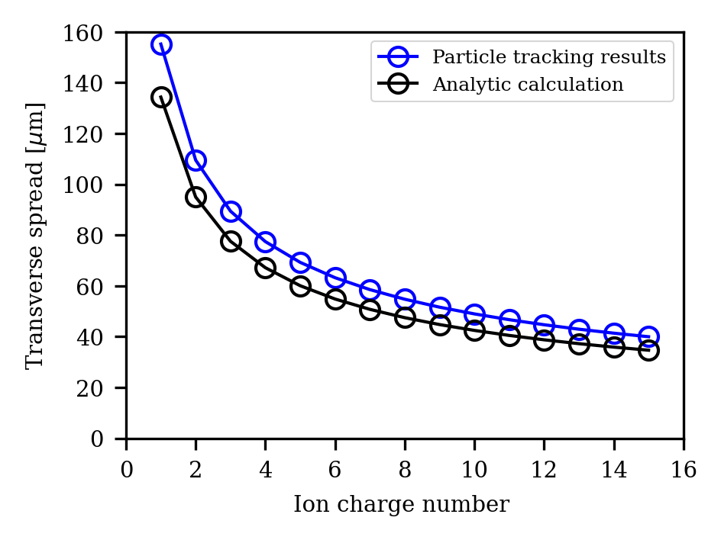
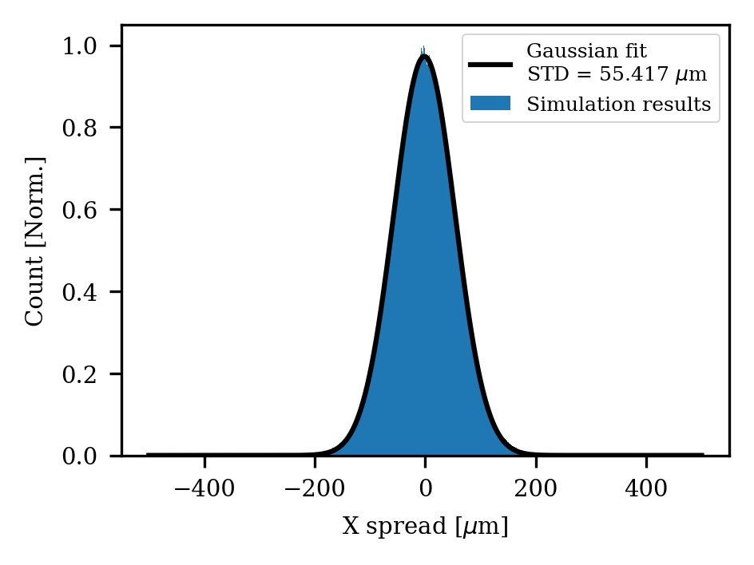
Point spread function analysis (Dec. 06, 24)
2. PSF calculation
If the ion's charge state differs, the force experienced during drift changes, leading to variations in the spread size.
By considering MPI, the final expected PSF was calculated.
Ion charge vs Transverse spread
Expected PSF from 4GSR-IVU20

Slide 11
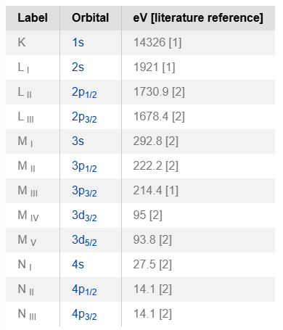
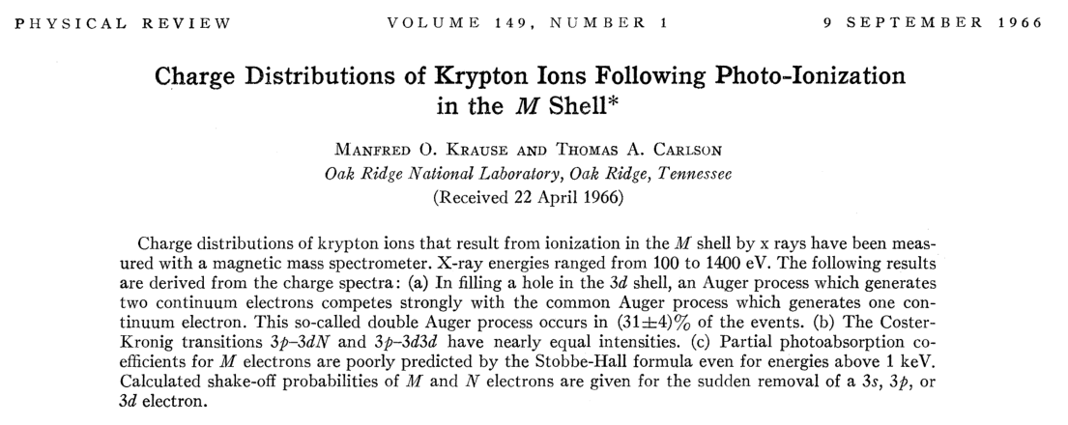
Point spread function analysis
- XIBPM, Krypton Exp.
PAL-XFEL SX beamline experiment
Injecting Krypton to compose residual gas.
Photon energies were set to 500, 700, 900, and 1100 eV.
→ The charge states of ions generated via the photoelectric effect in the M shell were used.

Slide 12
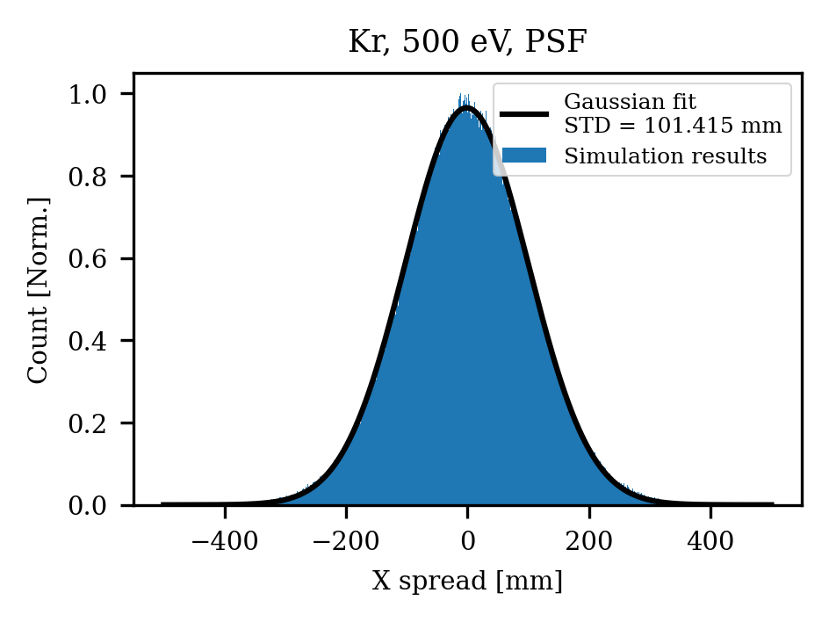
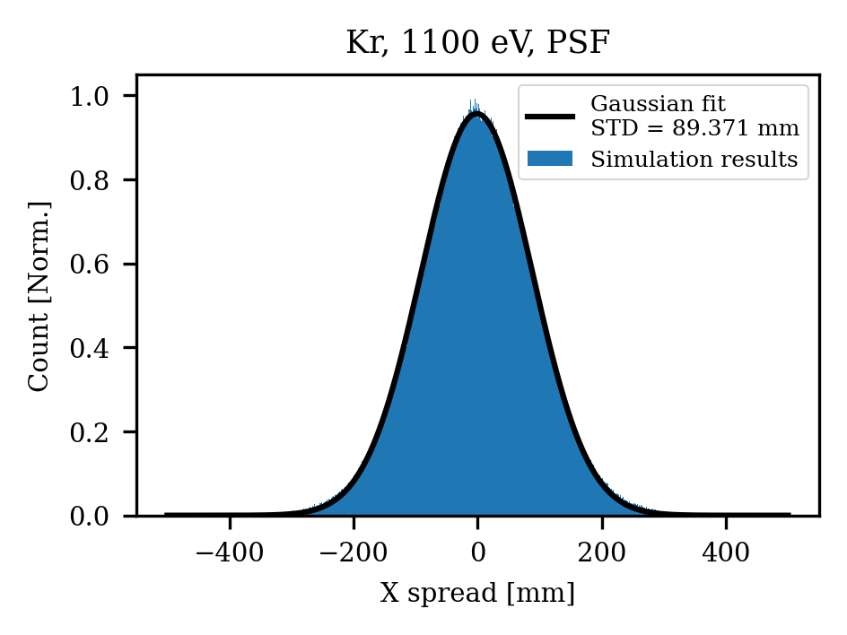
Point spread function analysis
- XIBPM, Krypton Exp.
As with the 4GSR - Xenon cases, a PSF simulation was performed for the current structure (with mesh).
 | Set A | Set B
Non-linearity | 10 um | 8 um
Defocusing field | +10% | +6%
 | MCP | Calibration
Resolution | 80 um | Not included

Slide 13
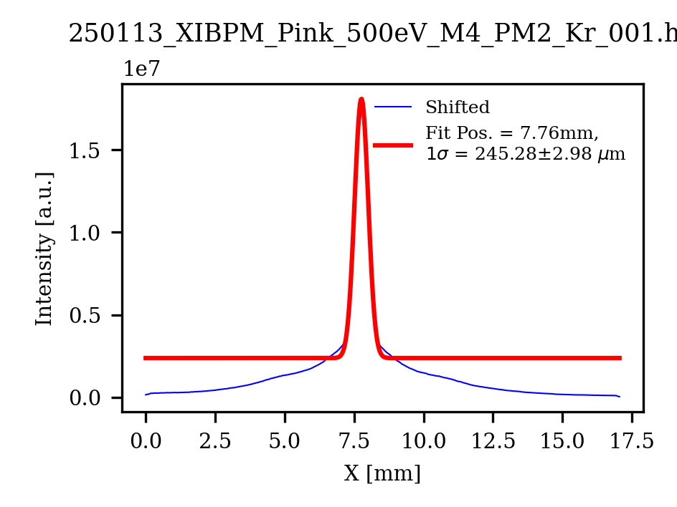
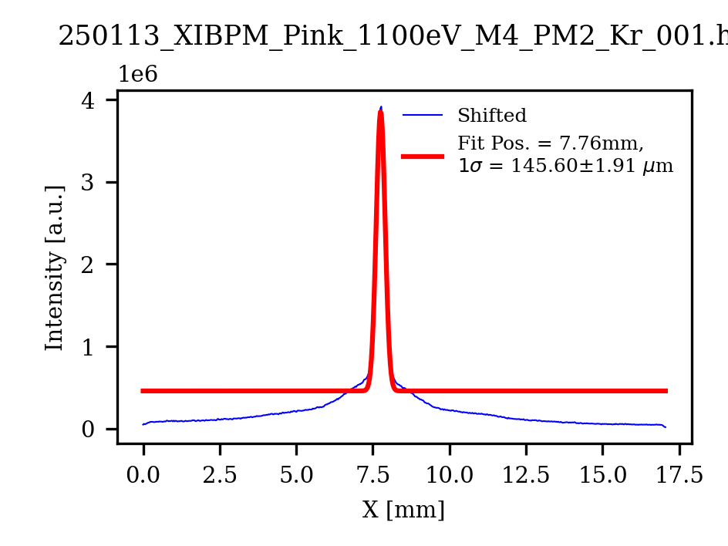
Point spread function analysis
- XIBPM, Krypton Exp.
Vset 1 |  | 500 eV | 700 eV | 900 eV | 1100 eV
Thermionic spread | Set A (um) | 122.464 | 118.593 | 112.686 | 107.919
Expected size |  | 162.048 | 158.594 | 153.396 | 149.271
Measured size |  | 245 | 245 | 201 | 145.60
In the case where the photon beam energy is 1100 eV, the measured results closely match the expectations.

Slide 14
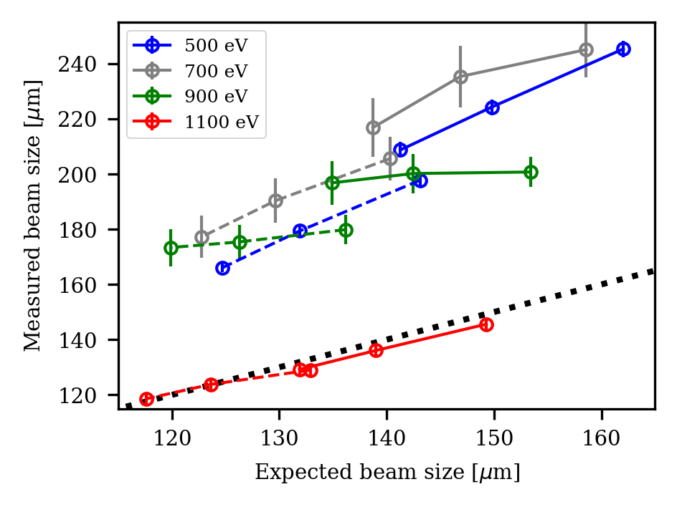
Point spread function analysis
- XIBPM, Krypton Exp.
A | MCP | M1 | M2 | Rep
V 1 | -1600 | -713 | 44 | 2000
V 4 | -1600 | -466 | 501 | 3000
V 7 | -1600 | -220 | 958 | 4000
B | MCP | M1 | M2 | Rep
V 1 | -1600 | -1600 | -630 | 2000
V 4 | -1600 | -1600 | -630 | 3000
V 7 | -1600 | -1600 | -630 | 4000
 | Set A, V 1 | Set B, V 1 | Set A, V 4 | Set B, V 4 | Set A, V 7 | Set B, V 7
Expected size | 149.271 | 132.909 | 138.97 | 123.59 | 131.877 | 117.632
Measured size | 145.60 | 129.00 | 136.05 | 123.77 | 129.18 | 118.59
Set A
Solid line
X=Y
Set B
Dashed line

Slide 15
Plan for WBPM experiment
Main goal: Photon beam profile (size) measurement
Major topics
Field design
  Field quality improvement
  1:1 mapping field
Theoretical approach
  Thermionic spread calculation
  (Photo-ion behavior)
New method
  Defocusing field
  (Magnification)
  Calibration method
Verification or demonstration
CST + Particle tracking simulation
& Displacement measurement at XFEL.
Point spread function measurement.
→ Done by the XFEL experiment.
(+ Need to check Mesh effect)
Experimental validation
→ Further testing needed with the final design.
(Calibration is explained using simulation results.)
Beam profile Meas. at PLS-II using both Hor. and Ver. Chamber.
→ PSF, Mag Meas. at PAL-XFEL using one chamber.

Slide 16
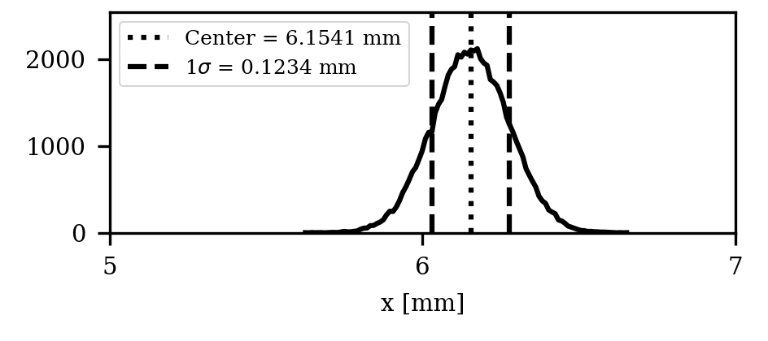
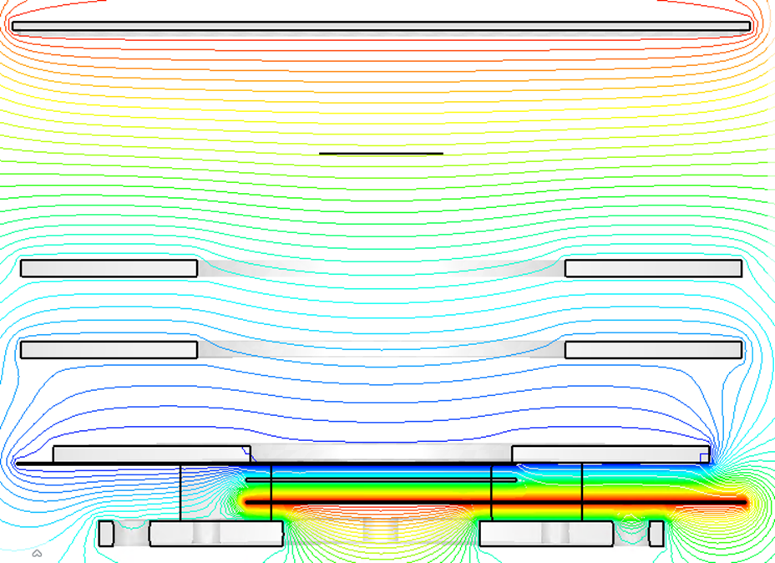
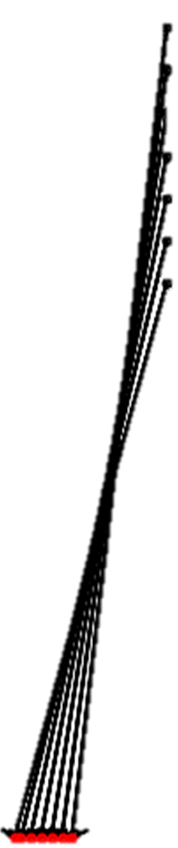
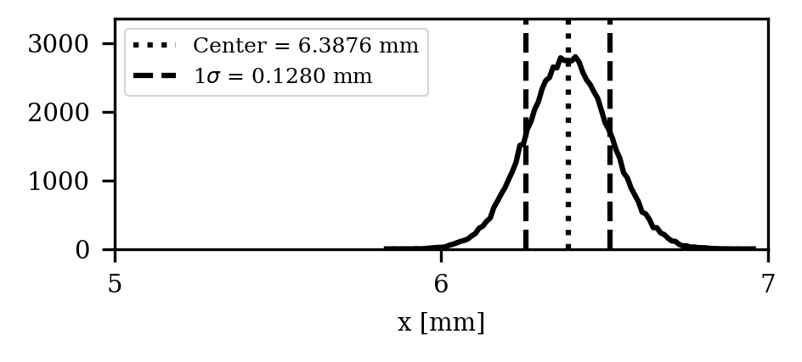

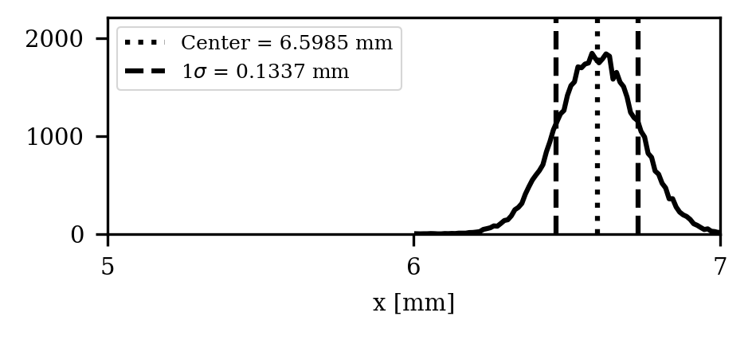
Magnification measurement test
Beam position : (5 mm, +5mm)
Beam position : (5 mm, 0 mm)
Beam position : (5 mm, -5mm)
The magnification varies with the vertical position
  → By confirming this phenomenon, the defocusing field design can be validated.

Slide 17
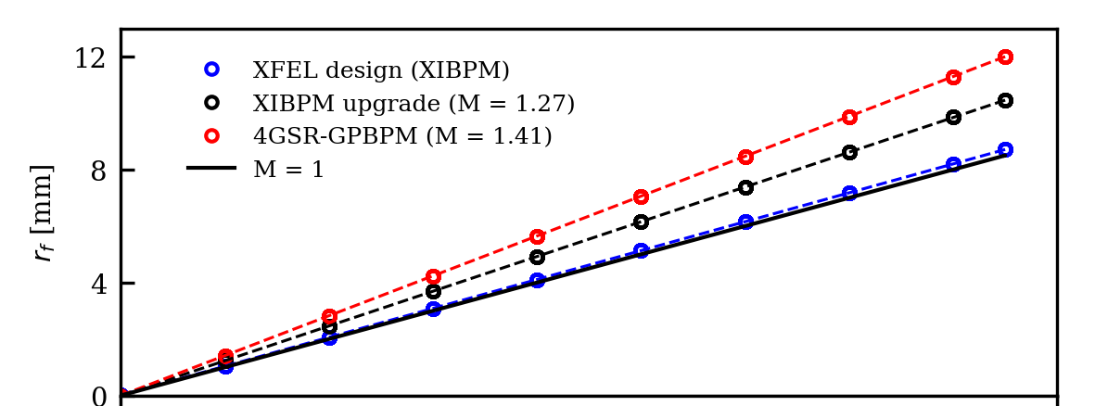

Magnification measurement test
Center
Repeller
Even without knowing the exact transverse position, magnification can be measured based on relative position changes.
→ As of the previous test, it is possible to measure using 8 or more points.
Same step
Electrode
MCP
Screen
Different distance (Caused by magnification)

Slide 18
Magnification measurement test
Center
Repeller
The variation in magnification with respect to vertical position changes allows calculation of the baseline magnification (design value).
→ At least three or more vertical position measurements are required.
Electrode
MCP
Screen
Magnification variation

Slide 19
Verification with changing magnification (applied voltage)
With the current design, magnification can be varied up to a maximum of x2.3.
It is also possible to configure the system for lower magnification (focusing field).
Magnification measurement tests were conducted for the cases of x0.5, x1, x1.5, and x2
→ Aimed at validating the defocusing field design.
 | Magnification | Repeller | Electrode 2 (upper) | Electrode 1 (lower)
x0.5 | x0.499 | 2500 | 1500 | -1500
 | x0.507 | 2500 | 1450 | 0
x1 | X0.981 | 2000 | 0 | -500
 | x1.008 | 4000 | 750 | -1500
x1.5 | 1.500 | 3000 | -1250 | 0
X2 | X2.002 | 3000 | -3000 | 0
High voltage PS: Maximum 4 kV
The MCP-In voltage is fixed at -1600 V (for the PSF analysis).

Slide 20
Summary
In the XIBPM experiment, the beam path direction changed in the obtained beam image.
This is suspected to be caused by the mesh, though the exact cause was not identified.
→ Mesh removal experiments are necessary.
Building upon the existing PSF calculations, analysis was extended to the PAL-XFEL XIBPM environment.
In the 1100 eV experiment, the measured results closely matched expectations.
→ It is necessary to confirm whether this agreement holds at other photon energies when the mesh is removed.
Since the resolution calculation has already been verified,
if the defocusing field is also experimentally validated, the overall logic is expected to be sound.
→ Therefore, a method for magnification measurement has been proposed.

Slide 22
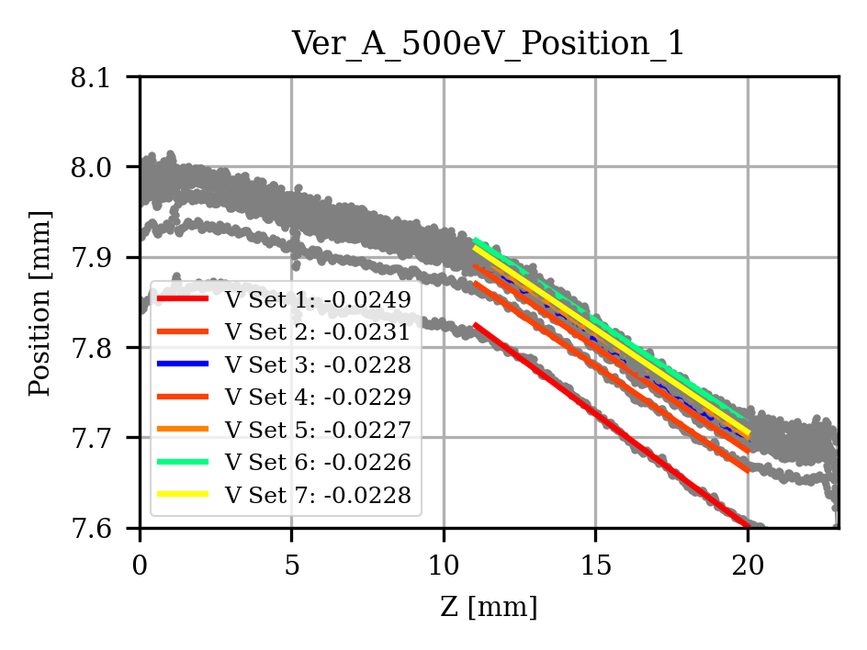
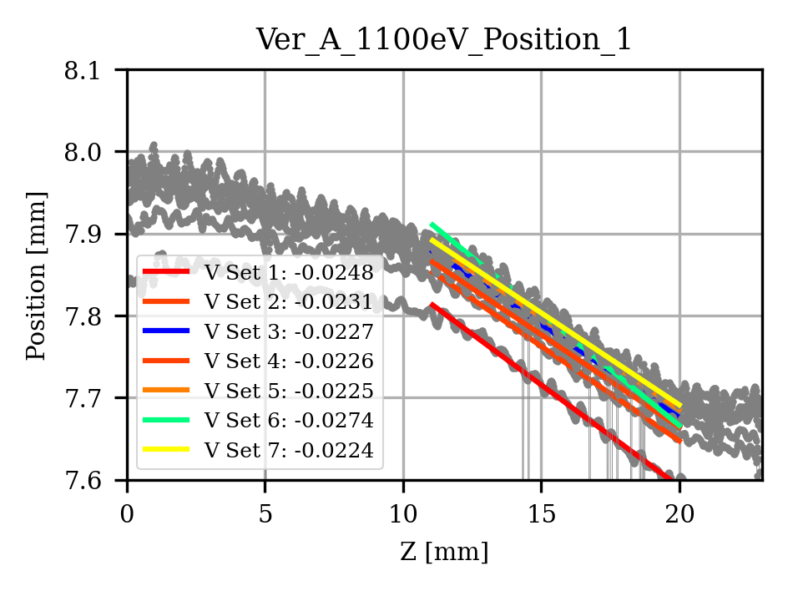
V set Num | 1 | 2 | 3 | 4 | 5 | 6 | 7
Screen | +3000 | +3000 | +3000 | +3000 | +3000 | +3000 | +3000
MCP-IN | -1600 | -1600 | -1400 | -1600 | -1600 | -1400 | -1600
Mesh1 | -713 | -589 | -316 | -466 | -343 | -69 | -220
Mesh2 | 44 | 273 | 610 | 501 | 729 | 1067 | 958
Repeller | +2000 | +2500 | +3000 | +3000 | +3500 | +4000 | +4000
E field (V/cm) | 631 | 718 | 771 | 806 | 894 | 946 | 981
Slope | 249 | 231 | 228 | 229 | 227 | 226 | 228

Slide 23
PAL-XFEL Soft X-ray beamline experiment results (Ver.)
500 eV
700 eV
900 eV
1100 eV

Slide 24
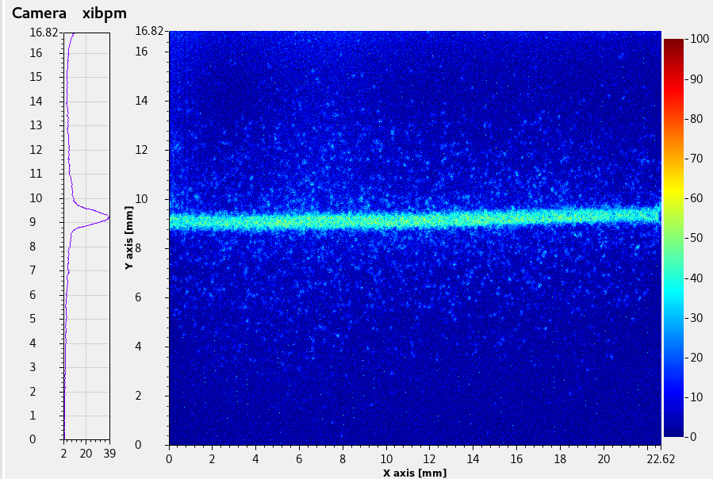
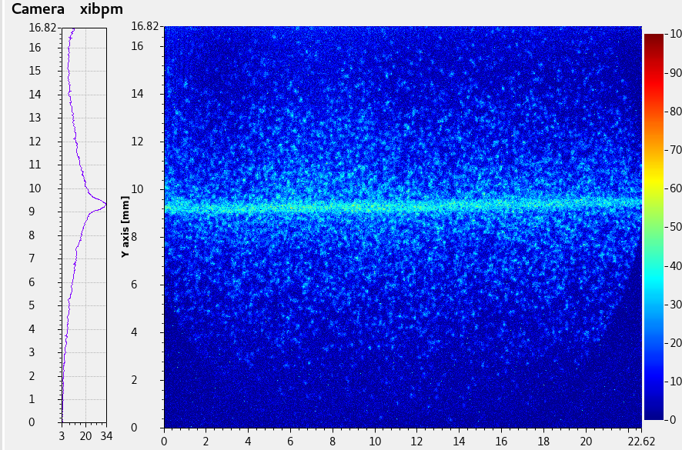
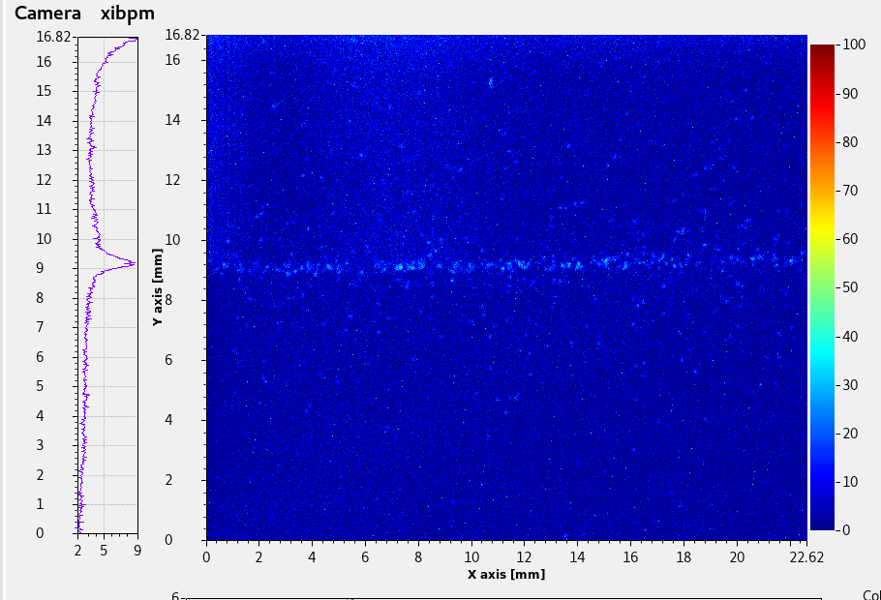
PAL-XFEL Soft X-ray beamline experiment results (Ver.)
500 eV
700 eV
900 eV
1100 eV

