Slide 1


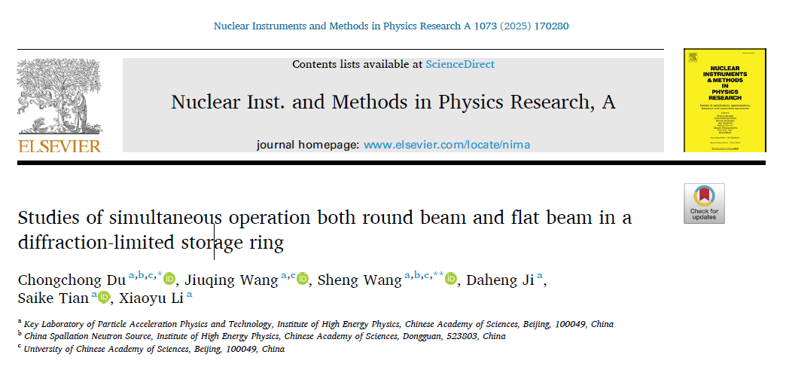
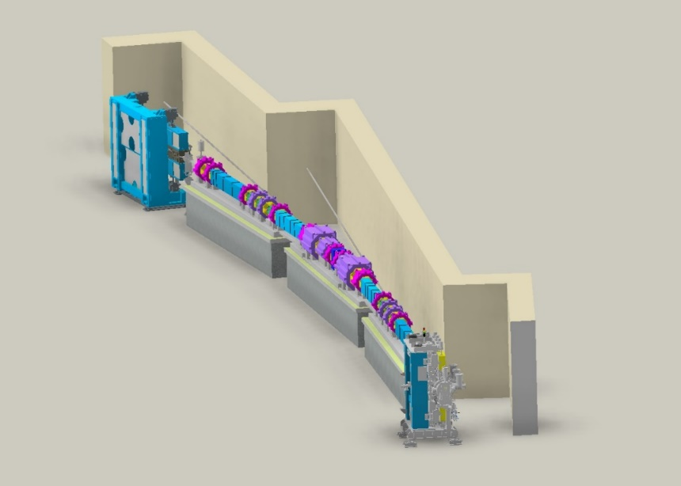

JKPS
Studies of simultaneous operation both round beam and flat beam in diffraction-limit storage ring
Junha Kim
March 7th, 2025

Slide 2
JKPS
Composition of the paper
Introduction
  The round beam mode mitigates strong intra-beam scattering (IBS) effects and increases the Touschek lifetime. However, some beamline applications prefer a horizontally elongated flat beam for higher photon beam brightness.
  To overcome the limitation of operating only in one mode (either round beam or flat beam), this paper proposes methods for simultaneous operation of both modes.
Simultaneous Operation Scheme Based on the HEPS Lattice
  Flat Beam Generation in Round-Beam Mode
    A weak skew quadrupole field is introduced to generate a round beam.
    A pre-kicker applies a continuous horizontal kick to a specific bunch, preventing the transverse betatron tunes from approaching each other, thereby creating a flat beam.
  2. Round Beam Generation in Flat-Beam Mode
    The machine operates in flat-beam mode.
    A pre-kicker applies a kick to a specific bunch, bringing the horizontal and vertical tunes closer together, generating a round beam.
Dynamic Aperture Analysis
  The impact of these methods on the dynamic aperture is analyzed
  Even after introducing random lattice errors, the dynamic aperture remains sufficient to support on-axis injection.

Slide 3
JKPS
Composition of the paper
4. Beam Tracking Simulation with ELEGANT
  Multi-particle tracking simulations using the ELEGANT code verify that a flat beam can be generated in roud-beam mode and vice versa
  The result confirm that simultaneous operation of both beam modes is feasible while maintaining long-term beam stability
5. Discussion
  The propose scheme is technically feasible with current technology. The use of nanosecond range pulse generators allows the implementation of pre-kickers with sufficiently high repetition rates
  Practical implementation requires further consideration of pulse flatness, repeatability, and impedance effects.
6. Conclusion

Slide 4
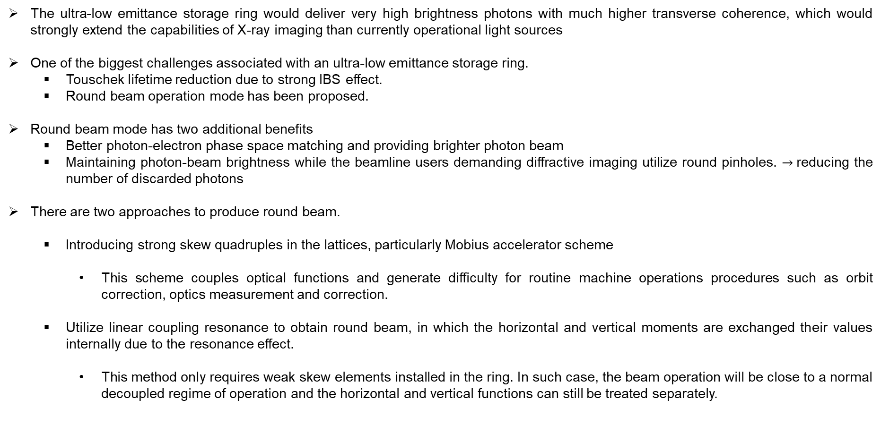
JKPS
I. Introduction
The ultra-low emittance storage ring would deliver very high brightness photons with much higher transverse coherence, which would strongly extend the capabilities of X-ray imaging than currently operational light sources
One of the biggest challenges associated with an ultra-low emittance storage ring.
  Touschek lifetime reduction due to strong IBS effect.
  Round beam operation mode has been proposed.
Round beam mode has two additional benefits
  Better photon-electron phase space matching and providing brighter photon beam
  Maintaining photon-beam brightness while the beamline users demanding diffractive imaging utilize round pinholes. $→$reducing the number of discarded photons
There are two approaches to produce round beam.
  Introducing strong skew quadruples in the lattices, particularly Mobius accelerator scheme
    This scheme couples optical functions and generate difficulty for routine machine operations procedures such as orbit correction, optics measurement and correction.
  Utilize linear coupling resonance to obtain round beam, in which the horizontal and vertical moments are exchanged their values internally due to the resonance effect.
    This method only requires weak skew elements installed in the ring. In such case, the beam operation will be close to a normal decoupled regime of operation and the horizontal and vertical functions can still be treated separately.

Slide 5
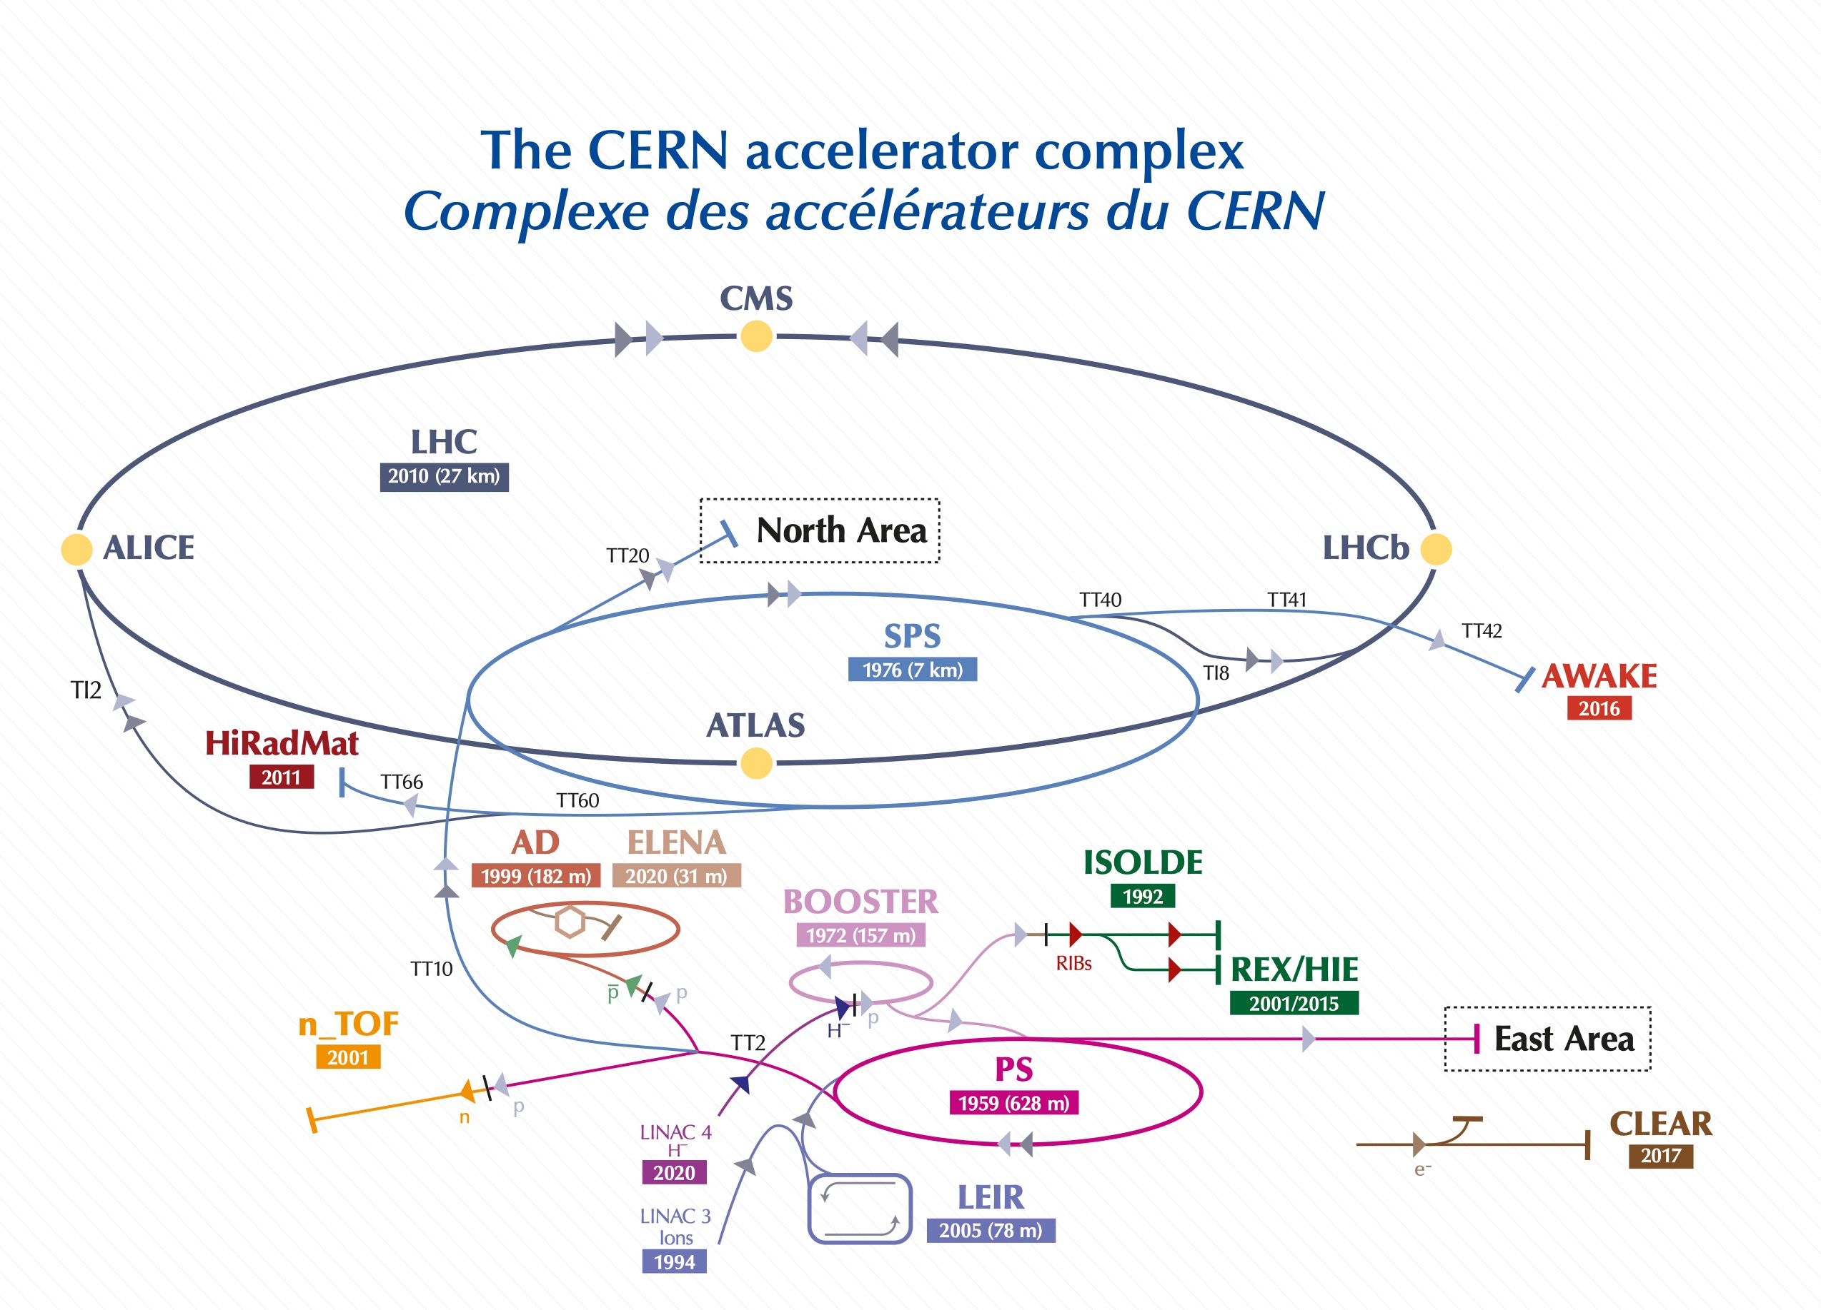
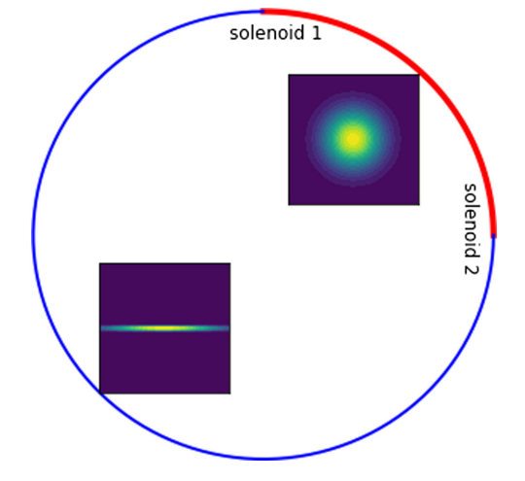
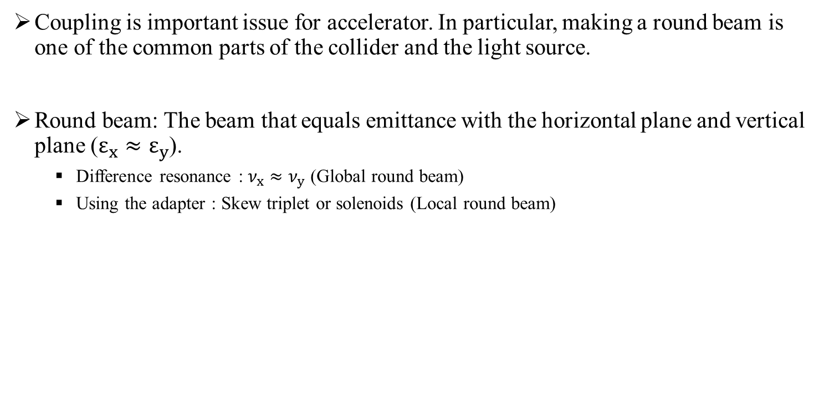
Round beam
Coupling is important issue for accelerator. In particular, making a round beam is one of the common parts of the collider and the light source.
Round beam: The beam that equals emittance with the horizontal plane and vertical plane ($ε_{x}≈ε_{y}$).
  Difference resonance : $ν_{x}≈ν_{y}$ (Global round beam)
  Using the adapter : Skew triplet or solenoids (Local round beam)
Images from. ‘Designing linear lattices for round beam in electron storage rings using the solution by linear matrices analysis’,Youngjun Li and Robert Rainer at BNL

Slide 6
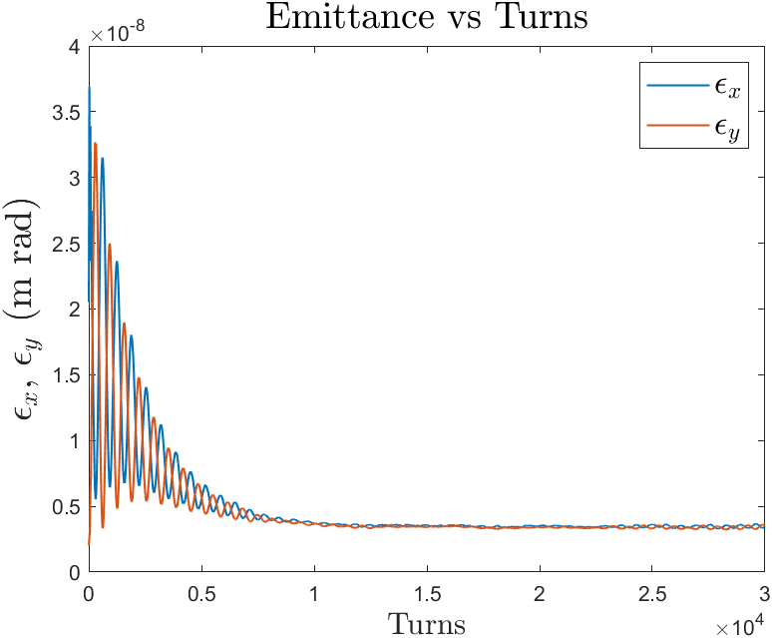
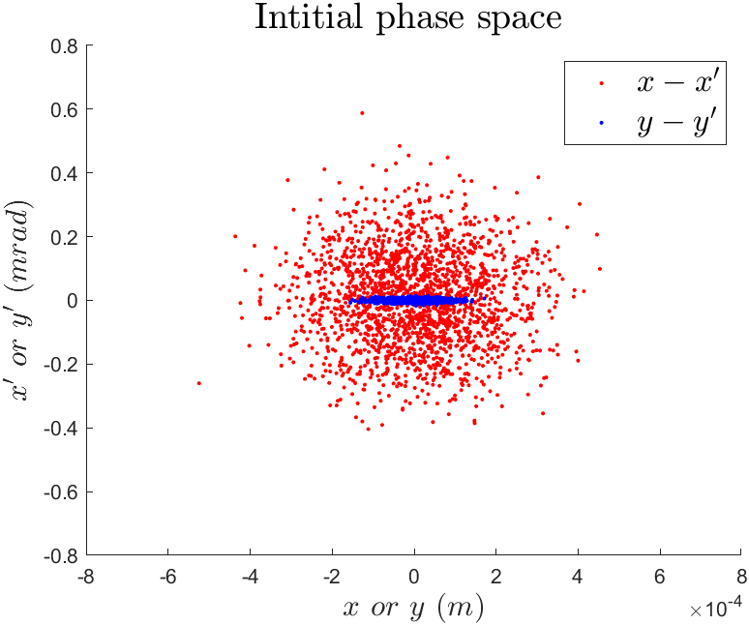
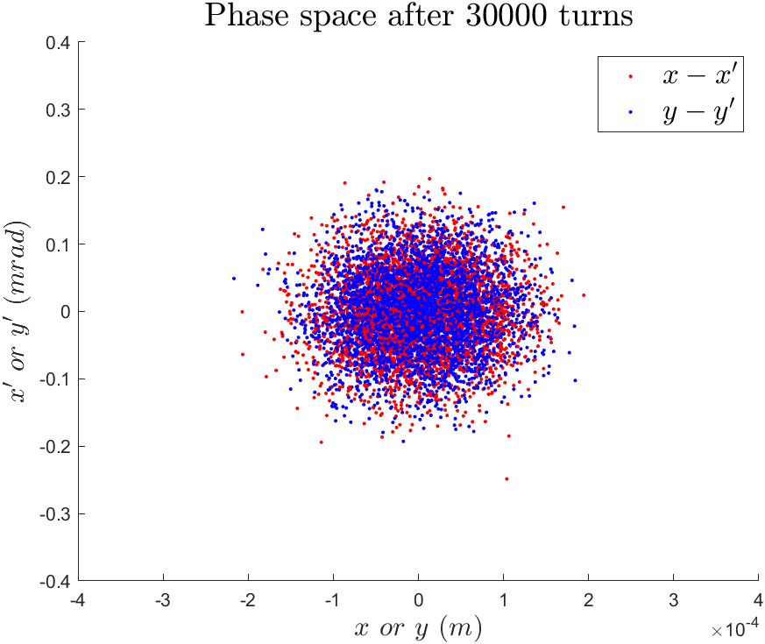
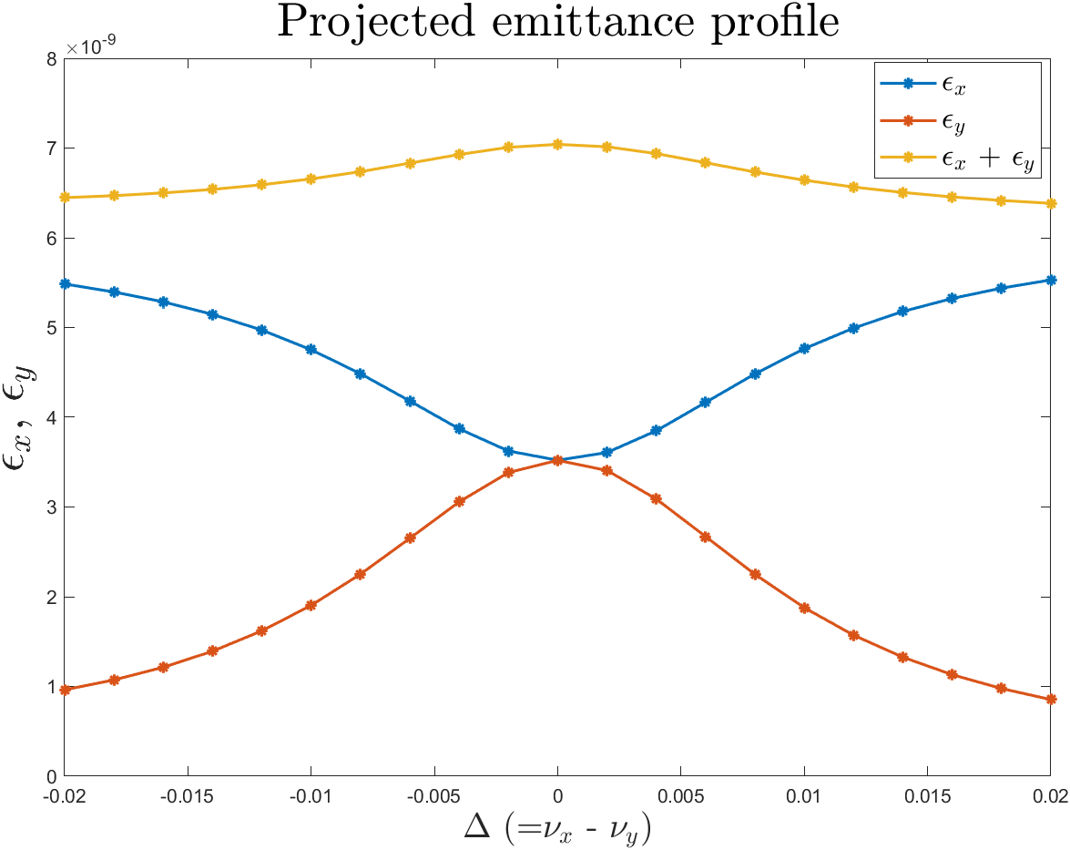
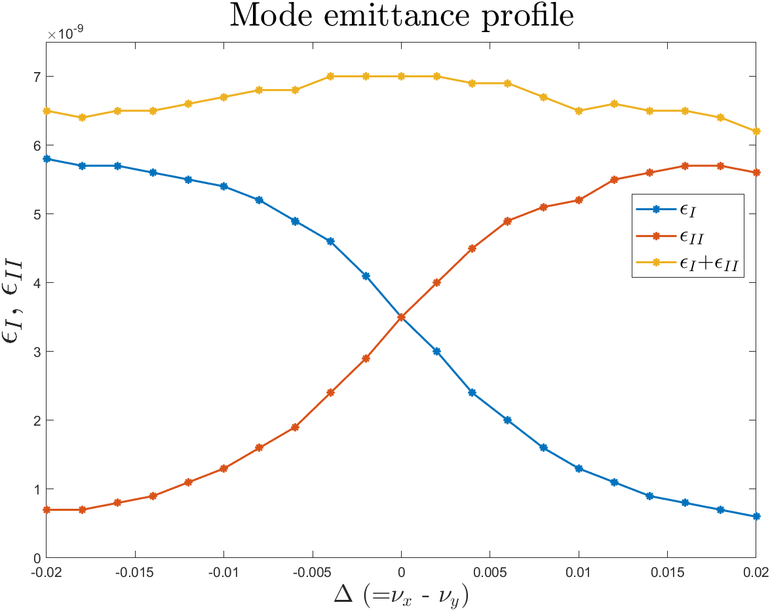
Round beam using resonance

Slide 7
Round beam
Advantage of the round beam in a circular accelerator
  Light source: The round beam has a larger emittance in the vertical plane than the flat beam, so the scattering effects (Intrabeam scattering & Touschek scattering) are mitigated.
  Collider: The round beam has a larger emittance in the vertical plan than the flat beam, so it can reduce the space charge effect in lower energy part of accelerator
Touschek lifetime
(Piwinski formula, elegant)
Touschek lifetime
(Piwinski formula, AT)
Single bunch charge : 1 nC (= 1.06 mA)
Coupling(emity/emitx) = 0.01
Touschek lifetime: 23.06 h
Single bunch charge : 1 mA
Coupling(emity/emitx) = 0.001
Touschek lifetime: 28 h
Single bunch charge : 1 nC (= 1.06 mA)
Coupling(emity/emitx) = 1
Touschek lifetime: 133.72 h
Single bunch charge : 1 mA
Coupling(emity/emitx) = 1
Touschek lifetime: 115 h

Slide 8





Round beam in light source
Parameters from. APS-U TDR paper
Main parameters in the APS-U
(Timing mode/Brightness mode)
Parameter
Value
Unit
Horizontal Emittance
31.9/41.7
pm-rad
Vertical Emittance
31.7/4.2
pm-rad
Beam Energy
6
GeV
Bunch spacing
76.7/11.4
ns
Brightness mode(324 bunches)
Number of Bunches
48/324
Brightness-8keV
$78/$130
${10}^{20}$photons/sec/0.1%BW/ $mm^{2}/mrad^{2}$
Single Bunch Brightness-8keV
$162/$40
${10}^{18}$photons/sec/0.1%BW/ $mm^{2}/mrad^{2}$
Charges/Bunch
$$4.16/0.6$$
mA
If charges in a bunch increase, the scattering effect also is increased and lifetime is decreased
Injection scheme : swap-out injection (on-axis)
Timing mode(48 bunches)

Slide 9
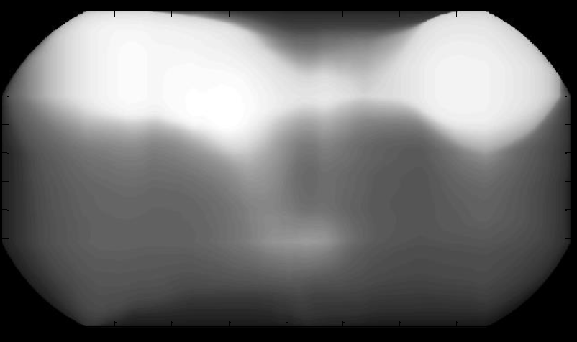
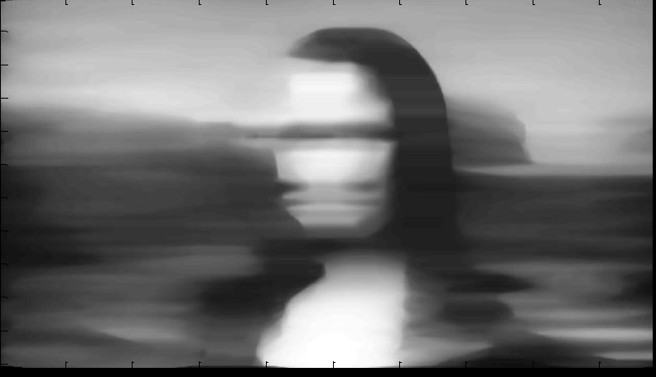
Round beam in light source
Advantage of the round beam for accelerator user
  The light source user who experiments using X-ray imaging also more prefers the round beam to the flat beam.
1000
300X300
600
10X300
Images from. ‘Benefit of small,round(ish) and coherent beam for scanning hard X-ray imaging’, A.Somogyi, K.Medjoubi,G.Baranton at Synchrotron Soleil

Slide 10
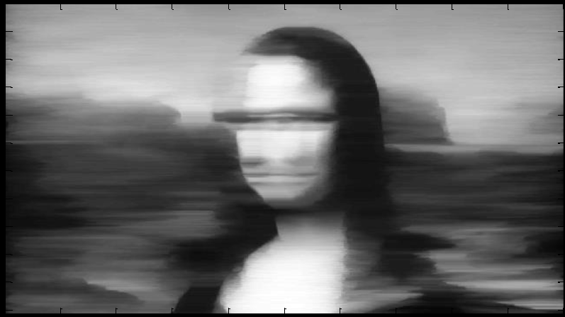

Round beam in light source
1000
1X100
600
10x10
Images from. ‘Benefit of small,round(ish) and coherent beam for scanning hard X-ray imaging’, A.Somogyi, K.Medjoubi,G.Baranton at Synchrotron Soleil

Slide 11

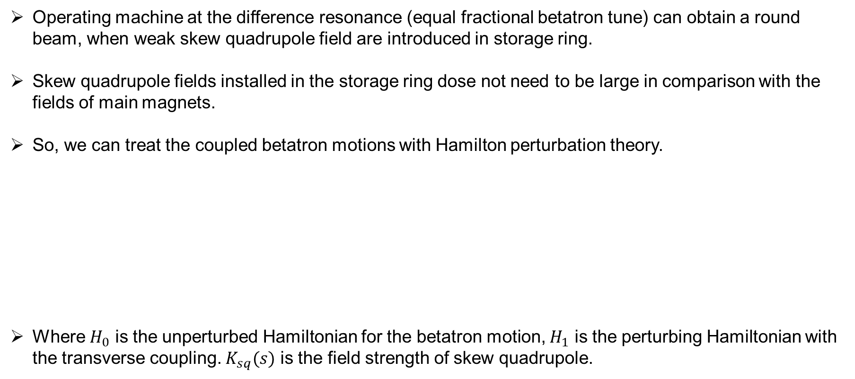
Beam physics group meeting
Linear coupling motion
Operating machine at the difference resonance (equal fractional betatron tune) can obtain a round beam, when weak skew quadrupole field are introduced in storage ring.
Skew quadrupole fields installed in the storage ring dose not need to be large in comparison with the fields of main magnets.
So, we can treat the coupled betatron motions with Hamilton perturbation theory.
Where $H_{0}$ is the unperturbed Hamiltonian for the betatron motion, $H_{1}$ is the perturbing Hamiltonian with the transverse coupling. $K_{sq}(s)$ is the field strength of skew quadrupole.
$$H=H_{0}+H_{1}$$
$$H_{0}=\frac{1}{2}\left(p_{x}^{2}+p_{y}^{2}+K_{x}\left(s\right)x^{2}+K_{y}\left(s\right)y^{2}\right)$$
$$H_{1}=K_{sq}\left(s\right)xy$$

Slide 12


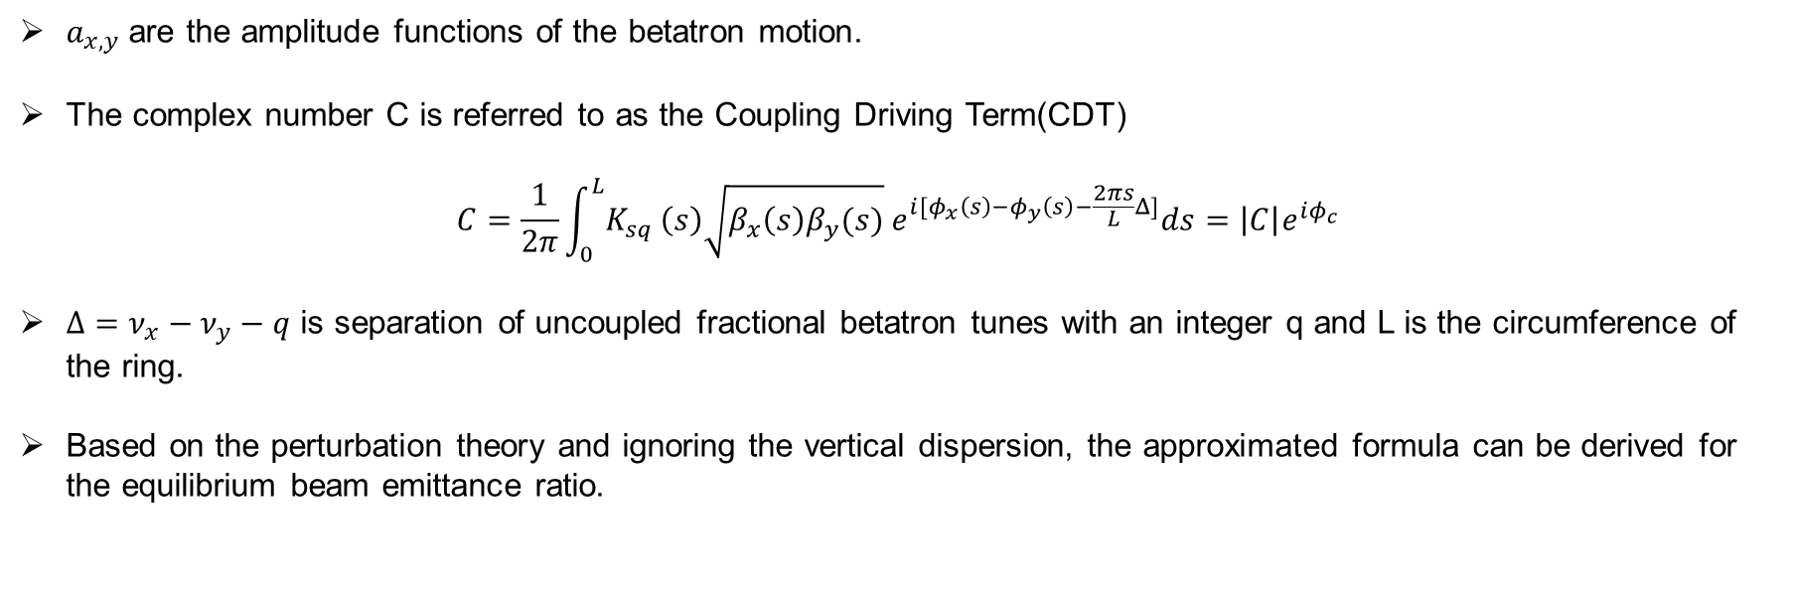
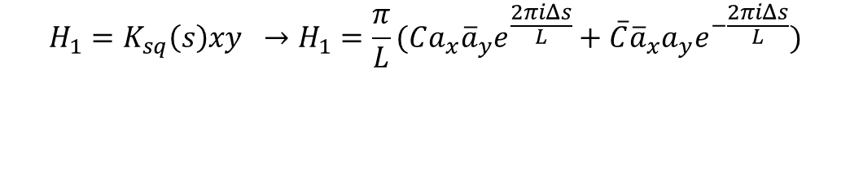
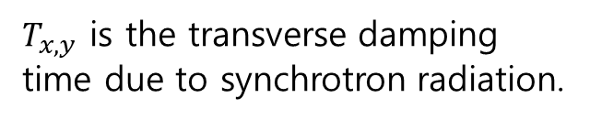
Beam physics group meeting
Linear coupling motion
$$H_{1}=K_{sq}\left(s\right)xy →H_{1}=\frac{π}{L}(Ca_{x}{\overline{a}}_{y}e^{\frac{2πiΔs}{L}}+\overline{C}{\overline{a}}_{x}a_{y}e^{−\frac{2πiΔs}{L}})$$
$a_{x,y}$are the amplitude functions of the betatron motion.
The complex number C is referred to as the Coupling Driving Term(CDT)
$$C=\frac{1}{2π}\int_{0}^{L}{K_{sq}}\left(s\right)\sqrt{β_{x}\left(s\right)β_{y}(s)} e^{i[φ_{x}\left(s\right)−φ_{y}\left(s\right)−\frac{2πs}{L}Δ]}ds=\left|C\right|e^{iφ_{c}}$$
$Δ=ν_{x}−ν_{y}−q$ is separation of uncoupled fractional betatron tunes with an integer q and L is the circumference of the ring.
Based on the perturbation theory and ignoring the vertical dispersion, the approximated formula can be derived for the equilibrium beam emittance ratio.
$$κ=\frac{ε_{y}}{ε_{x}}=\frac{\frac{1}{4}{\left|C\right|}^{2}}{\frac{T_{x}}{T_{y}+T_{x}}Δ^{2}+\frac{1}{4}{\left|C\right|}^{2}}$$
$ε_{x}=ε_{y}=$ $\frac{T_{x}}{T_{y}+T_{x}}ε_{0}$
$T_{x,y}$ is the transverse damping time due to synchrotron radiation.

Slide 13
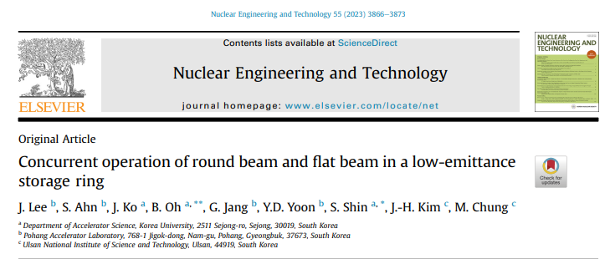
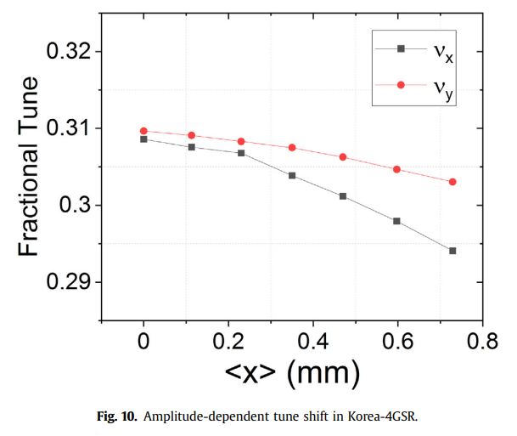
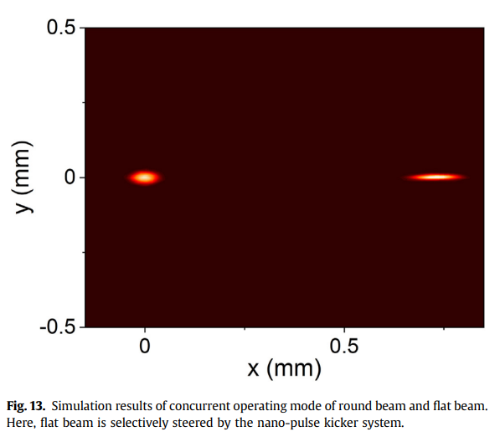
JKPS
I. Introduction
Many Future DLSR, such as APS-U and ALS-U, are planning to operate with round beam by using this method.
However, conventional storage rings are typically designed with inherent horizontal bending layouts
Some users favor flat beam for its high total brilliance, while some beamline users utilizing monochromators without an entrance silt also prefer flat beam.
To meet the requirements of different users in a DLSR, reference 16 has presented and simulated flat beam generation in round-beam mode of Korea-4GSR, however the simulation does not take into account error effect.
This paper proposes two approaches for simultaneous operation both flat beam and round beam.
  Flat beam generation in round beam mode
  Round beam generation in flat beam mode

Slide 14
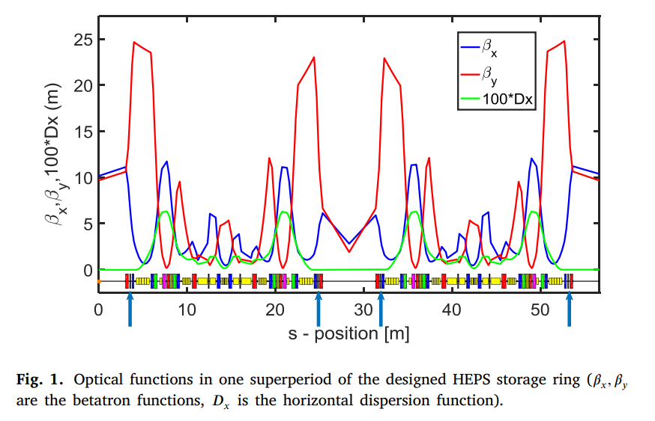
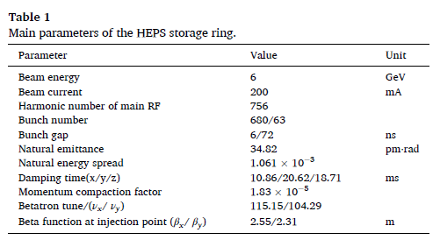
Beam physics group meeting
II. Scheme based on the HEPS lattice
The designed HEPS storage ring comprises 24 standard superperiods, with two symmetric multi-bend achromats(MBA).
In each superperiod, 4 multi-function correctors are situated at non-dispersive section, as shown with blue arrows.

Slide 15


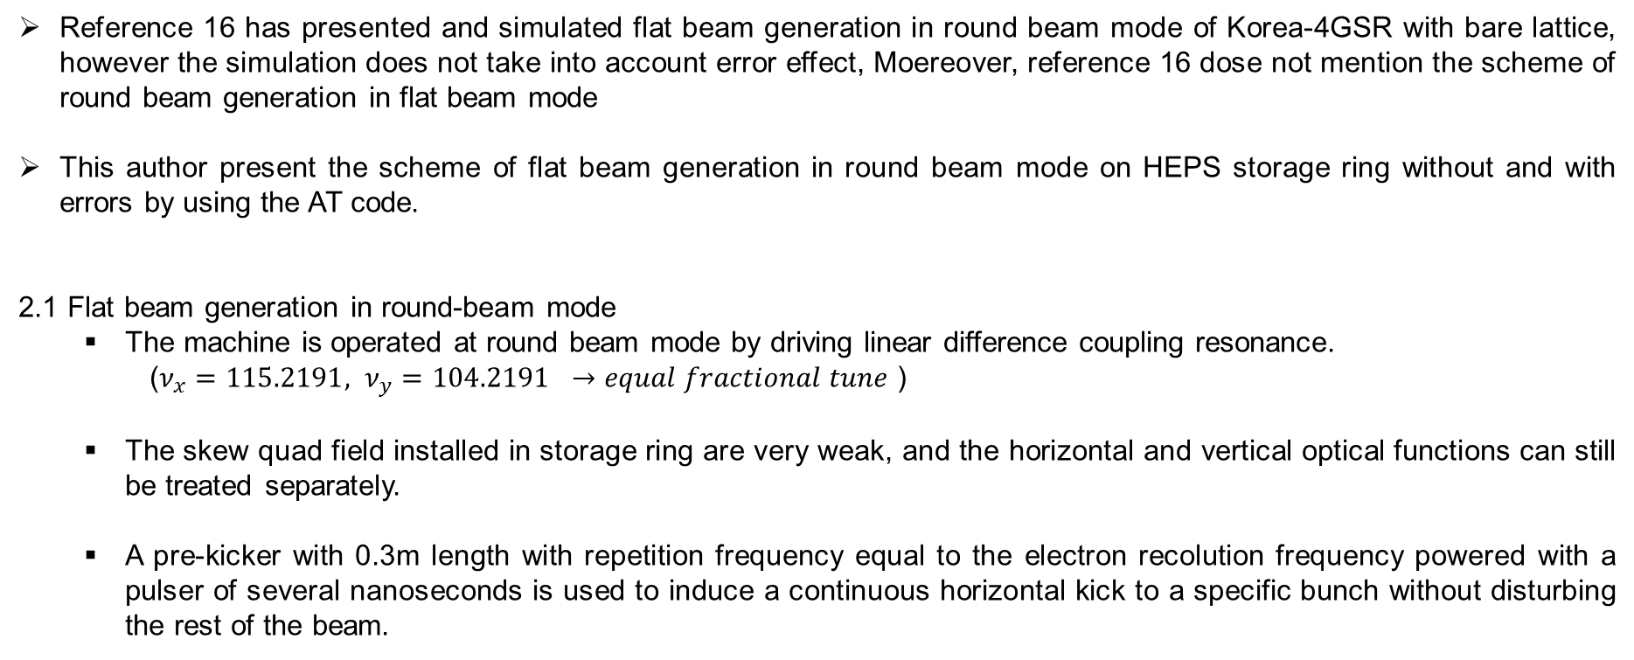
Beam physics group meeting
II. Scheme based on the HEPS lattice
Reference 16 has presented and simulated flat beam generation in round beam mode of Korea-4GSR with bare lattice, however the simulation does not take into account error effect, Moereover, reference 16 dose not mention the scheme of round beam generation in flat beam mode
This author present the scheme of flat beam generation in round beam mode on HEPS storage ring without and with errors by using the AT code.
2.1 Flat beam generation in round-beam mode
  The machine is operated at round beam mode by driving linear difference coupling resonance.
  ($ν_{x}=115.2191, ν_{y}=104.2191 →equal fractional tune$ )
  The skew quad field installed in storage ring are very weak, and the horizontal and vertical optical functions can still be treated separately.
  A pre-kicker with 0.3m length with repetition frequency equal to the electron recolution frequency powered with a pulser of several nanoseconds is used to induce a continuous horizontal kick to a specific bunch without disturbing the rest of the beam.
Kick
$$ν_{x}≈ν_{y}$$
0.05mm
6ns or 72ns (brightness mode/ high charge mode)
$$ν_{x}≠ν_{y}$$

Slide 16
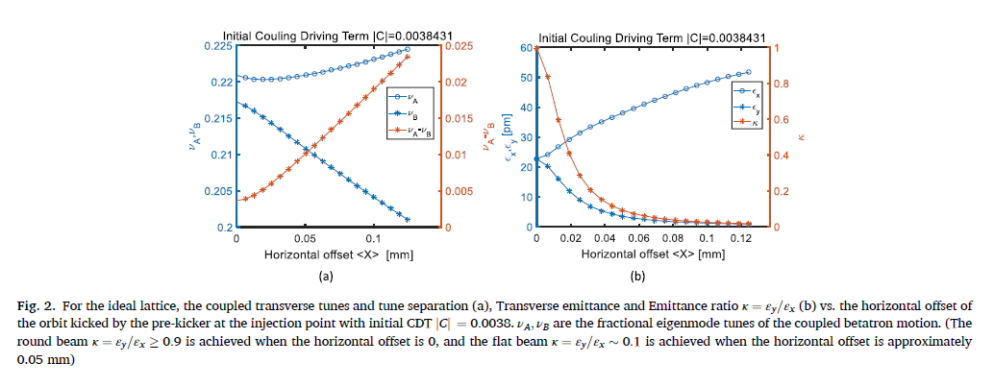
Beam physics group meeting
II. Scheme based on the HEPS lattice
As specification, the time jitter (<100ps) and the leaking field of the HEPS pre-kicker, will not affect the neighboring bunch.
Subsequently, this specific bunch is of flat beam circulating along a new closed orbit, which is different with the closed orbit of round beam.

Slide 17


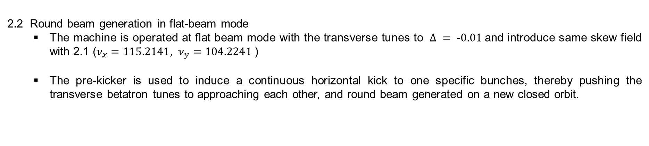
Beam physics group meeting
II. Scheme based on the HEPS lattice
2.2 Round beam generation in flat-beam mode
  The machine is operated at flat beam mode with the transverse tunes to $Δ = -0.01$and introduce same skew field with 2.1 ($ν_{x}=115.2141, ν_{y}=104.2241$)
  The pre-kicker is used to induce a continuous horizontal kick to one specific bunches, thereby pushing the transverse betatron tunes to approaching each other, and round beam generated on a new closed orbit.
Kick
$$ν_{x}≠ν_{y}$$
0.05mm
6ns or 72ns (brightness mode/ high charge mode)
$$ν_{x}{≈ν}_{y}$$

Slide 18
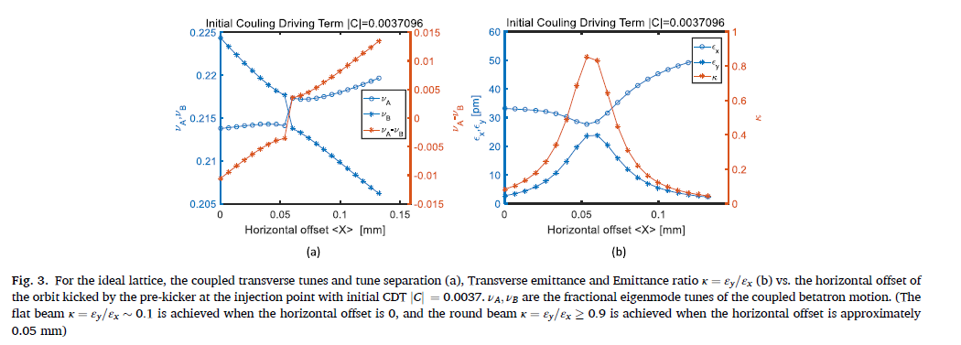
Beam physics group meeting
II. Scheme based on the HEPS lattice
2.2 Round beam generation in flat-beam mode
  The machine is operated at flat beam mode with the transverse tunes to $Δ = -0.01$and introduce same skew field with 2.1 ($ν_{x}=115.2141, ν_{y}=104.2241$)
  The pre-kicker is used to induce a continuous horizontal kick to one specific bunches, thereby pushing the transverse betatron tunes to approaching each other, and round beam generated on a new closed orbit.

Slide 19
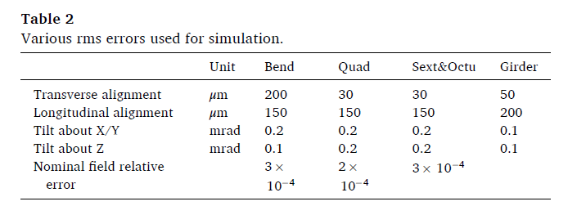
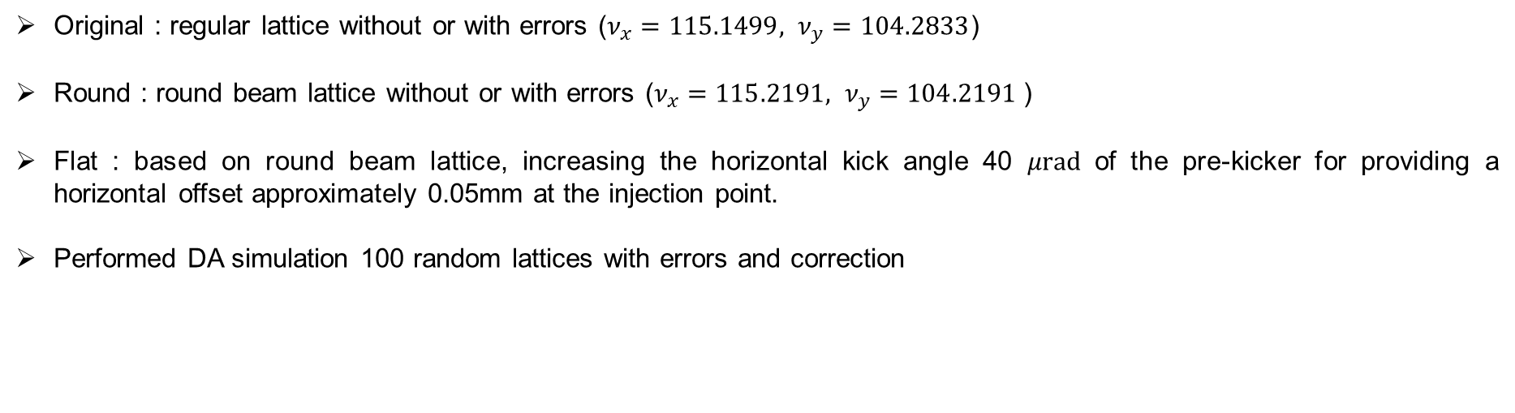
Beam physics group meeting
III. Dynamic aperture
Original : regular lattice without or with errors ($ν_{x}=115.1499, ν_{y}=104.2833$)
Round : round beam lattice without or with errors ($ν_{x}=115.2191, ν_{y}=104.2191$)
Flat : based on round beam lattice, increasing the horizontal kick angle 40 $μrad$of the pre-kicker for providing a horizontal offset approximately 0.05mm at the injection point.
Performed DA simulation 100 random lattices with errors and correction

Slide 20
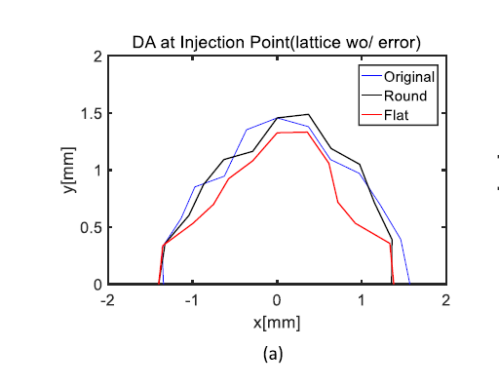
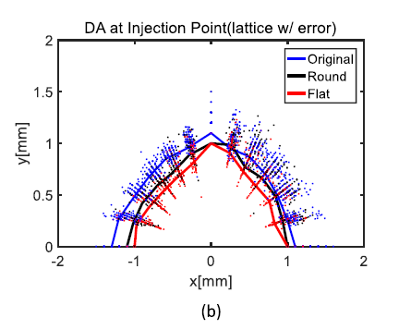
Beam physics group meeting
III. Dynamic aperture

Slide 21
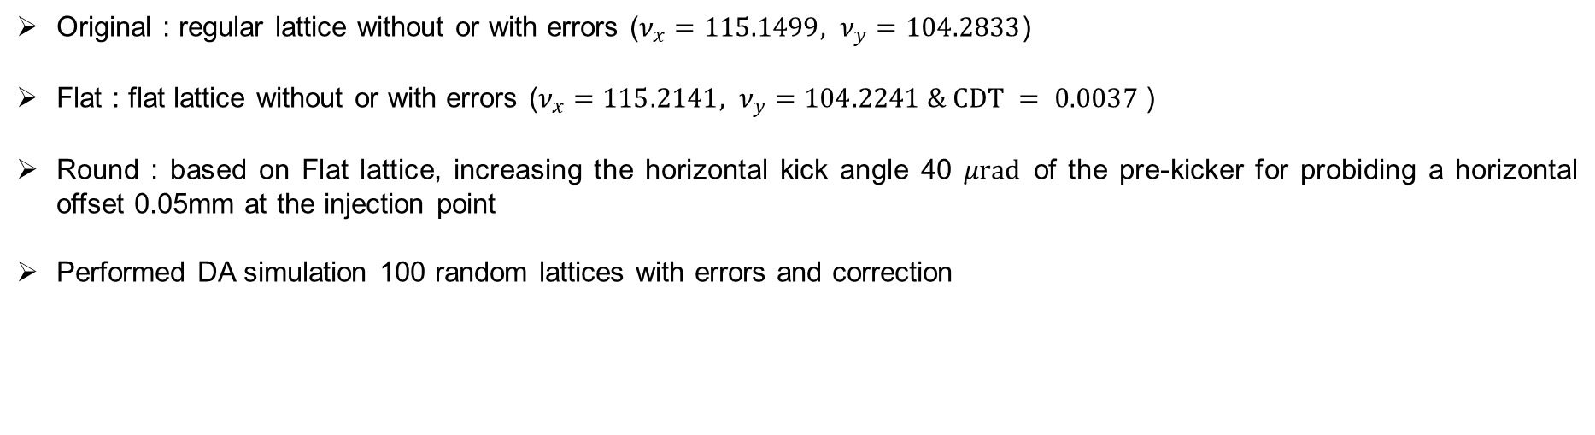
Beam physics group meeting
III. Dynamic aperture
Original : regular lattice without or with errors ($ν_{x}=115.1499, ν_{y}=104.2833$)
Flat : flat lattice without or with errors ($ν_{x}=115.2141, ν_{y}=104.2241 \& CDT = 0.0037$)
Round : based on Flat lattice, increasing the horizontal kick angle 40 $μrad$of the pre-kicker for probiding a horizontal offset 0.05mm at the injection point
Performed DA simulation 100 random lattices with errors and correction

Slide 22
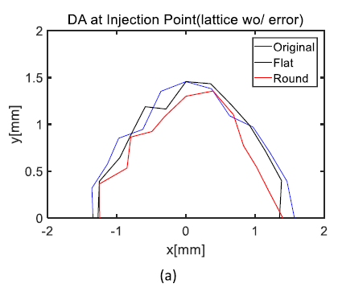
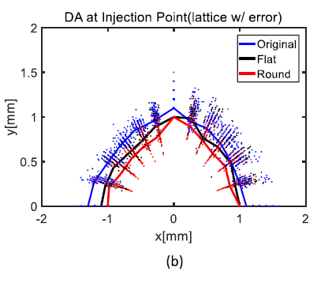
Beam physics group meeting
III. Dynamic aperture

Slide 23
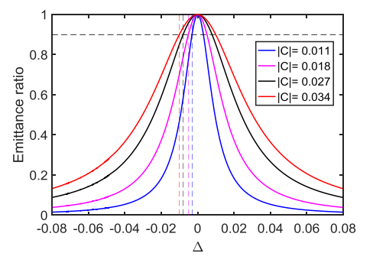
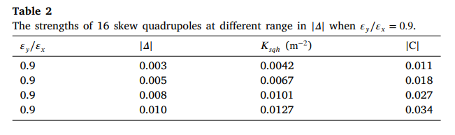
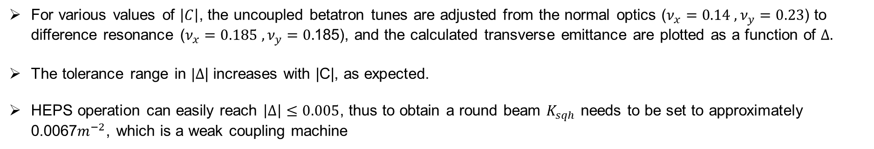
Beam physics group meeting
IV. Tracking with ELEGANT
For various values of $\left|C\right|$, the uncoupled betatron tunes are adjusted from the normal optics ($ν_{x}=0.14 , ν_{y}=0.23$) to difference resonance ($ν_{x}=0.185 , ν_{y}=0.$185), and the calculated transverse emittance are plotted as a function of $Δ.$
The tolerance range in $|Δ$| increases with |C|, as expected.
HEPS operation can easily reach $\left|Δ\right|≤0.005$, thus to obtain a round beam $K_{sqh}$ needs to be set to approximately 0.0067$m^{−2}$, which is a weak coupling machine

Slide 24
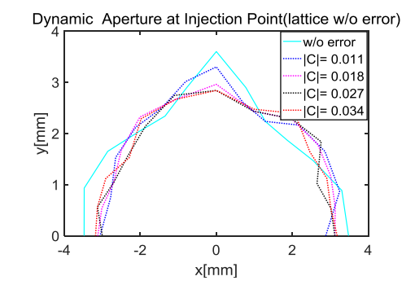
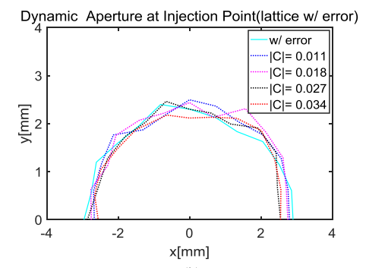
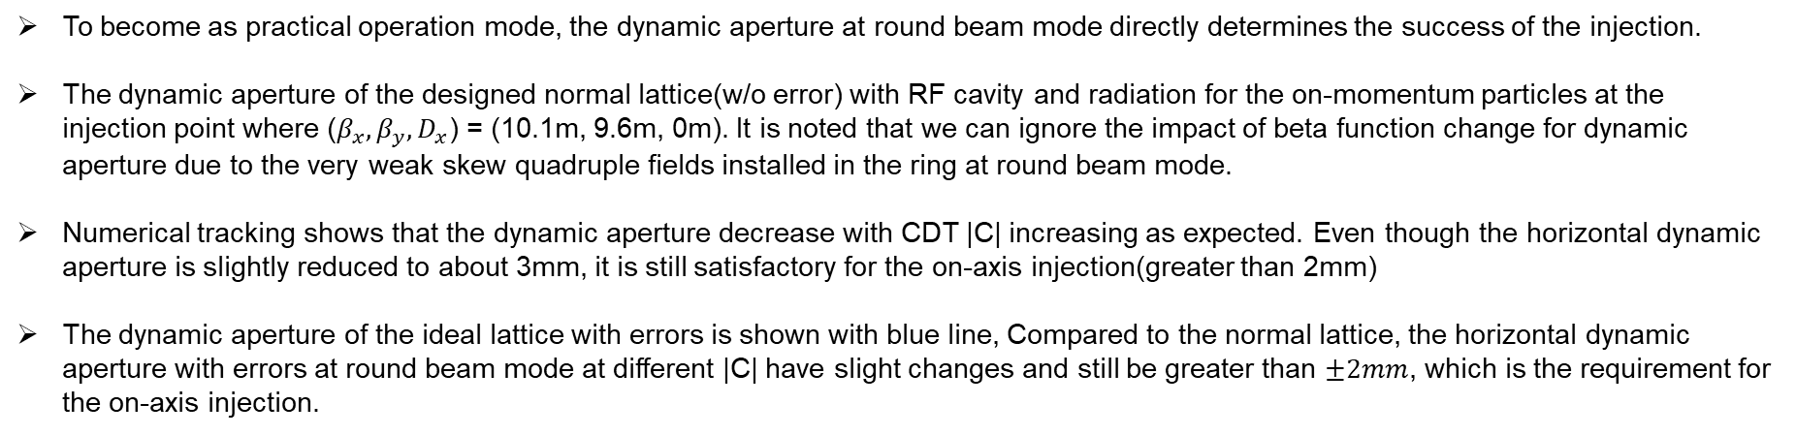
Beam physics group meeting
III. Realization of round beam
To become as practical operation mode, the dynamic aperture at round beam mode directly determines the success of the injection.
The dynamic aperture of the designed normal lattice(w/o error) with RF cavity and radiation for the on-momentum particles at the injection point where ($β_{x},β_{y},D_{x}$) = (10.1m, 9.6m, 0m). It is noted that we can ignore the impact of beta function change for dynamic aperture due to the very weak skew quadruple fields installed in the ring at round beam mode.
Numerical tracking shows that the dynamic aperture decrease with CDT |C| increasing as expected. Even though the horizontal dynamic aperture is slightly reduced to about 3mm, it is still satisfactory for the on-axis injection(greater than 2mm)
The dynamic aperture of the ideal lattice with errors is shown with blue line, Compared to the normal lattice, the horizontal dynamic aperture with errors at round beam mode at different |C| have slight changes and still be greater than $±2mm$, which is the requirement for the on-axis injection.

Slide 25
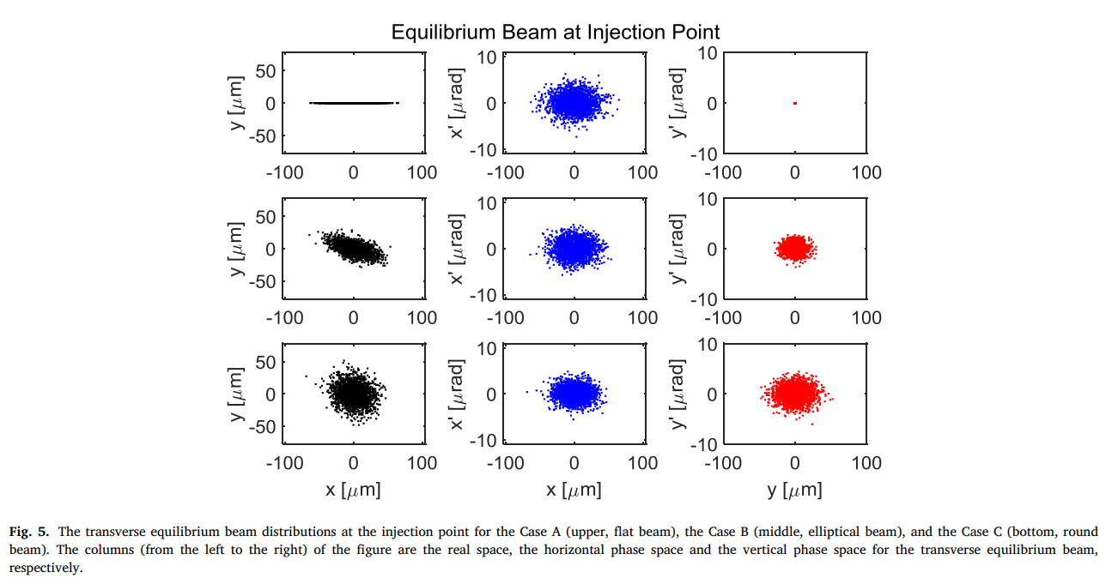
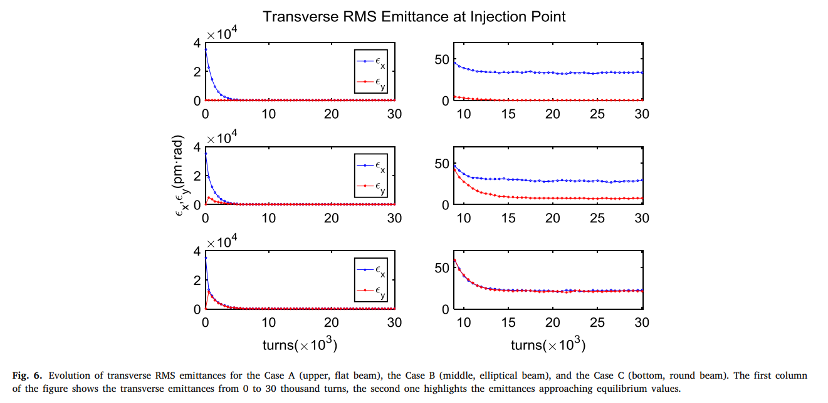
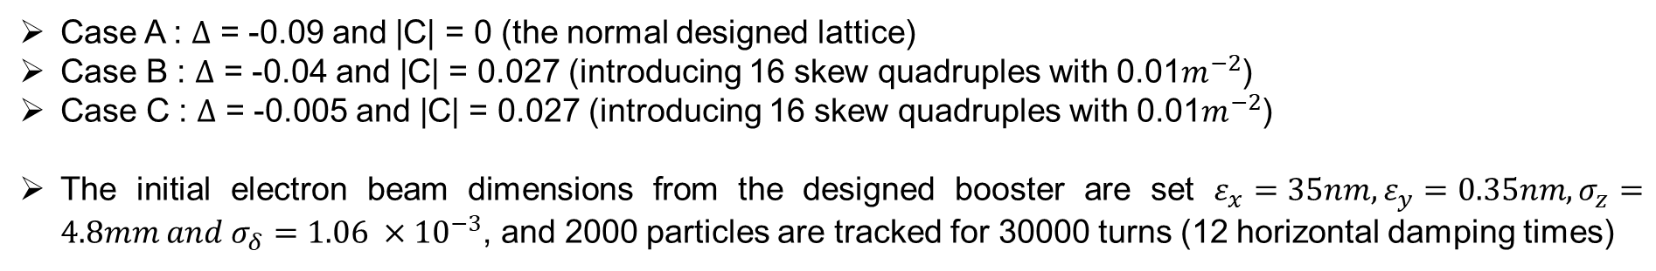
Beam physics group meeting
IV. Tracking with ELEGANT
A
A
B
B
C
C
Case A : $Δ$ = -0.09 and |C| = 0 (the normal designed lattice)
Case B : $Δ$ = -0.04 and |C| = 0.027 (introducing 16 skew quadruples with 0.01$m^{−2}$)
Case C : $Δ$ = -0.005 and |C| = 0.027 (introducing 16 skew quadruples with 0.01$m^{−2}$)
The initial electron beam dimensions from the designed booster are set $ε_{x}=35nm, ε_{y}=0.35nm, σ_{z}=4.8mm and σ_{δ}=1.06 ×{10}^{−3}$, and 2000 particles are tracked for 30000 turns (12 horizontal damping times)

Slide 26
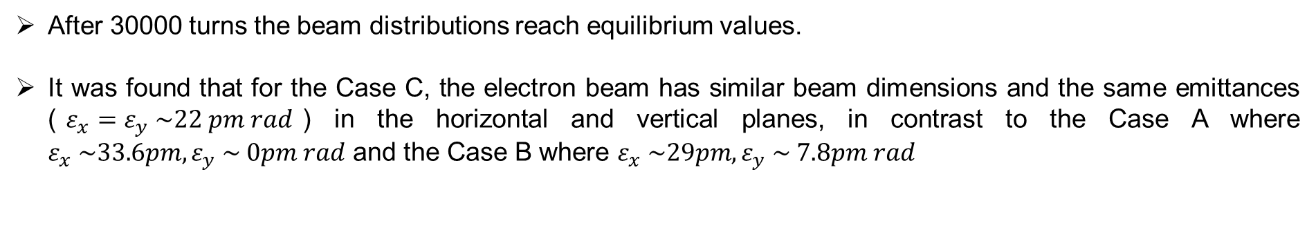
Beam physics group meeting
IV. Tracking with ELEGANT
A
A
B
B
C
C
After 30000 turns the beam distributions reach equilibrium values.
It was found that for the Case C, the electron beam has similar beam dimensions and the same emittances ($ε_{x}=ε_{y} \sim 22 pm rad$) in the horizontal and vertical planes, in contrast to the Case A where $ε_{x} \sim 33.6pm, ε_{y} \sim 0pm rad$ and the Case B where $ε_{x} \sim 29pm, ε_{y} \sim 7.8pm rad$

Slide 27
Beam physics group meeting
V. IBS and Touschek lifetime
Intra beam scattering (IBS) effect describes multiple Coulomb scattering between particles in accelerators. In low emittance machines, IBS leads to emittance growth and force energy to transfer from transverse to longitudinal planes which will result in particle loss and reduce Touschek lifetime.
In actual operation for HEPS, two types of filling pattern will be used.
  High-brightness mode : 680 bunches, 1.33nC/bunch
  High-charge mode : 63 bunches, 14.4nC
The emittance growth due to IBS can be significant in high-charge mode, thus a mitigation of the emittance growth is one main motivation for round beam.
Emittance growth due to IBS can be significant in high-charge mode; thus, mitigating emittance growth is a primary motivation for adopting the round beam.

Slide 28
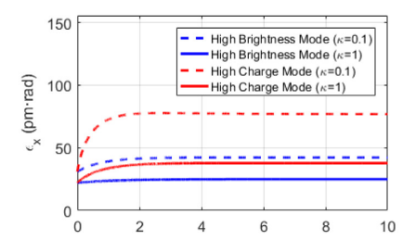
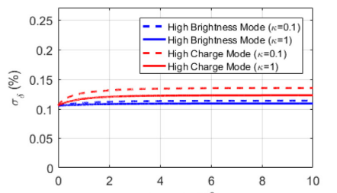
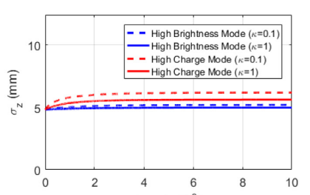
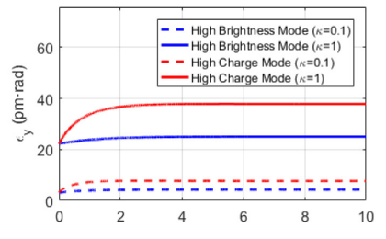



Beam physics group meeting
V. IBS and Touschek lifetime
Turns($×{10}^{3}$)
Turns($×{10}^{3}$)
Turns($×{10}^{3}$)
Turns($×{10}^{3}$)
For the IBS calculations, we employ the ELEGANT that computes growth rates and the turns evolution of the emittances for electron rings due to IBS based on Bjorken and Mtingwa’s formula.
For the sake of comparison, the IBS effect of round beam($κ=1$) which corresponds to the Case C in Sec iv and the flat beam($κ=0.1$) which corresponds to the ideal lattice (no errors) are calculated respectively.
The result of IBS calculations for the high-brightness mode and the high-charge mode with coupling $κ=0.1$ and $κ=1$ at the beam current of I=200mA are shown in Fig.7.

Slide 29

Beam physics group meeting
V. IBS and Touschek lifetime
Turns($×{10}^{3}$)
Turns($×{10}^{3}$)
Turns($×{10}^{3}$)
Turns($×{10}^{3}$)
Fig.7 indicates that the horizontal emittance growth in the case of round beam is smaller than half of that in the case of flat beam at high-charge mode.
The increase of the horizontal emittance due to IBS for round beam is a factor 70% and for flat beam is a factor 147% at high-charge mode without third-harmonic cavities, thus round beam can effectively mitigate horizontal emittance growth due to IBS.
In order to lower the particle intensity and mitigate the IBS and Touschek effect at the flat beam mode, the third-harmonic cavities were proposed to stretch the bunch length.
  At the high-brightness mode $: ε_{x}=ε_{y} = 15.1 pm$
  At the high-charge mode : $ε_{x}=ε_{y} = 18.1 pm$

Slide 30



Beam physics group meeting
V. IBS and Touschek lifetime
The Touschek lifetime is calculated by ELEGANT code.
Compared to flat beam mode, the momentum acceptance of round beam mode has almost no change due to introducing reasonably small skew quadrupole fields along the ring.
It was found that the Touschek lifetime at the coupling factor $κ=1$ will increase by a factor of 1.7 than that at the coupling factor of $κ=0.1$
Touschek lifetime of the high-charge mode is less than 0.5h even though at the round beam mode. In order to increase Touschek lifetime and decrease the emittance with IBS a control of bunch length by the third-harmonic cavities have been proposed.

Slide 31
Beam physics group meeting
VI. Conclusion
We have developed a systematic scheme based on the HEPS storage ring to achieve round beam by driving linear difference coupling resonance.
One can choose the 16 skew quadrupoles in non-dispersion section to introduce coupling driving term for obtaining round beam.
The dynamic aperture at round beam mode still be accommodated using on-axis injection.
Compared to the flat beam, round beam can effectively mitigate horizontal emittance growth due to IBS effect and increase Touschek lifetime.

Slide 32




Beam physics group meeting
Appendix A. The choice of the 16 skew quadrupoles
The right figure indicates that the tolerance range in $|Δ$| increases with |C| for obtaining a round beam, that is, the larger the |C| makes, the easier to achieve round beam at a certain $|Δ$|.
The CDT consists of the real part and the imaginary part with phase difference. Thus CDT is determined by the integral of phase difference of skew quadrupole fields along the ring and increases proportionally by introducing skew quadrupole fields with the same imaginary part.
$C=\frac{1}{2π}\int_{0}^{L}{K_{sq}}\left(s\right)\sqrt{β_{x}\left(s\right)β_{y}(s)}Λ ds , Λ=$ $e^{i[φ_{x}\left(s\right)−φ_{y}\left(s\right)−\frac{2πs}{L}Δ]}=e^{iφ_{Δ}(s)}=e^{i\left(2πν_{Δ}(s) \right)}$
$$\frac{φ_{Δ}}{2π}−q=ν_{Δ}−q$$
Where q is an integer. The value of $ν_{Δ}−q$ of skew quadrupole field in non –dispersive section along HEPS storage ring is shown in Fig.9 when $Δ$=0
We divide the 48 skew quadrupoles into 6 groups (the skew quadrupoles with the identical values $ν_{Δ}−q$ are listed as the same group), labeled as group 1,2,3,4,5,6, in high-beta non-dispersive section and low-beta non-dispersive section respectively.

Slide 33



Beam physics group meeting
Appendix A. The choice of the 16 skew quadrupoles
Table 4. shows the value $Λ_{sum}$ of different combinations, it is found that the best combinations are group 1+2, 3+4, 5+6 in high-beta non dispersive section and group 1+6, 2+3, 4+5 in low-beta non-dispersive section.
In this paper, as a demonstration example, the 16 skew quadrupoles group 3+4 are used to introduce the CDT for obtaining a round beam by linear difference coupling resonance.

Slide 34

Thank you!

